Slide 1
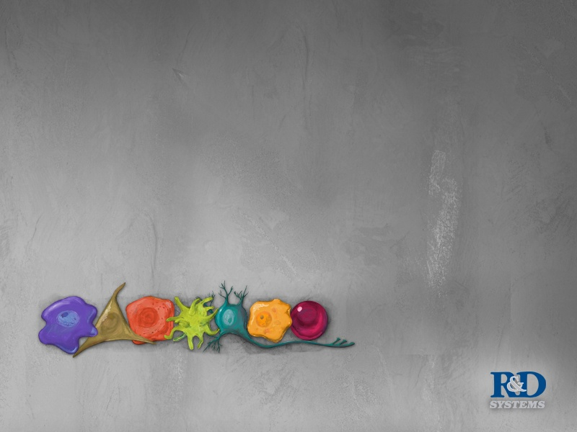

Overview of ELISAs
ELISAs产品和相关技术
R&D Systems China

Slide 2
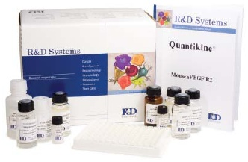
ELISA - 酶联免疫吸附法
(Enzyme-Linked Immunosorbent Assay)
基本原理：
采用抗原与抗体的特异反应将待测分子与酶连接, 然后通过酶与底物的反应，定量测定待测分子。
三大要素：
固相化
抗原/抗体特异反应
酶/底物反应-可测产物

Slide 3
免疫反应中常用的酶及底物
酶 | 常用底物 | 显色 | 测定波长(nm)
辣根过氧化酶 (horseradish peroxidase) HRP | TMB (3,3’,5,5’-Tetramethyl-benzidene) OPD (o-Phenylenediamine) Luminol /ECL DAB (3,3’-Diaminobenzidine) AEC | 黄色 橙红色 发光 棕褐色 红棕色 | 450 492 光单位 不溶 不溶
碱性磷酸酶 (alkaline phosphatase) AP | pNPP (p-Nitrophenyphosate) NADPH BCIP/BNT | 黄色 红色 深蓝色 | 405 490 不溶

Slide 4
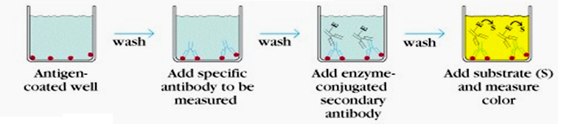
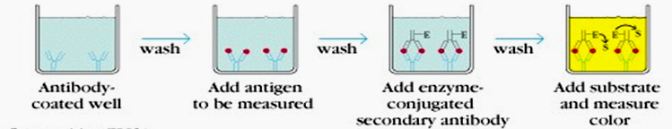
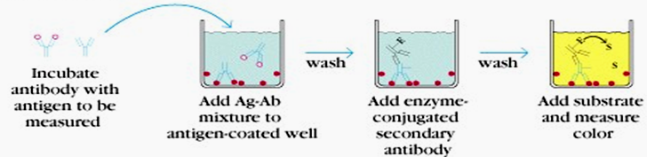
ELISA常用方法
间接法
双抗体夹心法
竞争法

Slide 5
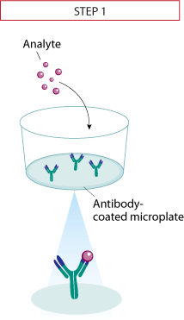
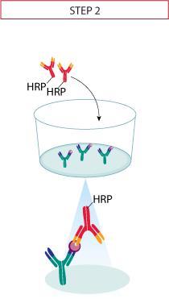
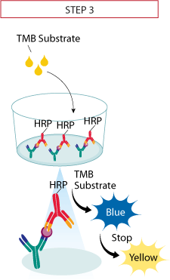


Quantikine® ELISA Assay Principle
Legend:

Slide 6
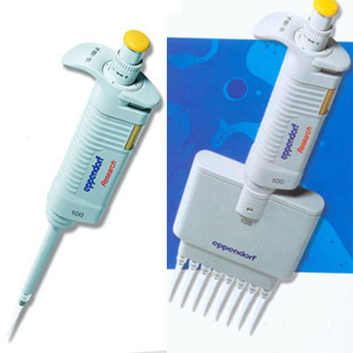
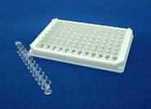
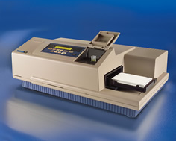
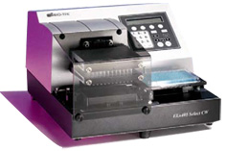
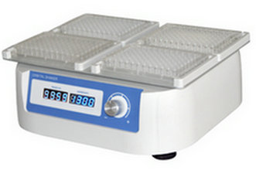
ELISA反应中常用的设备和材料

Slide 7
R&D Systems ELISA产品概况
完全ELISA试剂盒
Quantikine®– 在生物流体中测量分子的定量ELISA试剂盒. 行业金标准
Quantikine HS® – 高检测灵敏度，以检测目标分子含量极低的样本
Quantikine IVD® – 通过美国FDA和欧盟认证，用于体外诊断
QuantiGlo® –适用于更宽的动力学范围，需要化学发光检测仪。
Parameter™ – 竞争法检测如环核苷酸和类花生酸等多种小分子
Surveyor ® IC –用于检测细胞内参与信号传导和细胞凋亡的分子
Cell-Based ELISAs –双荧光检测手段, 可在完整细胞内同时检测2个生物分子

Slide 8
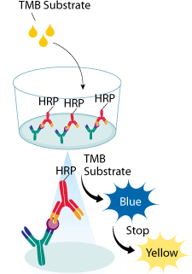
Quantikine® ELISA Kits
高度优化，实验重复性高
稳定性、灵敏度和精确度高
金标准-行业最广泛认可
检测范围在：10⁰~10³ pg/ml
近600个Kits，超过250个因子
可用于细胞上清、血清、血浆、尿液、唾液等
可检测人、大/小鼠、猪、犬等多个物种
包装规格：单块板、2块板、6块板、50块板
实验时长：4.5 小时

Slide 9
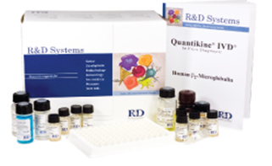
Quantikine® IVD ELISA Kits
体外诊断用试剂盒
通过美国FDA和欧盟认证
完全即用型
产品名称 | Human Epo | Human sTfR | Human β2-MG
目录号 | DEP00 | DTFR1 | DBM200
敏感性 | <0.6 mIU/mL | <0.5 nmol/L | <0.2 ug/mL
检测范围 | 2.5-200 mIU/mL | 3-80 nmol/L | 0.4-12 µg/mL
标本类型 | 血清、血浆 | 血清、血浆 | 血清、尿液

Slide 10
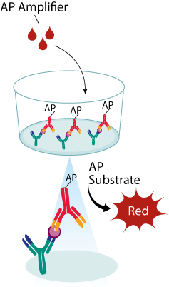
Quantikine® HS ELISA Kits
AP酶在底物NADPH作用下，循环反应，增强信号
灵敏度高，检测范围：10⁻³~10¹ pg/ml
完全即用、方便省事
高度优化，实验重复性好
已开发25个kits，涵盖11个人源蛋白
可检测细胞上清、血清、血浆、尿液等
有单块板、6块板、50块板
实验时长：6.5小时

Slide 11
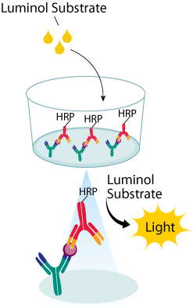
QuantiGlo® ELISA Kits
化学发光检测原理
更宽的检测范围：10⁻¹ ~ 10⁴ pg/ml
完全、即用型
高度优化，实验重复性好
有12个Kits，包含10个人细胞因子
可检测细胞上清、血清、血浆、尿液等
实验时长：5.5小时

Slide 12
R&D Systems三种ELISA试剂盒比较
人IL-6 | Quantikine® | Quantikine® HS | QuantiGlo®
目录号 | D6050 | HS600B | Q6000B
灵敏度 (pg/mL) | 0.7 | 0.039 | 0.16
检测范围 (pg/mL) | 3.13 - 300 | 0.156 - 10 | 0.48 - 1,500
酶标记物 | HRP | AP | HRP
底物 | 过氧化氢/TMB | NADPH/信号放大剂 | 过氧化氢/增强的化学发光底物
适用性 | 常规、普通标本 | 待测物浓度低的标本 | 宽动力学检测

Slide 13
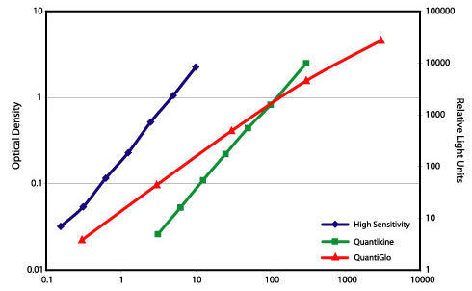
R&D Systems三种ELISA试剂盒比较
人IL-6三种ELISA Kit的比较

Slide 14
R&D Systems ELISA产品概况
ELISA研发试剂
DuoSet ® – ELISA的研发试剂(Development Kit)
DuoSet ® IC – 检测细胞内分子的ELISA研发试剂
DuoSet ® IC Phospho-specific – 检测磷酸化胞内分子的ELISA研发试剂
辅助ELISA 产品 – 微孔板、洗涤液、稀释液、底物、终止液等ELISA配套试剂

Slide 15
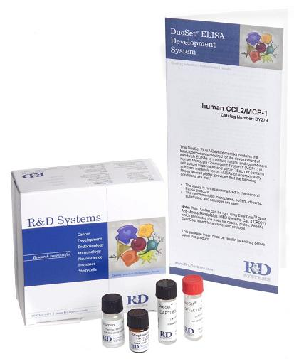
R&D Systems研发试剂盒 —DuoSet ELISAs
约1500个试剂盒，包括近500个不同的分析因子
人、大/小鼠、犬、猫、猪、马、棉鼠、牛、豚鼠、兔等多个物种
试剂盒内含：
定量标准品(做标准曲线)
捕获抗体(包被微孔板）
生物素标记的检测抗体
酶标链亲和素(Streptavidin-HRP)
足够做15块96孔微孔板*
辅助ELISA 产品 – 微孔板、洗涤液、稀释液、底物、终止液等ELISA配套试剂
*DuoSet IC (Intra Cellular) ELISA试剂盒有2, 5和15块板的选择

Slide 16
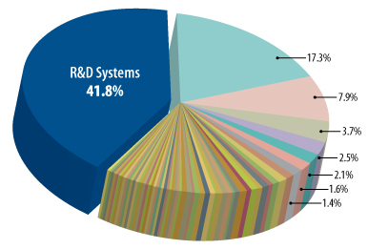
R&D Systems ELISAs:
Quality Manufacturing and Evaluation of Performance
调查统计：44个高影响因子杂志的860篇文献中有433篇使用了
ELISA试剂盒，R&D Systems以41.8%的绝对优势名列第一
R&D Systems Is the Most Referenced ELISA Manufacturer
Notes:
16

Slide 17
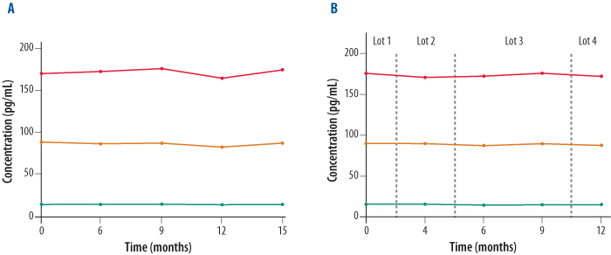
R&D Systems ELISAs:
Quality Manufacturing and Evaluation of Performance
Quantikine ELISA Kits Are Tested for Stability and Reproducibility
A. Three samples with different levels were assayed using the same lot Human IL-6 Quantikine ELISA Kit (Catalog # D6050) over a 15 month period.
B. Three samples with different levels were assayed using four different lots Human IL-6 Quantikine ELISA Kit (Catalog # D6050) t over a 12 month period.
Notes:
17

Slide 18
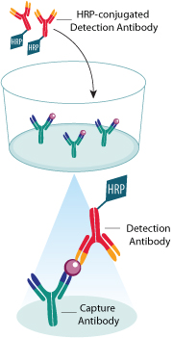
R&D Systems ELISAs:
Quality Manufacturing and Evaluation of Performance
Antibody Pairs Are Carefully Selected for Quantikine ELISA Development
Notes:
18

Slide 19
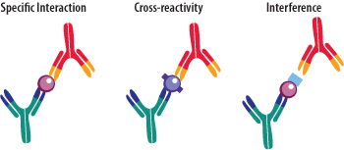
R&D Systems ELISAs:
Quality Manufacturing and Evaluation of Performance
ELISA Specificity: Measuring Only the Analyte of Interest
Antibodies play a crucial role in the development of a high performance ELISA.
Antibodies are tested for specificity, cross-reactivity with molecules other than the target analyte, and interference with matrix components.
Notes:
19

Slide 20
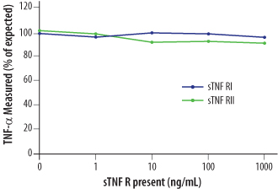
R&D Systems ELISAs:
Quality Manufacturing and Evaluation of Performance
Interference Testing of the Human TNF-alpha Quantikine ELISA Kit
TNF-alpha, at concentrations of 125-1000 pg/mL, was measured in the presence or absence of soluble TNF receptors (sTNF RI or sTNF RII) using the Human TNF-alpha Quantikine ELISA Kit (Catalog # DTA00C).
The results demonstrate that the presence of the soluble TNF receptors at concentrations up to 1000 ng/mL does not affect the TNF-alpha concentration determined.
Notes:
20

Slide 21
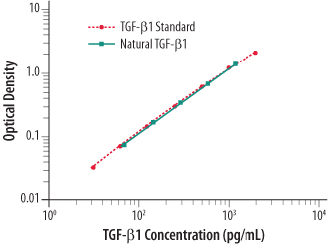
R&D Systems ELISAs:
Quality Manufacturing and Evaluation of Performance
Quantikine ELISA Kits Are Developed to Detect Natural and Recombinant Proteins
A serum sample containing activated human TGF-beta1 was serially diluted (blue line) and compared to the TGF-beta1 standard (red line).
Results show that the Human TGF-beta1 Quantikine ELISA Kit (Catalog # DB100B) measures recombinant and natural TGF-beta1 with equal effectiveness.
Notes:
21

Slide 22
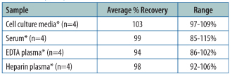
R&D Systems ELISAs:
Quality Manufacturing and Evaluation of Performance
Analysis of the Recovery of Dkk-1 Using the Quantikine ELISA Kit
The recovery of Dkk-1 spiked to various levels throughout the range of the assay was assessed for all validated sample types of the Human Dkk-1 Quantikine ELISA Kit (Catalog # DKK100).
Notes:
22

Slide 23
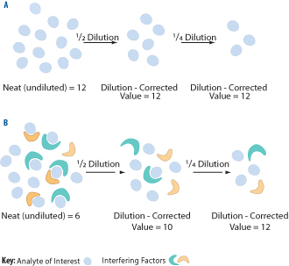
R&D Systems ELISAs:
Quality Manufacturing and Evaluation of Performance
Linear Dilution to Assess ELISA Matrix Effects
Expected results from a linearity of dilution experiment when no interfering factors are present in the matrix.
Potential results from the same experiment if interfering factors are present in the matrix. Factors in complex matrices can interfere with the analyte of interest. This effect may be revealed by unexpected linear dilution values.
Notes:
23

Slide 24
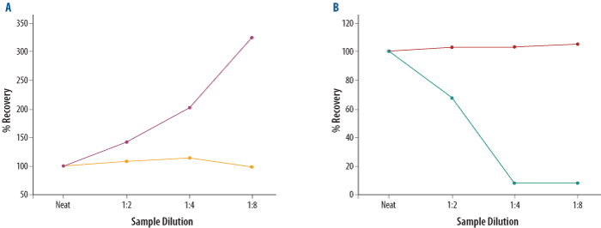
R&D Systems ELISAs:
Quality Manufacturing and Evaluation of Performance
Assay Linearity Is An Important Measure of Immunoassay Accuracy
A. Samples diluted and assayed for human Thrombomodulin using two different ELISA kits. Samples measured with the Human Thrombomodulin Quantikine ELISA Kit (Catalog # DTHBD0) had recovery values between 90-110% (gold line).
B. Samples diluted and assayed for human TFPI to determine the accuracy of two different ELISA kits. Samples measured with the Human TFPI Quantikine ELISA Kit (Catalog # DTFP10) showed acceptable recovery values (red line).
Notes:
24

Slide 25
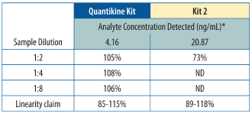
R&D Systems ELISAs:
Quality Manufacturing and Evaluation of Performance
False Positive Signals Can Be Identified by Assaying the Linearity of Dilution
Serial dilutions of a cell culture supernate were assayed for natural linearity using two different TIMP-2 ELISA Kits. Diluted samples measured using the Human TIMP-2 Quantikine Kit (Catalog # DTM200) gave recovery results between 105-108% of the neat sample.
Notes:
25

Slide 26
如何选择一个合适的ELISA试剂盒
样本的种属来源
- 人、小鼠、大鼠、猪、斑马鱼、豚鼠、、、、
待测因子的表达水平
- 预计水平？选用高灵敏、宽检测范围还是普通试剂盒？
样本的基质类型
- 细胞培养上清、血清、血浆（抗凝剂）、细胞裂解、、、、
相关文献支持
试剂盒使用中所涉及到的特殊要求
- 实验设备、检测仪器、、、、

Slide 27
ELISA实验中的常见问题
Possible Source
Insufficient washing
Incubation times too long
Buffers contaminated
Insufficient blocking
Reagents prepared or added incorrectly
Capture antibody did not bind to plate
Not enough antibody used
Standard has gone bad
No cytokine in sample
Sample matrix is masking detection
Substrate Solution mixed too early and turned blue
Too much streptavidin-HRP
Plate sealers or reagent reservoirs reused
Variations in incubation temperature
Variations in protocol
Samples contain cytokine levels above assay range
Incorrect wavelengths
Insufficient development time
Reagents not mixed well enough in wells
Uneven temperatures around work surface
Problems
High Background
No signal
Samples no signal but standard curve looks fine
Too much signal
Poor Duplicates
Poor assay to assay reproducibility
Samples are reading too high but standard curve looks fine
Very low readings across the plate
Green color develops upon addition of stop solution
Edge Effects

Slide 28
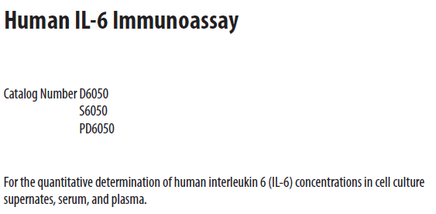
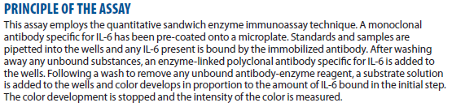
如何从试剂盒说明书中找信息
试剂盒适用种属和基质类型：
实验原理：

Slide 29
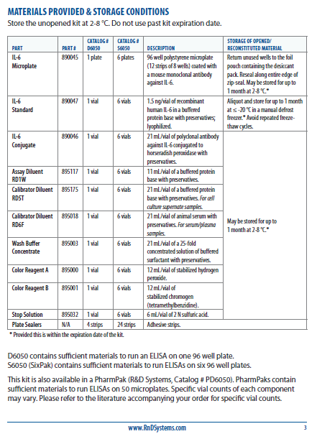
储存条件
没有拆封的试剂盒要储存在2-8℃，在试剂盒外包装上标注的有效期内使用。
拆封之后，按照各组分的储存条件存放，通常有效期为1个月。
试剂盒组分
打开试剂盒后，应首先检查各组分是否完整，包括微孔板、标准品、检测抗体、稀释液、冲洗浓缩液、显色液、终止液及封膜。并检查组分的Part#是否与说明书中的一致，

Slide 30
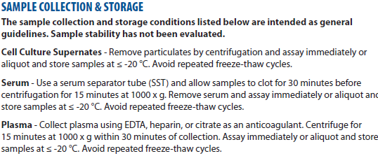
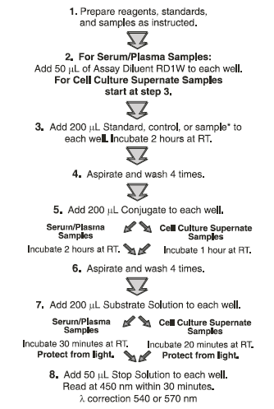
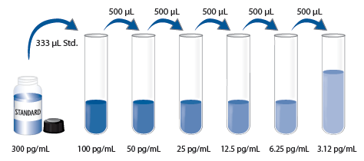
样本的采集和处理：
试验流程：
标准曲线的配置：

Slide 31
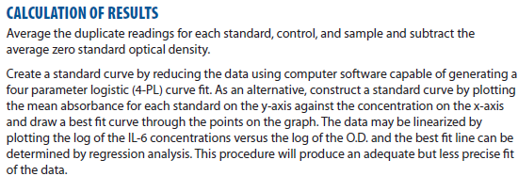
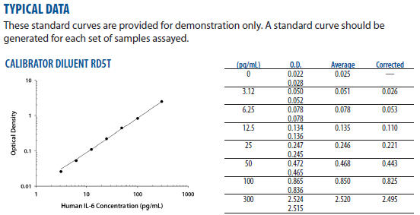
数据处理：
典型数据：

Slide 32
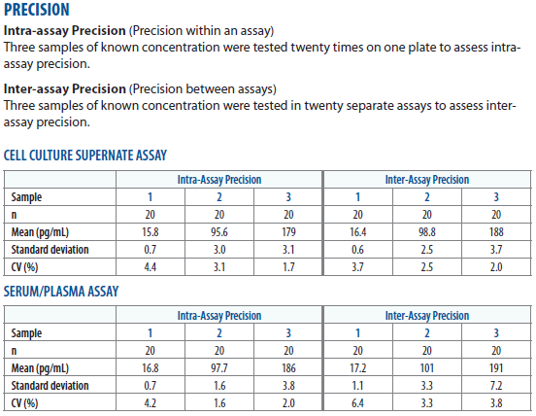
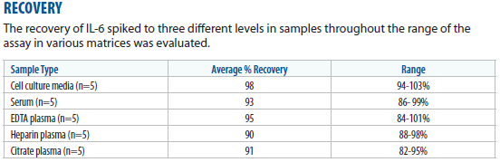
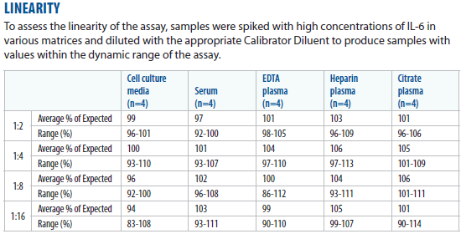
精确度、准确度和线性实验数据：

Slide 33

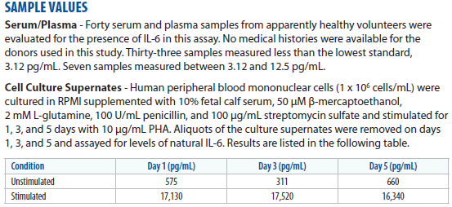
标定方法：
样品预值：

Slide 34
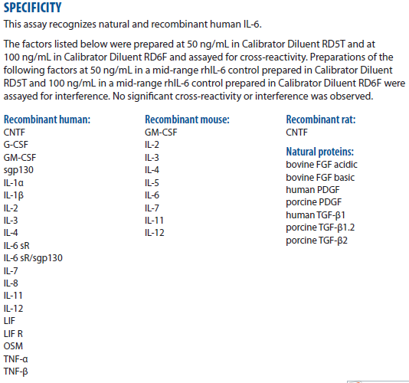
检测特异性实验：

Slide 35
R&D Systems ELISA试剂盒总体优势
快速简便 - 说明书详细，试剂完整，操作方便；
特异性强 - 我们选择最佳抗体-抗原配对；
精确度高 - 板间(inter)及板内(intra)差异性(CV)小；
重复性好 - 批次间的一致性高；
结果可靠 - 每个产品都经过仔细筛选、严格检验、质量高，
实验结果可信；
优质口碑 - 产品引用文献居行业第一位；
技术支持 - 专业而强大的技术支持团队，解决客户后顾之忧。

Slide 36
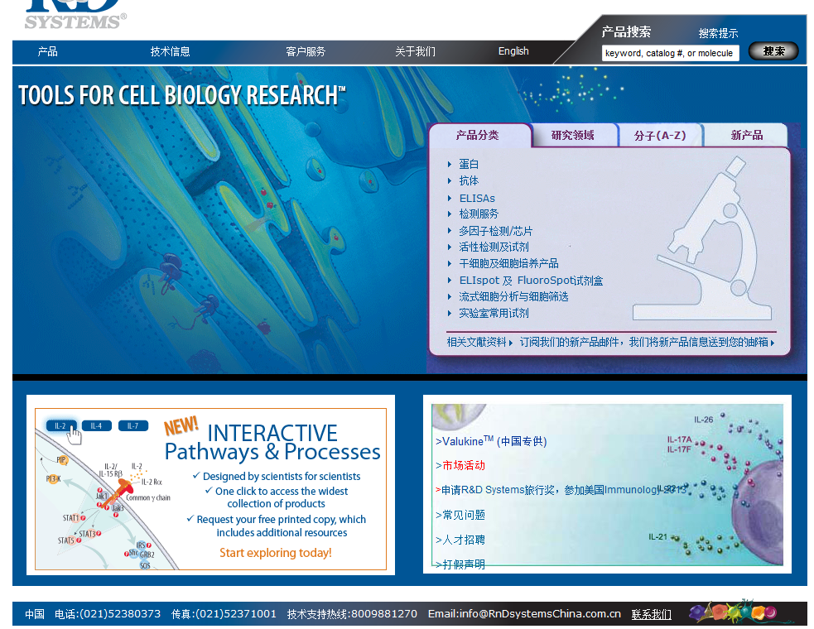
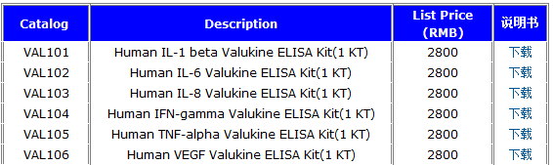
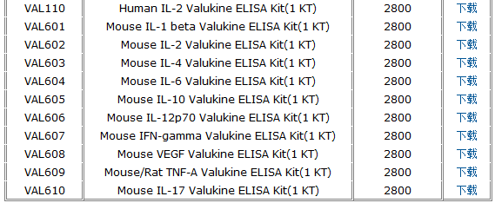
ValukineTM ELISA试剂盒
定量检测小鼠和人中的重要指标
经过细胞培养上清液严格优化
保证检测的灵敏度，重复性，特异性

Slide 37
Q&A

