Slide 1




Comments on Teaching Plan
Lesson 18
I Want to Explore the Animal World.
ABCDEFGHIJKLMNHIJKLMNOPQRSTUVWXYZ
Miss Yong

Slide 2
I Want to Explore the Animal World.
Lesson 1
Looking Ahead
By the end of this lesson, I will be able to：
（1）正确朗读含有“or”“ou”“ow”和“ph”的单词;
（2）根据发音和含义对单词进行分类;
（3）根据发音和含义写出单词;
（4）推断字母组合“ou”的另外两种发音;
（5）正确划分意群并有停顿地朗读文章。

Slide 3
Learning to Learn
or |  | ou |  |  | ow |  | p | ph
/ɜː/ | /ɔ:/ | /aʊ/ | /u:/ | /ʌ/ | /əʊ/ | /aʊ/ | /p/ | /f/

Slide 4
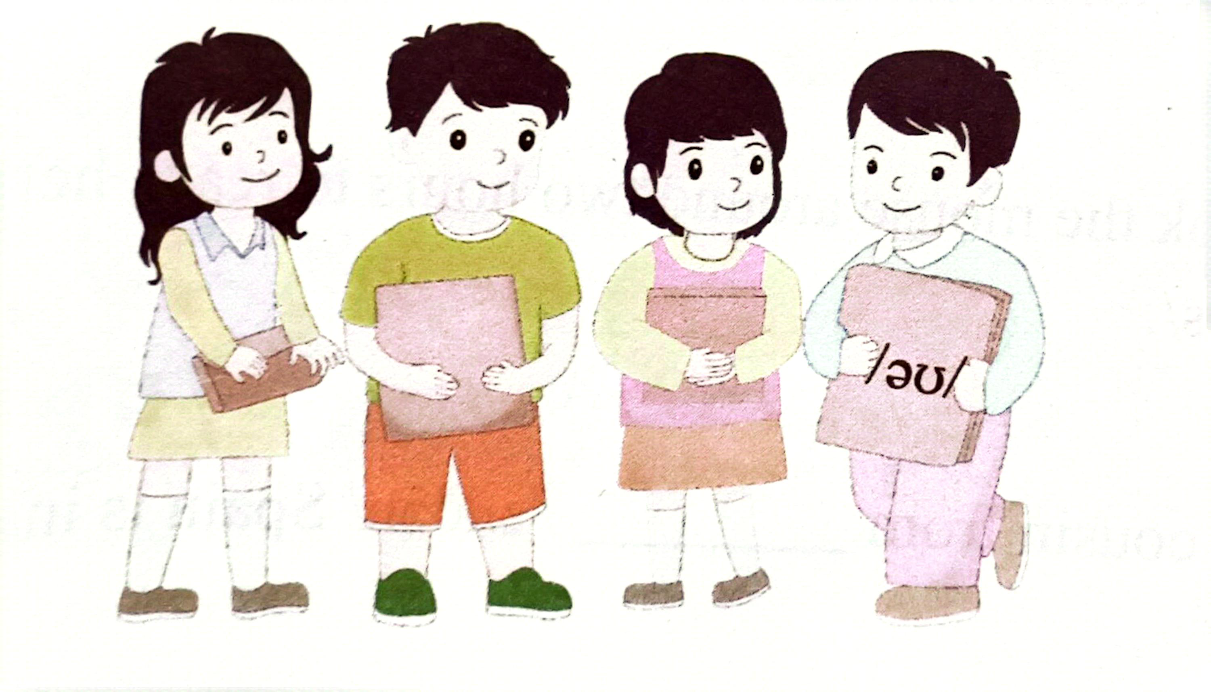
Learning Actively
1、Work in groups to read the flash cards and compete.
分小组朗读卡片上的内容，看谁读得又快又准。

Slide 5
2、 Read and think.读一读，想一想。
1)
/wɜːk/
/gru:p/
/'kʌntri/
/ləʊ/
/klaʊn/
/'peərənt/
/'fəʊtəʊ/

Slide 6
2)
worth through play route
throw corn house port

Slide 7
3)
phone me now
an old crown
park your car
explore the world
touch the horn
a white elephant

Slide 8
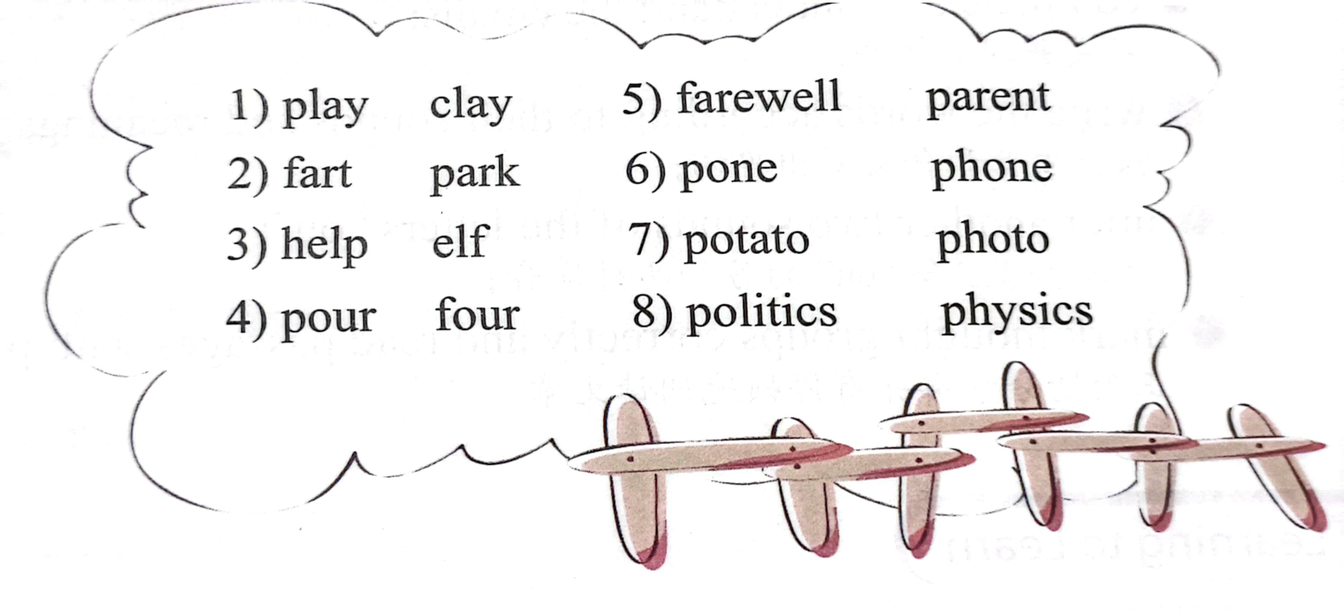
3、Listen and Circle the word you hear. 听录音，圈出你听到的那个单词。

Slide 9

4、 Read and write.读一读，写一写。
through town house slow horn
worth elephant southern explore
1) A bird in the hand is _____ /wɜːθ/ two in the bush.
2) The beautiful horse with a_____ /hɔ:n/ is a unicorn.
3) It took the mouse around two hours to reach her_____ /haʊs/.
4) My cousin from _____ / 'sʌðən/ Spain is in trouble.

Slide 10
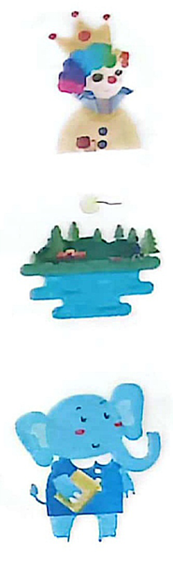
4、 Read and write.读一读，写一写。
through town house slow horn
worth elephant southern explore
5) The clowns with crowns brought us food in the_____ /taʊn/.
6) There is so much to _____ /ɪk'splɔ:(r)/in the park!
7) The _____ /'elɪfənt/ in the photo can talk on a phone.

Slide 11
Learning Creatively
1、Complete the sentences.完成句子。
or ow ou
A. So we all went to play and thr __ __ the sn __ __ ball.
B. I went to the Fun Times Park of the s __ __ thern t __ __ n.
C. Bye for n__ __ !
D. I was most excited by the Space W __ __ Id.
E. But I think it's all w__ __ th it.

Slide 12
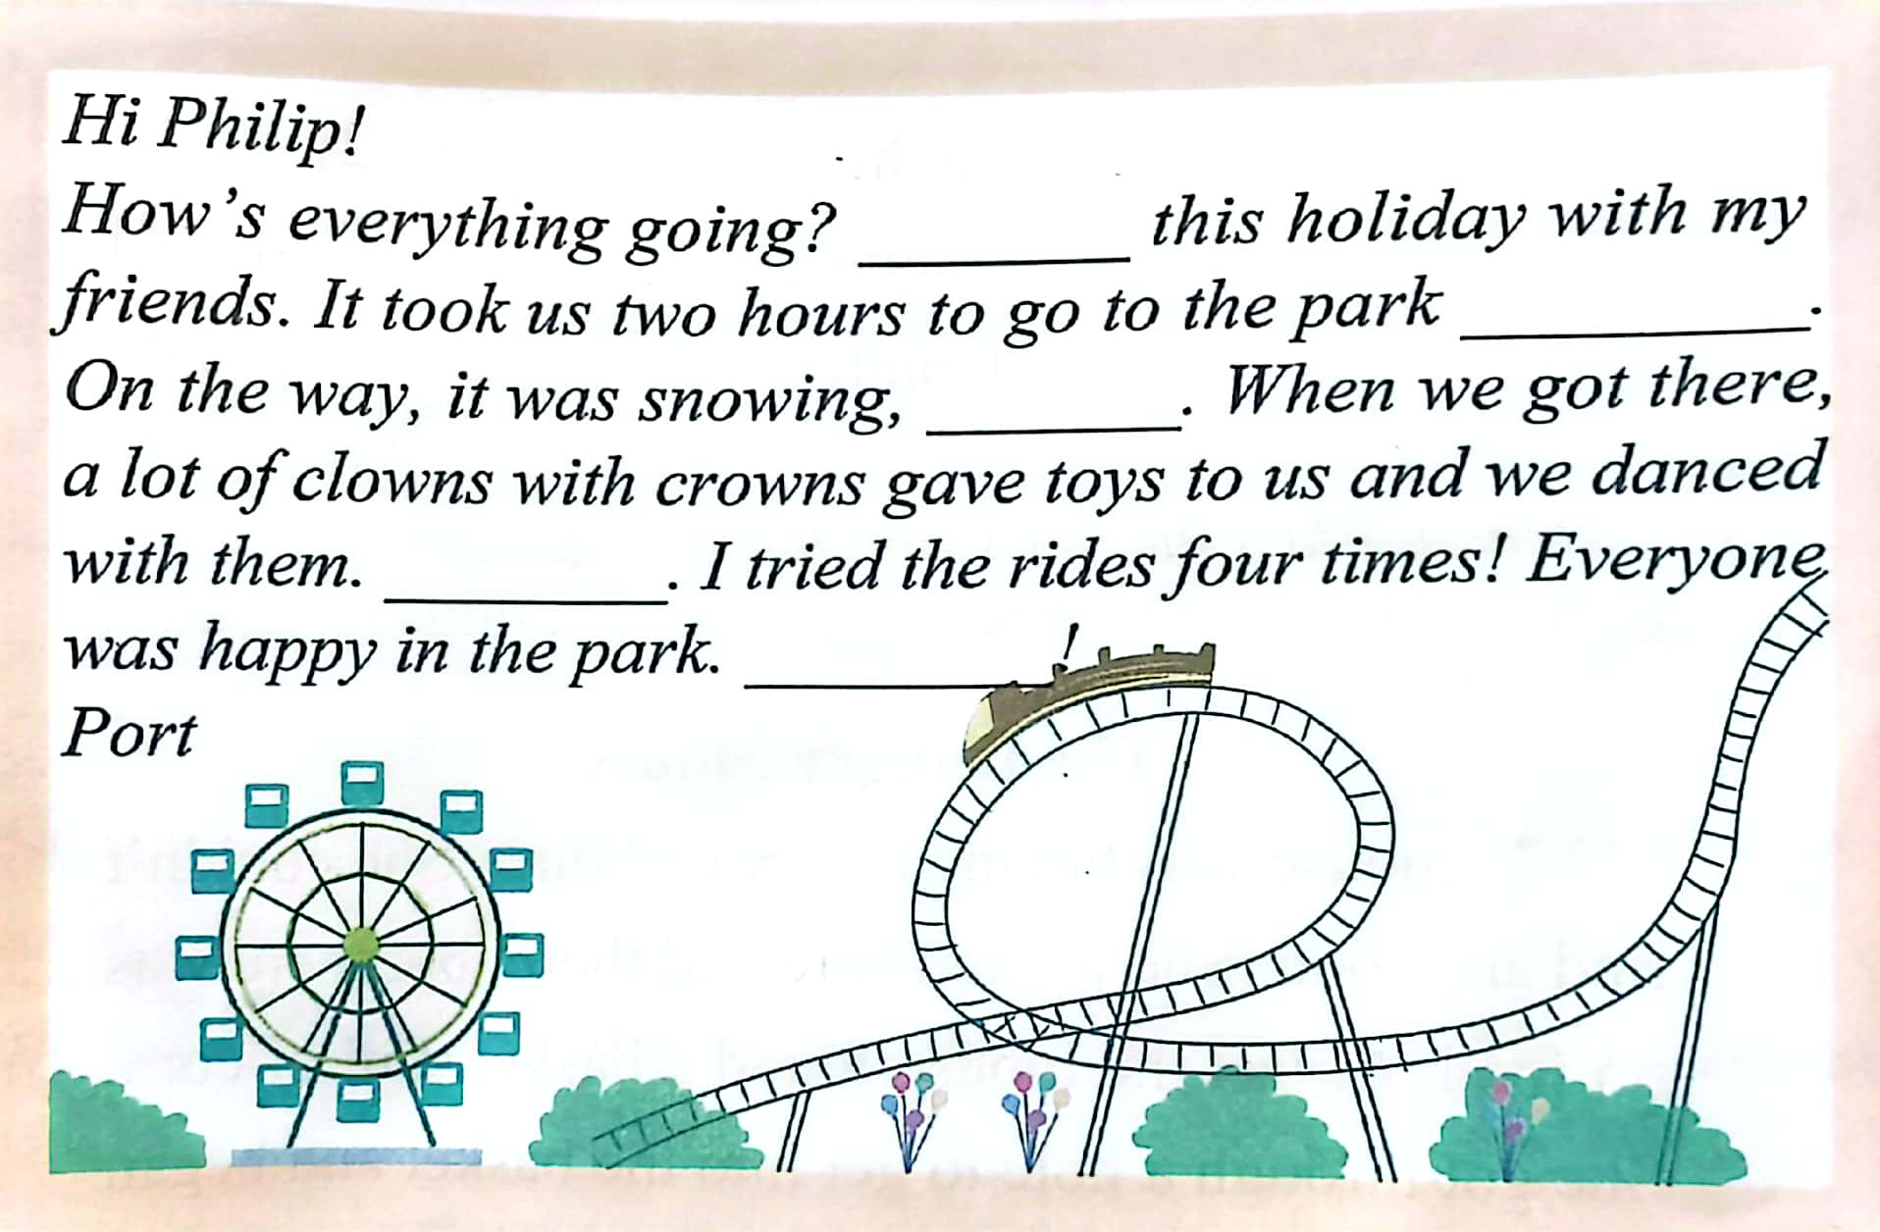
2、Choose the sentences above to complete the email.Then listen, check and repeat.把以上句子填入邮件中。然后听录音核对，并跟读。

Slide 13
3、 Listen,write and read.听一听，写一写，并读一读。
1) Listen and finish the email.听录音，完成邮件。
Hi, Port!
Everything's fine! Today I went to the zoo with my parents / because
I wanted to _______ the animal world. I saw a lot of animals, / like beautiful ______ ,/ snowy owls, / brown foxes / and so on. You should come with me! I took photos with ______. They are so cute!I'll _____ you/ as soon as I'm back. See you!
Philip

Slide 14
3、 Listen,write and read.听一听，写一写，并读一读。
2) Read the email aloud, paying attention to"/".大声朗读这封邮件，注意停顿。
Tip
在听录音前，阅读语篇预测内容，能够帮助你更好地理解听力大意,定位关键信息。

Slide 15
Challenging Yourself
1、Listen, repeat and choose the correct sound of the letters "ou".
听录音跟读，并选出字母组合“ou”的正确发音。
A./ɔ:/ B./aʊ/ C./u:/ D./ʊ/
1) bought
brought
thought
2) would
should
could

Slide 16
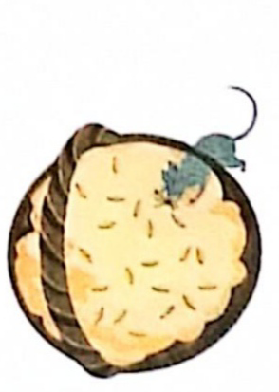
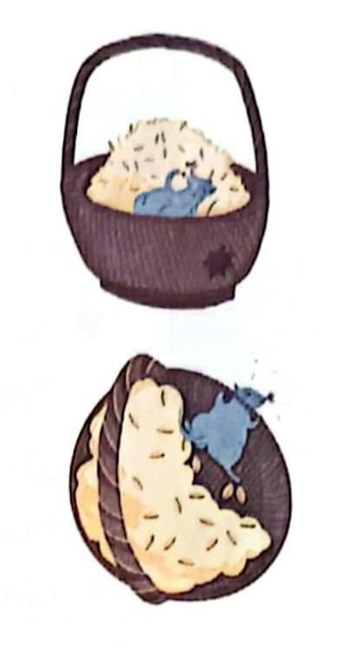
Challenging Yourself
2、Listen, mark(/) the story and tell it in groups.
听录音，用斜线“/”给故事划分意群，并在小组内讲述该故事.
The Hungry Mouse
A mouse was having a very bad time. She couldn't find any food. She looked here and there, but there was no food. At last the mouse found a basket, full of corn . She got through a hole to get into the basket and began to eat the corn.
She was very hungry so she ate a lot and went on eating and eating. She had grown very fat in a short time. When the mouse tried to get out of the basket, she could not make it at all. She was too fat to pass through the hole.
"How shall I get out?" said the mouse. "Oh, how shall I get out?"

Slide 17
Challenging Yourself
3、Discuss with your partner(s) to help the mouse out.
与同伴讨论如何帮助老鼠摆脱困境。
These sentences may help:
A:I think she could...
B: Right! And she can also...
C: I don't think so...
D:...

Slide 18
Learning Reflectively
1、Try to work out the rules. 试着找出规律。
I) We can pronounce the letters "or"as /_____/ in corn and as/_____/in worth.
2) We can pronounce the letters "ou' as /_____/ in house; as /_____/in touch; as /_____/ in group; as /_____/ in thought and as/______/ in could.
3) We can pronounce the letters “ow” as/______/ in now and as /_____/ in snowball.
4) We can pronounce the letters “ph" as /_____/in photo and elephant.

Slide 19
Learning Reflectively
2、Tick(√) what you can do.看看你今天学会了什么。
Now I can...
Great
Good
Ok
Try hard
正确朗读含有“or”“ou”“ow”和“ph”的单词;
根据发音和含义对单词进行分类;
根据发音和含义写出单词;
推断字母组合“ou”的另外两种发音;
正确划分意群并有停顿地朗读文章。

Slide 20
homework:
(1) read alound 含有“or”“ou”“ow”和“ph”的单词;
(2) wirte the phonetics for 5 times.

Slide 21
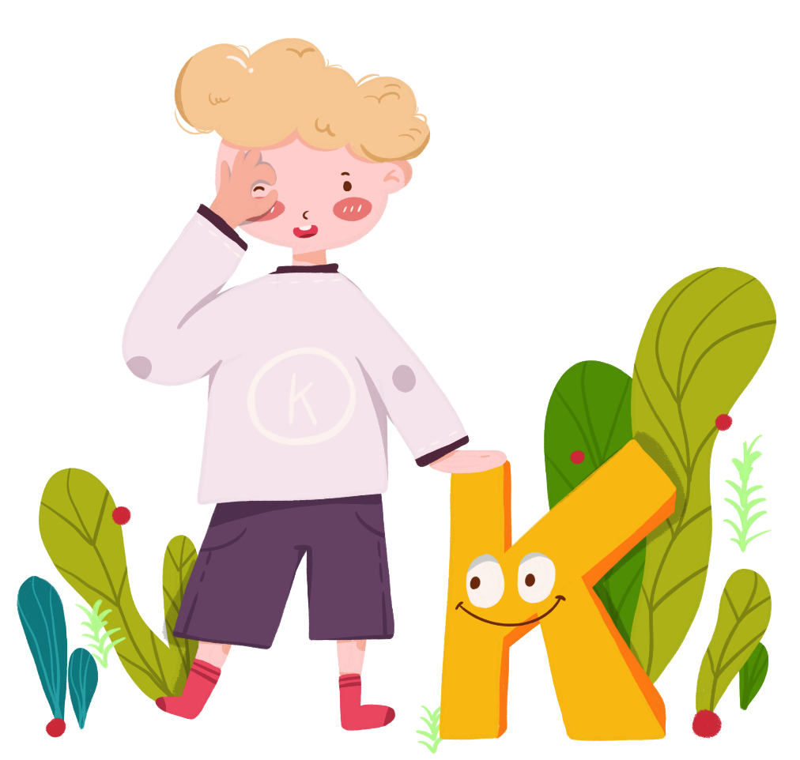
Comments on Teaching Plan
感谢您的观看
thanks
thanks
ABCDEFGHIJKLMNHIJKLMNOPQRSTUVWXYZ

