Slide 1
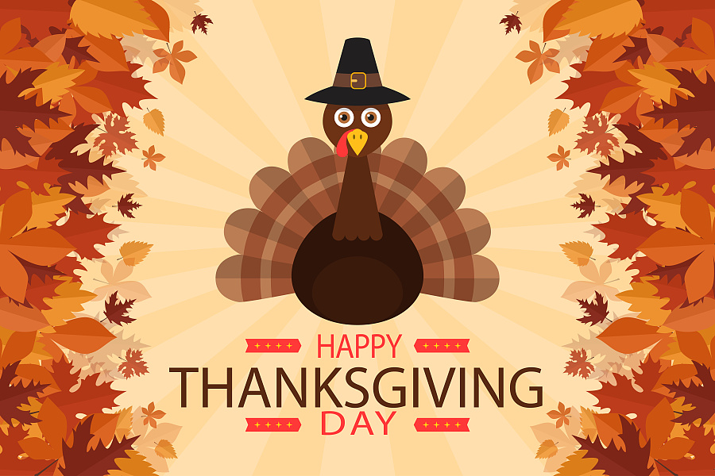
Unit 8
How do you make a banana milk shake?
Section B 2a—2e

Slide 2
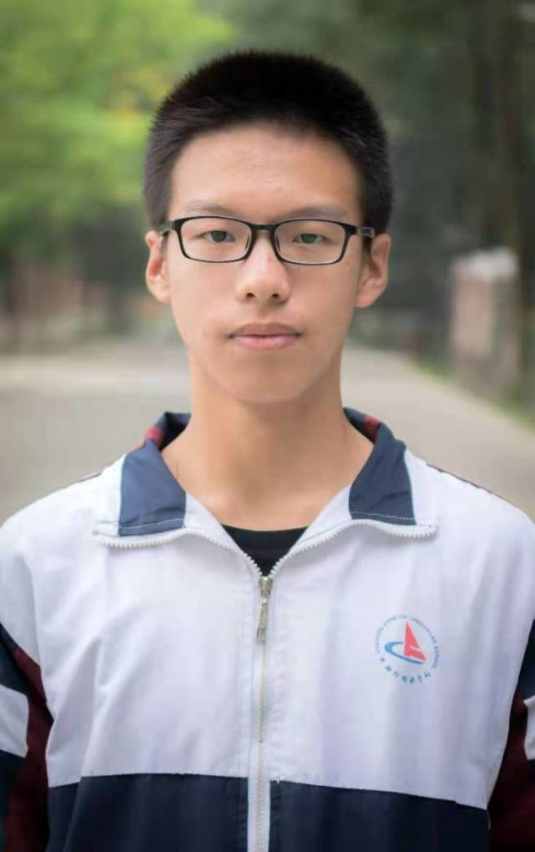
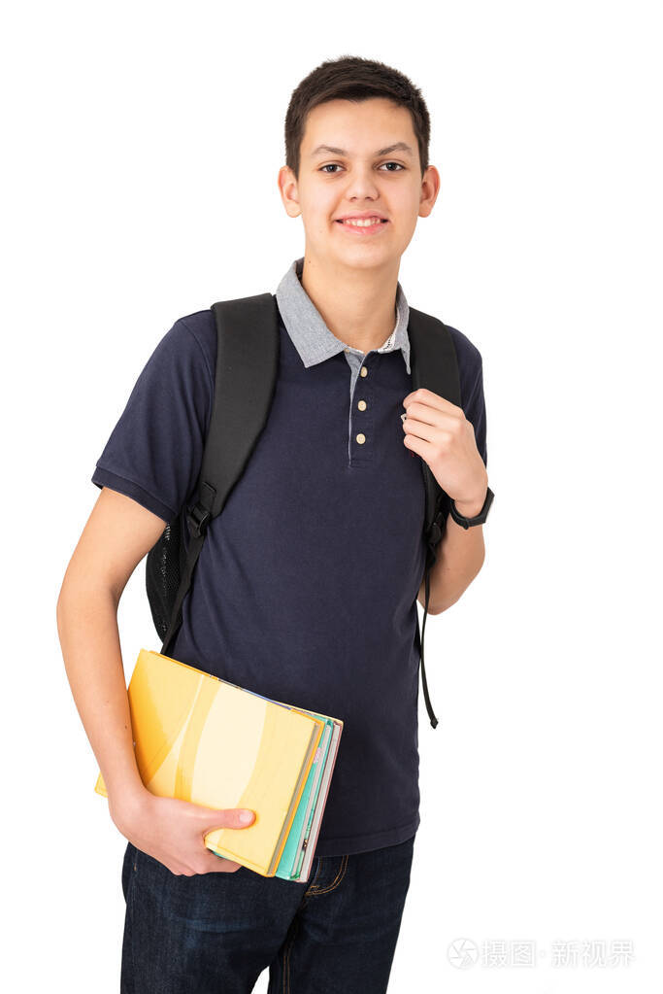
Zhu Hui
Jack

Slide 3

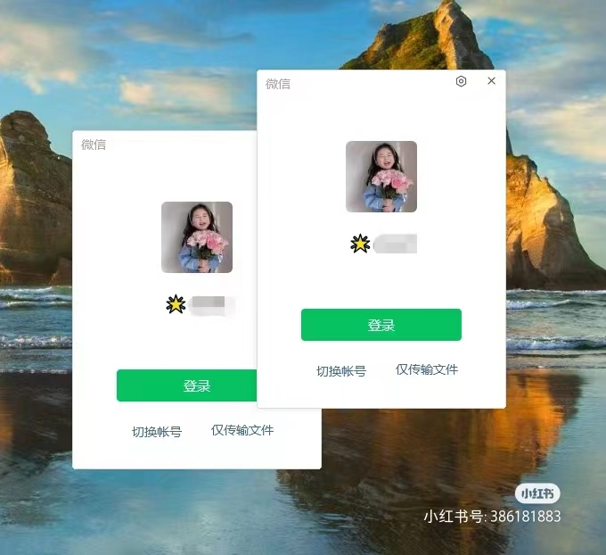

Slide 4
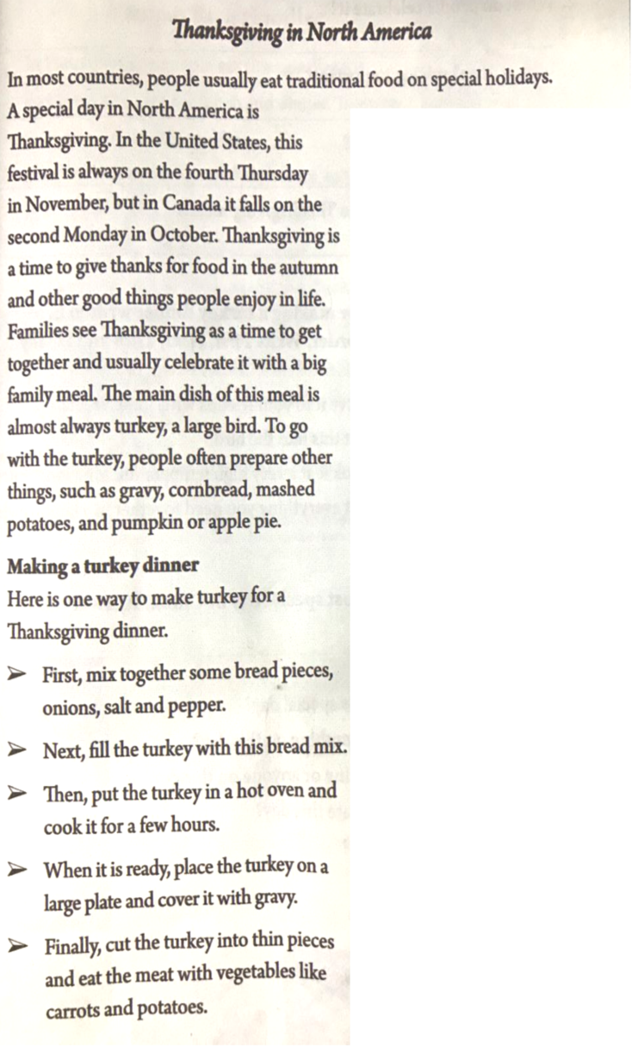
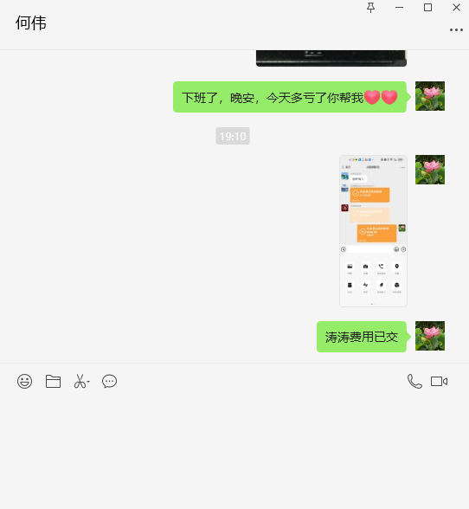
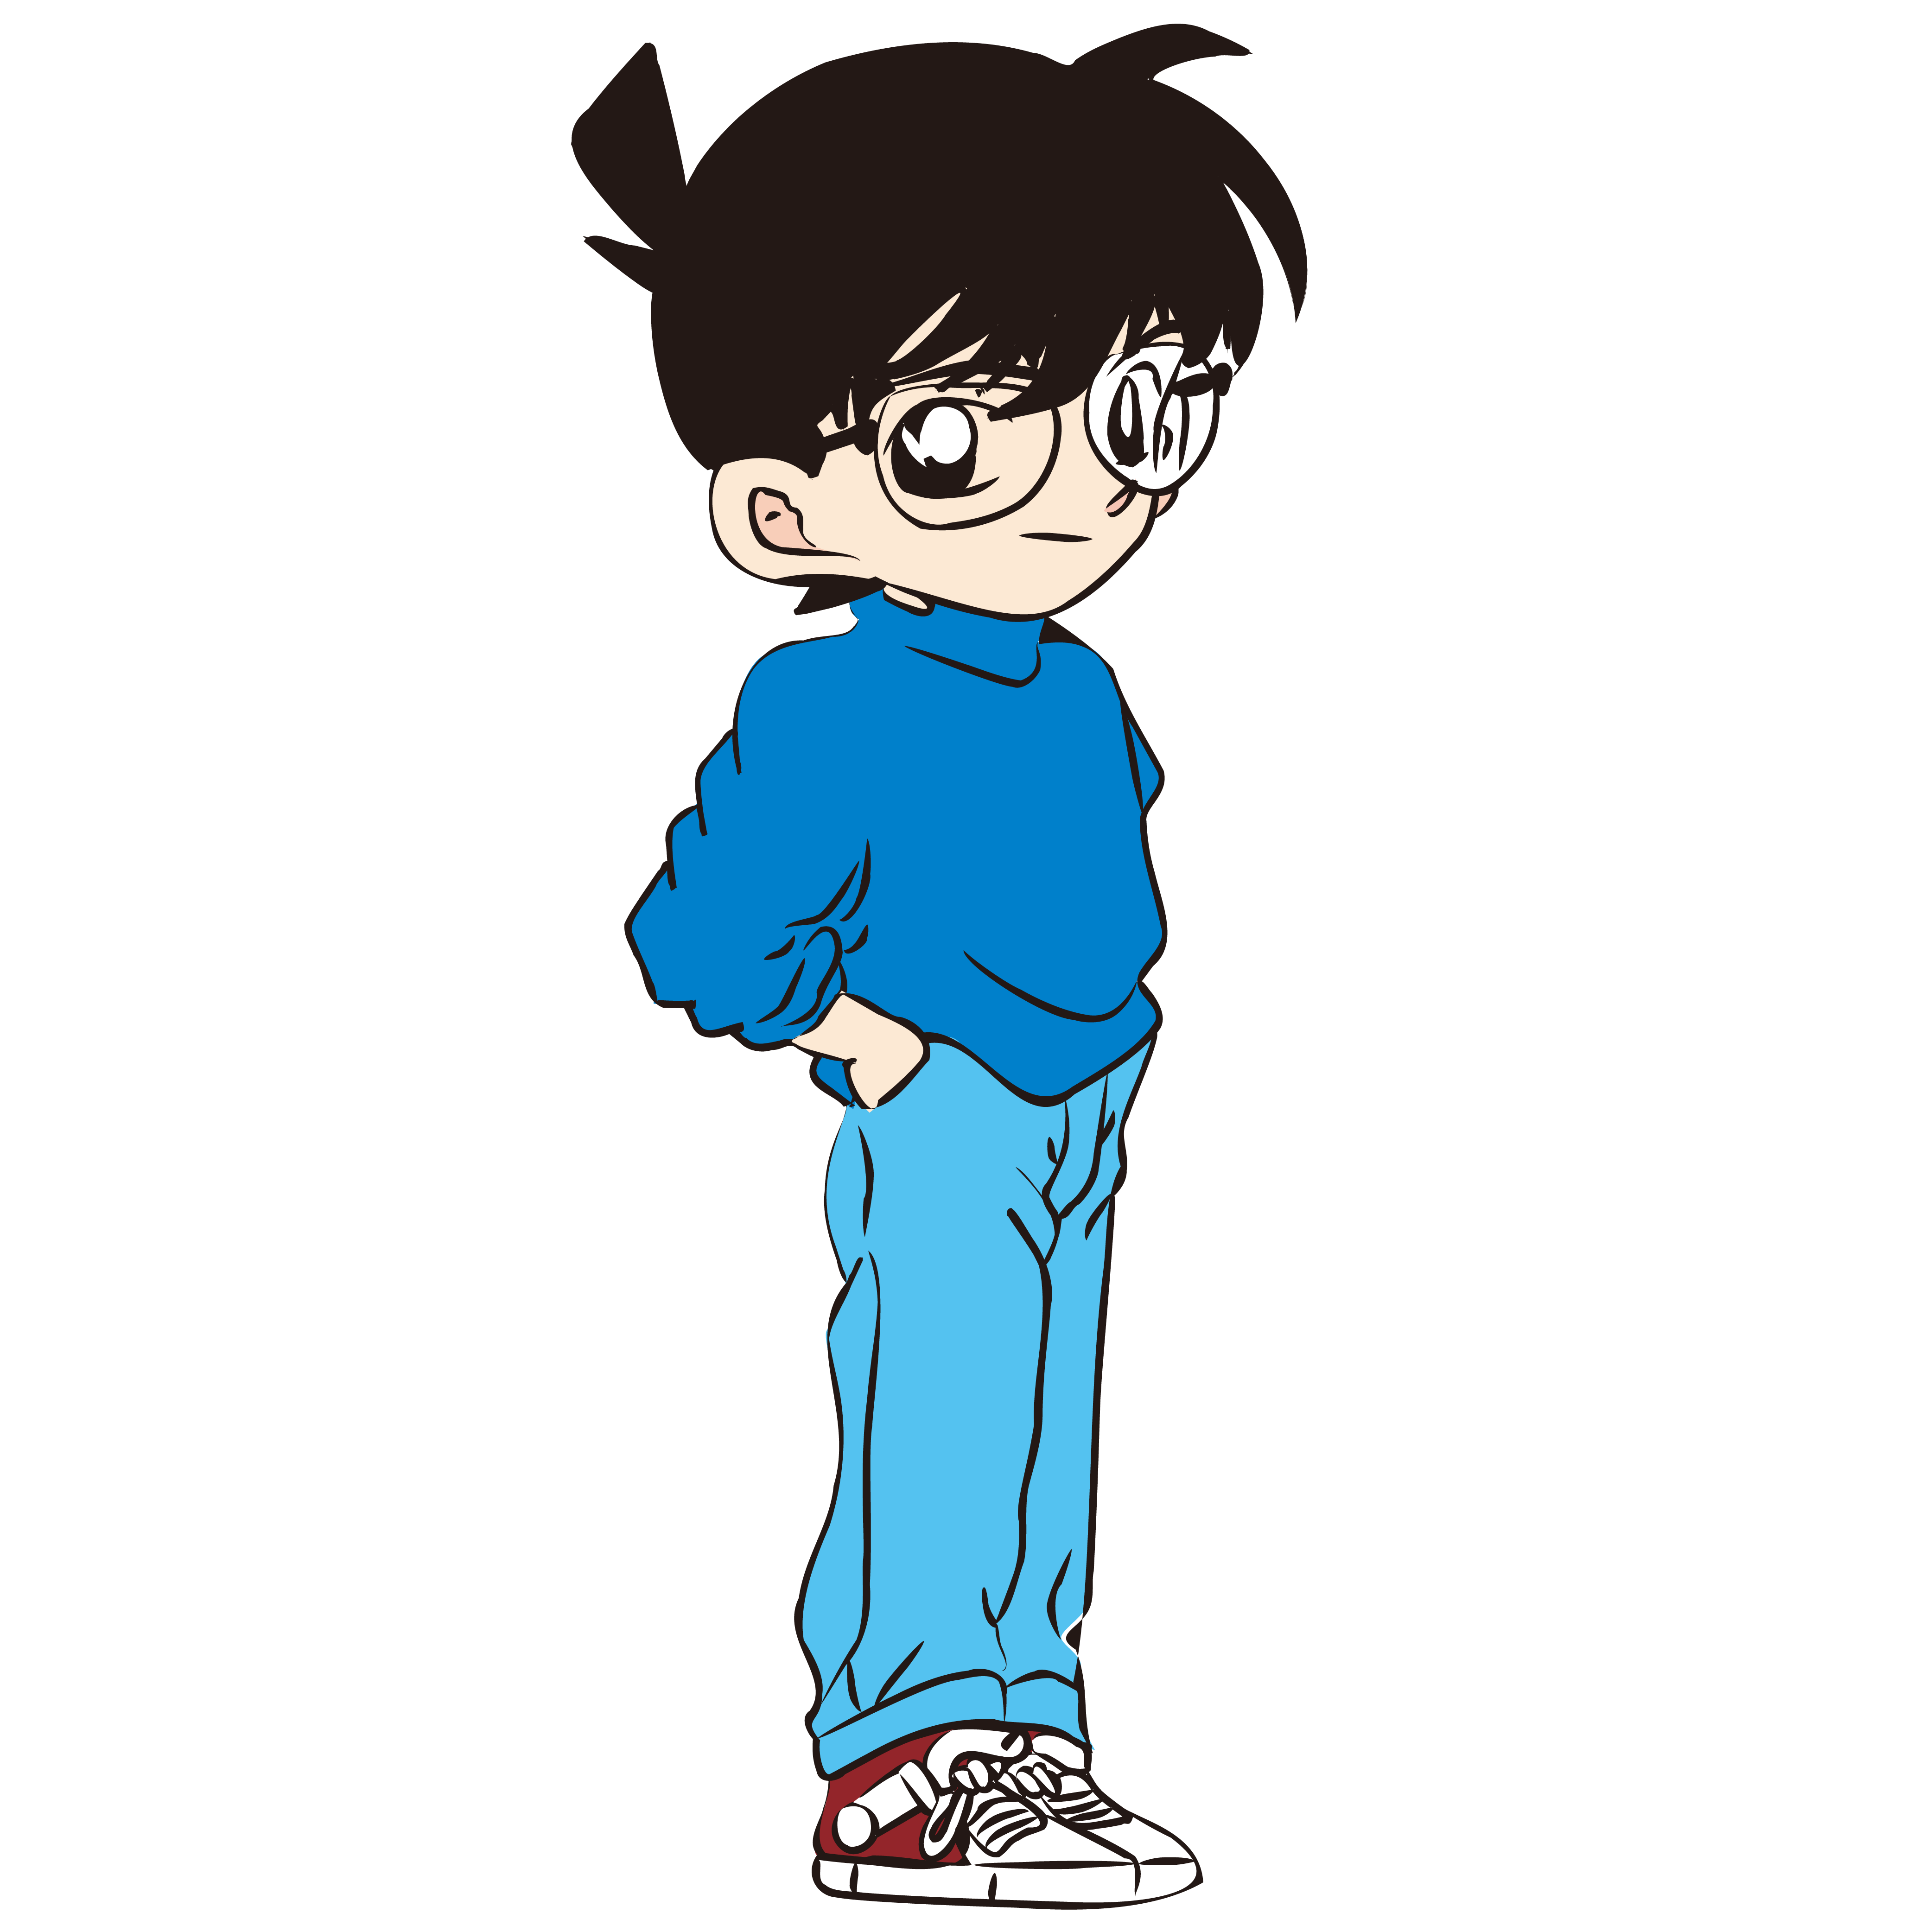
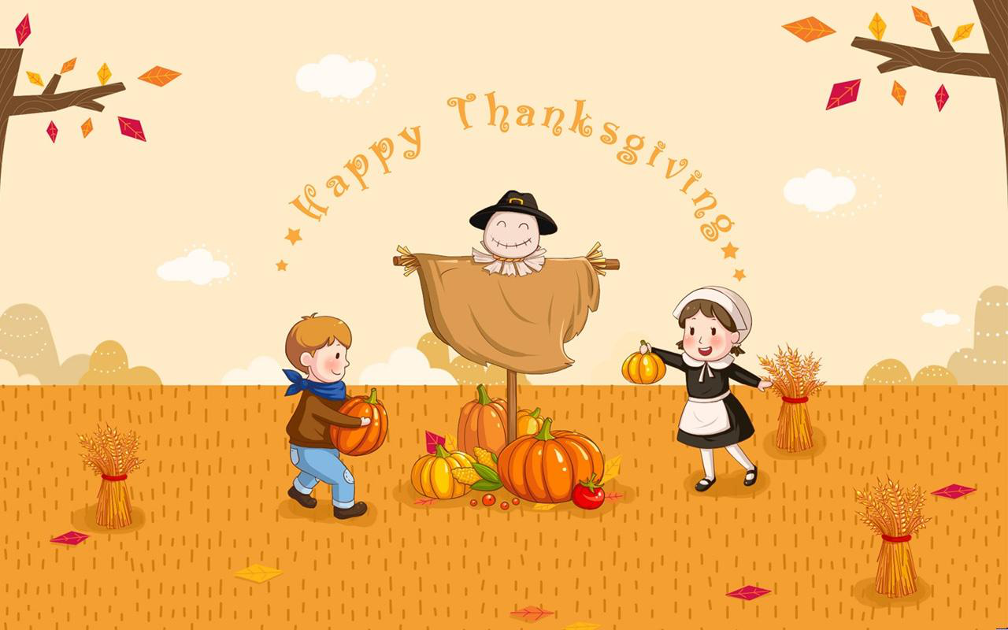
Hi,Jack! Long time no see! How’s everything ?
It’s great. Today is Thanksgiving.We are having a big meal.
Wow, sounds good. Could you please introduce something about Thanksgiving?
Sure. Have a look!

Slide 5
Read and get information about Thanksgiving from the following aspects.
Activity 1
1. Where do people celebrate Thanksgiving?
2. When do people celebrate it?
3. Why is Thanksgiving important?
4. How do people celebrate it?
5. What is the main dish of the Thanksgiving meal?
place
date
reason
activity
food

Slide 6
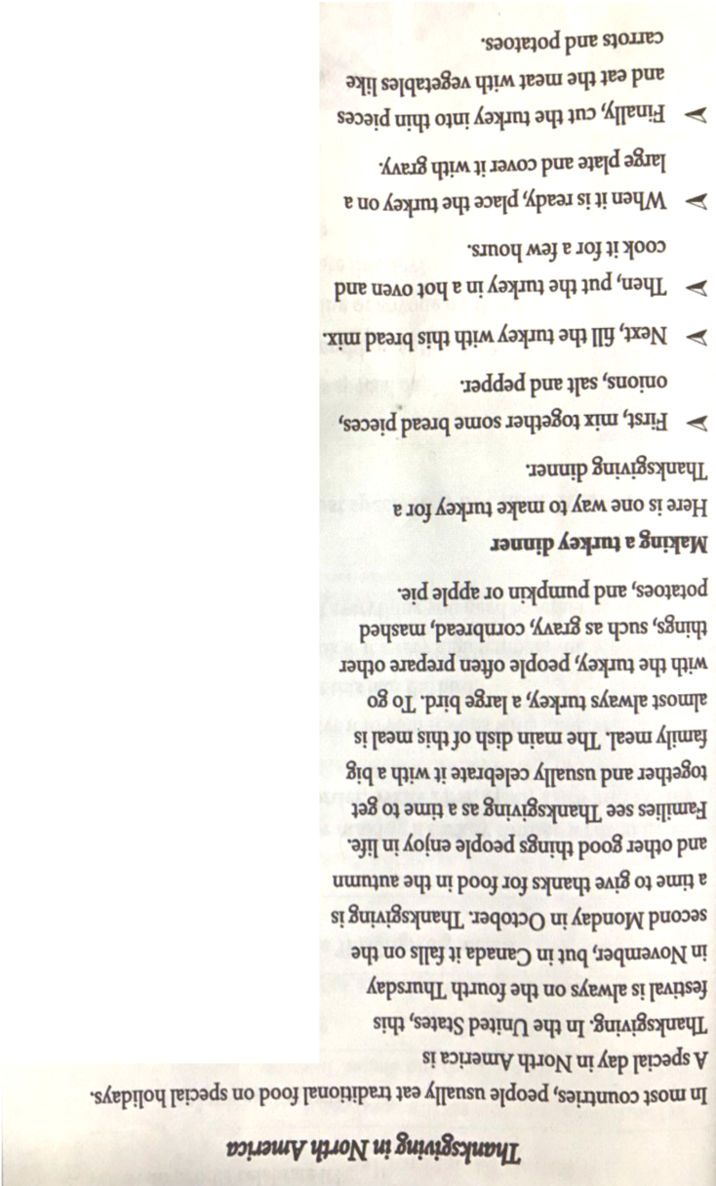
1
2
1. Where do people celebrate Thanksgiving?
2. When do people celebrate it?
3. Why is Thanksgiving important?
3
1. In North America.
2. It is always on the fourth Thursday in November in the United States, but in Canada it falls on the second Monday in October.
3. Thanksgiving is a time to give thanks for food in the autumn and other good things people enjoy in life.

Slide 7
4. How do people celebrate it?
5. What is the main dish of the Thanksgiving meal?
4. People celebrate it with a big family meal.
5. The main dish of the Thanksgiving meal is almost always turkey, a large bird.
4
5

Slide 8
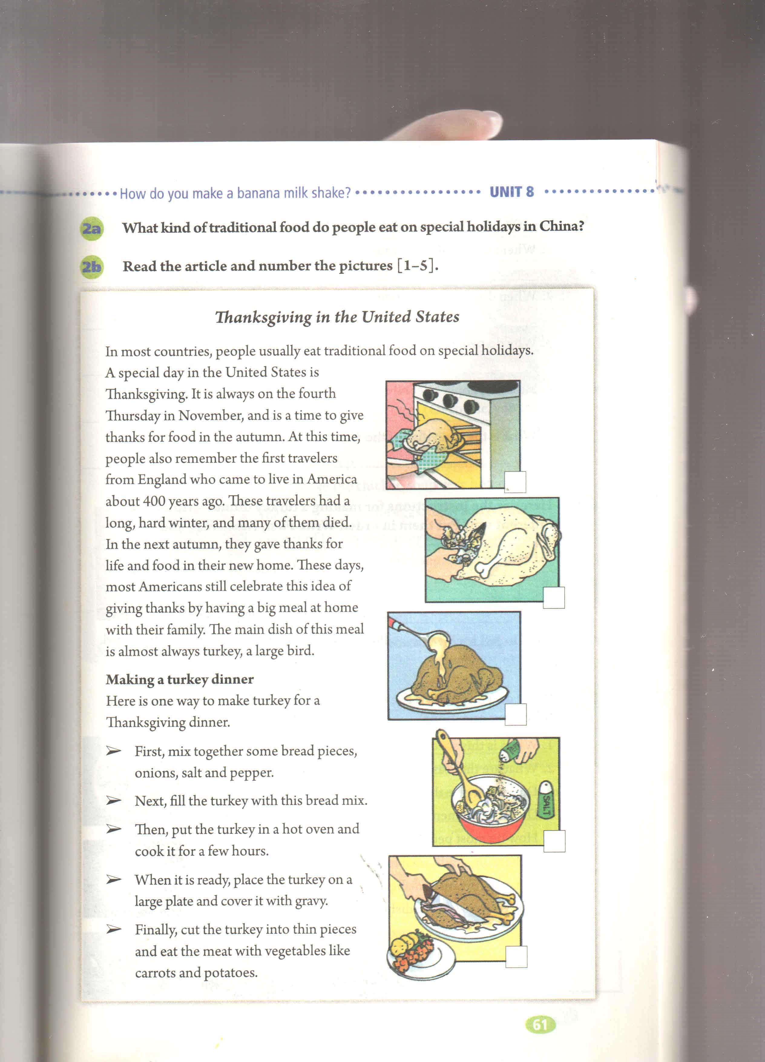
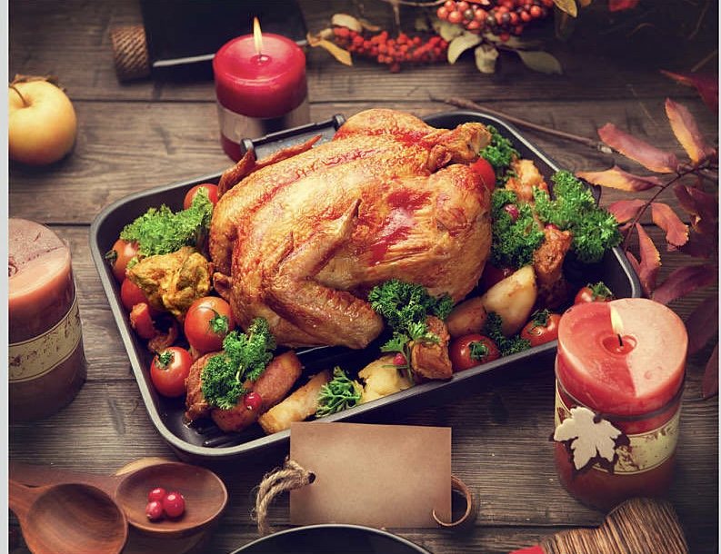
Jack!What do you usually eat on Thanksgiving?
Turkey!
Looks delicious! How do you make it?
Have a look!

Slide 9
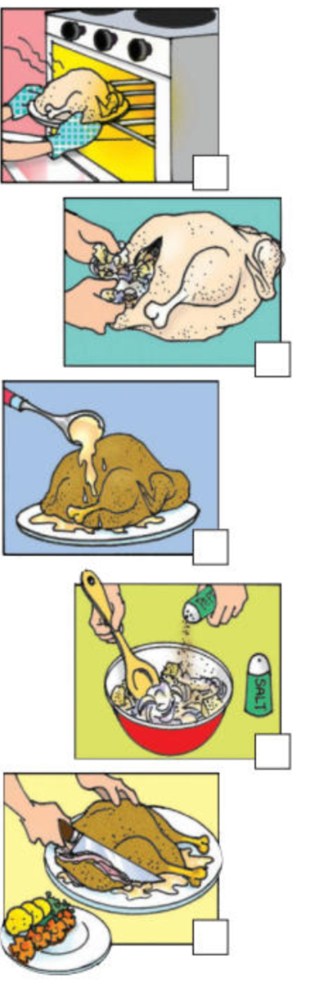
Activity 2 Read and find out how to make a turkey dinner.

Slide 10
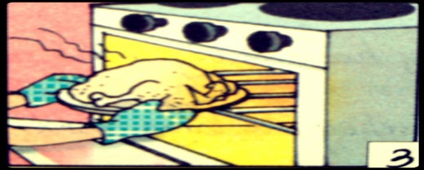
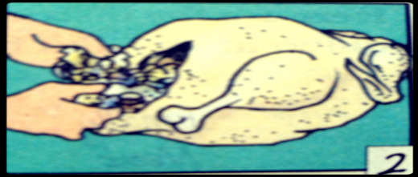
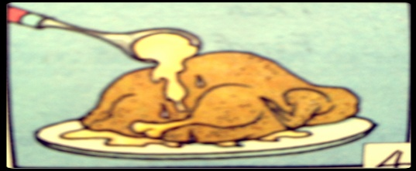
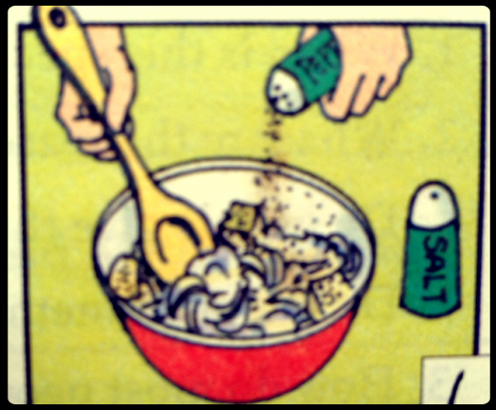
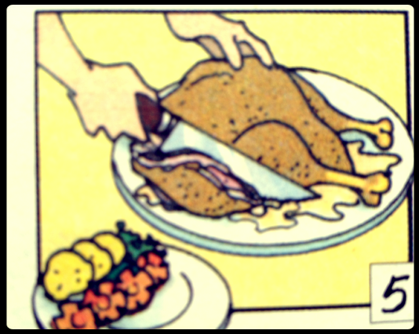
First, mix together some bread pieces, onions, salt and pepper.
3
2
Next, fill the turkey with this bread mix.
4
Then, put the turkey in a hot oven and cook it for a few hours.
1
When it is ready, place the turkey on a large plate and cover it with gravy.
5
Finally, cut the turkey into thin pieces and eat the meat with vegetables like carrots and potatoes.

Slide 11

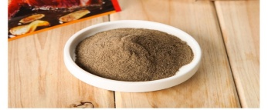


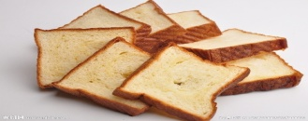
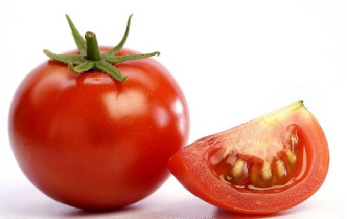
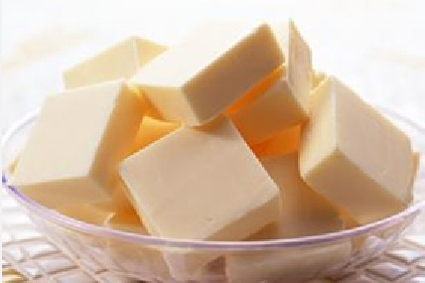
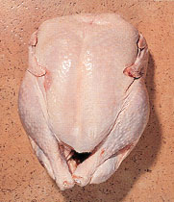
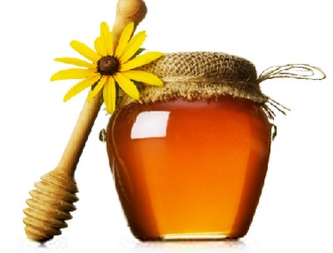
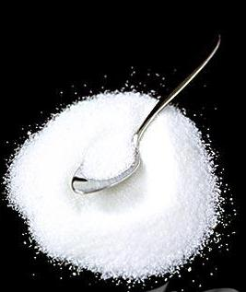
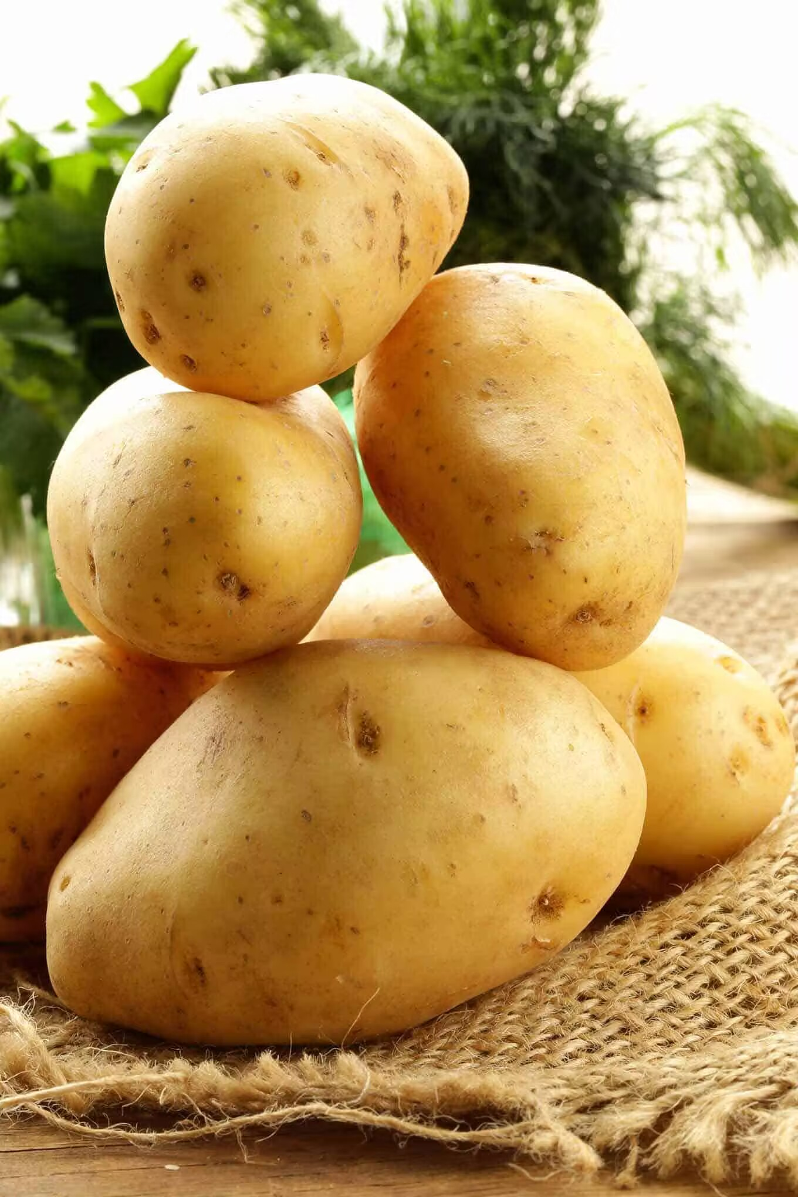
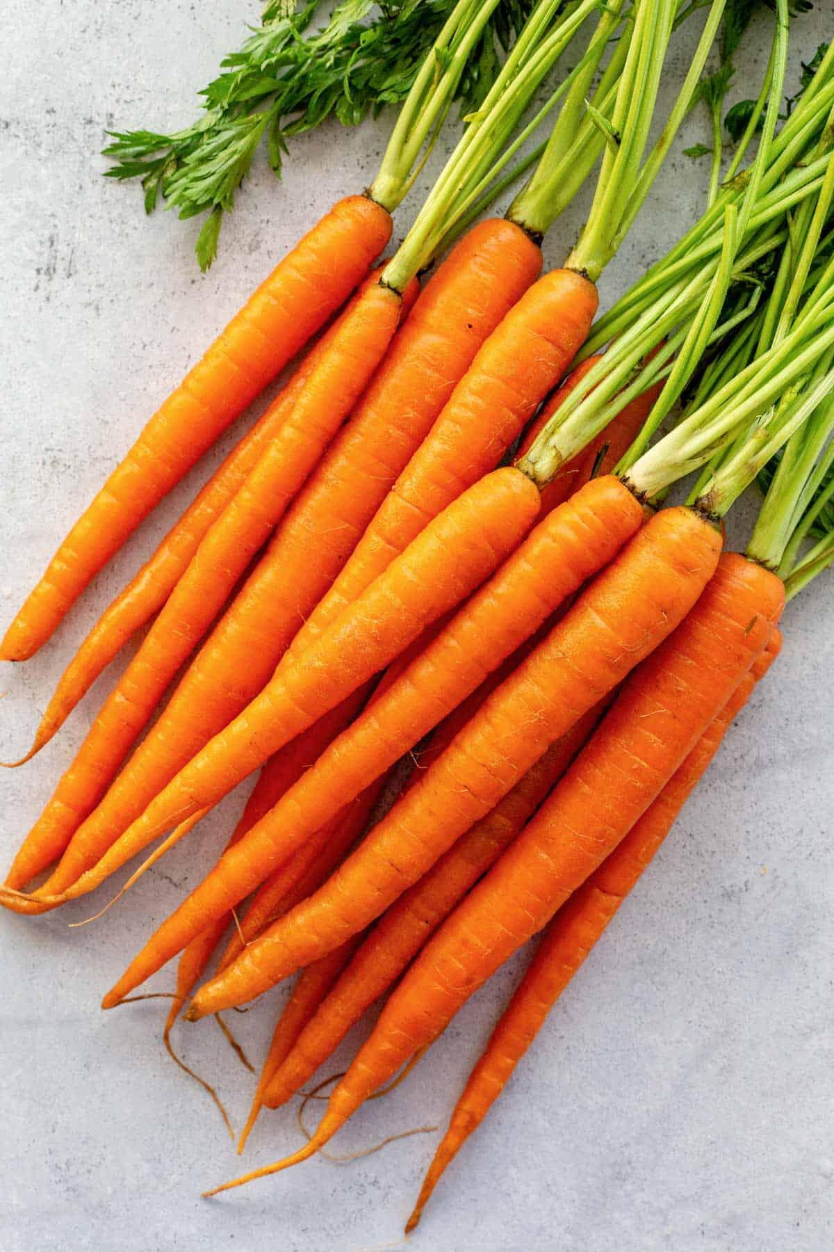
Activity 3 Do you have a good memory? Please check ( )the ingredients we need.
pepper
gravy
onions
bread pieces
tomatoes
butter
turkey
honey
salt
potatoes and carrots
turkey

Slide 12
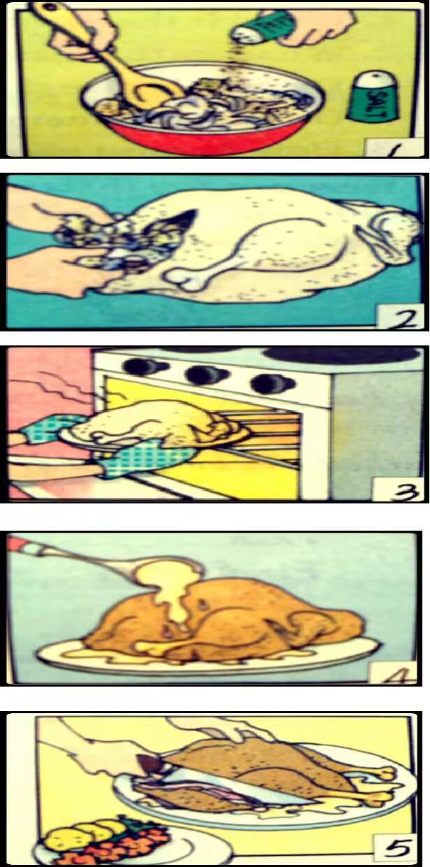
Activity 4 Let’s make a recipe for the turkey dinner.
first
cut..... into
place.....on
next
cover.....with
finally
fill.....with
mix....together
cook
when it’s ready
put.....in
eat
then
A recipe for the turkey dinner
To make a turkey dinner,
we need a turkey......
We should follow 5 steps:
First, mix together some
bread pieces.....
Next, .........

Slide 13
Now, how do you think about Thanksgiving?
It’s very special and interesting. Why do you celebrate Thanksgiving every year?
Let’s watch a video about the histroy of Thanksgiving!

Slide 14
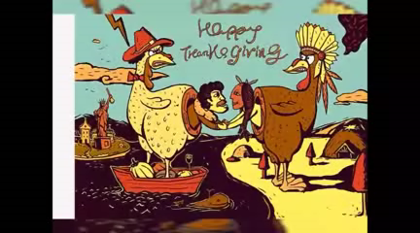
Activity 5 Watch a video to know the history of Thanksgiving.
What did the Englishmen do
on the first Thanksgiving?
They got together and ate turkey.
Why did the Englishmen eat turkey on Thanksgiving?
They wanted to give thanks to
Indians for the life and food.
Why do the people in the USA keep the tradition?
They want to give thanks to
everything they have.

Slide 15
Hui, I am very curious about Chinese traditon.What kind of traditional food do people eat on special holidays in China?
Let me introduce them to you.

Slide 16
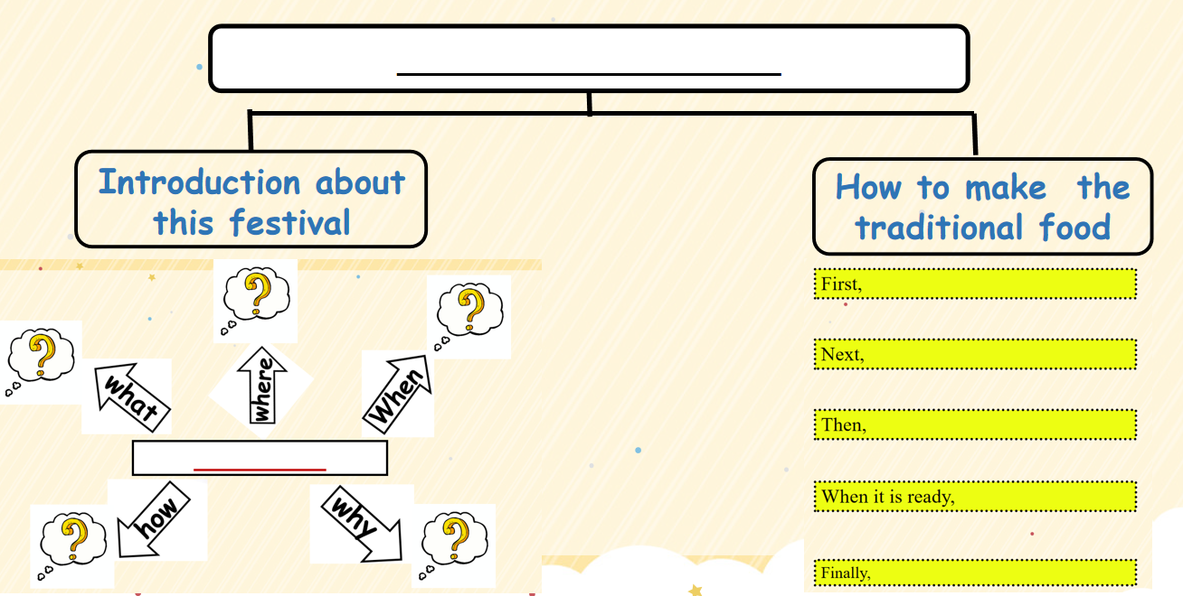
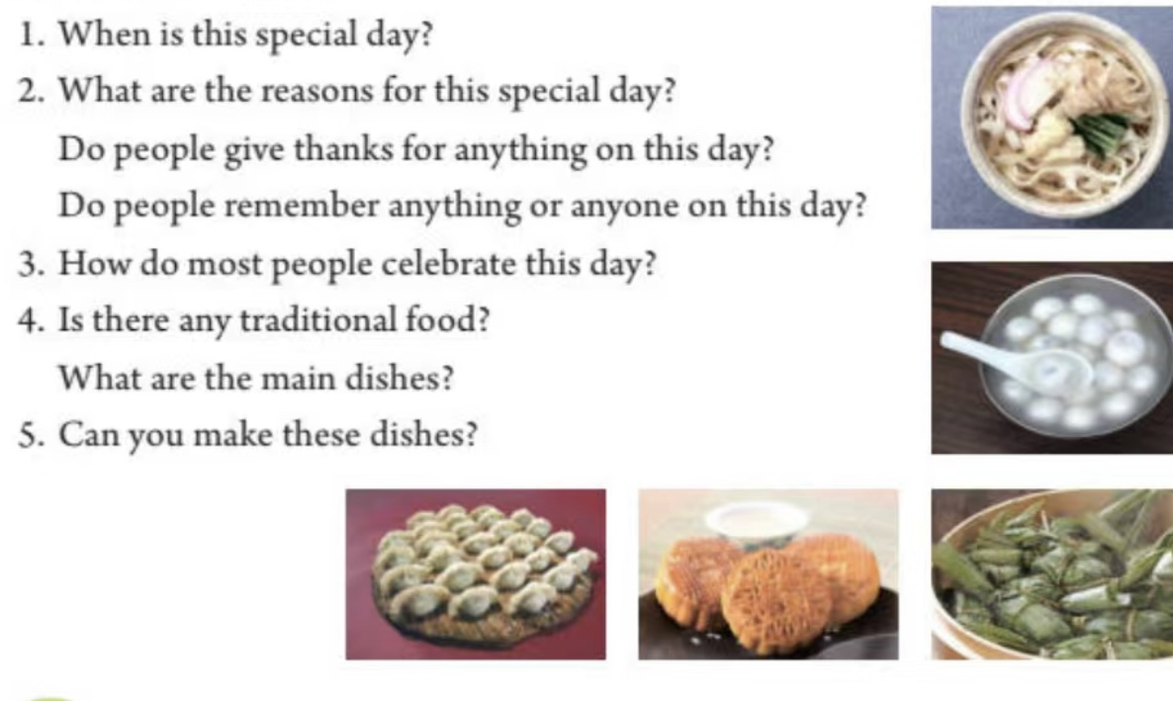
Activity 6 Let’s help Zhu Hui. Each group choose one task to finish with the help of the worksheet.
Task 1. Make a poster about a festival.
Task 2. Make a short introduction about a festival.
Task 3. Write a short script (脚本) of a festival video.

Slide 17
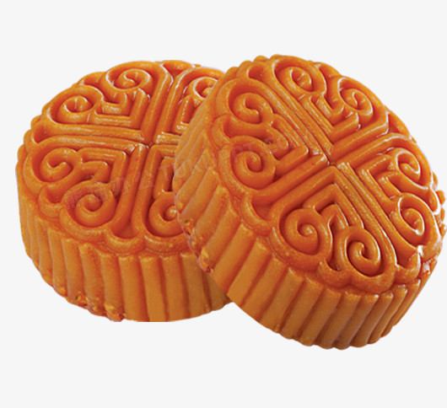
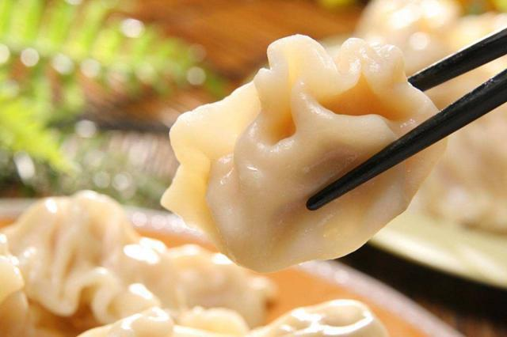
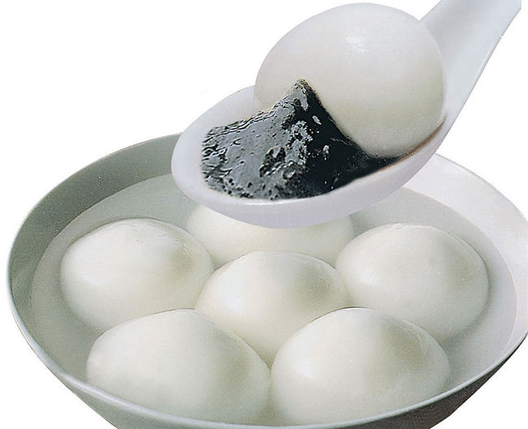
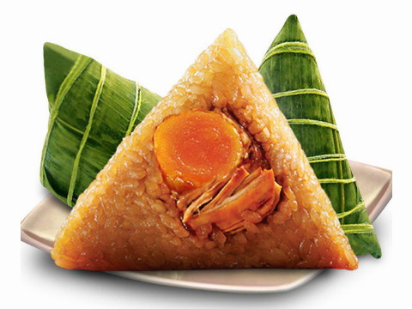
Activity 7 Let’s think deeply.
Why should we eat special food on the special holidays?
Food carries the special feelings and memories.
Food is the key to a happy holiday.
A holiday without special food is like a
day without sunshine.

Slide 18

Evaluate yourself
No. | Contents | Self-assessment
 |  | Excellent | Good | To be improved
1 | I can describe the information of Thanksgiving.
2 | I can use target language to express how to make turkey dinner.
3 | I can analyse and express the meaning of Thanksgiving and its food.
4 | I can say the reasons why we eat special food on special holidays.
5 | I can use what I learnt in class to introduce one Chinese traditional festival.

Slide 19


Homework
You can choose one task to finish.
Task 1:
Surf the Internet, then add more information about Thanksgiving.
Task 2 : Do a research about a traditional festival and show us your findings in your way.

Slide 20
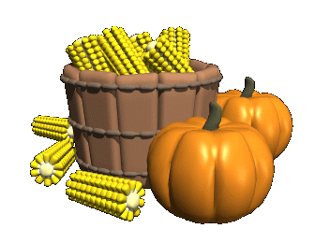
Thanks for your attending!

