Slide 1




Comments on Teaching Plan
Lesson 18
I Want to Explore the Animal World
——Yang Shuilu

Slide 2
Looking Ahead
By the end of this lesson, you will be able to：
Read the words with the letters “or” “ou” “ow” and “ph” correctly;
正确朗读含有 “or” “ou” “ow”和“ph”的单词；
group the words by their sounds and meanings;
根据发音和含义对单词进行分类；
complete and understand the emails;
完成并理解邮件；
write the words according to their sounds and meanings;
根据发音和含义写出单词；
infer another two sounds of the letters“ou”;
推断字母组合“ou”的另外两种发音；
mark thought groups correctly and read passages with pauses.
正确划分意群并有停顿地朗读文章。

Slide 3

Learning to Learn
or |  | ou |  |  | ow |  | p | ph
/3:/ | /ɔː:/ | /aʊ/ | /u:/ | /ʌ/ | /əʊ/ | /aʊ/ | /p/ | /f/
work world worth | corn explore horn | about around house | group route through | country southern touch | low snowball throw | clown crown now | parent park play | elephant phone photo

Slide 4
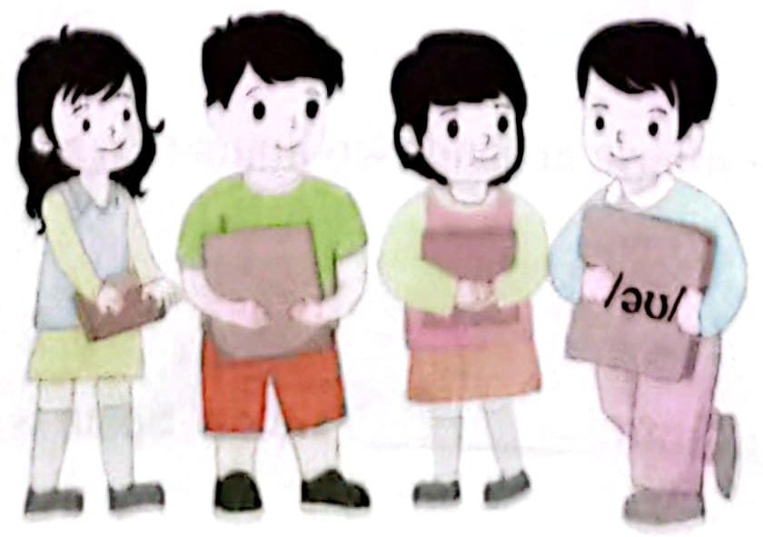
Learning Actively
1.Work in groups to read the flash cards and compete.
分小组朗读卡片上的内容，看谁读得又快又准。
/3:/ | /ɔː:/ | /aʊ/ | /u:/ | /ʌ/ | /əʊ/ | /aʊ/ | /p/ | /f/

Slide 5
2. Read and think．读一读，想一想。
1) /wɜːk/ /ɡruːp/ /ˈkʌntri/ /ləʊ/ /klaʊn/ /ˈpeərənt/ /ˈfəʊtəʊ/
2) worth through play route throw corn house port
3) phone me now park your car touch the horn
an old crown explore the world a white elephant

Slide 6
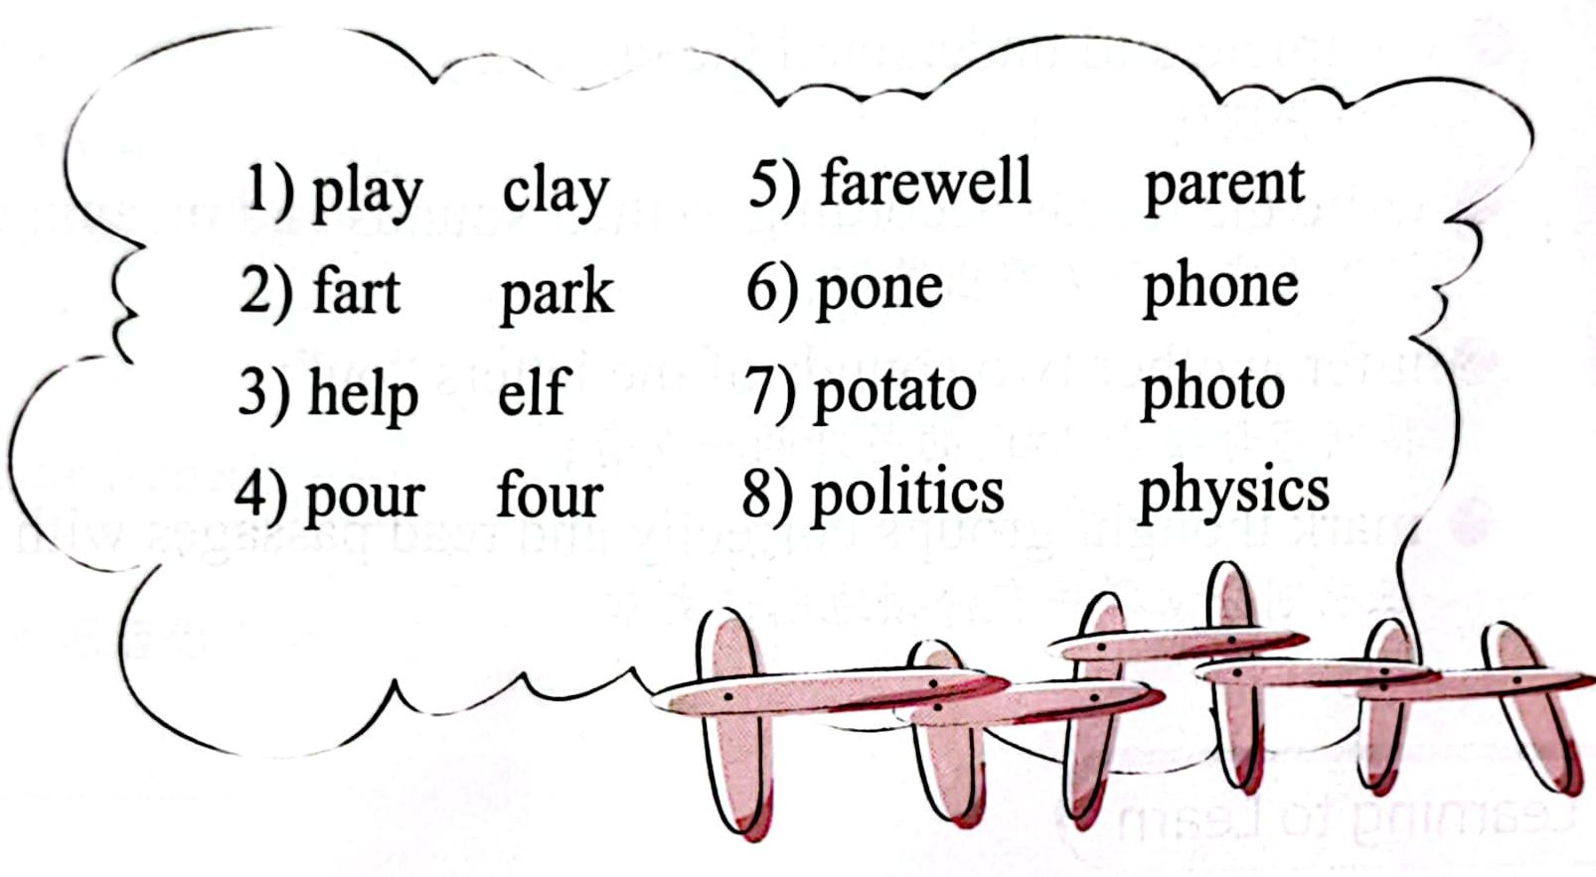
3.Listen and circle the word you hear.
听录音，圈出你听到的那个单词。

Slide 7

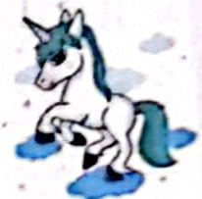
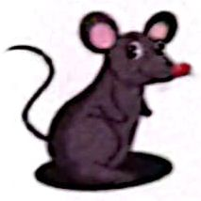

4. Read and write．读一读，写一写。
through town house slow horn worth elephant southern explore
worth
1) A bird in the hand is__________ /wɜːθ/ two in the bush.
2) The beautiful horse with a___________/hɔːn / is a unicorn.
3) It took the mouse around two hours to reach her______ /haʊs/.
4) My cousin from__________/'sʌðən/ Spain is in trouble.
horn
house
southern

Slide 8



town
5) The clowns with crowns brought us food in the______ /taʊn/.
6)There is so much to__________/ɪkˈsplɔː(r)/ in the park!
7)The ___________/'elɪfənt/ in the photo can talk on a phone.
explore
elephant

Slide 9
Learning Creatively
1.Complete the sentences.完成句子。
or ow ou
A.So we all went to play and thr__ __ the sn__ __ball. B.I went to the Fun Times Park of the s__ __ thern t__ __n.
C.Bye for n__ __! D.I was most excited by the Space W__ __ld. E. But I think it's all w__ __th it.
答案：A:throw snowball B.southern town C.now
D. World E.worth

Slide 10
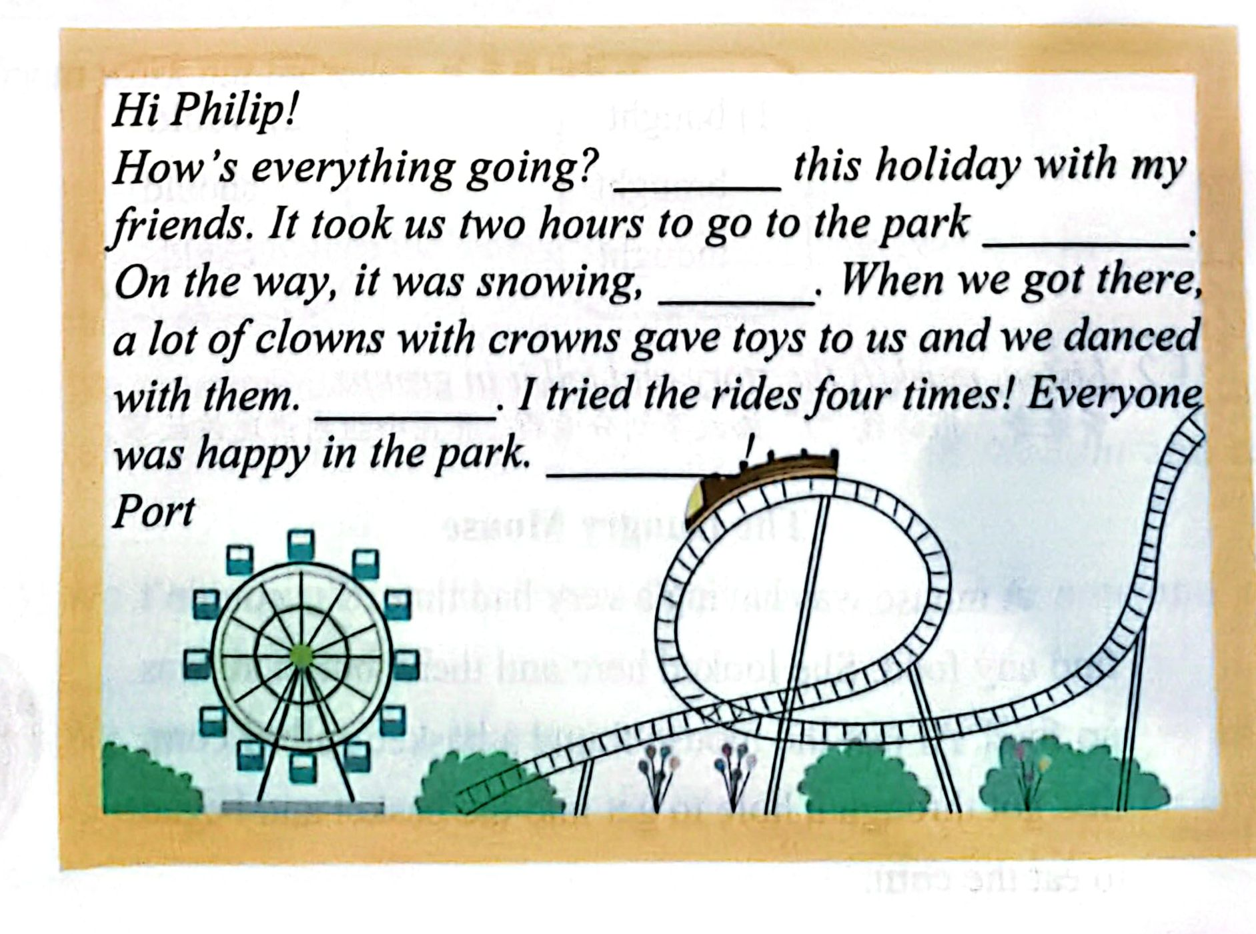
2. Choose the sentences above to complete the email.Then listen,check and repeat.把以上句子填入邮件中。然后听录音核对，并跟读
B
E
A
D
C

Slide 11
3.Listen, write and read.听一听,写一写,并读一读。
1)Listen and finish the email.听录音,完成邮件。
Hi, Port!
Everything's fine! Today I went to the zoo with my parents / because
I wanted to_______the animal world.I saw a lot of animals,/ like
beautiful_________,/ snowy owls, /brown foxes /and so on.You
should come with me! I took photos with__________.They are so cute! I’ll________you /as soon as I'm back.See you!
Philip
explore
horses
elephants
phone
tip：在听录音前，阅读语篇预测内容，能够帮助你更好地理解听力大意，定位关键信息。
2) Read the email aloud, paying atteation to“/”
大声朗读这封邮件,注意停顿。

Slide 12
Challenging Yourself
1.Listen,repeat and choose the correct sound of the letters "ou".
听录音跟读，并选出字母组合“ou”的正确发音。
A./ɔː:/ B./aʊ/ C./u:/ D./aʊ/
1)bought
brought
thought
2)would
should
could

Slide 13
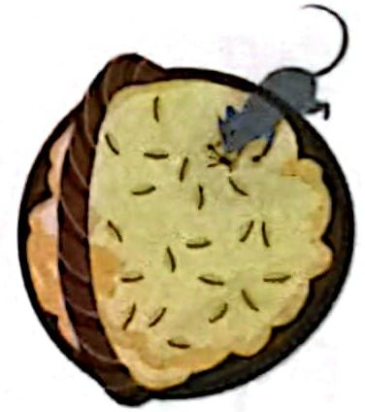
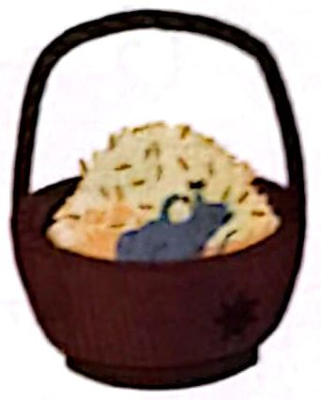
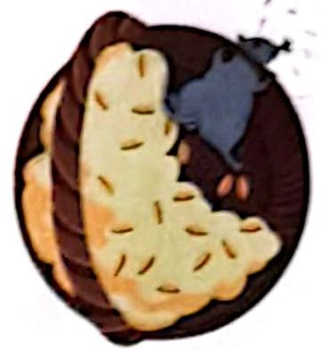
2 Listen, mark(/) the story and tell it in groups.
听录音，用斜线“／”给故事划分意群，并在小组内讲述该故事。
The Hungry Mouse
A mouse was having a very bad time. She couldn't find any food. She looked here and there, but there was no food. At last the mouse found a basket, full of corn.She got through a hole to get into the basket and began to eat the corn.
She was very hungry so she ate a lot and went on eating and eating. She had grown very fat in a short time. When the mouse tried to get out of the basket,she could not make it at all. She was too fat to pass through the hole.
“How shall I get out?” said the mouse.“Oh,how shall I get out?”
/
/
/
/
/
/
/
/

Slide 14
3.Discuss with your partner(s) to help the mouse out.
与同伴讨论如何帮助老鼠摆脱困境。
These sentences may help:
A:I think she could... B:Right! And she can also... C: I don't think so... D:...

Slide 15
Learning Reflectively
1. Try to work out the rules.试着找出规律。
ɔː:
1) We can pronounce the letters “or"as /____/ in corn and as/_____/ in worth. 2) We can pronounce the letters “ou" as/___/ in house;as/___/ in touch;as/____/in group;as/___/in thought and as /___/in could. 3) We can pronounce the letters “ow”as/___ /in now and as /______/in snowball. 4) We can pronounce the letters“ph”as/____/in photo and elephant.
3:
aʊ
ʌ
u:
ɔː:
ʊ
aʊ
əʊ
f

Slide 16
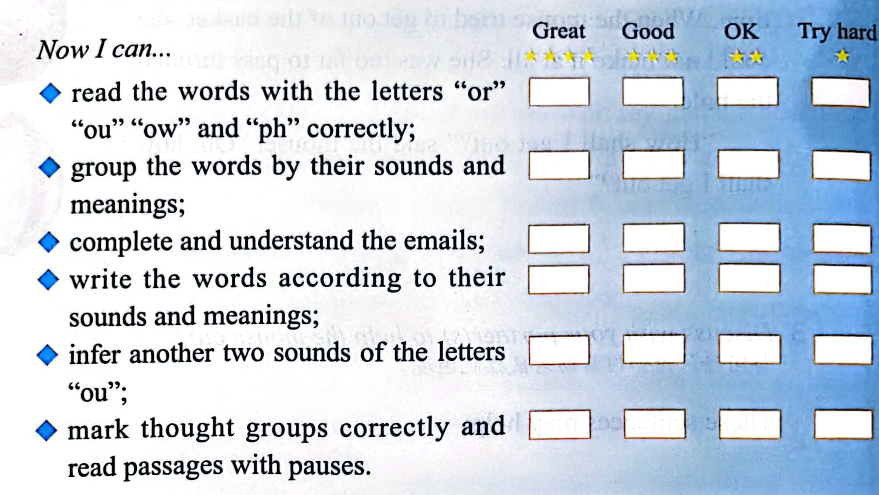
2.Tick(√)what you can do.看看你今天学会了什么

Slide 17
3.Write your learning log.完成学习日志。
1）学完本课后你有什么收获呢？
________________________________________________________________________________________________________________________________________________________________________ 2）学完本课后你还有什么疑惑呢？大胆写下来吧！
________________________________________________________________________________________________________________________________________________________________________

Slide 18
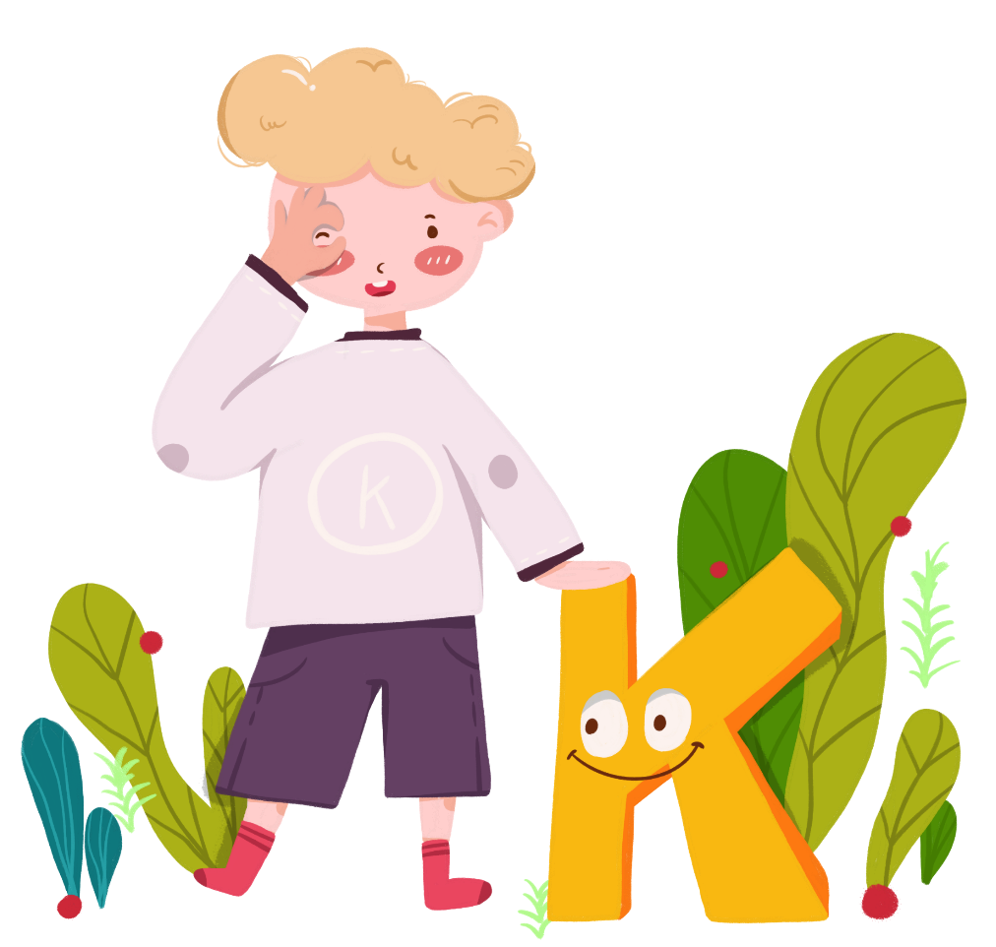
Comments on Teaching Plan
感谢您的观看
thanks
thanks
ABCDEFGHIJKLMNHIJKLMNOPQRSTUVWXYZ

