Slide 1


Reading
Module9 Friendship
Unit 2 I believe that the world
is what you think it is.
—— Faye
Notes:
Good morning, everyone! I’m Faye from Wenzhou. I guess you might feel a little bit nervous, so I’d like to show you some smiling faces.

Slide 2
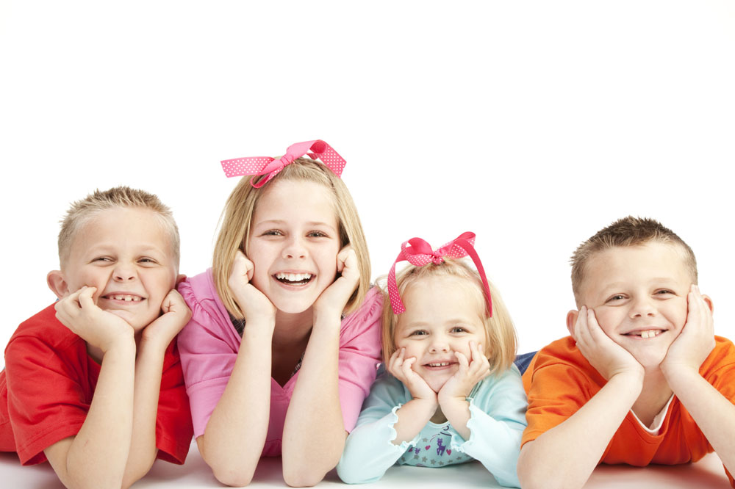
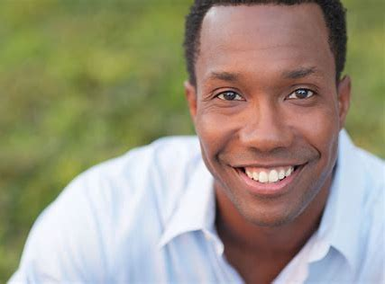
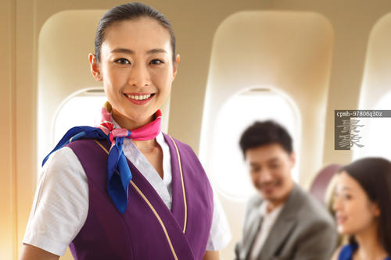

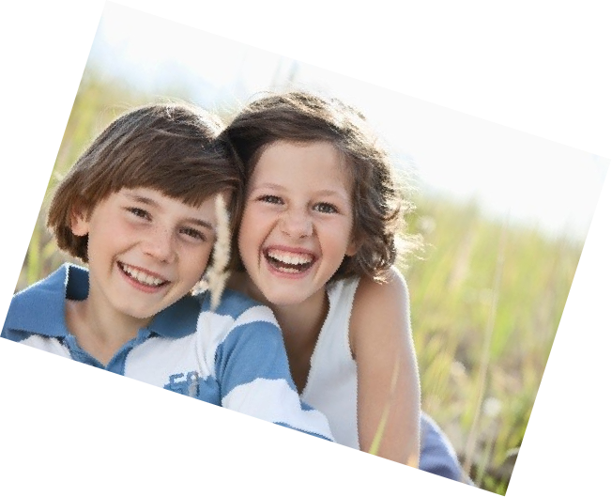

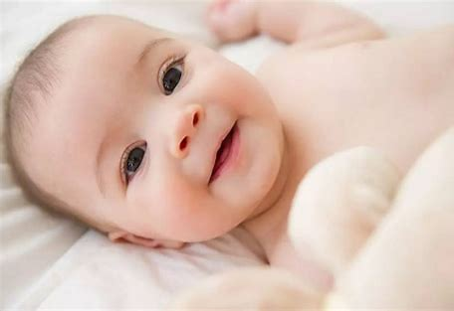
I think smile is/can ....
Notes:
What do you think smile?
Smile is sweet, beautiful, powerful, contagious, encouraging, comforting,
Smile can help me feel relaxed, happy become lively
I think smile is very powerful. You know sometimes after a day’s work, I feel very tired, but my daughter’s smiling face always makes me feel lively again.
What’s your idea about smile...

Slide 3
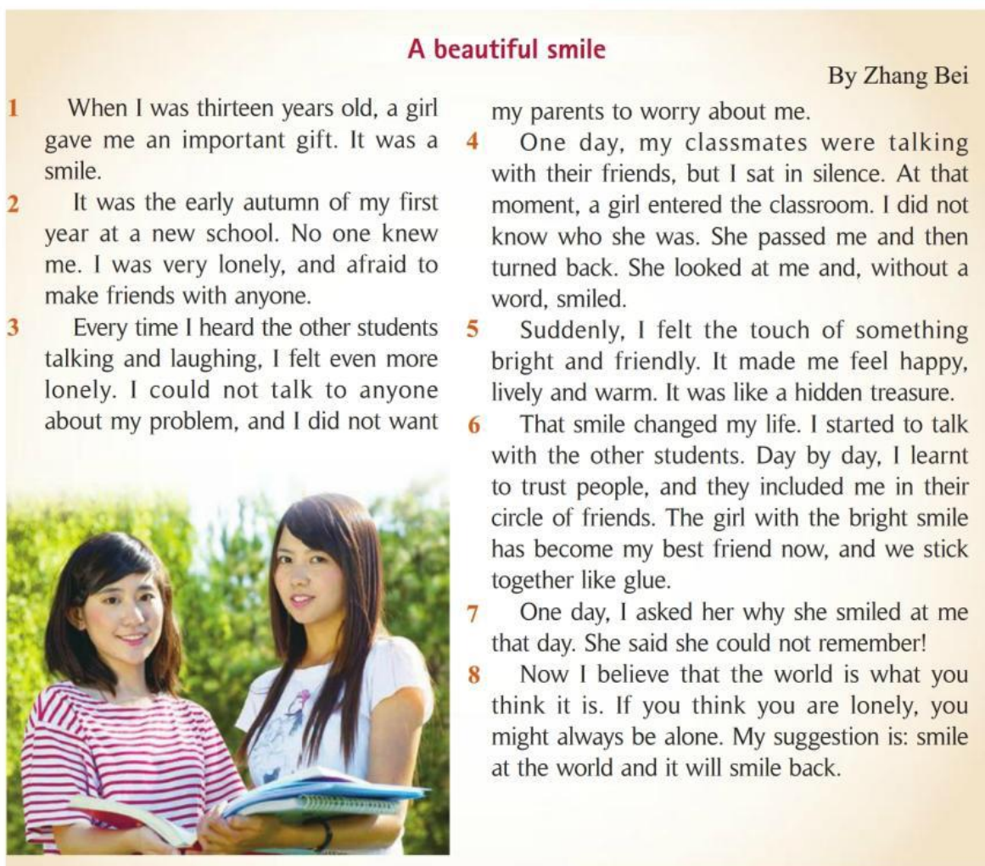
Fast reading
Why was the smile important to Zhang Bei?
Because it _______________.
changed her life
Notes:
But a girl, her name is Zhang Bei, the smile is important and also beautiful. Why was the smile important to her.

Slide 4

Before the smile
Read with feelings
2 It was the early autumn of my first year at a new school. No one knew me. I was very lonely, and afraid to make friends with anyone.
3 Every time I heard the other students talking and laughing, I felt even more lonely. I could not talk to anyone about my problem, and I did not want my parents to worry about me.
Q: How did Zhang Bei feel at school?
lonely
Q: What was Zhang Bei's life like?
new
School:
Zhang Bei:
shy,caring,kind,...
Notes:
What was her life like?
She had no friends. Nobody talked to her and she couldn’t talk to anyone.
That’s why she was very lonely.
Now let’s read with feeling. What kind of feeling should you read with?

Slide 5
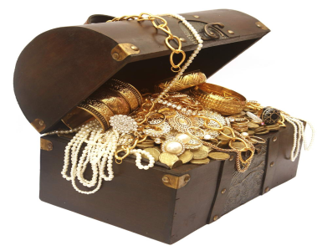




After the smile
Read with feelings
5 Suddenly, I felt the touch of something bright and friendly. It made me feel happy, lively and warm. It was like a hidden treasure.
['treʒə]
Q: How did Zhang Bei feel after the smile?
bright
happy
A
B
C
lively
friendly
warm
Q: What did Zhang Bei think the smile was like?

Slide 6



After the smile
Q: What was Zhang Bei's life like?
Before the smile
* No one knew her. * She was afraid to make friends with anyone. * She could not talk to anyone about her problem. * She didn't know who the girl was.
After the smile
A.
* They included her in their
circle of friends.
B.
They became friends.
C.
* She and the girl stick
together like a glue.
D.
They are always together.
Q: Which sentence do you think is better?
metaphor

Slide 7
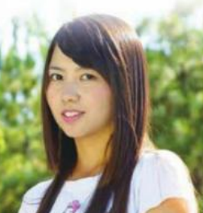
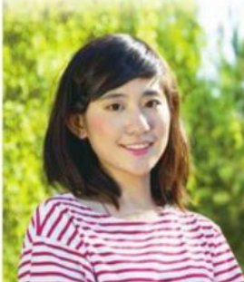
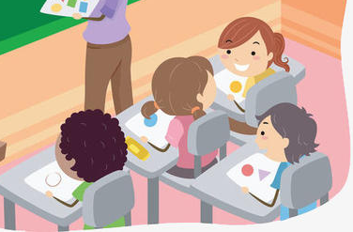
A beautiful smile
Act it out!
Who?
What?
Role 1
(女一号)
sat in silence
Role 2
(女二号)
entered, passed, turned back, looked, smiled
Role3 (群众演员)
talked and laughed
Role4 (旁白)

Slide 8

Read between lines
Why did the girl smile at Zhang Bei?
7 One day, I asked her why she smiled at me that day. She said she could not remember!
What can we learn from the girl’s answer?
A. The girl was forgetful and had a poor memory.
B. The girl was trying to help Zhang Bei at that time.
C. A casual(不经意的)smile may change a person’s life.
Think: What might happen if the girl didn’t smile at her?
/'kæʒʊəl/
beautiful,important,
gift, hidden teasure
casual

Slide 9
Read between lines
8 Now I believe that the world is what you think it is. If you think you are lonely, you might always be alone. My suggestion is: smile at the world and it will smile back.
What’s your understanding to the sentence?
What advice does Zhang Bei give to the readers?
What does Zhang Bei believe now?
If you think you are lonely, you might always be alone.
If you think you are happy, _____________________
If _________________, _____________________
…
If you_______________, _____________.
smile at the world
it will smile back
What does Zhang Bei really want to tell us?
you might always be happy.
A. to trust people
B. to make friends
C. to smile at others
D. to have a positive attitude (有积极的态度)
/'pɒzɪtɪv/
/'ætɪtjuːd/

Slide 10
Homework
*Must do
Listen and read the passage with feelings.
Retell the story according to the time.
*Choose to do
If you have similar experiences as Zhang Bei, prepare it and share it with us next class.

