Slide 1





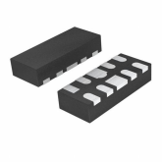




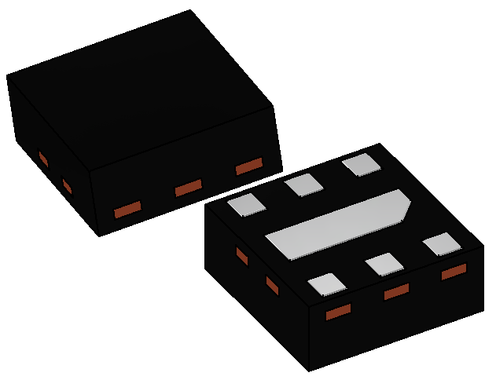



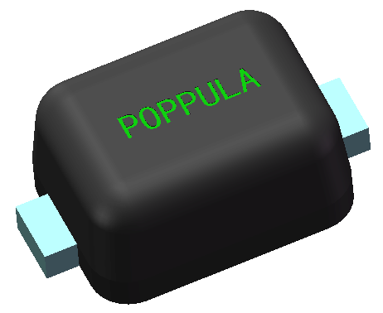

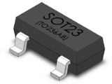
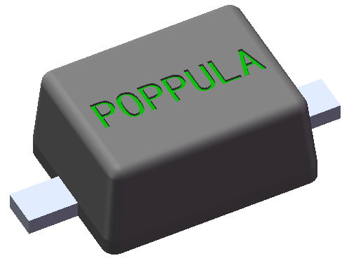

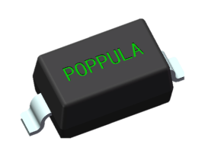
2018
A0
PREMIUM QUALITY
Semiconductor
DFN1006
DFN1006-3
DFN1610
DFN2020
DFN2020-3L
DFN1010
DFN2510
DFN1107-6L
DFN0603-2L
DFN1212
MULTI-LEADS PACKAGE
2023
2 LEADS PACKAGE

Slide 2
Content
公司简介Company Introduction
产品路线图Products & Roadmap
产线简介Production Line Introduction
质量认证，信赖性&失效分析
Quality Certifications, Rel & FA
产品应用Target Product Applications

Slide 3
公司简介Company Introduction
Products & Roadmap
Production Line Introduction
Quality Certifications & Rel-FA
Customers & Product Applications

Slide 4
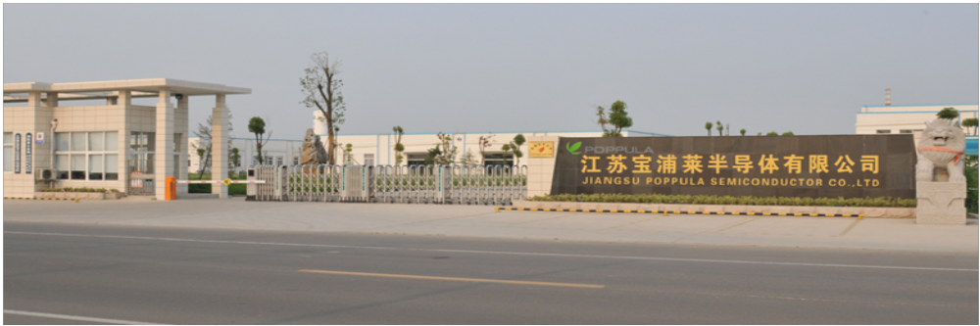
公司简介Company Introduction
COMPANY : Jiangsu Poppula Semiconductor Co., Ltd.
PRESIDENT : Jian Jun Zhang
ESTABLISHED : October 2011
CAPITAL : USD 20.0 Million
CURRENT : USD 70.0 Million
ASSETS
SALES : USD 60 Million (2022)
PRODUCT
: Semiconductors in SOD , SOT & DFN Packages
HEAD OFFICE
  : No.399,Jingyang Rd,Xiangcheng,Suzhou Jiangsu Province
Manufacturing Site
: No.36,Huanghe Rd, Economy Development Zone, Suqian, Jiangsu Province
HOMEPAGE : www.poppula.com
Total Land Area : 120,000 Sq. meter

Slide 5
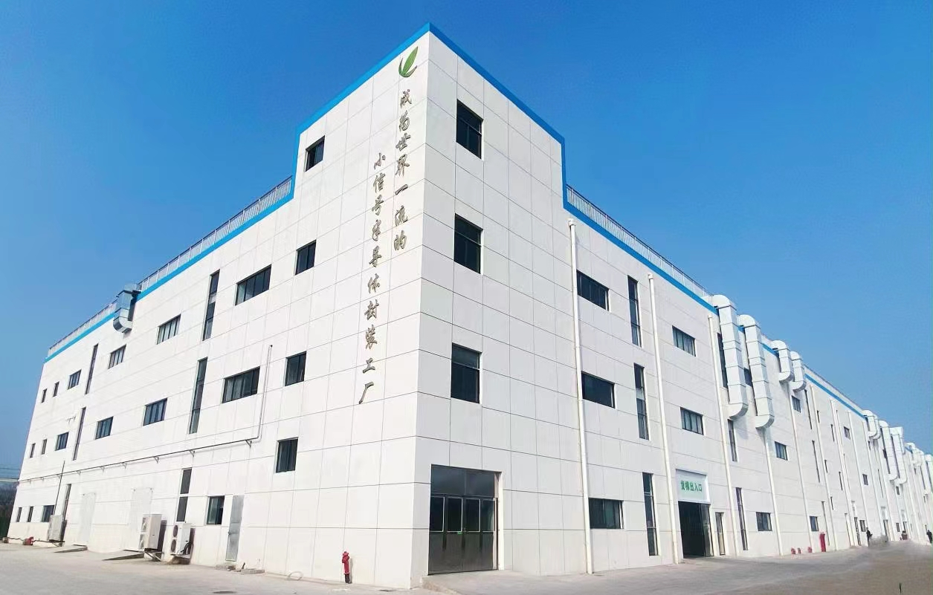
公司简介Company Introduction
Floor Area : 24,000 Sq.M
Max Capacity : 2,500 KK
(Designed)

Slide 6




































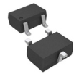
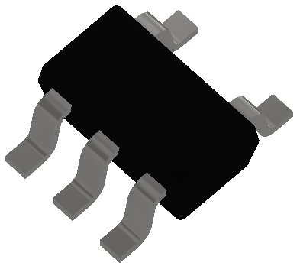

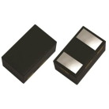

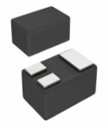

公司里程碑Company’s Milestone
KEC
RECTRON
ESTABLISHED
50KK
100KK
300KK
500KK
1000KK
1800KK
2011 | 2012 | 2013 | 2014 | 2015 | 2016 | 2017 | 2018 | 2019 | 2020 | 2021 | 2022
ISO9000
TS-16949
IATF-16949
ISO14001
QC080000
SOD323F
SOD923
SOD123
SOD323
SOD523
SOT23
DFN Series
SOT323/363
DFN2510
DFN0603
DFN1212
DFN1107
SOT523
SOT23-5/6
DIODES
ESD
ESD ARRAY
MOSFETS
TRANSISTORS
IC - LDO
DUAL MOS
IC - RF

Slide 7
组织架构Management Organization
Semiconductor Division
Common Goal
Oriented Team
GOAL
Business Dev’t
Sales & Mktg
OEM Projects
Purchasing & IT
Purchasing
IT
Quality
Quality System
MQE
SQE
FA/Rel
Calibration
CQE
Mftg. Operation
Assembly & Test
Plating
Supply Mftg
Equipment Engg
Planning
RD & Ext. Serv’s Engg
NPI
External Services Engg
Mftg.
Engineering
Process Engg
Product & Test Engg
Facility Engg

Slide 8
Company Introduction
产品 Products
Production Line Introduction
Quality Certifications & Rel-FA
Customers & Product Applications

Slide 9



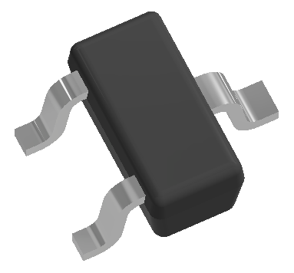





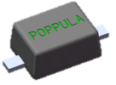


SOD/SOT 产品Products
Mass Productions (AEC-Q101 Optional)
Multi-Leads Gull Wing
Multi-Leads Flat
Flat Leads
Gull Wing
SOD923
SOD523
SOD323F
SOD323
SOD123
SOT523
SOT23
SOT323
SOT363
SOT23-5/6
SOT723
TVS/ESD
Zener / SKY
Switching
MOSFET
√
√
√
√
√
√
√
√
√
√
√
√
√
√
MSL 1 (Optional)
Halogen Free
RoHS Compliant
√
√
√
√
√
√
√
√
√
√
√
√
Wire Type
Leadframe
Die Bonding
Au,Cu or Pd-Cu
Cu
Eutectic/Epoxy
Au,Cu or Pd-Cu
A42 or Cu
Eutectic/Epoxy
Au,Cu or Pd-Cu
Cu
Eutectic/Epoxy
Au,Cu or Pd-Cu
Cu
Eutectic/Epoxy

Slide 10









DFN/QFN 产品Products
Mass Productions (AEC-Q101 Optional)
DFN0603
QFN2020-3L
QFN1010
DFN1006
DFN1006-3L
QFN2020-2L
QFN1212
DFN1107
DFN2510
DFN1610
TVS/ESD
Zener / SKY
Switching
MOS
IC / RF
√
√
√
√
√
√
√
√
√
PRODUCT
MSL 1 (Optional)
Halogen Free
RoHS Compliant
√
√
√
√
√
√
√
√
√
Wire Type
Leadframe
Die Bonding
Au, Cu or Pd-Cu
Cu
Epoxy/DAF/WBC
Au, Cu, or Pd-Cu
Cu
Epoxy/DAF/WBC
Au, Cu or Pd-Cu
Cu or PPF
Epoxy/DAF/WBC

Slide 11
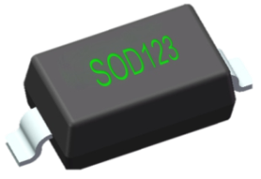
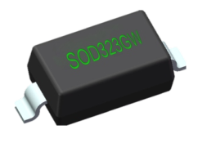
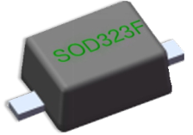
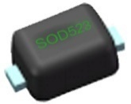
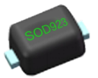
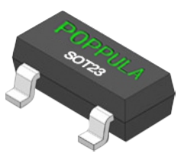

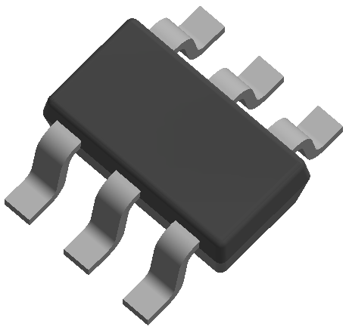
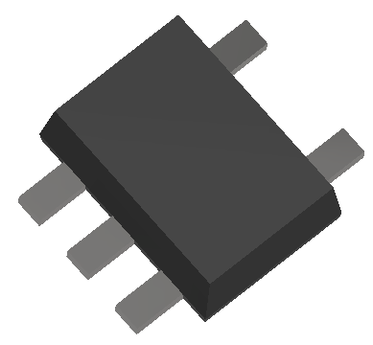
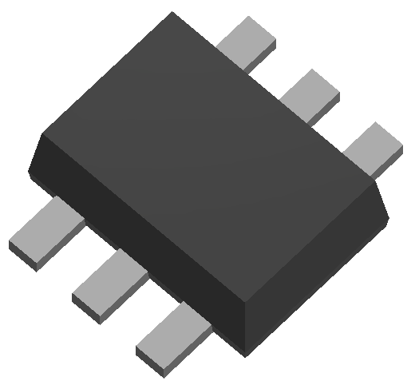

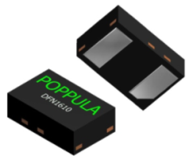
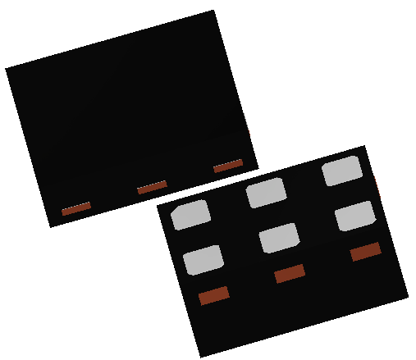
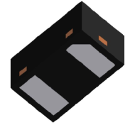
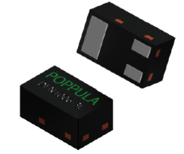
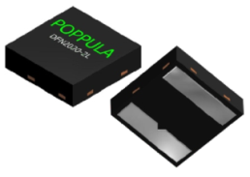
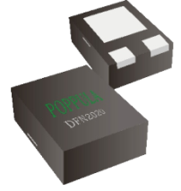
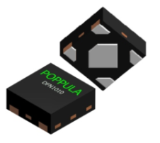
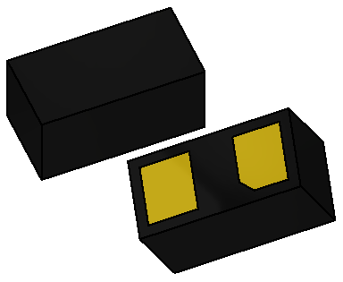
产品尺寸Product Portfolio & Dimensions
SOD123 | SOD323 | SOD323F | SOD523F | SOD923F
2.7x1.6x1.10 | 1.7x1.3x0.85 | 1.7x1.25x0.65 | 1.2x0.7x0.64 | 0.8x0.6x0.42
SOT23 | SOT323 | SOT363 | SOT523 | SOT723
2.9x1.3x1.0 | 2.1x1.25x0.95 | 2.1x1.25x0.95 | 1.6x0.8x0.75 | 1.2x0.8x0.42
SOT23-5 | SOT23-6 | SOT553 | SOT563
2.9x1.6x1.05 | 2.9x1.6x1.05 | 1.6x1.2x0.5 | 1.6x1.2x0.5
DFN2510-10L | DFN1610 | DFN1107 | DFN1006-2L | DFN1006-3L
2.5x1x0.48 | 1.6x1.0x0.48 | 1.1x0.7x0.48 | 1x0.6x0.48 | 1x0.6x0.48
DFN2020-2L | DFN2020-3L | DFN1212 | DFN1010 | DFN0603
2.0x2.0x0.53 | 2.0x2.0x0.53 | 1.2x1.2x0.455 | 1.0x1.0x0.45 | 0.6x0.3x0.30

Slide 12
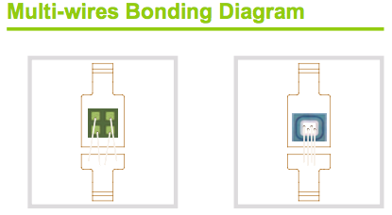
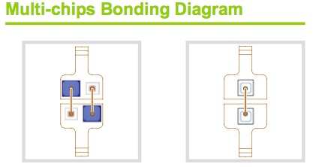

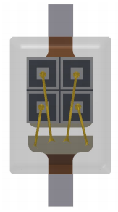
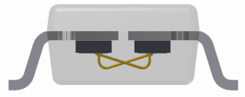
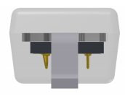
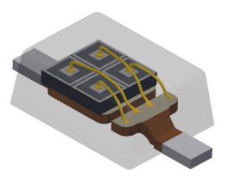
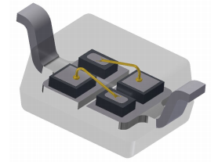
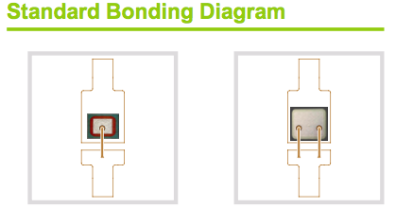
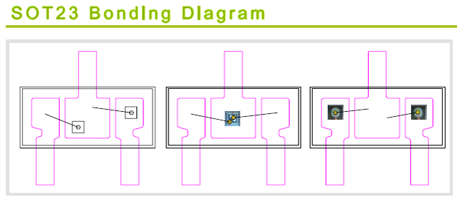
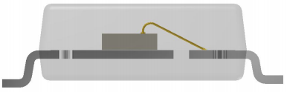
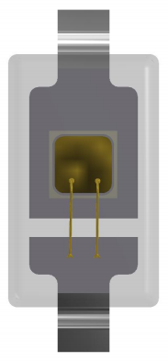
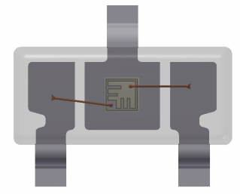
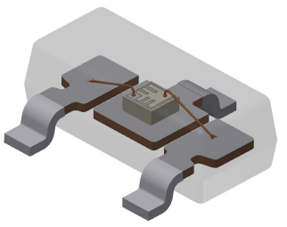

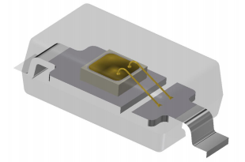
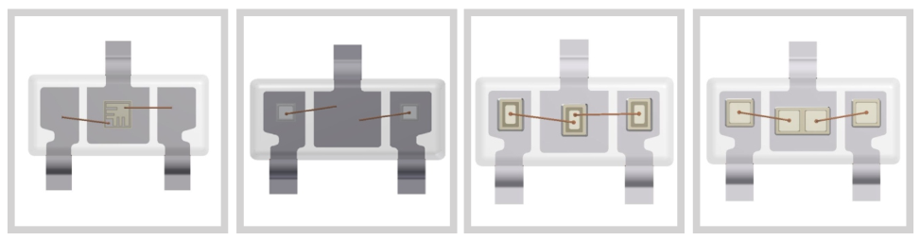
产品键合图Product Bonding Diagrams
High Volume
SOT23 Bonding Diagram
High Volume
High Volume

Slide 13
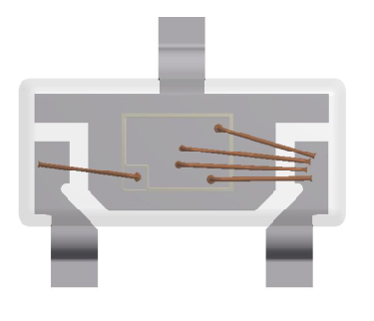
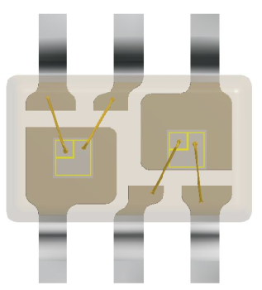
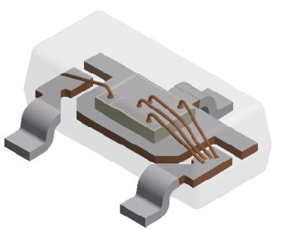
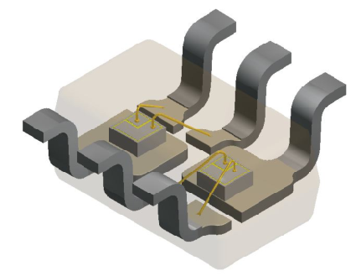








产品键合图Product Bonding Diagrams
SOT23 Large Pad Bonding Diagram
SOT363 Bonding Diagram
High Volume
High Volume
SOT323 Bonding Diagram
SOT723 Bonding Diagram
High Volume
High Volume

Slide 14

















产品键合图Product Bonding Diagrams
QFN2020-3L Bonding Diagram
QFN2020-2L Bonding Diagram
Diode
Mosfet
DFN1610 Bonding Diagram
DFN1610 Bonding Diagram
High Volume

Slide 15




















产品键合图Product Bonding Diagrams
DFN1006-2L Bonding Diagram
DFN1006-2L Bonding Diagram
High Volume
DFN0603 Bonding Diagram
DFN0603 Bonding Diagram
High Volume

Slide 16
















产品键合图Product Bonding Diagrams
QFN1010-4L Bonding Diagram
DFN2510-10L Bonding Diagram
High Volume
High Volume
DFN1107-6L Bonding Diagram
DFN1212-2L Bonding Diagram
High Volume

Slide 17





Product Roadmap
TBD possible PDFNs
Q1’23 | Q2’23 | Q3’23 | Q4’23 | Q1’24 | Q2’24 | Q3’24 | Q4’24 | Q1’25 | Q2’25 | Q3’25 | Q4’25
TO-220
Al Wire
TO-263
Al Wire
TO-247
Al Wire
TO-220
CLIP
TO-220FP
TO-220FP
CLIP
TO-252
Al Wire

Slide 18
Company Introduction
Products & Roadmap
产线简介Production Line Introduction
Quality Certifications & Rel-FA
Customers & Product Applications

Slide 19








生产设备Production Equipment
Wafer Saw
Die Attach
Wire Bonding
Molding
TMTT
Trim & Form
Plating
Laser Deflash (SOD923)

Slide 20
Company Introduction
Products & Roadmap
Production Line Introduction
质量认证，信赖性&失效分析
Quality Certifications, Rel & FA

Slide 21



质量认证
Product, System & Quality Certification
CERTIFIED
IATF16949
ISO9001
MSL 1 (Optional)
HF
ROHS Compliant
AEC-Q101 Compliant
AUTOMOTIVE GRADE

Slide 22


信赖性测试Reliability Tests Capability
Test Items | Definition
SSOP | Steady State Operational | MIL-STD-750-1 M10 38 Condition B
ACLV | Autoclave | JESD22 A-102
HTSL | High Temperature Storage | EIAJ ED-4701
RSH | Resistance to Solder Heat | JESD22 B-106
TMCL | Temperature Cycling (Air to Air) | JESD22 A-104
H3TRB | High Humidity High Temperature Reverse Bias | JESD22 A-101
HTRB | High Temperature Reverse Bias | JESD22 A-108
HTHH | High Temperature and High Humidity Storage | EIAJ ED-4701
HAST | Highly Accelerated Stress Test | JESD22 A-110
IOL | Intermittent Operation Life | MIL-STD-750 Method 1037
ESD | ESD Characterization | AEC Q-101-001,002 and 005
SAT | Ultrasonic Scanning Sonoscan D9600 | MSL 1 and MSL3 test
HAST PC-304R8D
HTRB、HTGB

Slide 23



失效分析Failure Analysis Capability
Definition
X-Ray
Decapsulation
Polishing
Reflow
Stereo Microscope (up to 800x)
Curve Tracer
ESD Simulator
Trr Tester
Precision Measuring Equipment
Wire Pull, Die & Ball Shear
XRF
EDX
CSAT (Sonoscan)
Hot Vf Characterization
Voltage Clamp Characterization (8/20u)
Ifsm Characterization (8.3mS)
X-Ray
Simulator test system
CSAT
(Sonoscan)

Slide 24
Company Introduction
Products & Roadmap
Production Line Introduction
Quality Certifications & Rel-FA
终端产品应用Target Product Applications

Slide 25











终端产品应用Target Product Applications
USB3.0
eSATA
DIGITAL CAMERA
COMPUTERS
USB
HDMI
CELLULAR PHONES
TABLETS
DATA LINES
White Goods
Automotive Electronics
And More : Data Servers, Games consoles, Set top box, External HDD, PCs, Chargers, LED Lightings

Slide 26
Sincerely Thank You!!!

