Slide 1





Cloze Tests
完形填空

Slide 2

What is it?

Slide 3
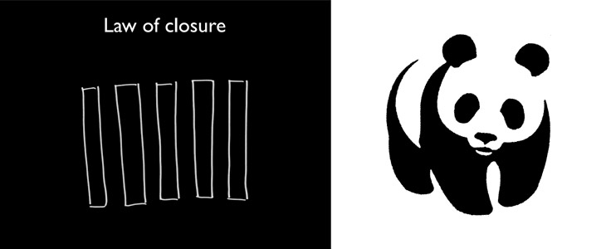
You can get the main idea of a passage even if it is not complete.
Every detail should be based on the main idea of the passage.
Complete the details!

Slide 4

How to do cloze tests?
Steps?
Step 1: Go through the passage and get the main idea (1-2 minutes)
Step 2: Read carefully and choose the answers
(from easy ones to difficult ones)(7-9 minutes)
(句内关系→句间关系→篇章关系)
Step 3: Review and check (1-2 minutes)

Slide 5
例1. I was ______ my that our 15-month old boy would fall into the creek (小溪). I tied a rope around his waist to keep him near to our spot. That lasted about ten minutes. He was ______, and his crying let the whole campground know it.
1-1. A. annoyed B. surprised C. disappointed D. worried
1-2. A. unhurt B. unfortunate C. uncomfortable D. unafraid
例2. The birds, usually around 10 to 15 in _______, would gather around her...
2. A. age B. size C. weight D. number
Tip 1: Choose the answers according to common sense.

Slide 6
例3. The first time we stayed there, we heard the chug-chug-chug of a motorbike ______ its way down the hill toward us.
3. A. making B. searching C. squeezing D. feeling
例4. As for Bailey, she is more confused about why her act is considered a big ______. ... “I feel like I was just doing the right thing.”
4. A. game B. problem C. lesson D. deal
例5. She had to say goodbye to her two dogs and to the beach, where she loved to ______ waves on her board.
5. A. cause B. observe C. ride D. strike
make one’s way toward(s)... 前往...
a big deal 了不起的大事
ride waves 冲浪
Tip 2: Choose the answers according to fixed structures.

Slide 7
例6. “I’m going to inspire so many people,” she said. “I’m ready to ______.” And shine she did.
6. A. shine B. fly C. dance D. score
例7. My husband, our children and I have had wonderful camping experience over the past ten years.
Some of our memories are funny, especially from the early years when our children were little. Once, we ______ along Chalk Creek.
7. A. camped B. drove C. walked D. cycled
v. 得分
Tip 3-1: Choose the answers according to repetition.
(原词复现/同源词复现)

Slide 8
例8. It might sound like one long, expensive ______, but the couple has an unusual way to make their travel ______.
8-1. A. game B. service C. vacation D. procedure
8-2. A. safe B. busy C. helpful D. affordable
例9. It’s good to eat things at the correct time, when they’re ______.
9. A. on view B. on sale C. in season D. in need
例10. I found that watching her perform this ordinary task with such ______ was both calming and beautiful.
10. A. confidence B. enthusiasm C. flexibility D. precision
n. 程序，步骤
在展出，上映着
打折，特价销售
应时，当令
被需要；在困难中
n. 精确，准确
Tip 3-2: Choose the answers according to repetition.
(近义词复现/反义词复现)

Slide 9
原词复现
同源词复现
复现词
近义词复现
反义词复现

Slide 10
例11. ...but storms moved in fast in the mountains, ... The ______ picked up and thunder rolled.
11. A. wind B. noise C. temperature D. speed
例12. Bailey took her arm to see if she could walk forward with aid. She couldn’t. Bailey then ______ to let Lenoue climb onto her back and carried her all the way to the finish line.
12. A. went away B. stood up C. stepped aside D. bent down
越来越强
Tip 4-1: Choose the answers according to logical relationship.
(并列关系/顺承关系)
顺承&递进关系常见的逻辑词：and, then, firstly, secondly, besides, furthermore, moreover, besides, in addition...

Slide 11
例13. Mario’s wine may have been cloudy and come out of an old bottle, but it was ______.
13. A. perfect B. useful C. convenient D. familiar
例14. Gorge, the husband, was trying to be calm, but I could tell this was ______ for him.
14. A. hard B. fine C. common D. lucky
例15. ______, before I reached it, one of the pigeons from the group picked up the necklace, ______ to the bench, and dropped it on her lap.
15-1. A. However B. Afterwards C. Gradually D. Fortunately
15-2. A. walked B. stuck C. pointed D. flew
Tip 4-2: Choose the answers according to logical relationship.
(转折关系/让步关系)
转折&让步关系常见的逻辑词：but, however, yet, although, though, despite, while, nevertheless…

Slide 12
例16. It was a very nice gesture for him to make. But when we looked at the tomatoes, we were ______ because they were so misshapen: ...
16. A. worried B. moved C. thrilled D. bored
例17. ...we were thankful for his kindness, so we ______ them (tomatoes and wine).
17. A. tried B. sold C. returned D. mixed
Tip 4-3: Choose the answers according to logical relationship.
(因果关系)
因果关系常见的逻辑词: as, since, because, for, therefore, thus, so, as a result/consequence, consequently

Slide 13
例18. He was uncomfortable, and his crying let the whole campground know it. So ______ tying him up, I just kept a close eye on him.
18. A. due to B. instead of C. apart from D. as for
例19. What if later in life they come to a metaphorical door, like an opportunity of some sort, and ________ opening the door and taking the opportunity, they just stare at it and wonder, “what if it isn't a door?”
19. A. by comparison with B. in addition to
C. regardless of D. instead of
与...相比较
不管，不顾
Tip 4-4: Choose the answers according to logical relationship.
(替代关系)
替代关系常见的逻辑词：instead, instead of, rather than...

Slide 14
例20. To become the Olympic champion in the individual all-around event, Gabby Douglas had to leave everything she knew best. She had to ______ her bedroom in Virginia. She had to say ______ to her two dogs and to the beach,...
20-1. A. take up B. pack up C. clean up D. do up
20-2. A. goodbye B. hello C. thanks D. no
例21. ...they always go beyond the homeowner’s expectations. For Jessica, that means ______ plenty of pictures of happy pets, keeping the house clean and leaving a nice small gift before heading to the next house.
21. A. admiring B. donating C. sending D. borrowing
系，扣
Tip 4-5: Choose the answers according to logical relationship.
(解释关系)
解释关系常见的逻辑词：that is to say, in other words, ... means...

Slide 15
例22. ...she learned that she had serious injuries in one of her knees. She would have struggled with extreme ______ to make it to that aid checkpoint without Bailey’s help.
22. A. hunger B. pain C. cold D. tiredness
Tip 4-6: Choose the answers according to logical relationship.
(条件关系)
条件关系常见的逻辑词：if, unless, in case, once, with(out), but for

Slide 16
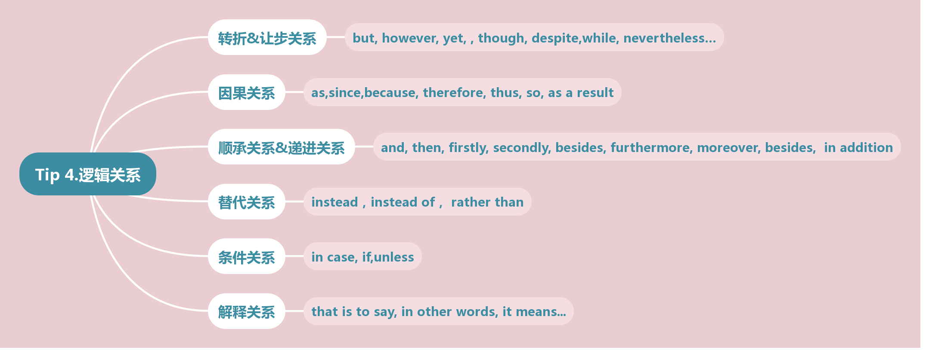
and, then, firstly, secondly, besides, furthermore, moreover, besides, in addition...
并列/顺承
but, however, yet, although, though, despite, while, nevertheless…
转折/让步
因果
as, since, because, for, therefore, thus, so, as a result/as a consequence
替代
instead, instead of, rather than...
解释
that is to say, in other words, ... means...
条件
if, unless, in case, once, without, but for

Slide 17
（2024新课标II卷）When I decided to buy a house in Europe ten years ago, I didn’t think too long. I liked traveling in France, but when it came to picking my favorite spot to 41 , Italy was the clear winner.
During my first visit to Italy, I 42 to ask for directions or order in a restaurant. But every time I tried to 43 a sentence of Italian together, the locals smiled at me and 44 my language skills. That encouragement helped me to get through the language 45 . After I made Italy my permanent home, I discovered how 46 Italians are. Neighbors will bring me freshly made cheese and will come to my door to 47 me to close the window in my car when rain is coming. It’s these small 48 of kindness that make a new country feel like home.
As a foodie, the way to my heart is through my stomach, and nowhere fuels my 49 quite like Italy. Each town has its own traditional 50 , and every family keeps a recipe passed from one generation to another. Families 51 for big meals on Sundays, birthdays, and whatever other excuses they can 52 . These meals are always 53 by laughter and joy. Whatever 54 life in Italy might have, the problems are 55 once you sit down to a big meal with friends and family.

Slide 19
例23. “I remember walking down the long hall and opening the door to my room to find an entire flock of seagulls,”...... “The seagulls immediately went ______. They rushed to the window, 30 or 40 birds all trying to ______ at the same time, and pepperoni---everywhere. The curtains were falling down; the lamps were falling down. It was a real ______.
23-1. A. hungry B. dead C. missing D. wild
23-2. A. wake up B. get out C. take off D. break in
23-3. A. mess B. puzzle C. fight D. challenge
Tip 5: Choose the answers according to context.
(语境：情境还原)

Slide 20
例24. The Chinese coach ______ Douglas into one of the best gymnasts in the ______, helping her skyrocket from an ______ member of the national team to the top of the sport. By ______ the Olympic all-around title, she became the first black woman to do so. She ______ the competition from beginning to end. She said she had felt ______ all along that she could win.
24-1. A. forced B. transformed C. persuaded D. put
24-2. A. world B. city C. team D. state
24-3. A. amateur B. elected C. average D. enthusiastic
24-4. A. clarifying B. defending C. winning D. demanding
24-5. A. followed B. organized C. watched D. led
24-6. A. confident B. nervous C. excited D. uneasy
Tip 5: Choose the answers according to context.
(语境)

Slide 21
例25. My husband, our children and I have had wonderful camping experience over the past ten years.
......
Now, every year when my husband pulls our camper out of the garage, we are filled with a sense of ______, wondering what camping fun and adventure we will experience next.
25. A. relief B. duty C. pride D. excitement
例26. Nowadays supermarket tomatoes look perfect but taste of water. Nobody’s going to have a ______ memory of those.
26. A. happy B. vivid C. short D. vague
c
Tip 6: Choose the answers according to emotions and attitudes.
(情感态度)

Slide 22
例27.
On Oct.11, hundreds of runners competed in a cross-country race in Minnesota. Melanie Bailey should have finished the course earlier than she did. Her delay came because she was carrying a competitor across the finish line.
......
Although the two young women were strangers before the meet, they’ve since become friends. Neither won the race, but the ______ of human kindness won the day.
27. A. secret B. display C. benefit D. exchange
Tip 7: Choose the answers according to the main idea.
(主旨大意：首尾呼应)

Slide 23
例28.
One day, we had a family dinner. While the adults were busy with their serious talk outside, I was left alone in the kitchen to help my grandmother wash dishes. As always, my grandmother would tell me stories about her childhood.
......
I’ve never faced the problem of education. I guess our different childhood background is what makes my grandmother such an amazing person to talk to: her stories always make my history textbooks ______.
28. A. come true B. come round C. come out D. come alive
Tip 7: Choose the answers according to the main idea.
(主旨大意：首尾呼应)

Slide 24
Summary
文化/生活常识
固定搭配
句内/
句间
关系
复现
原词复现，同源词复现，近义词复现，反义词复现
并列/顺承: and, then, firstly, secondly, besides, furthermore, moreover,
besides, in addition...
转折/让步: but, however, yet, although, though, despite, while, as
nevertheless…
完形
填空
逻辑关系
因果: as, since, because, for, therefore, thus, so, as a result/ consequence
替代: instead, instead of, rather than...
解释: that is to say, in other words, ... means...
条件: if, unless, in case, once, without, but for
语境：情境还原
段落/
篇章
关系
情感态度
主旨大意：首尾呼应

