Slide 1





B5M4 Carnival
Language Points
Rebecca Zhou

Slide 2

Phrases

Slide 3
Phrases
pretend
end
in secrect
dress
Notes:
版权授权声明：【呢呢素材设计】高端精品模板使用授权！官方网店：https://nnsck.taobao.com

Slide 4
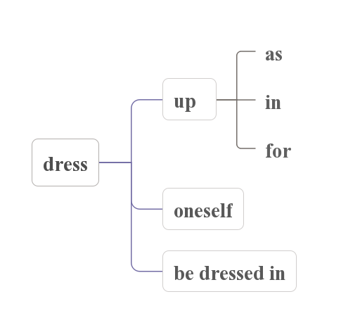
Phrases

Slide 5
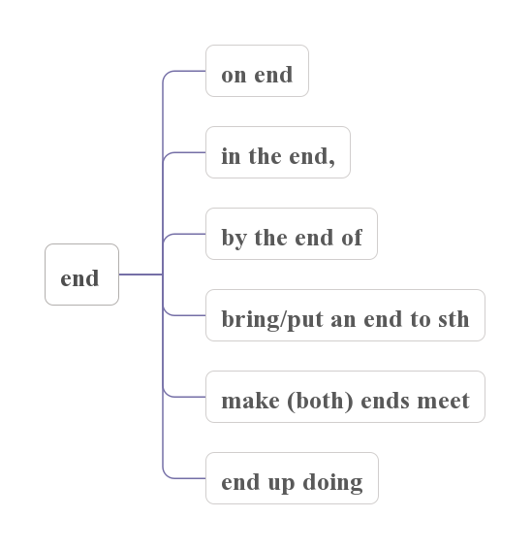
Phrases

Slide 6
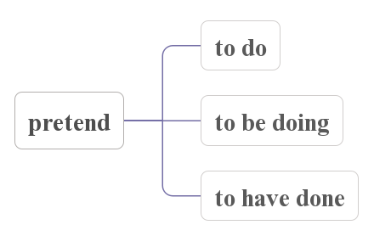
Phrases

Slide 7
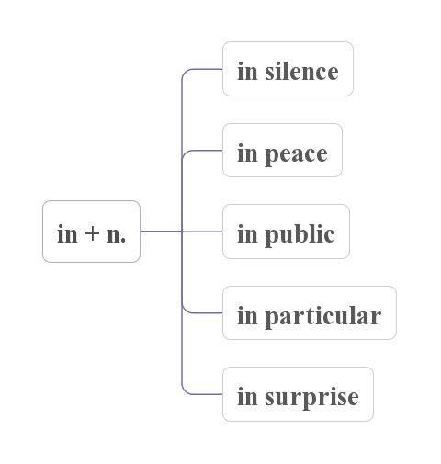
Phrases

Slide 8
Sentences

Slide 9
Key Sentences
a. Think of carnival, and you think of crowds, costumes, and confusion. （para.1)
本句是“祈使句+ and +陈述句”句型，祈使句相当于if引导的条件状语从句，陈述句表示结果，意为“做某事，就会……”。

Slide 10
◆“祈使句+or/otherwise/or else+陈述句”意为“做某事，否则/不然的话就会……”。
Practice
1. 想到主题公园，你就会想到过山车。
2. 穿上外套，否则你就会感冒。
3. 试一试，你会发现你能做到。

Slide 11
Key Sentences
非限
时间状语从句
b. In Europe, where it began, carnival was followed by forty days without meat, as people prepared for the Christian festival of Easter. （para.2)
Practice
起源于中国的端午节在农历五月初五庆祝，人们在这一天吃粽子。
In China, where it began, the Dragon Boat Festival is celebrated on the fifth day of the fifth lunar month, when people eat zongzi.

Slide 12
Key Sentences
c. People saw Carnival as a last chance to have fun at the end of the winter season.（para.2)
把...当作/看作...
see/consider/regard...as
look on...as; think of...as; refer to...as
Practice
人类应该把动物看作是自己的朋友。

Slide 13
Key Sentences
as引导时间状语从句
with time __?___
d. As time passed, however, the carnival period was extended, so that it began after Christmas. （para.3)
extend vi.延长，延伸 ~ to
extension n. a two-year extension to the contract
extensive adj. extensive land/knowledge
so that 为了...
so...that... 如此...以至于...

Slide 14
Key Sentences
e. Ordinary people could pretend to be rich and important, while famous people could have romantic adventures in secret. （para.3)
while作并列连词用,表示前后两者的对比,意为“然而”。
Practice
The first few kilometres had plenty of street lights, _____turning onto a side road in the suburbs she found herself in the dark.

Slide 15
Key Sentences
f. Their use was limited by laws, the first of whichdates back to the fourteenth century. （para.4)
“介词+关系代词”引导定语从句时,介词的宾语只能用which或whom。
Practice
There are five people winning the award, two of ______ come from China.

Slide 16
Exercises

Slide 17
『主题与语篇填空』
Carnival, which comes from two Latin words, 1. ______________ (mean)“no more meat”, is connected with crowds, costumes and 2._____________
(confuse). The sounds and sights change from one country to another but the 3.__________(excite)is the same everywhere. It began in Europe. People saw it as a last chance 4._______________(have)fun at the end of the winter season. 5._______________(have)fun meant eating,drinking,and dressing up.The most famous carnival in Europe was in Venice.
meaning
confusion
excitement
to have
Having

Slide 18
For weeks on end people walked round the streets wearing masks, doing 6. _______________ they wanted without being recognised.Many crimes went unpunished. So the use of masks was limited by laws, the first of 7._______________ dates back to the 14th century. At the end of the 18th century,masks were banned. But in 8. _______________ late 1970s, the tradition 9._______________(revive) by students. Today, carnival in Venice is celebrated for five days in February. As you wander through the streets, you see thousands of masks. However, nobody takes them off; otherwise, the magic is 10._______________(lose).
what
which
the
was revived
lost

Slide 19
『主题与短文改错』
In Trinidad, the slaves painted their faces white, imitate their masters and making fun with them. At the same time they continued their own African traditions which they thought will bring good lucks. When the slave trade was abolished in the 1838, the former slaves took over the carnival.
imitating
of
would
luck
Notes:
运用根据中文完成英文句子。
⑴ 我们与其在街上闲逛，倒不如去看电影。
We might as well go to see a movie rather than in the street.

Slide 20
It became much colourful and exciting than it had been ago. Carnival became a celebration of free. As the passing of time, Carnival became a way to unite different communities. Carnival today is international, multicultural experience.
more
before
With
freedom
an

Slide 21
Thank you

