Slide 1
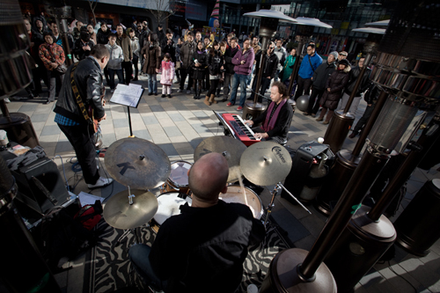
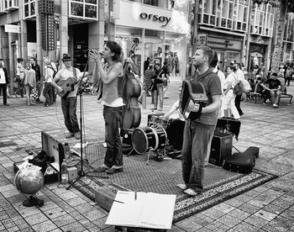


Slide 2

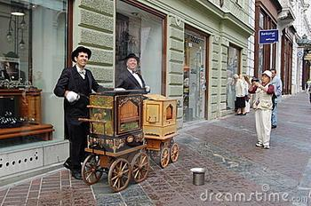
A pipe(管乐器) musician is playing the bagpipe风笛.
A barrel organ(手摇风琴);
musician is turning
the handle.

Slide 3
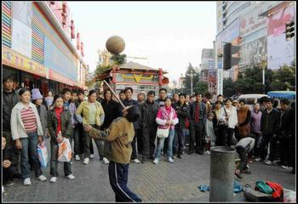
A gang of people are standing in a
semi-circle around the boy, watching
attentively.

Slide 4
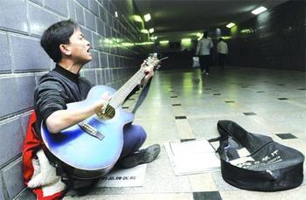
A young man is playing the classical guitar music in the tunnel.
The music echoes along the tunnel.

Slide 5
When you see street musicians, how will you react?
--- tap feet and sing along or even dance to the music
---ignore and walk past with my head down
---willingly throw in a few coins for the brief interval of music as we go shopping
---feel spirits lifted on the way to work in the morning and feel refreshed after a day’s hard work.
轻拍，轻敲
忽视，不理睬
间隔，间距，幕间休息
重新提起精神

Slide 6
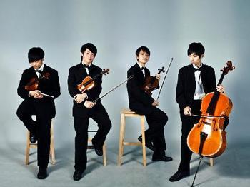
a quartet of musicians

Slide 7

a magnificent cathedral

Slide 8
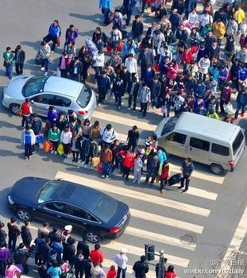
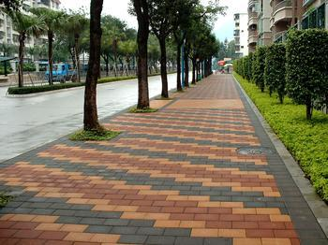
Many pedestrians are crossing the street, ignoring the traffic lights.
a pavement

Slide 9

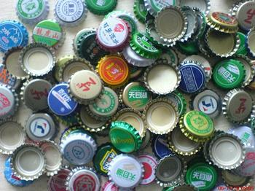
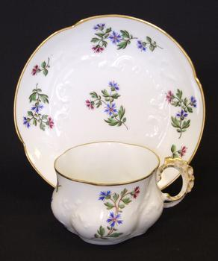
popcorn
colorful lids
saucer
When you cook
rice, do you put
a lid on the pot?
Street performers hold the
saucer and ask for money.

Slide 10
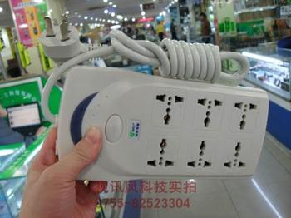

a socket
plug into the
electrical socket
a socket

Slide 11
Read the text and choose the best summary( Act. 2 On P₄₈)
4

Slide 12
Scan for the main idea of each paragraph:
Para 1:
The street music in Barcelona.
Para. 2:
The street music in Paris.
Para. 3:
The street music around the world.
Para. 4:
The importance of street music.

Slide 13
According to the text, what are the meanings of the street music?
It keeps alive a culture which has almost disappeared in our lives.
It gives life to everyone who listens.
It offers relief from the cares of the day.

Slide 14
What is the context(环境) for street music?
/In what circumstances can people enjoy street music?
Street music must be in people’s ordinary life.

Slide 15
1.挤过去
2.悄悄走开
3.因为…感激
4.占地方
5.空出地方
6.随……某人唱
7.低着头
8.一帮一帮的
9.擦汗
10.把…插/进入
11.突然
12.随着音乐跳舞
13.提起精神
14.使…保存生机
15.赋予生命
16.减轻生活的烦恼
1. push one’s way through
2. slide away
3. be grateful for
4. take a place
5. make…vacant
6. sing along with
7. with their heads down
8. gangs of
9. mop one’s head
10. plug…into…
11. all of a sudden
12. dance to the music
13. lift the spirits
14. keep… alive
15. give life to
16. offer relief from the cares

Slide 16
Translate the following sentences:
…but the crowd shrinks as some people slide away.
随着一些人悄悄走开，人群一下子就缩小了。
A shy man shrinks from meeting strangers.
Faced with difficult tasks, he has never shrunk back.
shrink---shrunk/shrank---shrunk
退缩，回避

Slide 17
2. Below the window of my apartment in Paris, a music man takes a place made vacant by an earlier musician.
在我巴黎的公寓窗户下面，一位音乐人占据了早先另一位音乐家空出来的地方。

Slide 18
3. In the London Underground a student plays classical guitar music, which echoes along the tunnels. It lifts the spirit of the passengers, who hurry past on their way to work.
在伦敦的地铁里，一个学生演奏古典的吉他音乐，音乐在地铁的隧道里回响。它提起了那些匆匆忙忙赶着去上班的过路人的精神。

Slide 19
4. In a street in Vienna or Prague or Milan a group of pipe musicians from the far Andes fill the air with the sounds of South America.
在维也纳，布拉格或米兰的街道上，一群来自遥远的安第斯山脉的管乐器演奏者让空气中弥漫着南美洲的乐曲。

Slide 20
All contributions are voluntary, no one has to pay.
2. They’re grateful for this brief interval of music as they go shopping.
3. It lifts the spirits of the passengers, who hurry past on their way to work.
所有的捐赠都是自愿的，没有人必须要掏钱
他们感谢使他们的购物途中为之短暂驻足的音乐
它提起了那些匆匆忙忙赶着去上班的过路人的精神

Slide 21
4. The street musician is keeping alive a culture which has almost disapperaed in our busy organised, and regulated lives: the sound of music when you least expect it. In a recording studio even when relayed by microphone, music loses some of its liveliness. But street music gives life to everyone who listens and offers relief from the cares of the day.
街头音乐家保持了一种文化的生机，而这种文化在我们紧张忙碌，组织有序，一成不变的生活中几近消失：在录音室里即使被麦克风传播，音乐也失去了它的些许生动。在你最想不到的时候听到音乐的声音。但是街头音乐赋予了每位倾听者以生命，让人们减轻了生活的烦恼。

Slide 22
尽管教授见到我们有些惊讶，但是还是很热情地欢迎了我们．
Though surprised to see us, the professor gave us a warm welcome.
尽管缺钱，那对贫穷的父母还是设法送他上大学．
Though lacking money, his poor parents managed to send him to university.
如果方便的话，下次请把你的数码相机给我带来．
If (it is ) convenient for you, please take your digital camera for me next time.

Slide 23
6. 令我们感到欣慰的是，所有的孩子都安全到家了。
To our relief, all children arrived home safely.
我最庆幸的是没有迟到．
To my great relief/ Much to my relief, I wasn’t late.
看到我的家人安然无恙，我感到极大的欣慰。
It was a great relief to find that my family was all safe.
“What a relief!” She said, as she took her tight shoes off.
这种药可以减轻一些痛苦．
The drug gives some relief from pain.
a relief driver轮换的驾驶员
a relief bus 增加的公共汽车
have a feeling of relief

Slide 24
1. I breathed a sigh of _____ when I heard they were safe and sound.
2. Your sweater will _____ if you wash it at too high a temperature.
3. After he got married, he came back to see his parents at regular _____.
4. 月光下，姑娘们开始伴着音乐翩翩起舞。
The girls began to _____ _____ _____ _____ by the light of the moon.
relief
shrink
intervals
dance to the music

Slide 25
5. 令我们感到欣慰的是，所有的孩子都安全到家了。
___________, all children arrived home safely.
6. 汽车销量一直在下降。
Car sales have been________.
7. 你可以从人群中挤过去。
You can push your way ________ the crowd.
To our relief
shrinking
through

Slide 26
be grateful for
8.You will not _____ ______ ___ what we have until we lost it, and not be consious of health until we are ill.
---Helen Adams Keller
人们只有在失去一样东西时才知道它的可贵，只有在失去健康时才感到健康的重要。

