Slide 1




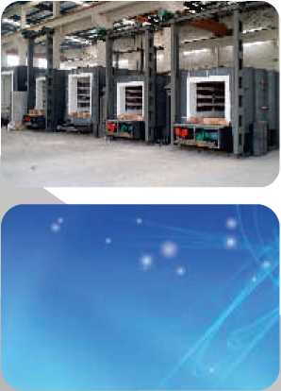


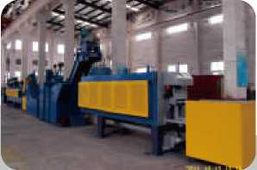

人K •高效•誠信•卓越
HUMANISM. HIGH EFFICIENCY. SINCERITY. EXCELLENCE
HUASHUNFURNACE
常規熱處理爐
convenf-ona- hea二reafmen- furnace
熱處理生産綫
HeaffreafmeM produa-on -me
熱處理設備專業制造商 PROFESSIONAL INUSTRIAL HEAT TREATMENT EQUIPMENT BUILOERS WWW. H UASLY.COM
浙江息疆譚肓IE公司
ZHEJIANG HUASHUN FURNACE INDUSTRY CO., LTD.
湖州地址：
電 | 話：
傳 | 真：
郵 | 箱：
網 | 址：
杭州地址：
電 | 話：
傳 | 真：
郵 | 箱：
浙江省長興縣虹星橋工業園經西南路1號
+86 572 6090988 6902988 +86 572 6903308 HUASLY@163.COM //WWW. HUASLY.COM 浙江省杭州市機場路163號
+86 571 86460948 86467780 +86 571 86460325 XJLO319@163.COM
Huzhou Address： No.1 Jingxinan Road Hongxing Bridge Industrial Park Changxing Zhejiang
TEL： +86 572 6090988 6902988
FAX： +86 572 6903308
E-mail： HUASLY@163.COM
Http： //WWW.HUASLY.COM
Hangzhou Address： No. 163 Airport Road, Hangzhou, Zhejiang Province
TEL： +86 571 86460948 86467780
FAX： +86 571 86460325
E-mail： XJLO319@163.COM
□
□
口
浙江華順膻業有眼公司
ZHEJIANG HUASHUN FURNACE INDUSTRY CO” LTD.
版权所有，翻录必究
公司聲明：産品的技術數據是由所釆用的測試標準測得的平均值，會在一定範圍内波動.敢數據不代表產品的質置保證數據。本公司保留規格配備變更或停用之權利。 All rights reserved.not allowed to copy
The company declares： the technology data of the products is the average value that get from testing according to the testing standard and will fluctuate within a certain range. The data does not represent the quality assurance data of the products Our company keeps the rights to alter or stop the specification allocation.

Slide 2



董事長致辭
各界朋友：
回顧過去，我們倍感欣慰；展望未來，我們信心百倍。華順爐業 在社會各界賓朋的信任與支持下，經歷了由小到大、由弱到强的歷 史性跨越。在此我謹代表公司全體員工歡迎您的到來，并向您致以 最誠摯的問候和最衷心的祝福！
華順爐業,是專業從事國家和省部級重點項目配套的大中型熱處理 設備的研發、設計、制造、安裝、調試等總承包的現代化企業。我 們以超前的意識，豪邁的氣派，秉承“人本、高效、誠信、卓越” 的企業精神，開拓進取，鋭意創新，面向未來。我們將通過增强核 心競争力，以實現企業的可持續發展。努力創建擁有一流管理團隊、 一流設計研發隊伍和一流制造實力的優秀高新技術企業。
挑戰與機遇共存，勇攀與希望并進。華順爐業本着“質量第一、服 務至上”的經營理念竭誠爲廣大新老客户全方位服務，并歡迎國内 外各界朋友與我司合作，共同開發爐業新技術、新産品，使用新材 料、新工藝，爲進一步提高工業爐技術水平共同努力。
沐浴着新世紀的陽光，華順爐業已破浪遠航!我們滿懷豪情與海内 外各界朋友携手奮進，以更加昂揚的姿態迎接挑戰；更加堅實的步 伐邁向未來。
研究員級高工
杭州市“136”優秀中青年人才 董事長：6柄
處机郭
春邛;2
New norm
New vision -
New leap forward A?
The chairman delivered a speech
Friends from all walks of life:
Reviewing the past, we feel gratified; Looking ahead, we confidence one hundred times. HuaShun furnace industry in underthe trust and support offriends from all walks of life, has experienced from small to large, from weak to strong historic leap. Here I on behalf of the company all staff welcome your arrival, and send you the most sincere greetings and heartfelt blessing!
HuaShun furnace industry, is a professional engaged in national and provincial key projects supporting large and medium-sized processing equipment research and development, design, manufacture, installation, debugging and other general contracting of modern enterprise. With our advanced consciousness, heroic style, adhering to the "people-oriented, high efficiency, integrity, excellence" spirit of enterprise, pioneering spirit, innovation, for the future. We will enhance the core competitiveness, in order to realize the sustainable development of enterprises. Efforts to create a first-class management team, first-class design research and development team and first-class manufacturing capabilities of outstanding high-tech enterprises.
Challenges and opportunities coexist, bravely and hope hand in hand. HuaShun furnace industry in line with "quality first, service first" business philosophy wholeheartedly for the general new old customers full service, and welcome friends from all walks of life both at home and abroad to cooperate with our company, to jointly develop furnace industry new technology, new products, using new material, new craft, in order to further improve the level of industrial furnace technology together.
Bathed the sun of the new century, HuaShun furnace has the waves to sail! We are full of lofty.sentiments with domestic and overseas friends from all walks of life hand in hand advances boldly, meet the challenge with the attitude of more high; Amore solid pace towards the future
Researcher level senior engineer Hangzhou "136" outstanding young talents Chairman:Xinlong Zhan

Slide 3
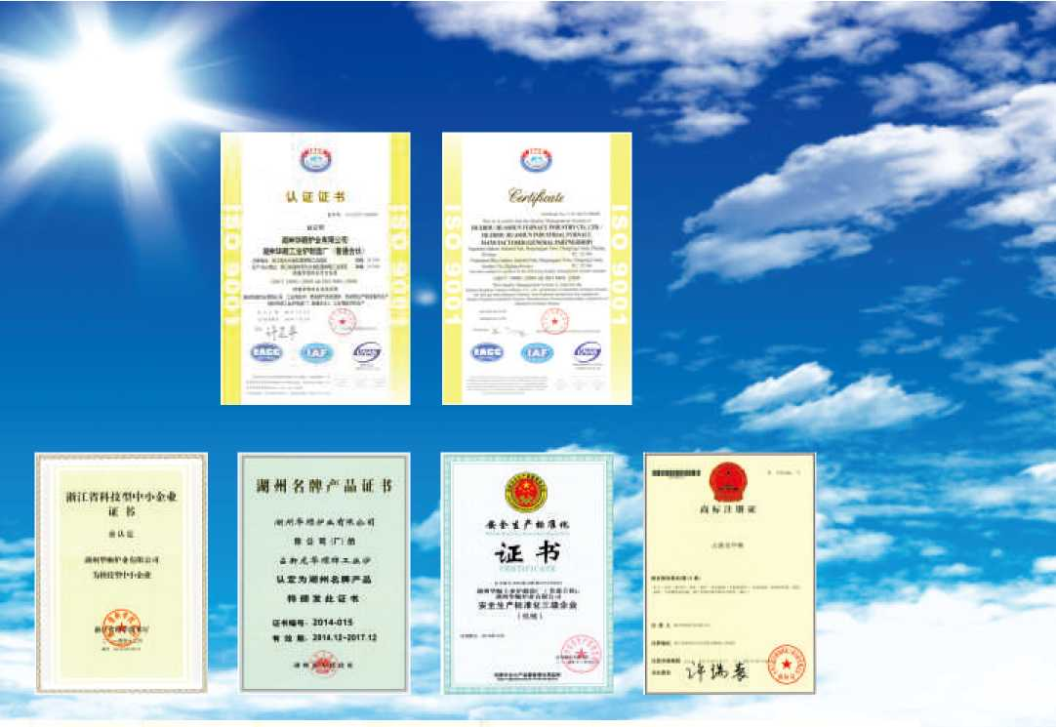
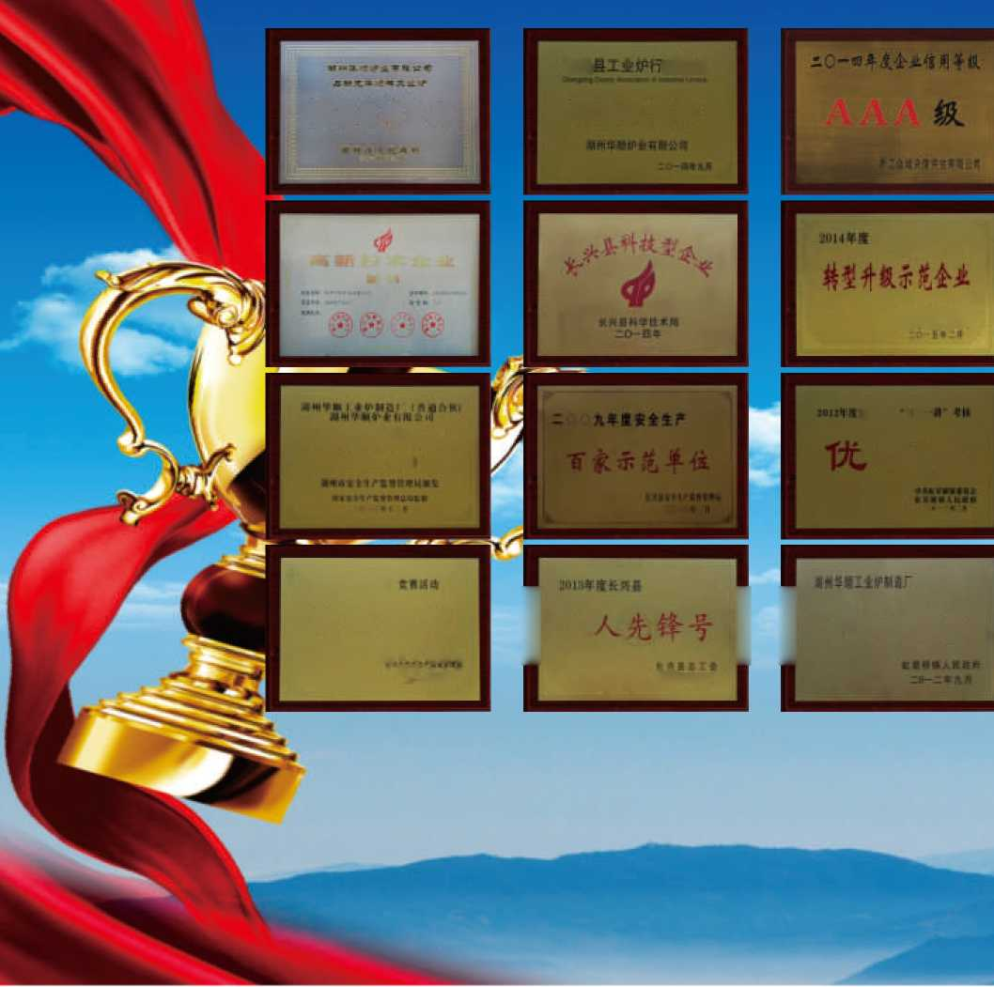
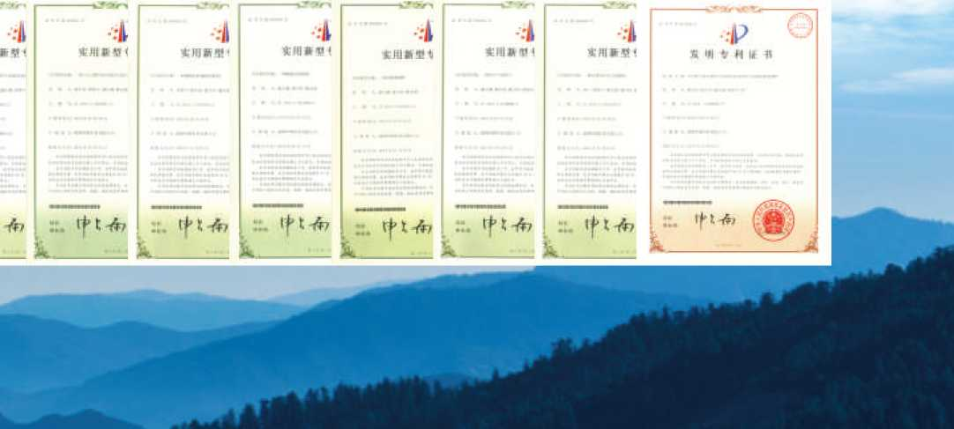
HONOR AND QUALIFICATIONS
长兴业协至
"名牌卢*
，会於琅位
fiHEiiiHatt
■ ■■・ Ai J^H H
安垒生产魅谁化
q. iM
[.•♦• It
胜奖
3in：iJfjr -«r
[工 I ["坳学奖
—.M
优胜企业
1 » I 1 X I
■ # i ' 1 ■
«F»
01
HUMANISM. HIGH EFFICIENCY. SINCERITY. EXCELLENCE
ZHEJIANG HUASHUN FURNACE INDUSTRY CO., LTD.
02

Slide 4
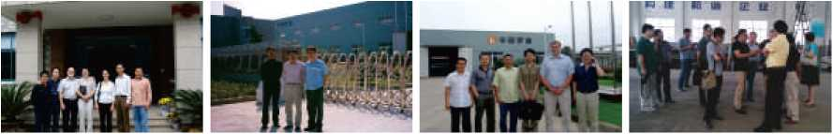
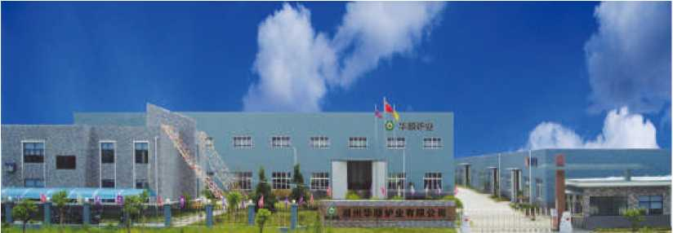
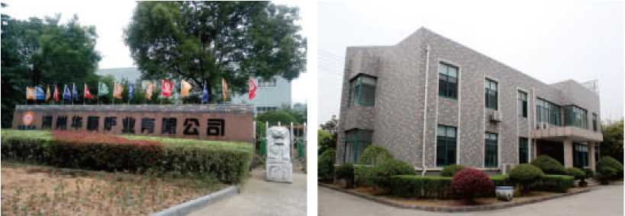
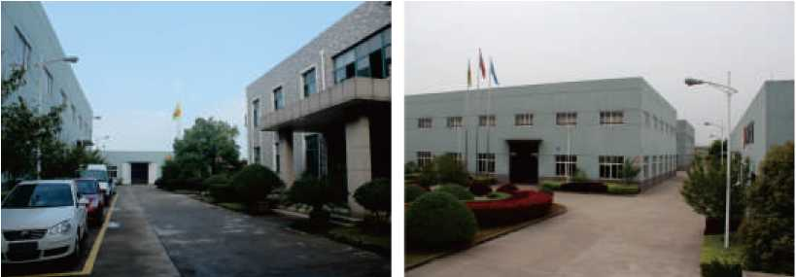
正蕖福rr ::
COMPANY INTRODUCTION/ ''' ''' '''
華順爐業是專業從事國家大中型熱處理設備的研發設計、制造安裝和調試總承包交鑰匙工程 的現代定制服務綜合型企業。産品已廣泛應用于航空航天、船舶制造、軍工裝備、核電裝備、水 電裝備、機車行業、化工機械、重工機械、車輛制造、礦山機械、鑄造、冶金及鋼鐵等行業。公 司現有在職員工一百多人，專業技術人員占30%以上，其中研究員級高工1名,工程師9名，助理工 程師10名、技術員和技師15名。公司被浙江省科學技術廳認定爲2009年第二批高新技術企業。企 業已全面貫徹實施6S管理及IS09001質量管理體系，爲成爲行業的領跑者奠定了堅貴的基礎。
公司以新機制、高起點爲準則，以優良的品質、完善的服務爲宗旨。不斷秉承以客户需求爲 中心，連續研制和開發一系列“高效、節能、先進、環保”的全纖維燃氣、燃油爐、電阻爐、成 套的熱處理生産綫等各種熱處理爐及成套自動控制系統。公司擁有核心自主知識産權專利11項, 軟件著作權7項，包括華順爐業大型燃油爐控制軟件V1.0等，近三年來公司共有科研項目15項, 平均每年5項,已實現科技成果轉化13項，成果已成功向社會推廣，并取得良好的經濟和社會效益, 省市領導曾多次到我們公司視察并給予高度肯定。
公司以“人本、高效、誠信、卓越”爲中心。本着“以科技爲先導，以質量爲中心，不斷創 新，向用户提供滿意的産品和服務"爲準則。經過十幾年的努力發展，華順爐業博得了國内外衆 多企業的信任和好評。公司先後榮獲《AAA級咨信企業》、《重合同守信用企業》等榮譽稱號, 并通過了《安全生産標準化》及《IS09001： 2008質量管理體系認證》。公司將一如既往地持續 改進質量管理體系，不斷滿足、提高用户的需求，確保客户對産品更加滿意，全力打造華順品牌, 進一步開拓國内外市場，増强公司在市場競争能力！
華順爐業以質量和設計打造品牌，以服務與誠信共赢天下！熱忱歡迎國内外各界人士與我司 洽談、合作，携手共進，共創輝煌！
HuaShun furnace industry is a professional engaged in national large and medium-sized processing equipment research and development design, manufacture, installation and commissioning general contracting turn-key project of modern comprehensive enterprise custom services. Product has been widely used in aerospace, shipbuilding, military equipment, nuclear power equipment, water and electricity equipment, locomotive, chemical machinery, heavy machinery, vehicle manufacturing, mining machinery, casting, metallurgy, iron and steel industry,etc. Company existing staff more than one hundred people, professional and technical personnel more than 30%, the researcher level high 1,9 engineers, 10 assistant engineers, 15 technicians and technicians. Companies were identified as science and technology department of zhejiang province in 2009 the second batch of high-tech enterprises. Enterprises have to implement the 6 s management and comprehensive IS09001 quality management system, to become the industry leader has laid a solid foundation.
Company with new mechanism, a high starting point for the guidelines, with excellent quality, perfect service for the purpose. Constantly adhering to the customer demand as the center, continuous research and development a series of "high efficiency, energy saving, advanced, environmental protection" of the whole fiber gas, oil furnace, resistance furnace, all kinds of heat treatment furnace and complete sets of heat treatment production line, such as complete sets of automatic control system. Company has 11 core independent intellectual property rights, patents, copyright of seven, including large oil burner HuaShun furnace industry control software V1.0, nearly three years the company a total of 15 scientific research project, 5 per year on average, 13 have realize the transformation of scientific and technological achievements, achievements have been successfully promote to the society, and achieved good economic and social benefits, provincial and municipal leadership has repeatedly to visit our company and give high praise.
Company to "people-oriented, high efficiency, integrity, excellence" as the center. In line with "by the science and technology as the forerunner, take the quality as the center, continuous innovation, to provide customers with satisfactory products and services" for the guidelines. After years of efforts to develop, HuaShun furnace industry gained the trust and high praise from domestic and international enterprises. Company has won the "AAA client letter enterprise", "enterprise of observing contracts and keeping promise" and other honorary title, and adopted the "safety production standardization" and "IS09001:2008 quality management system certification. Company will, as always, continue to improve the quality management system, constantly satisfy and improve the user's needs, to ensure that customers satisfied with the products more, to create HuaShun brand, further expand the domestic and international market, enhance the company in the market competition ability.
HuaShun furnace industry and design to build brand by quality, service and integrity and win-win world! Sincerely welcome people from all walks of life both at home and abroad to our company to negotiate, cooperation, hand in hand, create brilliance!
03
HUMANISM. HIGH EFFICIENCY. SINCERITY. EXCELLENCE
ZHEJIANG HUASHUN FURNACE INDUSTRY CO., LTD.
04

Slide 5
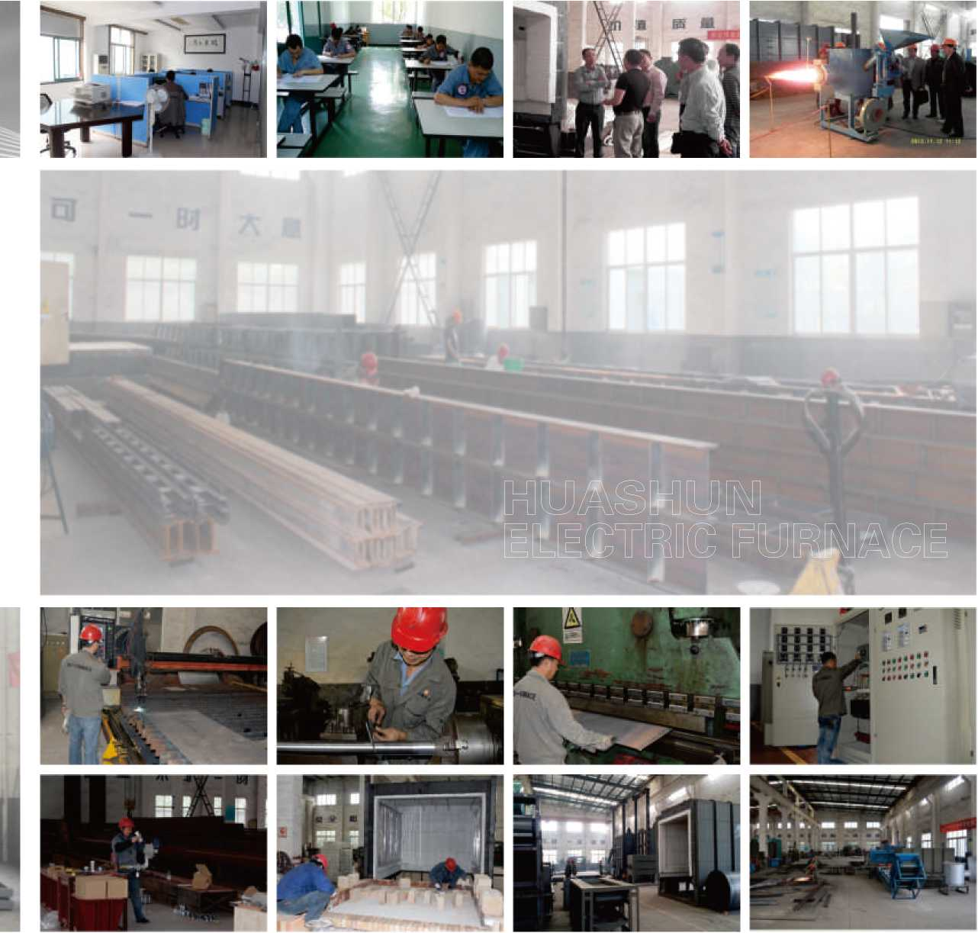
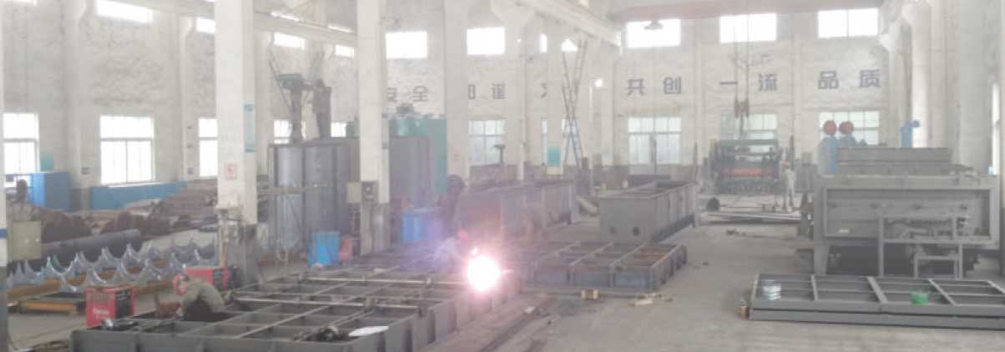
精益求精締造完美品質
Excellence Strive to create the perfect quality
現代化的生産車間，先進的加工設備，
精湛的制造技術，科學的企業管理，
使生産實現了有序化，精準化，高效化，
確保每一臺産品優質、按時地提供給用户
Modern production workshop, advanced processing equipment,
Superb manufacturing technology, scientific management,
Enable production to achieve the orderly, accurate, efficient,
Ensure that each product quality, on time and provided to the user.
05
HUMANISM. HIGH EFFICIENCY. SINCERITY. EXCELLENCE
ZHEJIANG HUASHUN FURNACE INDUSTRY CO., LTD.
06

Slide 6
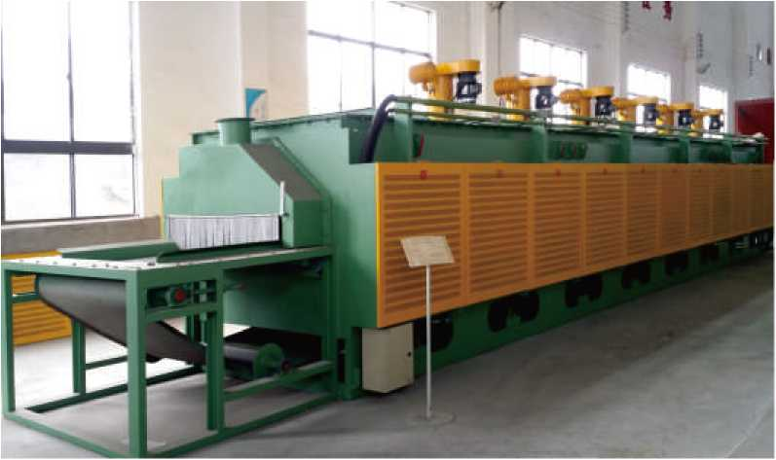
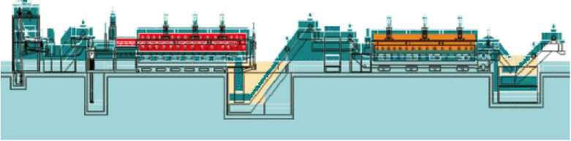
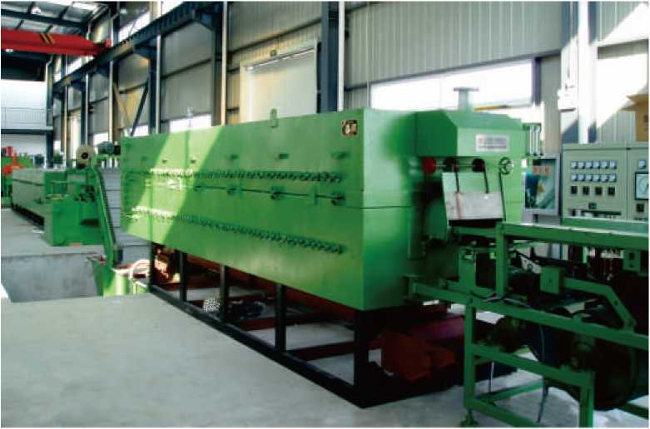
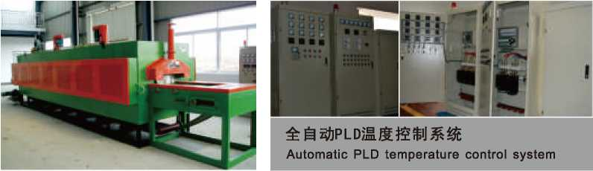
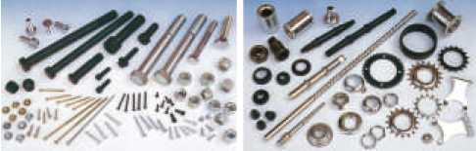
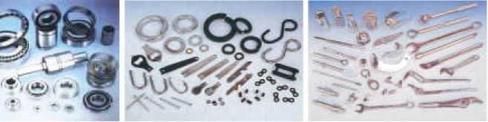
网带式热处理生产线
Network with heat treatment furnace production line
设备用途：淬火、回火、浅层渗碳等工艺
适用行业：紧固件、传动件、五金零件、标准件、五金工具等行业领域
能源类型：电加热
生产线组成(可选配):前清洗机一加热淬火炉一多功能油(水)槽一后清洗机一回火炉一 发黑一烘干一上油
控制系统：具备温度智能控制、动作控制、过程记录、报警、自动关机等功能。
产品规格：按需要定制。
Equipment use: quenching, tempering, shallow carburizing process
Applicable Industries: fastener,driving medium,hardware parts,standard parts,hardware tools and other industries.
Energy types: Electric heating
Production line composition (optional):Before cleaning machine - heating quenching furnace -Multifunctional oil (water) tank - After washing machine - furnace - black - drying - oil Control system: with intelligent temperature control, motion control, process recording, alarm, automatic shutdown feature.
Specifications: customized according to needs
网带式回火炉
Mesh belt furnace
设备用途：适用于紧固件(螺栓、螺丝、螺帽等)、传动件(轴承、链条、 链轮等)、五金零件、五金工具等零件的回火处理。
设备特点：配有强热风机，以强制空气循环，达到每件工件温度一致。直 棒式加热元件便于维修及更换。
Device Uses： suitable for fastener(bolt.,screw.nutsclass).driving medium (bearings.chains,chain wheels)hardware parts, ha rd ware tools.tempering of parts. Features: with a strong register, with forced air circulation, reach consensus each workpiece temperature. Straight rod-type heating elements for easy maintenance and replacement.
适合网带炉处理的工件产品
Suitable mesh belt furnace heat treatment of workpieces Products
网带式热处理生产线
Network with heat treatment furnace production line
o
螺丝、螺帽类 汽车、摩托、自行车零件 传动轴承类 五金零件类 手动工具类
Screws, nuts class Car, bike parts Transmission bearing class Metal parts category Hand tools
07
HUMANISM. HIGH EFFICIENCY. SINCERITY. EXCELLENCE
ZHEJIANG HUASHUN FURNACE INDUSTRY CO., LTD.
08

Slide 7
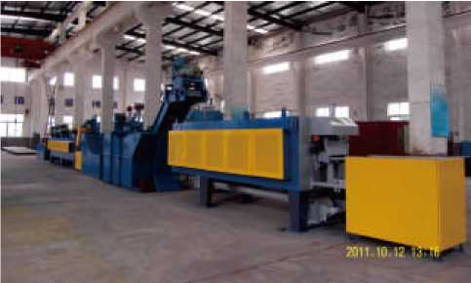
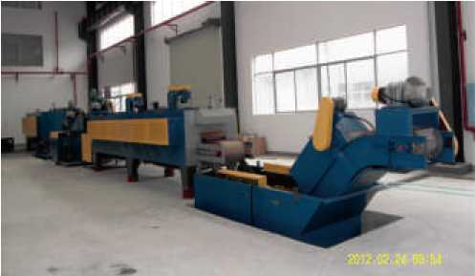
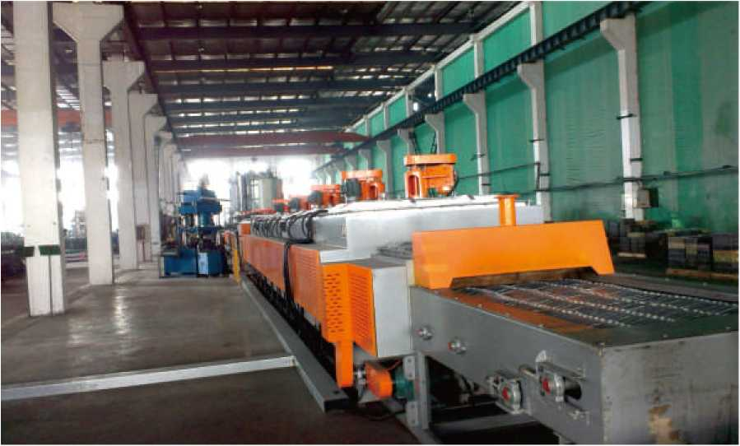
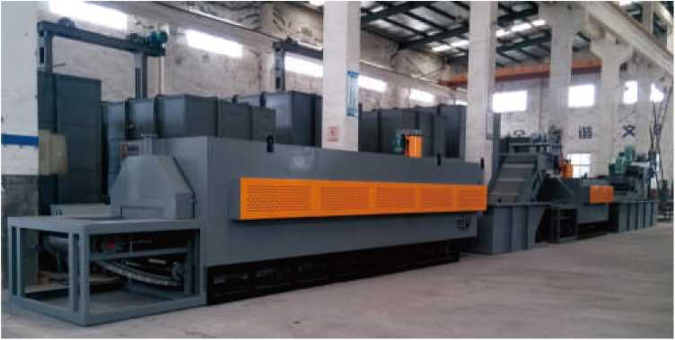
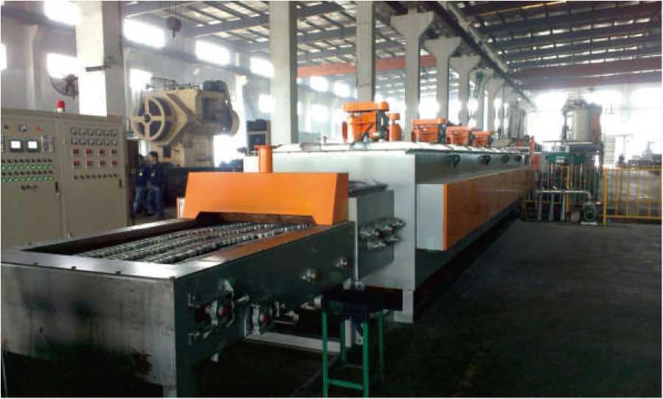
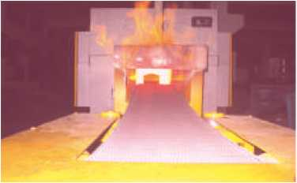
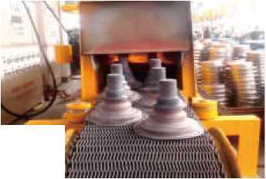

连续网带式铝合金固熔时效热处理线
Continuation mesh belt Aluminum solution heat treatment production line
连续式网带炉生产线
网带式热处理生产线使用现场
Continuous mesh belt furnace production line
Network with heat treatment production line use of the site
网带式发黑热处理生产线
Black mesh belt heat treatment production line
设备用途：该网带式连续生产线适用于金属零件的发黑、浸油及烘干等热处理工艺，具有工艺参 数易于调节、无污染、节能显著、生产效率高等特点。
工艺流程：人工上料-►预热T发黑-►烘干■►浸油-►吹干■►自动出料
Device Uses: The network with continuous production line for metal parts black, oiled and drying heat treatment process, with the process parameters are easy to adjust, no pollution, energy saving significant, high production efficiency.
Process: artificial feeding — preheating 一 black — drying 一 oiled 一 dry 一 automatic discharge
网带式光亮退火炉
Network with bright annealing furnace
额定功率：300KW
设备总长：28M 额定温度：600°C 炉温均与性：±3°C
Rated power： 300KW
Total length of equipment： 28M
Rated temperature： 600°C
Temperature uniformity： ±3°C
09
HUMANISM. HIGH EFFICIENCY. SINCERITY. EXCELLENCE
ZHEJIANG HUASHUN FURNACE INDUSTRY CO., LTD.
10

Slide 8
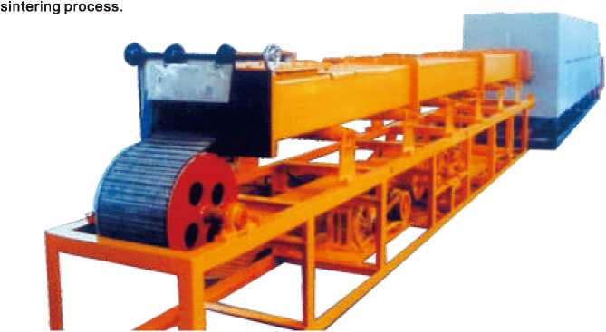
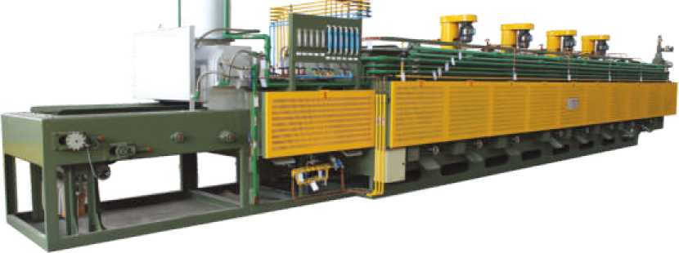
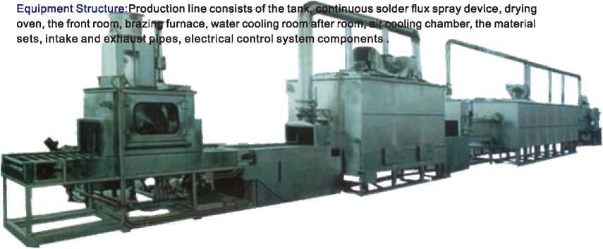
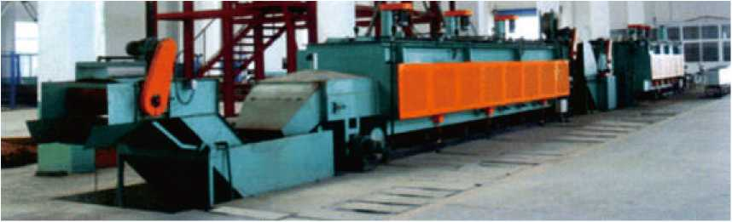
无马弗网带炉
No muffle mesh belt furnace
RSH系列网带式粉末冶金烧结炉
RSH series powder metallurgy sintering furnace mesh belt
设备特点：该烧结炉系连续作业式烧结生产线，具有控制先进、节能显著、维修容易等特点。 适用范围：主要用于压制成型的铁基、铜基及其它相关粉末冶金制品，在保护气氛条件下进 行理想的连续烧结工艺流程。
Equipment Features: continuous operation of the sintering furnace sintering production lines, with advanced control significant energy saving, easy maintenance.
Applicable Scope: Mainly used for compression molding of iron, copper and other related powder metallurgy products, under the protection of atmospheric conditions feedideal line continuous
炉膛结构：整个炉膛形成了一个循环通道，使炉气能够循环流动，保证温度气氛的均匀性，延长了辐射管 寿命，使工件质量稳定性更好。
设备特点：传送带平衡可靠，不“跑偏卡死”、故障率降低60-70%_{o}气氛耗量节约55-65%,炉内处在正压 状态N10- 100Pa、渗层深、效率提高30-40%,且表面表面光洁，无脱碳。完善的自动控制系统（包括气氛 控制），安全方便，可配上料机、清洗机、回火炉组成自动生产线。
Furnace structure:The whole forming a circulation passage furnace, the furnace gas can be circulated to ensure uniformity of the temperature of the atmosphere, extending the life of the radiant tube, so that the work piece quality better stability.
Equipment Features:Conveyor balanced and reliable, no "deviation stuck" 60-70% failure rate. Atmosphere consumption savings of 55-65呛 the furnace is in the positive pressure 0-100Pa, diffusion layer deep efficiency 30-40%, and the surface smooth surface, no decarburization. Complete automatic control systems (including climate control), safe and tonvenient, can be coupled with the feeder, washing machine, furnace form an automatic production line.
RCM系列网带式无马弗热处理生产线
RCM series without muffle mesh belt heat treatment production line
结构特点：无马弗炉膛结构，整个炉膛形成了一个循环通道，使炉气能够循环流动，保证温度气氛的均匀性， 延长了辐射管寿命，使工作质量稳定性更好。
传动机构：机械传送带平稳可靠，不“跑偏卡死”，故障率降低60-70%
炉门装置：新型密封炉门，使气氛耗量节约55-65%,炉内处在正压状态^10-100pa,渗层深，效率提高30-40% 且表面光洁，无脱碳。
控制系统：完善的自动控制系统(包括气氛控制)，安全方便，可配上料机、清洗机、回火炉组成自动生产线。 Equipment Features: non-muffle furnace structure, the entire chamber to form a circulation path, the furnace air can circulate, to ensure uniformity of temperature atmosphere, extending the radiant tube life, so that the quality of work and better stability. Transmission mechanism: smooth and reliable mechanical conveyor, no "deviation stuck", the failure rate decreased 60-70% Door means: new sealing door, the atmosphere in consumption savings of 55-65%, the furnace is in the positive pressure >10-100pa, diffusion layer deep, 30-40% efficiency and smooth surface, no decarburization.
Control system: complete automatic control systems (including climate control), safe and convenient, can be coupled with the feeder, washing machine, furnace form an automatic production line.
NB系列网带式连续钎焊炉生产线
NB series mesh belt type continuous brazing furnace production line 设备特点：该生产线是在氮气保护条件下，使用非腐蚀性钎剂连续钎焊铝制品的设备。 适用范围：主要用于冷凝器、蒸发器、散热器、中冷器等铝制品在氮气的保护气氛下钎焊之用 额定功率：240-600kw,额定温度70（TC
设备结构：生产线由储液罐、连续式钎焊剂喷淋装置、干燥炉、前室、钎焊炉、水冷却室、后室、 风冷却室、出料台、进排气管道、电气控制系统等组成。
Equipment Features: The production line is under nitrogen conditions, the use of non-corrosive flux brazing continuous aluminum equipment.
Applicable Scope: Applicable to the condenser, evaporator, radiator, and other aluminum products in the cold under nitrogen protective atmosphere brazing purposes
Rated power: 240-600kw, rated temperature 700°C
11
HUMANISM. HIGH EFFICIENCY. SINCERITY. EXCELLENCE
ZHEJIANG HUASHUN FURNACE INDUSTRY CO., LTD.
12

Slide 9
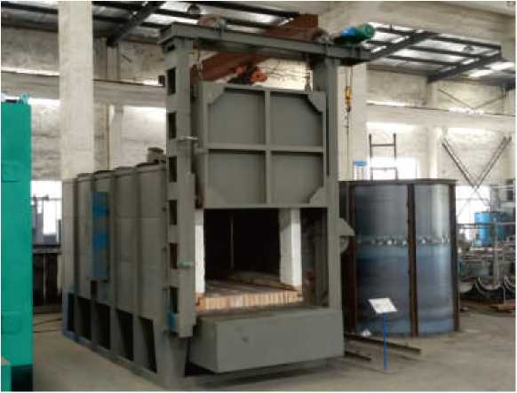
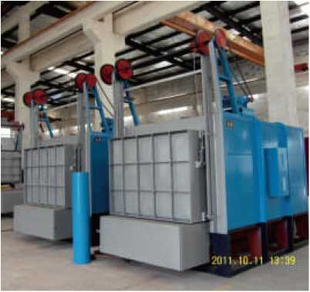
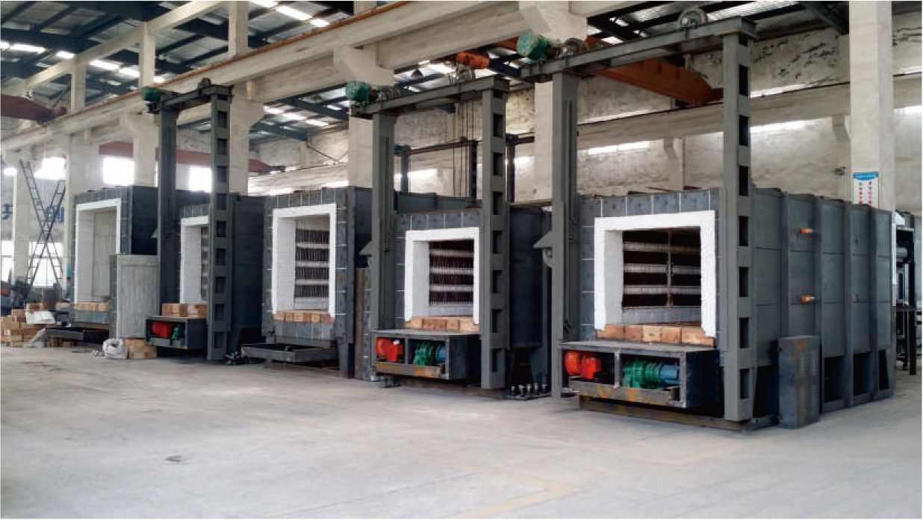
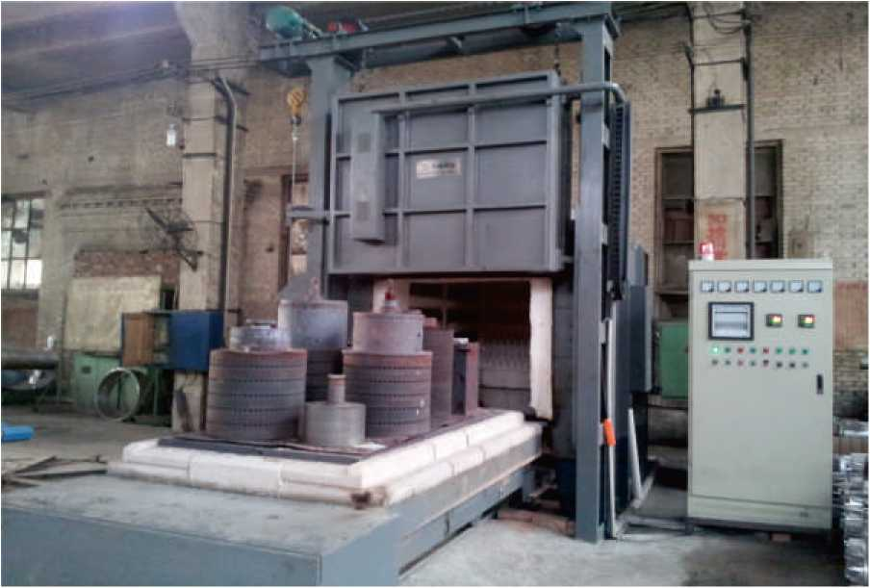
RT3系列台车式回火炉
RT3 Series trolley-type furnace
RT3系列台车式电阻炉
RT3 Series trolley resistance furnace
设备结构：全纤维炉体，热风循环系统，控温系 统，电动提升炉门，台车减速机自行。
Equipment Structure: Full fiber furnace, hotair circulation system, temperature control system electric lift door, trolley gear themselves.
型号规格 specification | 工作尺寸 长X宽X高(mm) Working size length * width * height | 加热功率 (kw) Heating power | 工作温度 | 电源 power supply |  | 备注 Remarks
 |  |  | CC) temperature | 相数 Phase | 电压 Voltage
RT3-15-9 | 1200X600X450 | 65 | 950 | 3 | 380
RT3-105-9 | 1800X900X600 | 105 | 950 | 3 | 380
RT3-180-9 | 2100X1050X750 | 180 | 950 | 3 | 380
RT3-320-9 | 3000X1350X950 | 320 | 950 | 3 | 380
RT3-45-9Z | 1200X600X500 | 45 | 950 | 3 | 380 | 非标 N-S
RT3-75-9Z | 1800X900X600 | 75 | 950 | 3 | 380 | 非标 N-S
其他非标尺寸可按要求设计。
Other non-standard sizes can be designed.
台车式电阻炉使用现场
Trolley Type furnace use of the site
13
HUMANISM. HIGH EFFICIENCY. SINCERITY. EXCELLENCE
ZHEJIANG HUASHUN FURNACE INDUSTRY CO., LTD.
14

Slide 10
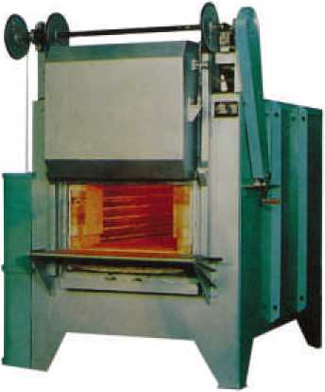
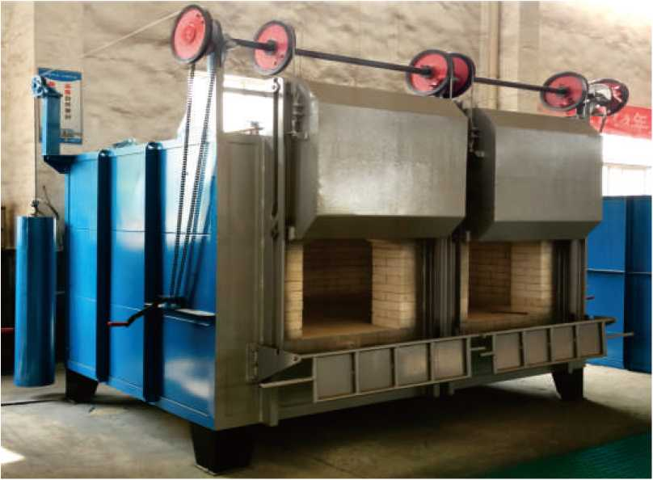
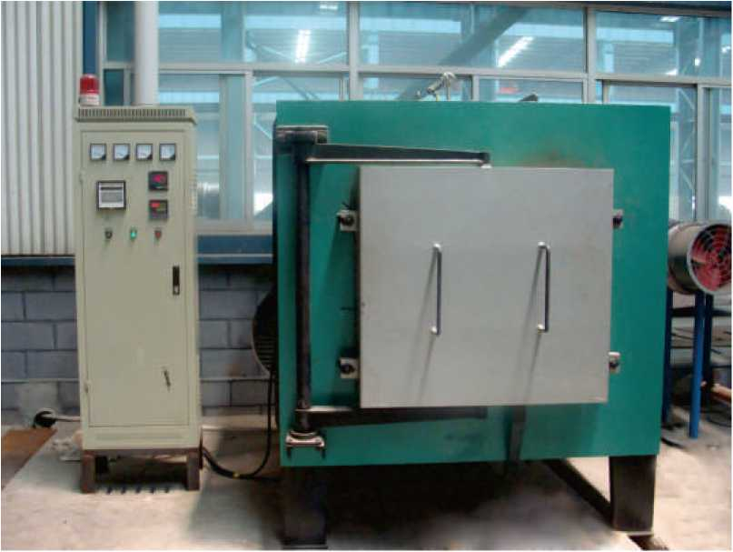
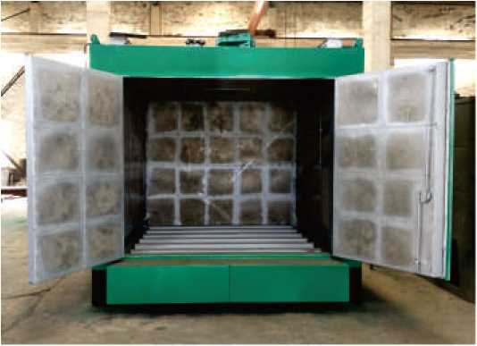
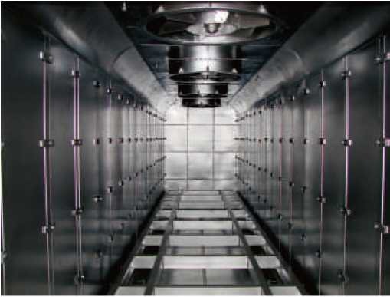
高温双室式炉
High temperature dual chamber furnace
RX3系列950°C箱式电阻炉
RX3 Series 950°C Box resistance furnace
型号规格 Specification | 工作尺寸 长X宽X咼(mm) Working size Length x width x height | 加热功率 (kw) Heating power | 工作温度 CC) Temperature | 电源 Power supply |  | 备注 Remarks
 |  |  |  | 相数 Phase | 电压 Voltage
RX3-15-9 | 650X300X250 | 15 | 950 | 2/3 | 380
RX3-30-9 | 950X450X350 | 30 | 950 | 3 | 380
RX3-45-9 | 1200X600X400 | 45 | 950 | 3 | 380
RX3-60-9 | 1500X750X450 | 60 | 950 | 3 | 380
RX3-75-9 | 1800X900X450 | 75 | 950 | 3 | 380
其他非标尺寸可按要求设计。
Other non-standard sizes can be designed.
室式电阻炉
Room type resistance furnace
台车式烘箱
Trolley Type Oven
烘箱导流系统
Oven diversion system
15
HUMANISM. HIGH EFFICIENCY. SINCERITY. EXCELLENCE
ZHEJIANG HUASHUN FURNACE INDUSTRY CO., LTD.
16

Slide 11
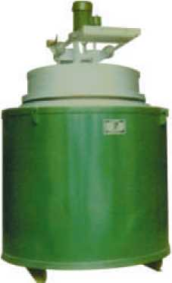
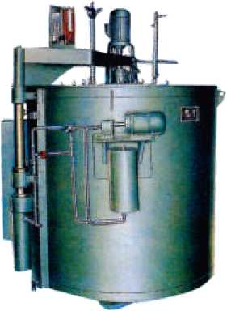
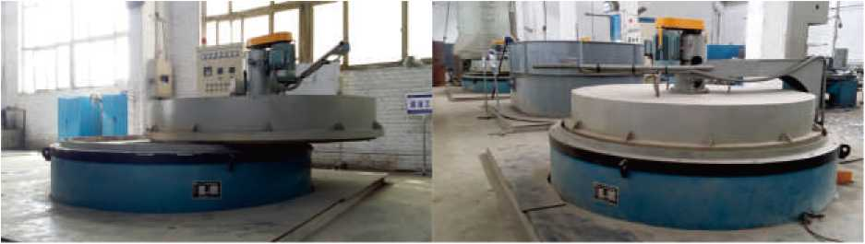
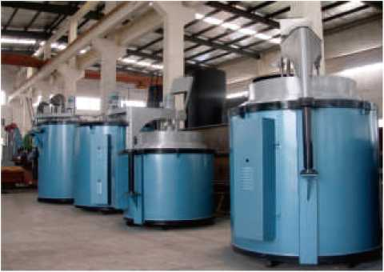
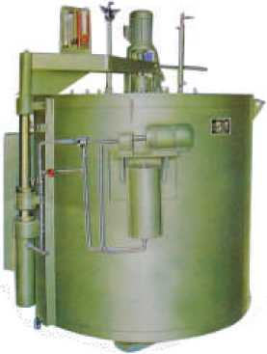
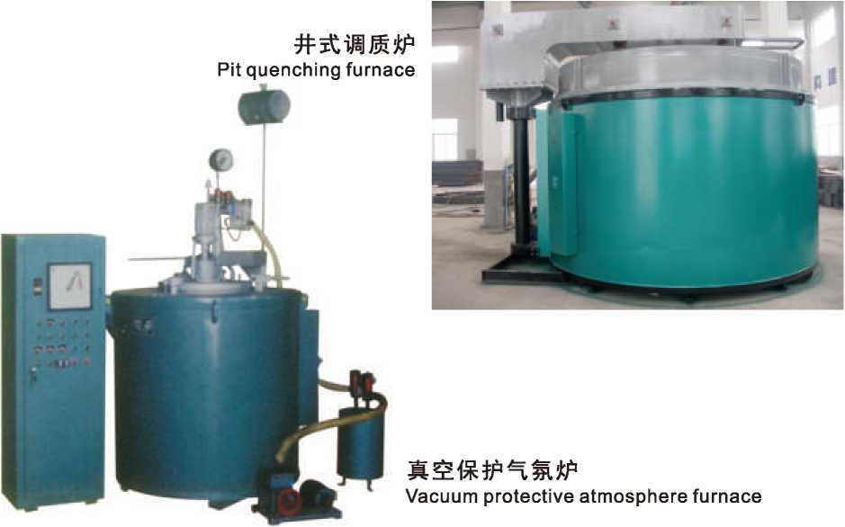
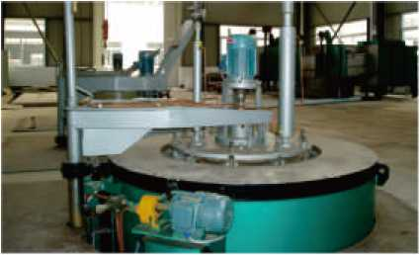
RJ2系列井式回火炉
RJ2 Series Pit Furnace
RJ系列井式氮化炉
RJ Series Pit nitriding furnace
型号规格 Specification | 工作尺寸 长X宽X咼(mm) Working size Length x width x height | 加热功率 (kw) Heating power | 工作温度 | 电源 power supply
 |  |  | CC) Temperature | 相数 Phase | 电压 Voltage | W /王 Remarks
RJ2-24-6 | 0400X500 | 24 | 650 | 2/3 | 380
RJ2-36-6 | 0500X650 | 36 | 650 | 3 | 380 | 杠杆升 poletise
RJ2-55-6 | 0700X900 | 55 | 650 | 3 | 380
RJ2-75-6 | (P950X1200 | 75 | 650 | 3 | 380
型号规格 Specification | 工作尺寸 长X宽X咼(mm) Working size Length x width x height | 加热功率 (kw) Heating power | 工作温度 (°C) Temperature | 电源 power supply |  | 备注 Remarks
 |  |  |  | 相数 Phase | 电压 Voltage
RJ-30-9 | 0 500X650 | 30 | 950 | 3 | 380 | 杠礼升 pole tise
RJ-45-9 | 0 700X900 | 45 | 950 | 3 | 380
RJ-75-9 | 0800X1000 | 75 | 950 | 3 | 380 | 吊盖升 hanging cover
RJ-90-9 | 0900X1200 | 90 | 950 | 3 | 380
RJ-135-9 | 0800X2300 | 135 | 950 | 3 | 380
其他非标尺寸可按要求设计.
Other non-standard sizes can be designed.
其他非标尺寸可按要求设计。
Other non-standard sizes can be designed.
井式回火炉'渗碳炉
Pit furnace, carburizing furnace
井式回火炉使用现场
RQ3系列井式气体渗碳炉
Pit Furnace use of the site
RQ3 Series Pit gas carburizing furnace
型号规格 Specification | 工作尺寸 长X宽X高(mm) Working size Length x width x height | 加热功率 (kw) Heating power | 工作温度 | 电源 power supply |  | 备注 Remarks
 |  |  | (°C) Temperature | 相数 Phase | 电压 Voltage
RQ3-25-9 | *300X450 | 25 | 950 | 3 | 380
RQ3-35-9 | (P300X600 | 35 | 950 | 3 | 380
RQ3-60-9 | 4)450X600 | 60 | 950 | 3 | 380
RQ3-75-9 | 0450X900 | 75 | 950 | 3 | 380
RQ3-90-9 | *600X900 | 90 | 950 | 3 | 380
RQ3-105-9 | 4)600X1200 | 105 | 950 | 3 | 380
其他非标尺寸可按要求设计。
Other non-standard sizes can be designed.
井式渗碳炉使用现场
Pit carburizing furnace Use of the site
17
HUMANISM. HIGH EFFICIENCY. SINCERITY. EXCELLENCE
ZHEJIANG HUASHUN FURNACE INDUSTRY CO., LTD.
18

Slide 12

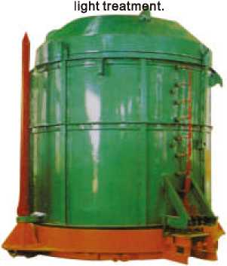
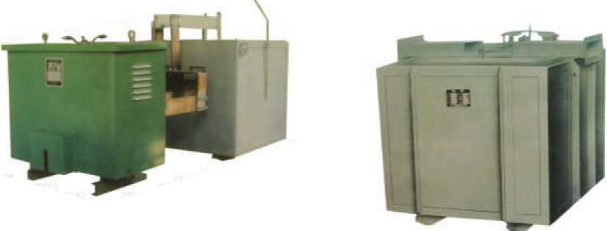
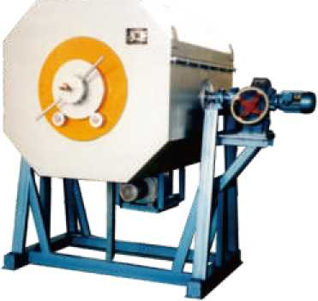
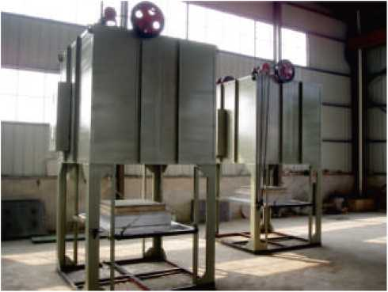
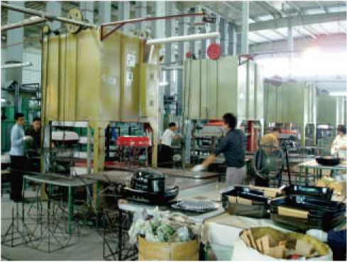
强对流钟罩式光亮退火炉
Strong convection Bell bright annealing furnace
侧埋式盐浴炉
Buried side bath heaters
设备用途：适用于黑色金属和有色金属材料在保护气氛下进行光亮退火
设备特点：炉内装有热流风机，使炉内保护气氛形成强对流循环，有效提高炉温均与性，确保退火工件物 理性能的均与一致。设备设有密封罩、抽真空、充保护气氛系统，能有地防止工件表面氧化、脱碳现象, 达到可靠的光亮处理。
型号规格 Specification | 工作尺寸 长X宽X高(mm) Working size Length * width * height | 加热功率 (kw) Heating power | 工作温度 | 电源 Power supply |  | 备注 Remarks
 |  |  | (°C) Temperature | 相数 Phase | 电压 Voltage
DM-35-8 | 250X300X600 | 35 | 850 | 3 | 380
DM-50-8 | 300X350X600 | 50 | 850 | 3 | 380
DM-75-8 | 350X450X650 | 75 | 850 | 3 | 380
DM-100-8 | 400X550X665 | 100 | 850 | 3 | 380
Device Uses: Suitable for ferrous and non-ferrous material bright annealing under protective atmosphere Equipment Features: furnace equipped with heat blower, the furnace atmosphere to form strong convective circulation, improve temperature were associated with sex,Ensure annealing of workpiece are consistent with the physical properties. Equipment provided with a sealing cap, vacuum, charge protective atmosphere
system, to have Prevent oxidation of workpiece surface, decarburization, achieve a
其他非标尺寸可按要求设计。
Other non-standard sizes can be designed.
型号规格 Specification | 工作尺寸 (mm) Working size | 加热功率 (kw) Heating power | 工作温度 CC) Temperature | 最大装料 (kg) Maximum loading | 备注 Remarks
RZD-120-9 | 0 800X1600 | 120 | 900 | 2000
RZD-160-9 | 01000X1600 | 160 | 900 | 3000
RZD-200-9 | 01200X1600 | 200 | 900 | 4000
RZD-300-9 | (D1400X2000 | 300 | 900 | 7000
RZD-150-1 | 0 800X1500 | 1150 | 1150 | 1800
其他非标尺寸可按要求设计。
Other non-standard sizes can be designed.
埋入式盐溶炉 Embedded salt furnace
滚筒式电阻炉
Roller resistance furnace
型号规格 Specification | 工作尺寸 长X宽X局(mm) Working size Length x width x heigh | 加热功率 (kw) Heating power | 工作温度 CC) Temperature | 电源 power supply |  | 备注 Remarks
 |  |  |  | 相数 Phase | 电压 Voltage
RG-30-9 | 0300X620 | 30 | 950 | 3 | 380
RG-45-9 | 0520X680 | 45 | 950 | 3 | 380 | 八角形 Octagon
RG-60-9 | 0600X750 | 60 | 950 | 3 | 380
RG-120-9 | 0750X1000 | 120 | 950 | 3 | 380
其他非标尺寸可按要求设计。
Other non-standard sizes can be designed.
开底式搪瓷烧结炉
Open hearth enamel sintering furnace
开底式搪瓷烧结炉使用现场
Open hearth furnaces enamel firing site
19
HUMANISM. HIGH EFFICIENCY. SINCERITY. EXCELLENCE
ZHEJIANG HUASHUN FURNACE INDUSTRY CO., LTD.
20

Slide 13
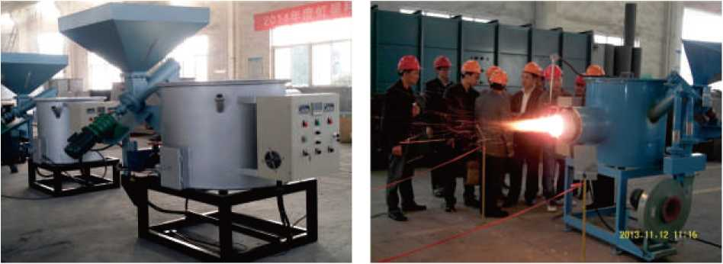






立式铝合金淬火炉
Vertical aluminum alloy quenching furnace
设备用途：主要用于铝轮毂、铝铸件及各种铝 合金标准件的快速固熔热处理，恒温时间结束 后工件的转移速度在7—10秒以内。
工作参数：额定温度550°C,水槽温度70-80°C Equipment use: Mainly used aluminum wheels fast solid solution heat treatment of aluminum castings and various aluminum standard parts, after the holding time.workpiece within 7-10 s Working parameters: temperature at 550 °C water bath temperature of 70-80 °C
环保焚烧炉
Biomass pellet incinerator 设备特点：节能、环保、使用成本低
专家现场鉴定
Expert on-site appraisal
Equipment Features: Low energy, environmental protection, the use of cost
燃料类型：生物质颗粒
设备用途：工业热处理加热炉、热水 锅炉、轻纺行业、工业供暖等
Fuel Type: biomass particles
Equipment Application: Industrial heat treatment furnaces, hot water boilers, textile industry, industrial heating, etc.
对开式移罩炉
Off-type shift cover furnace
铝板退火炉
Aluminum annealing furnace
制动梁燃油加热炉 Brake beam furnace fuel
枷钉加热炉 Rivet Furnace
适用行业：机车行业
Applicable industries: automotive industry
设备特点：全纤维炉体，燃烧机加热，汽缸升降式炉门。 Features: full fiber furnace, burner heating cylinder lift door.
玻璃晶化炉
Glass crystallization furnace
21
HUMANISM. HIGH EFFICIENCY. SINCERITY. EXCELLENCE
ZHEJIANG HUASHUN FURNACE INDUSTRY CO., LTD.
22

Slide 14




烘包器 Dryer package
设备简介：钢铁水罐烘烤装置是对钢、铁罐升温用 的设备，其按功能可分为在线预热装置、维修区干 燥装置；按结构形式可分为立式开启型、卧式移动 型和龙门升降型等。公司可为用户提供全套设备的 设计、生产服务，满足各种吨位的钢、铁水罐对烘 烤的需要。
设备特点：烘烤温度测量、显示与自动控制功能； 燃气的压力、流量监测显示功能；升温曲线控制功 能；温度、压力、流量参数远传功能；自动点火功 能；火焰监测连接报警功能；燃气泄漏报警功能。
Equipment introduction:Steel ladle device is steel, tin heating equipment used, it can be divided by function online preheating device, drying device maintenance area; according to the structure can be divided into open type vertical, horizontal and gantry moving type lift type. Companies can provide users with a full set of equipment design, production and services, to meet the various tonnage of steel, iron tank needs to bake.
Features: baking temperature measurement, display and automatic control functions; gas pressure, flow monitoring display; control the heating curve; temperature, pressure, flow parameters remote functions; automatic ignition function; flame monitorconnection alarm; gas leak alarm function.
推杆式热处理生产线
Pusher heat treatment production line
设备用途：适用于所有需要调质处理的配件。应用该热处理炉的铁路机车车辆配件有：钩舌、车钩、钩尾 框、缓冲器箱体等，产品经调质处理后，满足TB/T 2942-E级钢的要求，并保持稳定的热处理质量。
能源类型：电阻加热
生产线组成(可选配):推料机构-加热淬火炉-多功能油(水)槽-淬火机构-传送装置-回火炉-冷却装置 控制系统：具备温度智能控制、动作控制、过程记录、报警、自动关机等功能。
有效工作尺寸：按需要定制。
Equipment Application:Suitable for all needs quenching accessories. Application of the heat treatment furnace railway rolling stock parts are: knuckle, coupler, Yoke, a buffer tank, and other products after after quenching, meet the requirements of TB / T 2942-E grade steel, and maintain heat quality.Energy types: resistive heating
Production line composition (optional): pusher mechanism - Hardening furnace - Multifunctional oil (water) tank - quenching mechanism - transfer device - furnace - cooling device
Control system: with intelligent temperature control, motion control, process recording, alarm, automatic shutdown feature.
Effective working size: customize as needed.
设备用途：适用于铸件、锻件的调质、 淬火等处理.
额定功率：120- 360kw
工作温度：950°C
Device Uses: Suitable for castings, forgings quenching, quenching process.
Rated power: 120-360kw
Working temperature: 950 °C
电池烧结炉生产线使用现场
Battery sintering furnace production line use of the site
RCG辐底式电阻炉
RCG roller hearth resistance furnace
23
HUMANISM. HIGH EFFICIENCY. SINCERITY. EXCELLENCE
ZHEJIANG HUASHUN FURNACE INDUSTRY CO., LTD.
24

Slide 15













































部份重要客户
Some important clients
Q
DSIC^^ 大连船舶重工
O
江阴博威材料
cssc
TOSHIBA
Leading Innovation »
家乏 MQsa（nuti）
江苏联通轻合金
上海沪鑫铝业
青海瑞合铝箔
浙江天喜实业
中国船舶工业集团
玮诲玉柴關即濯T1
A
广西南南铝业
FFEP
atJLWF aECTWCAL rcmEREOUPABIT 新江双富电n设备
l-IOKKAI 北i亩封头
Jr
isatan
JOINWORLD
新疆众和股份
ALCDA
美铝上海铝业
榮剛材料科技
WEIDE HEADS
EG徳対貝
乳源东阳光精箔
BAOSTEEL
ALSTOM
阿尔斯通
武汉锅炉股份
昆山长发铝业
浙江军马铝业
重庆捷和铝业
成都阳光铝业
宝铜集团
湖北新冶钢
SNTO
帛匾集团
湖南晟通铝箔
洛庆审团
r-MfTrJMR rwrau" 江苏常发制冷
内蒙通辽同禹铝业
曲IMTH妲时 浙江万泰铝业
SINOPEC
vncc EHSfE
五南大为化工叢备
ZCM
张家港化工机械
WCE
无鶴化工装备
材料供应商
Raw Material Supplier
中国石化
明由壬盲■装
C
O\R
中国：it军
CSR
ballUr
百w
昭s
Industrial Burner Systems 来自德国的工业燃烧系统
U Morgan
Advanced Materials 卜英国摩根
Hualing 球机
航天晨光股份
中国南车
COI\ICH
寤SK水服
AKB
QERpr）酬a現
正京电工
赛瑞机器
SERI MACHINERY
51NOMRCH
ldz~rl
中核动力设备
湖州中联机械
38南SS8H新
TEC0
1 ft-Ff（3f rT rurtfi（?rs
富士电机
pgh DELIXI
，週1應投爲’
PISOLITE
▲
THIaHBN 威海石岛直工
东元电机
上海沪临直工
太原重工股份
辽宁福鞍重工
武汉重工铸锻
扛我泰IB渥1S01
JIANGSU TAILONG DECELERATOR
SUNTOU 5北京兴达奇热工控制
普^ ~T Bejhg Suntxjch Themiprocess
LUVANG塲徳
山东鲁阳
®TISC
CHUANG DIAN
価州联隅■工
山西北方OIBI
中国建材集团
ASTEEL
马钢集团_{L}—Ifi钢集团
26

Slide 16




太湖的珠
至南京
奏
张家港
Huashun Furnace Business Consulting Market Department Technical Department
Purchasing Manufacturing Aftermarket Service Finance Ministry Enterprise Manage FAX R&D
FAX Office Shandong Office: Yu IE
Sha nxi Office: Su IE
Hebei Office: Han IE Hunan Office:Yao IE Guangxi Office： Lian IE Dongbei Office:Wang IE
華順爐業 業務咨詢: 市場部: 技術部: 采購部: 制造部: 售後服務: 財務部: 企管部:
+86 400
+86 572
+86 572
+86 572
+86 572
+86 572
+86 572
+86 572
995 9000
6090988
6090033
6090022
6090033
6901222
6090055
6902988
6903308
86460948
86467780
86460325
至合肥
Y芜湖
申苏浙皖高速 J 广德
宁匱箍
Taihu Pearl
Changxing
苏州
长兴
傳
真:+86
572
571
571
571
和平 安吉
南潯
夕上海
研發部:
傳 真： 辦事處:
+86
+86
+86
噩I皆膻業
HUASHUNFURNACE
山東辦事處：于工13853217618
15763979128
山西辦事處：蘇工18235102815
15935149310
宁波
河北辦事處：韓工13011594246
湖南辦事處：姚工18273266919
廣西辦事處：練工18078187288
東北辦事處：王工13804527162
27
HUMANISM. HIGH EFFICIENCY. SINCERITY. EXCELLENCE

