Slide 1

Integrated Skills
9上 Unit 4 Growing up

Slide 2
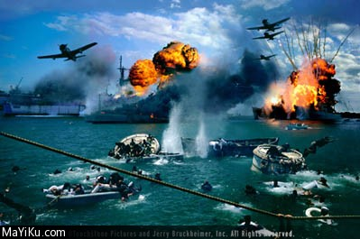

Watch a short movie

Slide 3

Pearl Harbor
a story about Japanese army secretly attacked Pearl Harbor in the USA

Slide 4
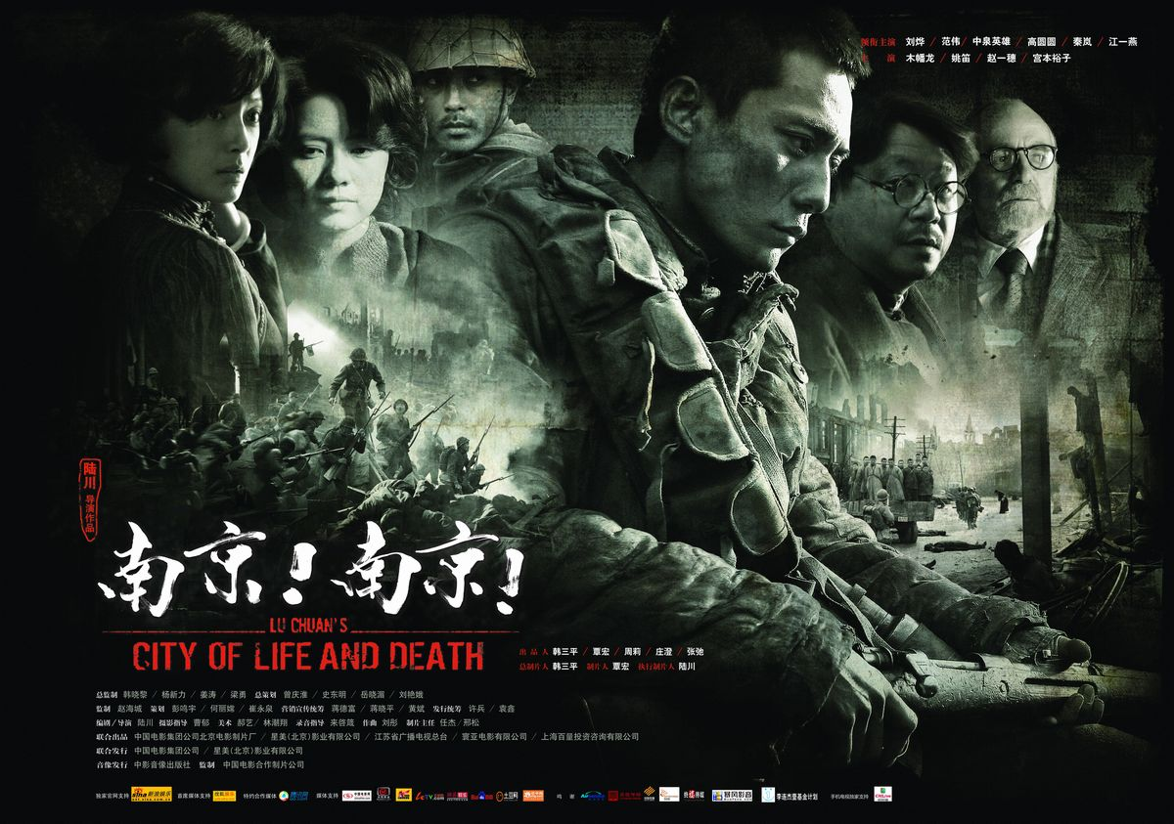
City Of Life And Death
a story about Japanese army killed the people in Nanjing in China

Slide 5
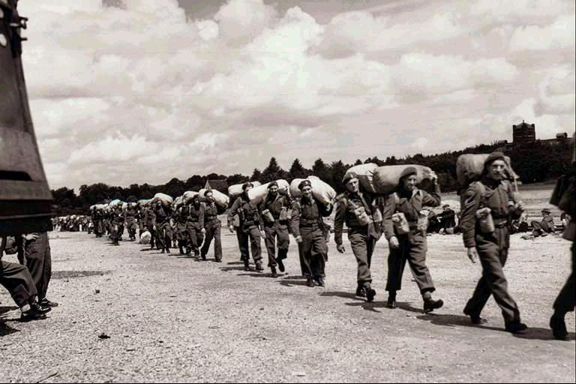
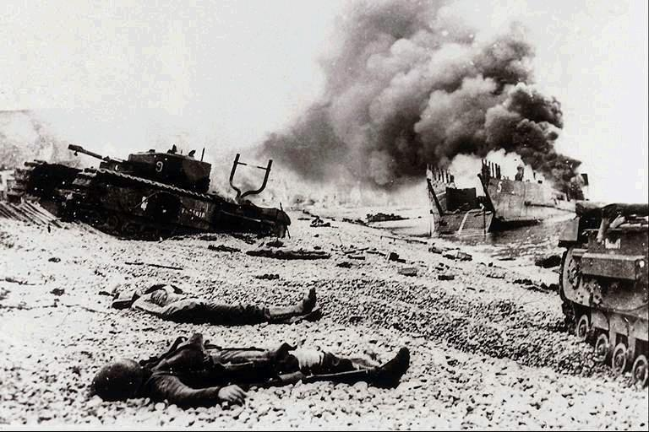
World War II
start suddenly
World War II in Europe
in 1939 and ended in 1945.
broke out

Slide 6
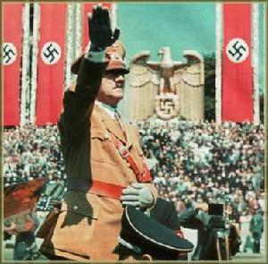

World War II
Hitler (希特勒) came from Germany .
He was the chief leader of German Nazis .

Slide 7
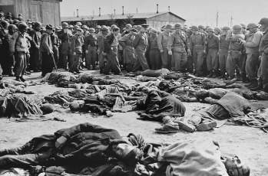
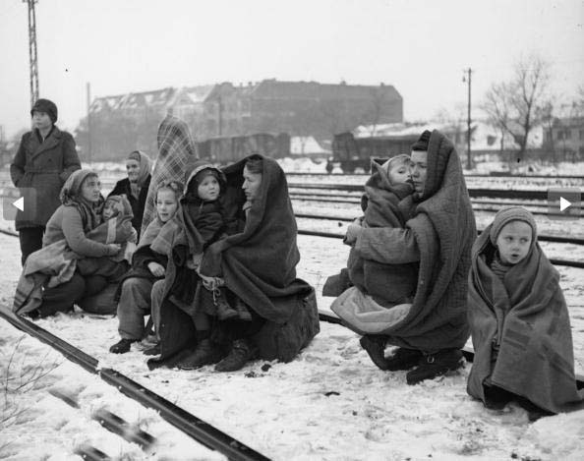
World War II
Because of the war, people lost their
and .
lives
homes
Many people died in the war.
Life changed for everybody.

Slide 8
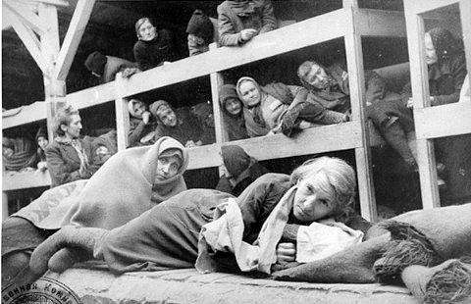
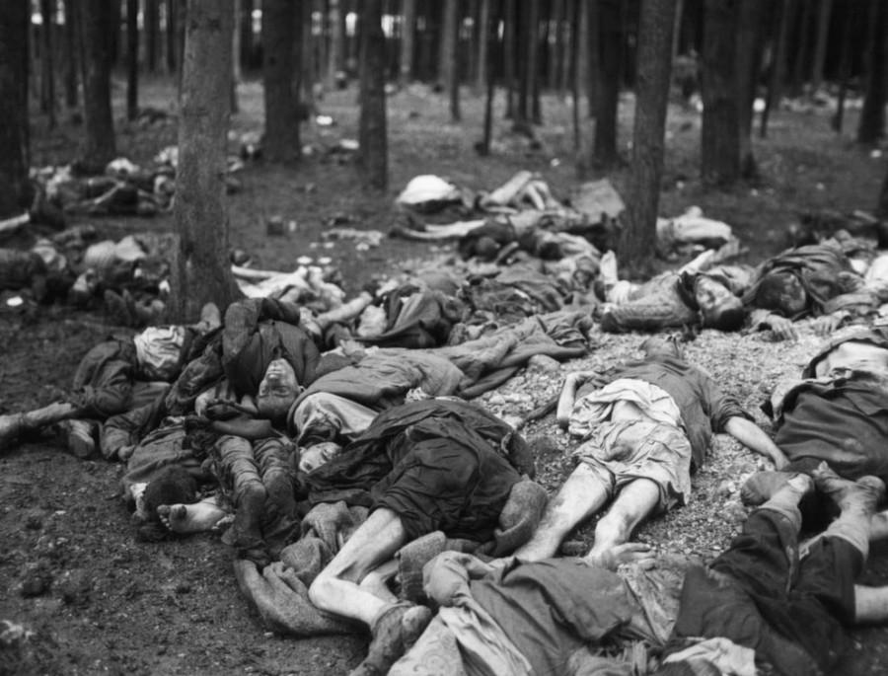
World War II
Jew n.
The German Nazis hated the Jews and
sent the Jews to the Nazi Camp.

Slide 9
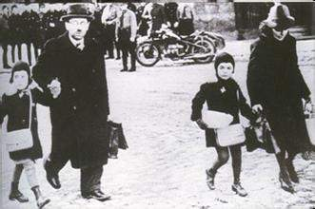
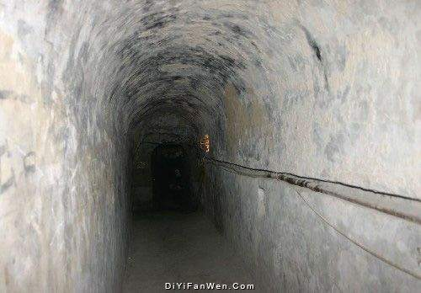
went into hiding （hid in safe places）
lived in fear of their lives （were afraid of dying）

Slide 10
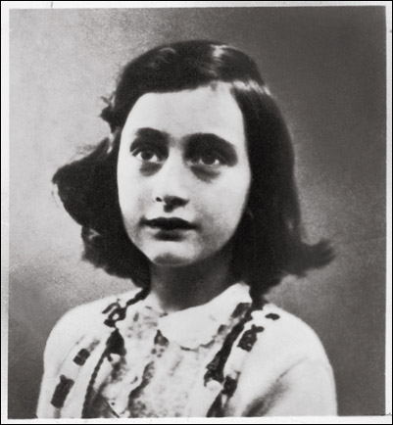
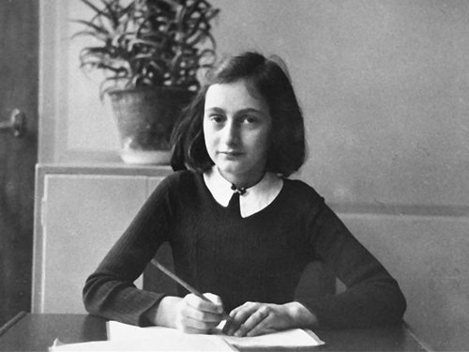
Anne Frank(安妮.弗兰克)
(1929-1945)
a Jew

Slide 11



The Dairy of a Young Girl
the life in hiding & the life in a Nazi camp

Slide 12
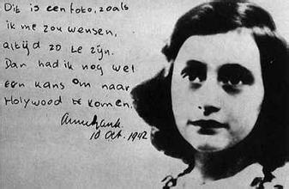
Anne’s diary
The sun is shining, the sky is deep blue, there's a gentle breeze[bri:z], and I'm longing -- really longing -- for everything: conversation, freedom, friends, being alone. I long. . . to cry!
太阳出来了，天空湛蓝，微风轻拂。我好渴望，渴望一切！渴望交谈，渴望自由，渴望友情，也渴望独处。甚至我渴望······
哭一场！
—— Anne Frank

Slide 13

The Diary of a Young Girl
我们的自由被一连串的反犹太命令严格限制：命令犹太人身上要佩一颗黄星；……犹太人禁止搭电车；
理想、梦想和宝贵的希望也在我们心中浮现 。
Her diary was published.
Some of the English was translated into Chinese.

Slide 14
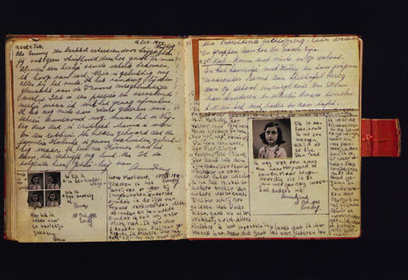
The record of World War II
A symbol of the victory of the human spirit
The Dairy of a Young Girl (安妮日记)

Slide 15
Practice
Read part A1 and answer the following questions.
1.Who wrote the book The Diary of a Young Girl?
2.When was the book first published?
3.How many languages has the book been translated into?
4.Why is the book so important?
Tips:Pay attention to key words.

Slide 16
Practice
Read part A1 and answer the following questions.
1.Who wrote the book The Diary of a Young Girl?
2.When was the book first published?
3.How many languages has the book been translated into?
4.Why is the book so important?
Anne Frank.
In 1947.
67.
It was a record of that time, and it has also become a symbol of the human spirit.

Slide 17


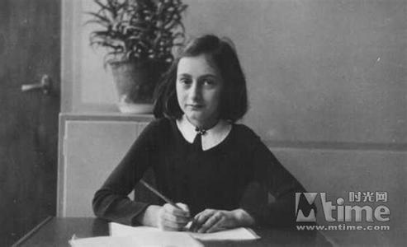

Retell
Anne Frank and World War Ⅱ
A. born in Germany...
A
B. broke out in 1939
B
C. went into hiding...
C
D. were caught and sent to ...
D
her mother died in…Anne and her elder sister died...the war ended…
E
F. had the dairy published
F
Jun.1929.
1939
Jul.1942
Aug.1944
1945
1947

Slide 18


More books about wars
Which books are they talking about?
A Small Free Kiss in the Dark
I Am David

Slide 19
Listening
I hope war never happens again
How old was the boy in the book I am David? | He was __1__ years old.
What does Simon admire? | He admires those children for their __2____.
What dose Millie hope? | She hopes ___3__.
1. A 11 B12 C 13
2. A courage B victory C achievement
3. A the war was over.
B the war never happens again.
C A＆B

Slide 20
Read and write
Books | Writers | Content
The Dairy of a Young Girl
the life in hiding & the life in a Nazi camp
Anne Frank
a boy’s journey to Copenhagen after he got away from a Nazi camp
I Am David
------------
A Small Free Kiss in the Dark
a story about a young homeless boy survived the war with his friends
------------

Slide 21
Speak up
Millie: Have you read any other stories about children in the
war?
Simon: Yes. I’ve just finished the book I am David, a story
about a 12-year-old boy and his journey to
Copenhagen after he got away from a Nazi camp.
Millie: The book A Small Free Kiss in the Dark is
also about a young homeless boy and how
he survived the war with his friends.
Simon: I admire these children for their courage.
However, it’s a pity that they couldn’t live
a happy life just as we do.
Millie: Yes. Although we live in peace, some
children in other parts still live in fear of
their lives. I hope war never happens again.
What was the harm(危害) of the war?

Slide 22
A story in World War Ⅱ
The story happened during the Second World War. An old man lived in a small town of Germany. He had three sons and they all worked in the same factory where he had worked. After the war had begun, his sons were all made to join the army one after another and they all died in the fights. The old man was very sad. He didn’t have enough food and was often hungry. And nobody helped him and he didn’t know how to go on living.
It was a very cold winter night. The old man couldn’t go to sleep. He had been hungry for two days and it was so cold in his room that ice could be seen. He had to get up and began to run in the room until he lay down on the floor. The next morning he had to beg from door to door. He had been to a lot of cities and knew a lot.
Once he came to a village, but the villagers were all poor and couldn’t give him anything. He was too hungry to go to another village. He thought hard and found a way. He came to a police station and called out, “Hitler is a foolish pig!”
Out came an old policeman at once. He took the old man into a room, gave him some bread and a cup of tea. Then he said, “Don’t say so in our village, sir!”
“I’m sorry, sir,” said the old man. “I don’t know it’s Hitler’s hometown.” “No, no, sir,” the policeman said in a hurry. “It’s pigs’ hometown!”

Slide 23
1.The old man’s sons joined the army because_________.
A．they were all strong B．they loved their country
C．they wanted to be full D．they had to do so
2.The old man was sad because _________.
A．his three sons had to join the army
B．his three sons lost their lives during the war
C．he lived in the small town alone
D．he had neither food nor clothes
3.From the passage we can infer that _________.
A．the old policeman would send the old man into prison
B．the old policeman hated Hitler, too
C．the old policeman thought Hitler was better than pigs
D．the old man found a friend at the police station
4.In the old policeman’s opinion, _________.
A．Hitler was more foolish than pigs
B．the old man insulted（侮辱）their hometown
C．the old man had to say sorry to him
D．the old man had to fight with Hitler
5.What would probably be the best title for this passage?
A．An Old Man and His Three Sons B．Hitler is a Foolish Pig
C．It’s Hitler’s Hometown D．It’s Pigs’ Hometown

Slide 24
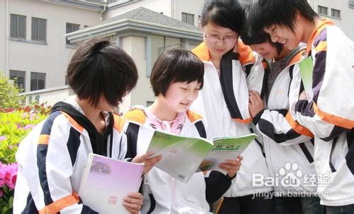
Discussion:
During the World War Ⅱ, Anne lost her life.
In the past, Chinese people lived a hard life.
Now , what do you think of our life?
We live a happy life.
Who gives us the life?
What should we do for the future?

Slide 25

The real and lasting victories are those of peace, and not of war.
真正而持久的胜利就是和平, 而不是战争.
- 拉尔夫•沃尔多•埃莫森(美国思想家，文学家)

Slide 26

Enjoy your life!
Cherish your time!
Thank you!

Slide 27

Homework
1. Search the Internet for more
information about WWII, Anne Frank
and The Diary of a Young Girl.
2.Then talk about them with your
classmates or friends.

