Slide 1

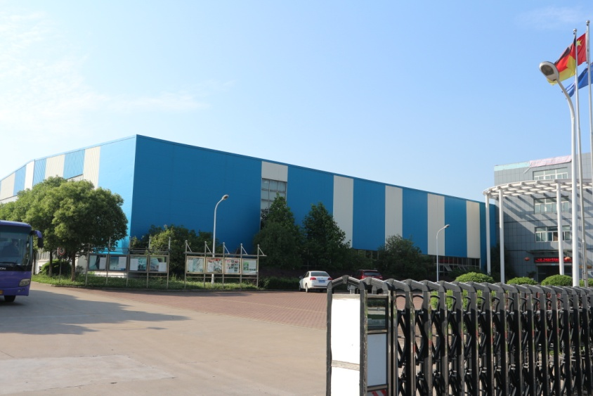
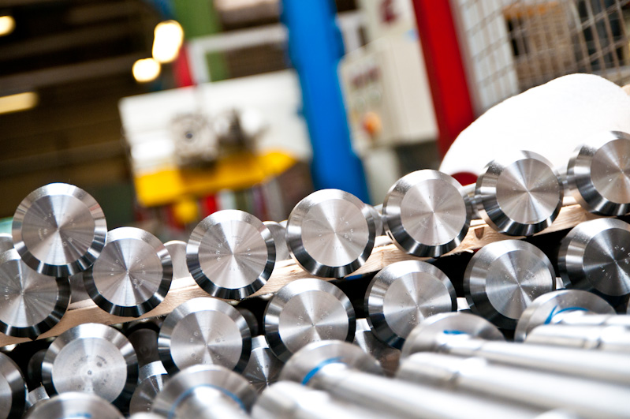
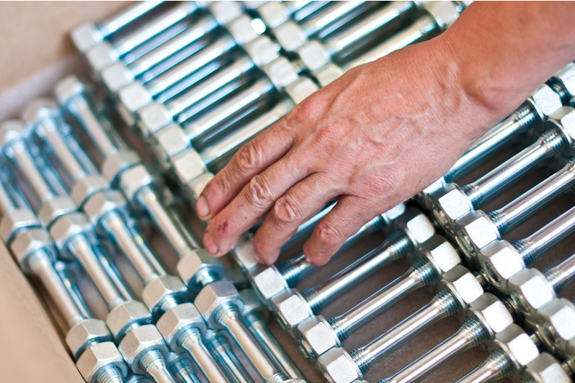
Welcome to
Jungeblodt®
Rongbraute, Germany®Welcome to you
Super nuts Presentation
Super nut introduction
  Guoliang
M: +86-13917317454
liang.guo@kpmdrive.com.cn

Slide 2
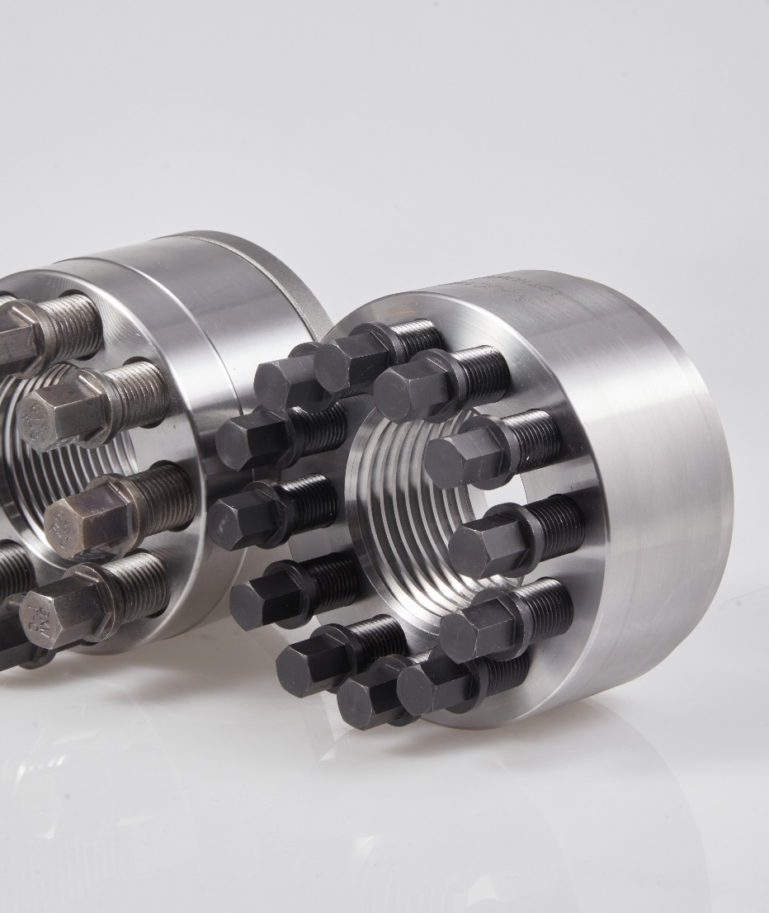
Super nut Tensioners
Super nut (pretensioning nut)
Current problems of the ordinary connection system:
1. Special pneumatic or hydraulic tools are required for large-size nut installation. It res more personnel and construction time.
2. The generation of the pretension force needs to overcome the friction force, resulting in the inaccurate pretension force. This then causes the bolts to loosen or even break.
3. Installation requires a lot of operating space and additional power source, which is difficult to operate in compact environments or environments with safety risks.
4. In the process of disassembly and assembly of fasteners, the traditional installation method is easy to cause the deformation and wear of the threads, and affect the secondary use.
5. In high temperature and corrosion environment, the bolt is easy to thread bite and disassembly difficulties.

Slide 3
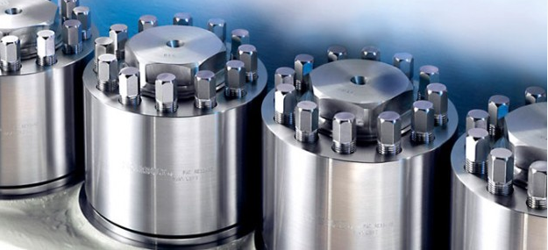
What is super nut Tensioners
What is a super nut tensioner
The supernuts were designed to replace the traditional nuts directly. The device can be rotated into a new or existing bolt, stud, screw, or shaft. The main thread is used to place the tensioner on the bolt or stud and placed on the hard washer and bearing surface. After manual installation in place, the actual tension of the bolt or stud only requires you to tighten the thrust screw with a simple manual tool around the straight thread. The thrust screw uniformly transfers the pretension force to the main thread, and thus also to the connector. The main thread is locked by pure tension.

Slide 4
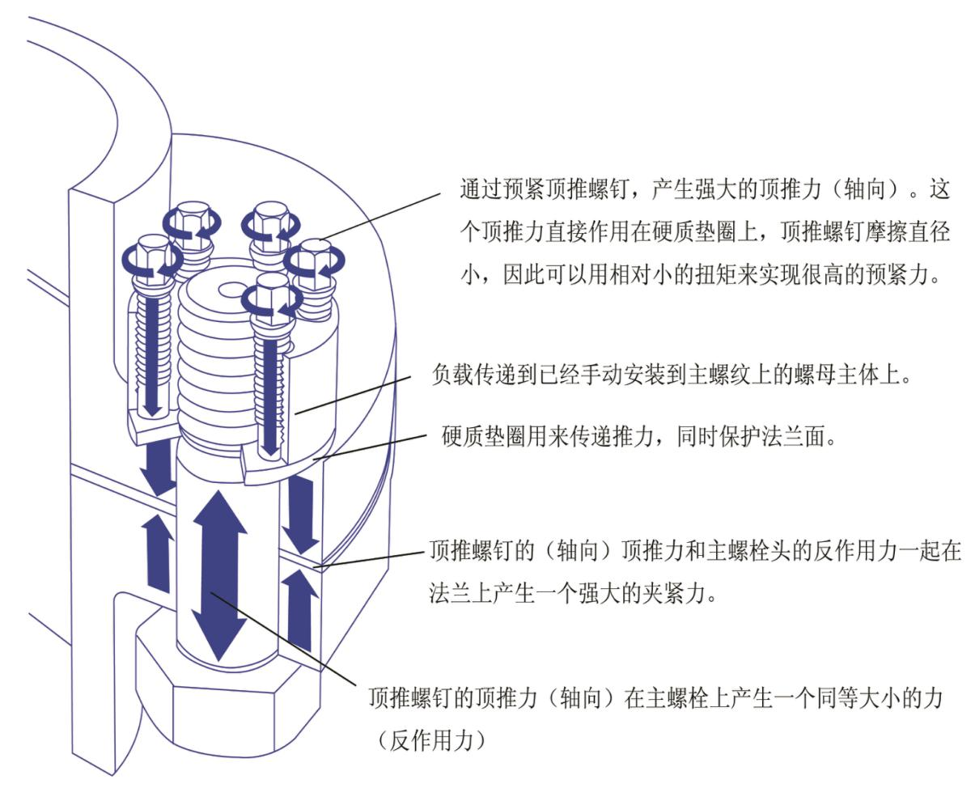
How does the super nut Tensioners work
How the super nut tensioner works

Slide 5
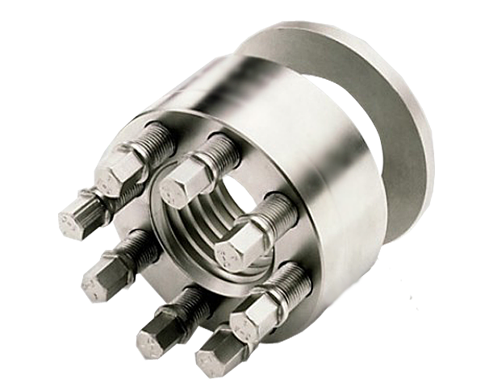
Basic structure of super nut Tensioners
The basic structure of the super-nut tensioner
Hard washer
To deliver thrust
Also protect the flange face
Top push screw
With very little torque to achieve very high pretension
The nut main body
The top thrust of the thrust screw produces a force of equal magnitude on the main bolt

Slide 6
Advantage of super nut Tensioners
Advantages of the super-nut tensioner
one. Design advantages
1. Higher pretension force. With pure tension tightening, it can achieve greater pretension and higher accuracy than ordinary nut installation.
2. Better threaded connection considers the impact of dynamic load to generate sufficient and correct pre-tightening force, so that the connection system can be tightened without loosening.
3. Under the same pretension and accuracy requirements. Smaller bolts can be designed, and the compact size reduces the size of the equipment and reduces material and processing costs.
two. Advantages of the initial installation
1. Tighten and loosen the operation only by using conventional manual tools.
2. Higher security. Because only manual tools are needed, the installation is safe and there is no danger of using large electric or gas-hydraulic tools.
3. Less space constraints. More convenient to complete the installation in a narrow space.
4. Shorter disassembly and assembly time. The super bolt can be tightened or removed in a shorter time than most other methods.

Slide 7
Advantage of super nut Tensioners
Advantages of the super-nut tensioner
three. Advantages during equipment operation
1. Higher vibration resistance characteristics. The pretension force beyond the separation torque prevents bolt vibration.
2. Accurate pre-tightening. The accurate and balanced pretension force of each bolt on the flange ensures the uniform distribution of the pretension force and reduces the risk of lax flange surface sealing.
3. Higher reliability. Accurate pretension can prevent the coupling from loosening, thus minimizing fatigue and extending the service life of the bolts;
4. Less downtime. Accurately designed and tightened connections maintain safe in use, thereby reducing maintenance downtime.
four. Advantages of the maintenance
1. Convenient access for maintenance. Inspection and twisting of torque can be performed safely and conveniently using only manual tools.
2. No wear with the help of pure tension tightening, can eliminate the common thread wear when using the direct torque method;
3. Quick disassembly. Super nut disassembly is convenient;
4. Reuse it. Reusable to restore pretension at any location using simple manual tools.

Slide 8
A small torque produces a large preload
Small pretension force produces large pretension force
Comparison table of super bolt and hydraulic wrench
Thread size (inches) | Bolt load (pound) | Hydraulic wrench torque (Pound feet) | Super Bolt Standard Series Torque (pound / ft)
1 | 48,600 | 716 | 14
1-1/2 | 98,400 | 2,173 | 25
2 | 175,200 | 5,160 | 57
3 | 428,4 | 18,925 | 114
4 | 806,400 | 47,497 | 114
5 | 1,008,00 | 74,214 | 189
6 | 1,209,600 | 106,868 | 189

Slide 9
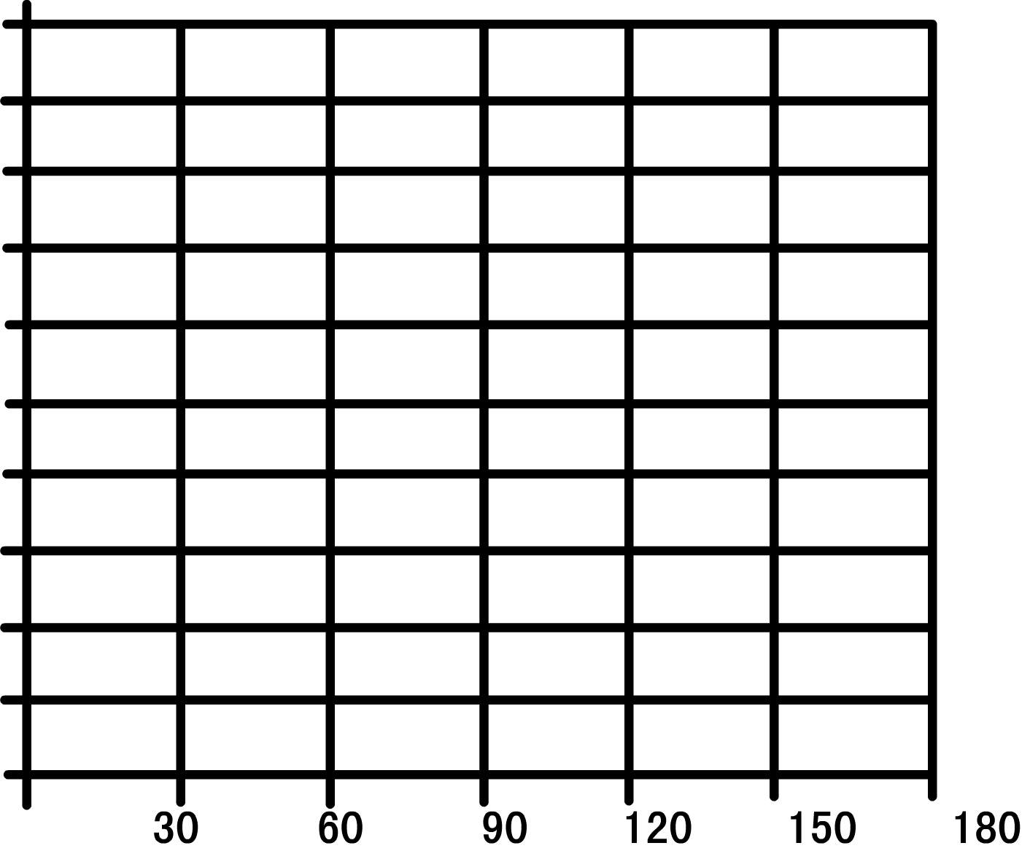

Why use super nut Tensioners
Why use the Super Nut pretenoner
torsion (Nm)
140,000
310Mpa bolt stress torque curve
Torque required for the common nuts
70,000
JUNGEBLODT®Torque required for the supernut
On large size bolts / nuts, the torque required for ordinary nuts will increase in diameter cube with increasing thread diameter, JUNGEBLODT®The torque required for the supernut is almost constant.
Thread diameter (mm)

Slide 10
Less torque loss
Torque loss is smaller

Slide 11
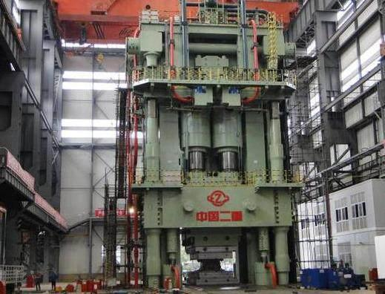
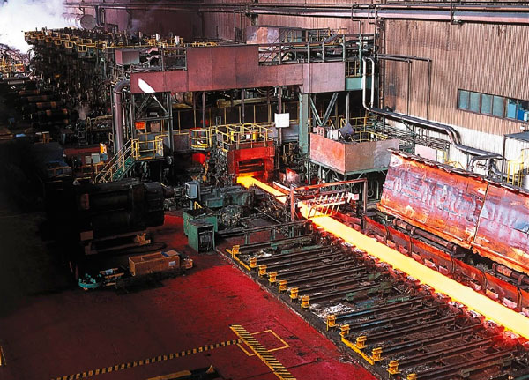
Forging press and steel plant application
Forging and press and steel mill applications
All this time, the fasteners connecting the reducer to the gear rack on the hot mill have been fastened using three hundred kilograms of weight and suspended from the ceiling through the crane. Pull the weight from the temporary scaffolding and let it tap the wrench like a hammer. The whole procedure requires five people: three pulling the load, one tightening the wrench, and one operating the crane. It takes an hour to tighten a bolt, and participants need to face multiple safety hazards.
After using the JUNGEBLODT super nut, the installation process becomes the safest maintenance task. Now each connection takes only take one person to handle and 15 minutes. With 12-28 M12 bolts on each installation application, significantly reducing overall downtime and improving productivity.
installation site:
forging press:Press machine column, transverse pull rod, bearing block, high-pressure pipe, mold gasket, cylinder head bolts, anchoring bolts, etc.
Steel rolling industry: thrust ring, connecting bolt, transverse rod bolt, anchor bolt, rolling mill motor, bearing, bearing seat, roller way, BOF and EAF application, rolling machine, hydraulic cylinder, lifting crane, longitudinal cutting machine blade, general joint, spare roller bearing, working roller bearing, pipe mill, etc.

Slide 12
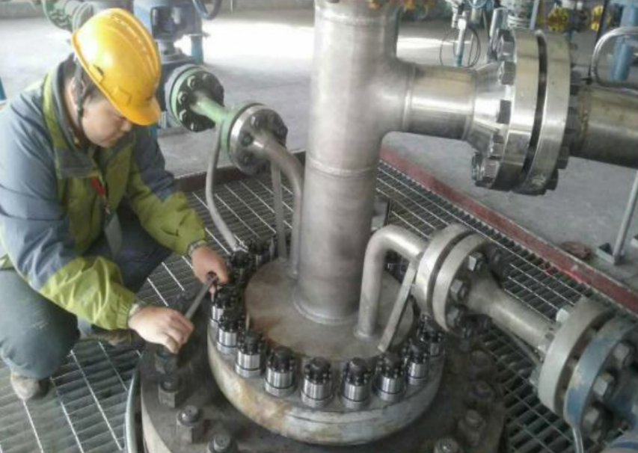
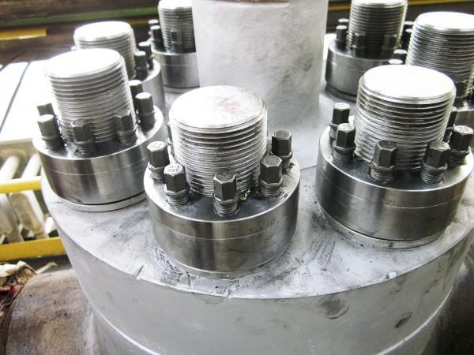
Oil 、Gas and Petrochemical application
Petroleum, natural gas and other petrochemical industries
At present, the domestic petrochemical enterprises generally have the problems of bolt loosening and seal leakage. Because the industry has the characteristics of high temperature and high pressure, therefore, in the use of ordinary nuts, due to the lack of pretension and common nuts easy to loosen the natural defects. Therefore, it is inevitable that the bolts due to stress concentration lead to fatigue fracture, disassembly difficulties and other problems, leading to high customer maintenance costs, high spot inspection frequency problems!
Jungeblodt In addition to the accurate pre-tightening force and good sealing performance, the special surface treatment process and special coating of the thrust screw will ensure that the lubrication function can still be maintained after working at high temperature, so as to avoid the fracture of the thrust screw caused by excessive torque.
installation site:
Top driver, antispray device
Mud pump, fracturing pump
Reactor cover plate and heat exchanger
Turbine control valve, turbine connections, pipe flange,
Anchoring bolts, coupling bolts, etc

Slide 13
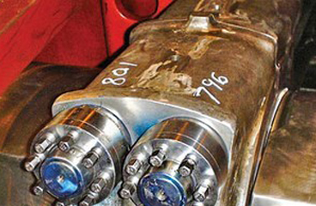
Compressor industry application
Compressor, turbine industry
The reciprocating compressor piston nut used to be fastened by large wrench with electric heater. The installation method of this nut needs to drill a slender hole in the middle of the piston rod, the piston. In the process, the slender hole is easy to shift, resulting in uneven thickness of the piston rod head, which greatly reduces the strength of the piston rod and reduces the service life. The installation of electric heating method is time-consuming and laborious, and the rotating torque is extremely difficult to grasp. When the pretension force is insufficient, it is easy to produce nut loosening accident. When the pretension force is excessive, it is easy to make the material plastic deformation and reduce the service life. At the same time, because of the need for power heating, there are major safety risks in the natural gas environment.
When the super nut structure scheme is adopted, not only the above problems can be avoided, but also the compressor piston nut is composed of the super nut system (super nut, top wire and cushion), when rotating and installed on the piston rod. With only one torque wrench to tighten step by step, the ordinary torque wrench can also achieve extremely high tightening force, which is very suitable for pistons bearing alternating loads.
installation site:
Croslet lock nut, head lock nut, coupling, connector nut, spacing plate,
End position plate, compressor cylinder block, narrow space bolt, piston end position nut,
Body top push screw, etc.

Slide 14
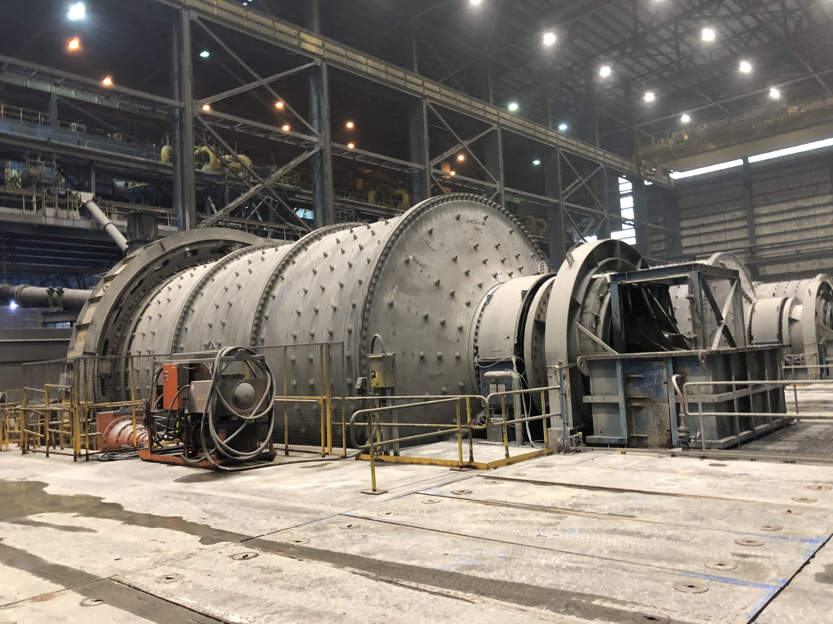
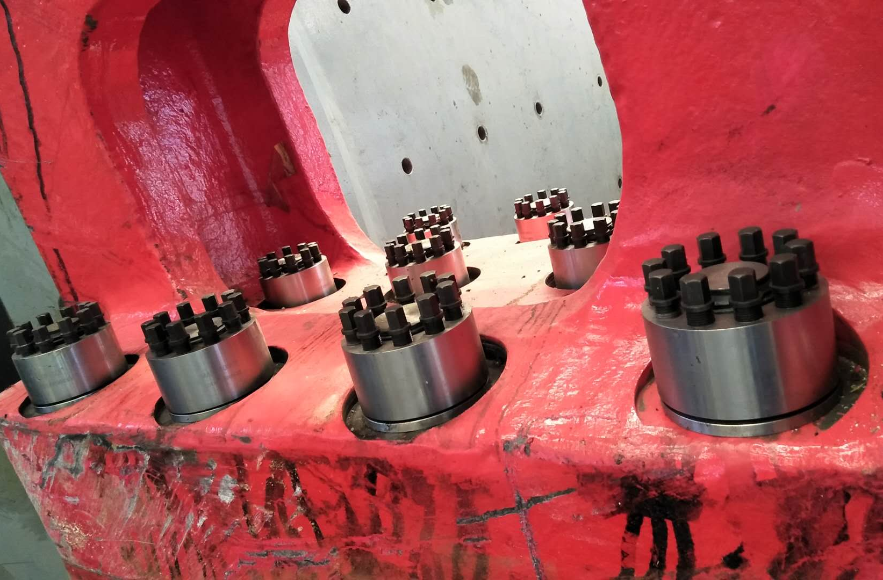
Mining and crushing application
Mining and crushing industries
Mines and quarries are filled with heavy machinery used for breaking and drilling rock. These machines are subject to the harsh conditions of extreme load and uninterrupted vibration. To supply the world's endless demand for precious metals and minerals, they need to work continuously in strongly vibrating working conditions. Regardless of the strength and durability of the machine, the smaller bolted joints often fail first. Because the first minute of downtime is costly, the mining industry cannot afford the huge practical and financial losses of the machine shutdown.
Rongbolt's super nut connection system protects all parts, including tools and important exposed joints, ensuring that your machine is never shut down due to ear wear and repair, and prevents heavy vehicles from becoming loose.
installation site:
Blasting point, ring gear, side frame, lifting motor, shaft frame tightening bolt, pull spread surface, pinion, lifting and pull drum, split gear, section gear bolt, excavator, bearing cap, etc

Slide 15
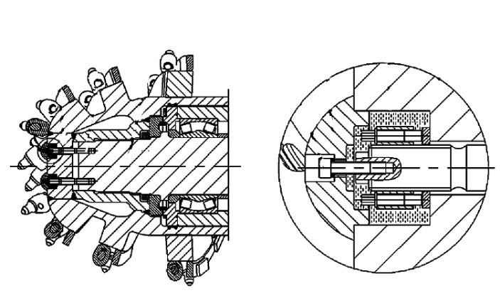
Actual case on Tunnel Boring Machine
Actual cases on the roadheader
The cutting head of the traditional high-power heavy cantilever roadheader is generally connected with the cutting shaft through 2 M30 or larger bolts. This connection mode has the following problems:
The bolt tightening torque is large (generally more than 1 900 Nm), and the bolt around the tooth seat, can not use the torque multiplier or hydraulic pull device, only through the torque wrench tightening time and effort;
It is not easy to directly tighten the two bolts through the torque wrench to generate sufficient and correct pretension force, and the bolts are easy to loosen when the roadheader cuts the rock and causes large vibration;
Every time the cutting head is removed or the loose connecting bolt is replaced once, it is necessary to directly tighten the connecting bolt once, which is easy to cause excessive wear of the thread on the cutting spindle and scrap. The super nut is a good way to solve these problems.
Wing laut Super Nut Scheme:
The main thread of the super nut is M30, the thrust screw is M8, the number is 8, the tightening torque of the screw is 36 Nm, and the pretightening force applied on the stud is 285 kN. The thrust screw shall be tightened in two times.

Slide 16
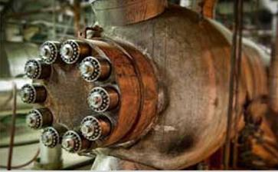
Power and generation application
Power and power generation industries
As we become more dependent on power and energy, power equipment also needs to withstand increasing pressure under extreme conditions, which means that the bolted connections have to be more reliable than ever before.
Ronglaut supernuts provide customers with a variety of quick and simple fastening solutions without frequent inspection or re-tightening. These advantages extend application life and minimize downtime, whether open or deep underground. Including wind turbines, solar panels, steam power generators, hydropower valves, radiation areas and so on.
installation site:
Including nuclear power, wind power, hydropower, thermal power and others. Turbine coupling, load bearing rod, shaft, manhole, inlet flange, boiler pump, main flange, boiler feed pump, cylinder shell, blade bolt, bucket turbine nozzle, servo piston nut, etc

Slide 17
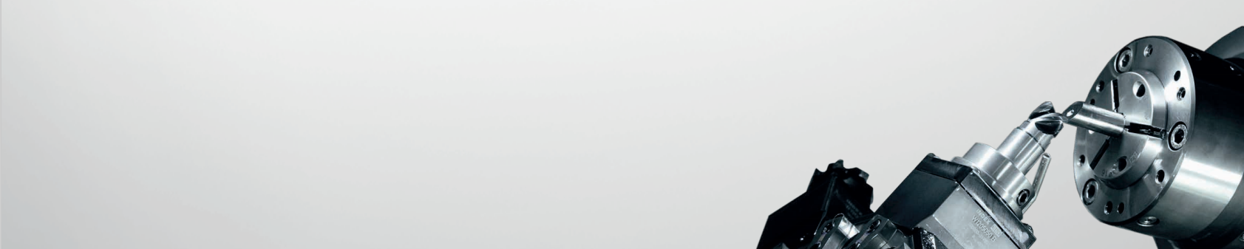
Focus on C ustomer and G row T ogether
Pay attention to customers and grow together
www.jungeblodt-kpm .com
liang.guo@kpmdrive.com.cn

