Slide 1
HD Controller
HD控制

Slide 2
Synopsis （概要）
HD control structure（HD 控制结构）
  HD parameters（HD参数） (knld, knlp, knli, kniv)
  HD parameters gains （HD参数系数）(knlusergain, lmjr, nlmaxgain)
  HD extended parameters（HD扩展参数） (1*LPF, 3*Anti-Vibration, 2*Notch)
  Flexibility Compensation
  柔性补偿
  Smooth filters/Gearing Filter
  平滑滤波 /锯齿滤波
  Acceleration Feedforward
HD Loop Tuning Sequence (HD环路调试顺序)
Tuning Issues and Solutions（调试问题点和处理方案）

Slide 3
HD Control Loop（HD控制环）
Acceleration Feedforward加速度前馈
Position command
位置指令
Position
Error
位置偏差
HD controller HD控制
PWM
Smooth \ Gear Filter
平滑/齿轮滤波
Position Loop位置环
M
+
+
Current Loop电流环
Velocity Loop速度环
Feedback
Position feedback位置反馈

Slide 4
HD Control Loop（HD控制环）
Acceleration Feedforward加速度前馈
Flexibility compensation柔性补偿
Position Loop位置环
KNLI
Acceleration command加速度指令
Current command电流指令
Current loop电流环
KNLIV
+
+
KNLUSERGAIN全局增益
NLMAXGAIN最大自适应增益
+
LMJR/MKT负载惯量比/转矩常数
LPF
NOTCH低通滤波 /NLNOTCHCENTER1/2 陷波器1/2
Position command
(after smooth filter) 位置指令（经过平滑滤波）
-
Position error
KNLP
ANTI VIBRATION ½ 抑振滤波器1/2
KNLD
ANTI VIBRATION 3
抑振滤波器 3
Velocity Loop速度环
Position feedback反馈环节

Slide 5
HD Parameters(HD参数)
KNLD 速度环微分增益
  Derivative gain, used to reduce velocity error and decreasing the response time
  微分增益，用于减小速度误差和缩短响应时间
KNLP位置环比例增益
  Proportional gain, used to reduce position error in motion
  比例增益，用于减少运动中的位置误差
  KNLIV 位置环积分-微分增益
  Derivative-Integral gain, used to reduce position error in motion and at standstill (may cause overshoot or oscillations)
  微分-积分增益，用于减少在运动和静止时的位置误差（可能引起过冲或振荡）
KNLI位置环积分增益
  Integral gain, used to reduce the position error at standstill (may cause overshoot or oscillations)
  积分增益，用于减少位置稳态误差（可能导致过冲或振荡）

Slide 6
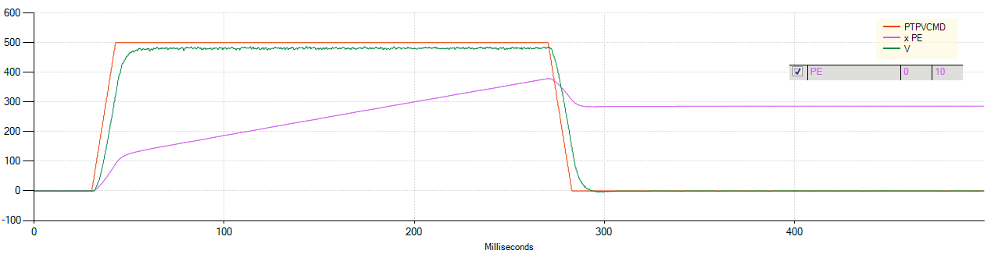
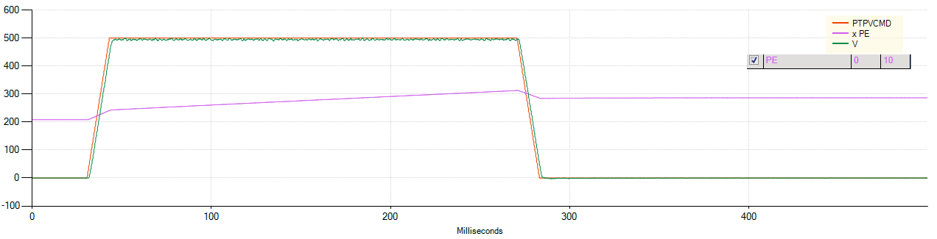
KNLD速度环微分增益
KNLD 80
KNLD 300

Slide 7
KNLD速度环微分增益
Advantage:（优点） Smaller rise time
Good tracking 更少上升时间，很好跟随性
Disadvantage:
Large position error 更大的位置偏差
KNLD 80
KNLD 300

Slide 8
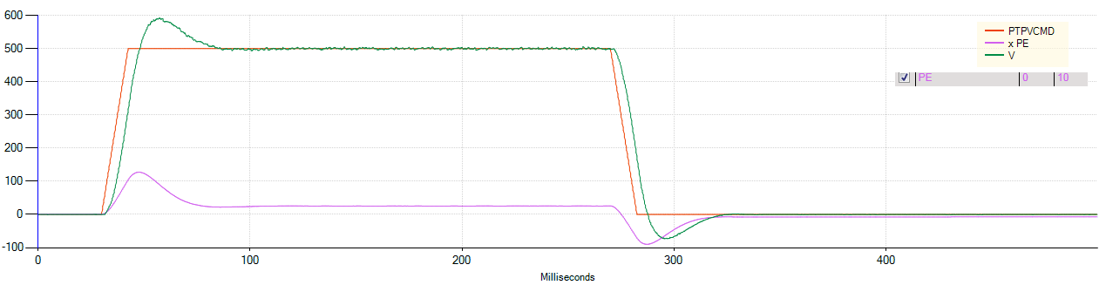
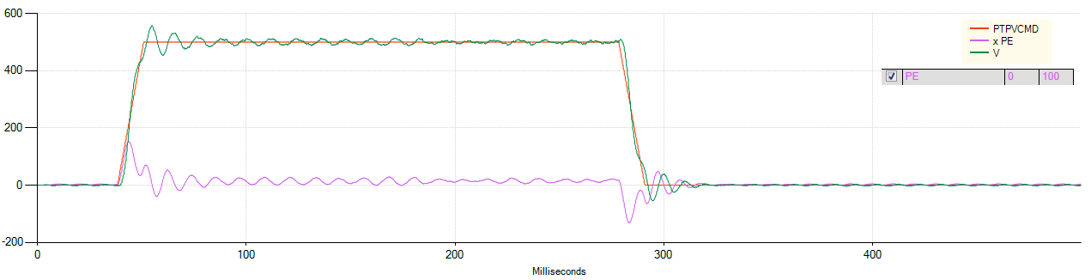
KNLP位置环比例增益
KNLP 20
KNLP 100

Slide 9
KNLP位置环比例增益
Advantage：（优点）
Position error is smaller
位置偏差更小
Disadvantage:（缺点）
Long settling time 更长整定时间
KNLP 20
KNLP 100

Slide 10
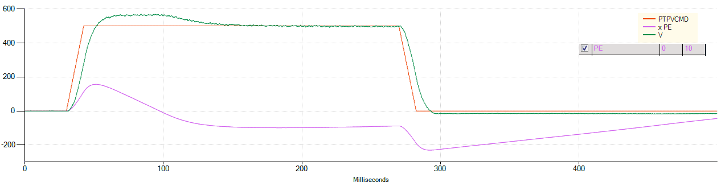
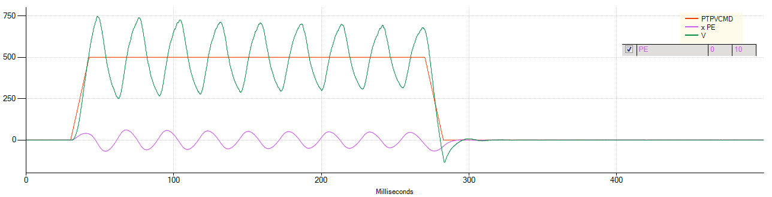
KNLIV位置环微分-积分增益
KNLIV 10
KNLIV 40

Slide 11
KNLIV位置环微分-积分增益
Advantage:（优点）
Position error is smaller
Good settling time 位置偏差更小，更好整定时间
Disadvantage:（缺点）
High value can cause Over shoot and
Oscillations太大容易导致超调及振荡
KNLIV 10
KNLIV 40

Slide 12
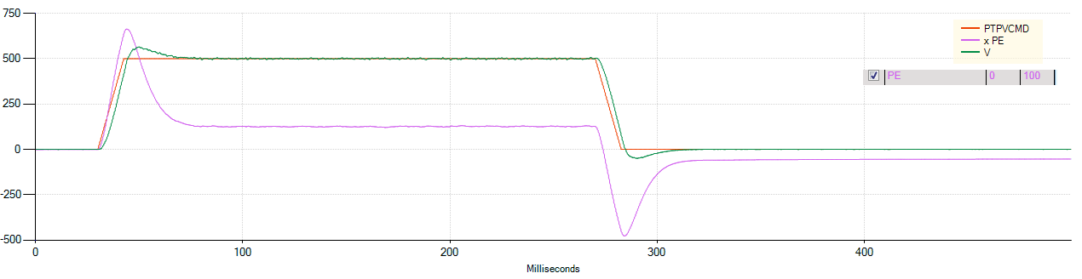
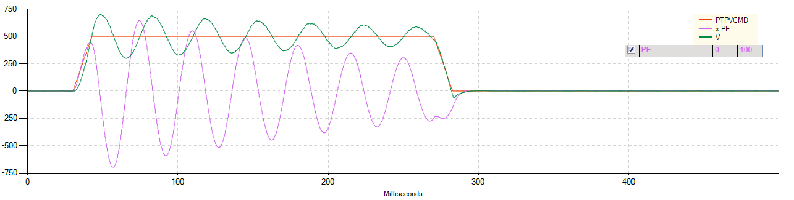
KNLI位置环积分增益
KNLI 0
KNLI 25

Slide 13
KNLI
Advantage:（优点）
Good settling time 更好的跟随性
Disadvantage:（缺点）
High value can cause Over shoot and
Oscillations 太大容易导致超调及振荡
KNLI 0
KNLI 25

Slide 14

HD Parameters Gains HD参数系数
KNLUSERGAIN自适应增益比例因子
Adaptive gain scaling factor- determines the rigidity of the control loop.
  Reducing the user gain will reduce the BW of the system (and vice versa).
  自适应增益比例因子-决定控制回路的刚性。
  降低使用增益将减少系统的带宽（反之亦然）。
LMJR负载惯量比/质量比
  The ratio between the load inertia to the motor inertia.
  It can be set by the user or determined by the load inertia estimation tool (Auto Tuning). High LMJR defines the how stiff the control of the system will be.
  负载惯性与马达惯性之比。它可以设置由用户或由负载惯性估计工具（自动调整）确定。高LMJR决定了系统控制的刚性。
LMJR = $\frac{J_{Load}}{J_{Motor}}$
Notes:
KNLUSERGAIN 自适应增益比例因子
REDUCING USER GAIN WILL REDUCE THE BW (CONTROL CAPABILITIES) OF THE SYSTEM.
INCREASING USER GAIN WILL INCREASE THE BW (CONTROL CAPABILITIES) OF THE SYSTEM.
降低使用增益将降低系统的带宽（控制能力）；增加用户增益将增加系统的带宽（控制能力）。
LMJR 负载惯量比/质量比
HIGH VALUE WILL MAKE IT HARD TO REACH STIFF CONTROL I.E. WE WILL GET A MORE FLEXIBLE OPERATION OF THE SYSTEM DUE TO LACK OF STIFF CONTROL.
IT IS VERY IMPORTANT TO SET THIS PARAMETER AS TRUE AS POSSIBLE TO THE SYSTEM DUE TO IT HIGH EFFECT ON THE CONTROL OF THE SYSTEM.
高设置值会很难控制高刚性，由于缺乏刚性控制，系统会有更灵活的操作。设置这个参数非常重要，越真实越好高效率控制系统。

Slide 15
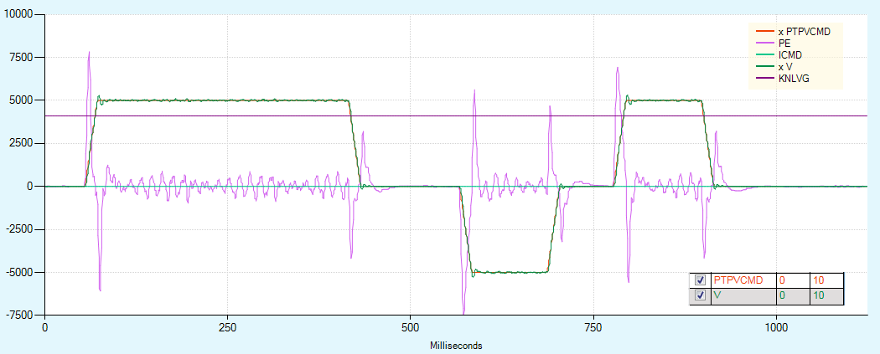
HD Parameters Gains HD参数系数
NLMAXGAIN最大自适应增益
  Variable gain that dynamically change during operation. When the position error is starting to build (during acceleration\ deceleration\ other disturbances to the system) NLMAXGAIN is activated. At steady state, target velocity reached, or at standstill target position reached, the variable gain is at its minimum value (=1) i.e. not activated. 自适应增益（在运动期间动态改变），当位置误差开始产生时（在加速/减速过程中，系统受到其影响），NLMAXGAIN被激活。在稳定状态下，目标速度达到，或在达到静止目标位置时，可变增益处于其最小值（=1）即未激活。
NLMAXGAIN 1

Slide 16
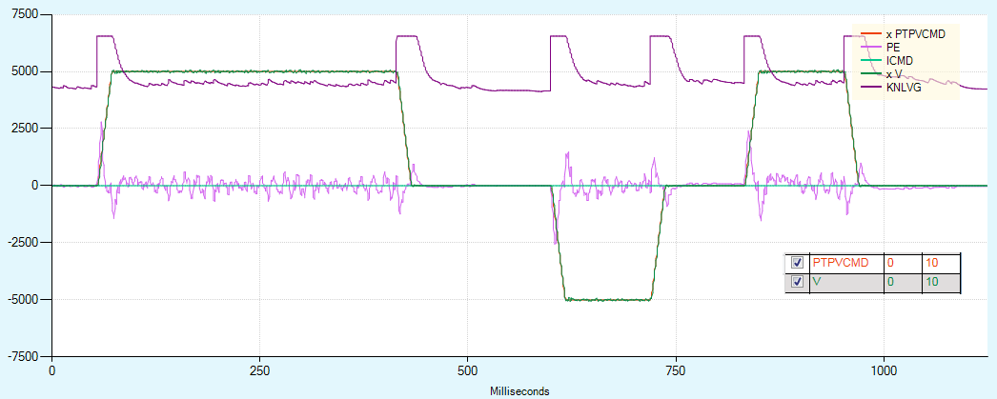
HD Parameters Gains
NLMAXGAIN
  Variable gain that dynamically change during operation. When the position error is starting to build (during acceleration\ deceleration\ other disturbances to the system) NLMAXGAIN is activated. At steady state, target velocity reached, or at standstill target position reached, the variable gain is at its minimum value (=1) i.e. not activated. 自适应增益（在运动期间动态改变），当位置误差开始产生时（在加速/减速过程中，系统受到其影响），NLMAXGAIN被激活。在稳定状态下，目标速度达到，或在达到静止目标位置时，可变增益处于其最小值（=1）即未激活。
NLMAXGAIN 1.6
NLMAXGAIN 1

Slide 17
Hands On 实操
Notes:
Short Hands on, on the DEMO units in order to get the feel on what each gain does
简要实操，在DEMO演示，以获得每个增益实际效果。

Slide 18
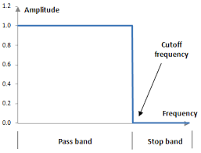
HD Extended Parameters HD扩展参数
HD loop have two types of filters:HD环有两类滤波
Low pass filter 转矩低通滤波器
A filter that passes signals with a frequency lower than a certain cutoff frequency and attenuates signals with frequencies higher than the cutoff frequency.
这种滤波器，它传递频率低于截止频率的信号，且衰减频率高于截止频率的信号。
Notch filter 陷波器
Passes most frequencies unaltered, but attenuates those in a specific range to very low levels. In the CDHD we have two types of notch filters: high frequency notch and low frequency notch(also called anti-vibration filter) 通过大多数频率不变，但衰减那些在特定范围内非常低的水平。在CDHD中，我们有两种陷波器：高频陷波器和低频陷波器（也称为抗振滤波器）。

Slide 19
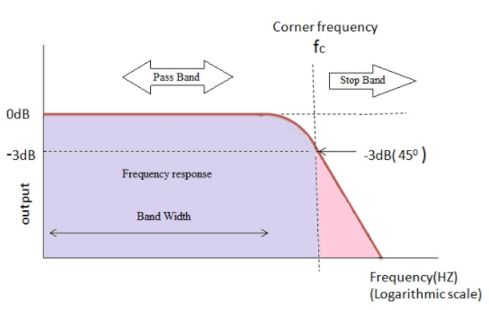
Bandwidth带宽
The low pass filter determines the BW of the system.
The bandwidth is equal to its upper cutoff frequency. The higher the Bandwidth the faster the response of the system.
低通滤波器决定了系统的带宽。
带宽等于其上限截止频率。带宽越高，系统响应速度越快。

Slide 20
Low Pass Filter低通滤波器
The following parameters define the Bandwidth of the controlled system:
下列参数定义被控系统的带宽:
NLFILTT1 [ms]
NLFILTDAMPING 阻尼
The goal is to insure a stable and quiet system that reduce the gains of high frequencies.
Setting NLFILTT1 and NLFILTDAMPING to provide the optimal BW without damaging the system performance.
其目标是确保一个稳定和静态的系统下，尽量减少高频增益。
设置NLFILTT1和NLFILTDAMPING以提供最佳的BW而不损害系统性能。
These set of parameters helps us define efficiently a second order filter to the defined BW:
这些设置参数帮助我们有效地决定了BW的二阶滤波器。
Notes:
lower bandwidth to provide high frequencies attenuation, but allow system margin
较低的带宽提供高频衰减，但允许系统裕量
In regards to the torque filter, reducing the bandwidth also reduce the gain margin and phase margin of the system. So we want it lower,,,,but still not too tight to have some margins in the system
在转矩滤波器方面，减小带宽也降低了系统的增益裕量和相位裕量。所以我们希望它更低，但是，但是仍然不能太低以保证系统中有足够的裕量
These set of parameters helps us define a specific Bandwidth with a maximum efficiency
These 2 parameters change together according to the following table:
这些参数集帮助我们以最高的效率定义特定的带宽
这两个参数根据下表一起改变：
Notice that when T1 decreases so do the damping parameter.
注意，当T1减小时，阻尼参数也会减小

Slide 21
Low Pass Filter (CDHD2- coming soon即将出品)
NLTFDESIGNMODE 低通滤波器模式
  0 → Notch defined by NLFILTT1 and NLFILTDAMPING parameters.
  0 → 滤波器由NLFILTT1 和 NLFILTDAMPING两参数定义
  1 → new design mode based NLTFBW parameter
  1 →新的设计模式将由NLTFBW参数定义
NLTFBW
  Set the low pass filter parameters NLFILTT1 and NLFILTDAMPING to set the required BW with 10% overshoot. The value you enter is the BW of the system, NLFILTT1 and NLFILTDAMPING are set internally according to the defined BW.
  设置低通滤波器参数NLFILTT1和NLFILTDAMPING由带宽超调10%才设置。您输入的值是系统的BW，NLFILTT1和NLFILTDAMPING根据定义的BW在内部设置。

Slide 22
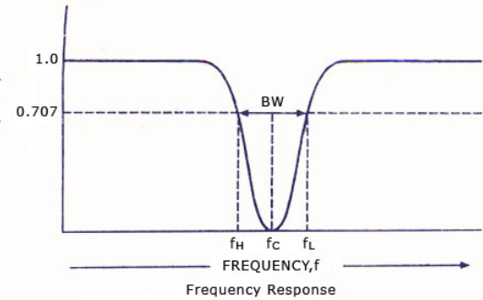
Notch Filters陷波器
NLNOTCHCENTER & NLNOTCH2CENTER
  Notch center frequency
  陷波中心频率
NLNOTCHBW & NLNOTCH2BW
  Notch bandwidth陷波带宽
  We use notch filter to block high
  frequencies which cause vibrations in the system.
  我们用陷波滤波器处理引起系统振动的频率。
  Notch filter is effective for frequencies higher than 400[Hz].
  陷波有效频率高于400[Hz]
  For low frequency vibrations, we have vibration suppression filter.
  对于低频振动，我们有抑振滤波器。
Notes:
FOR VERY HIGH FREQUENCIES YOU CAN SET THE BW TO BE VERY WIDE. FOR EXAMPLE 1200Hz NOTCH 500Hz BW
对于很高的频率，你可以将BW设置得很宽，例如1200Hz陷波500Hz BW
THE GOAL IS TO DAMP THE HIGH FREQUENCIES.
目标是抑制高频率。

Slide 23
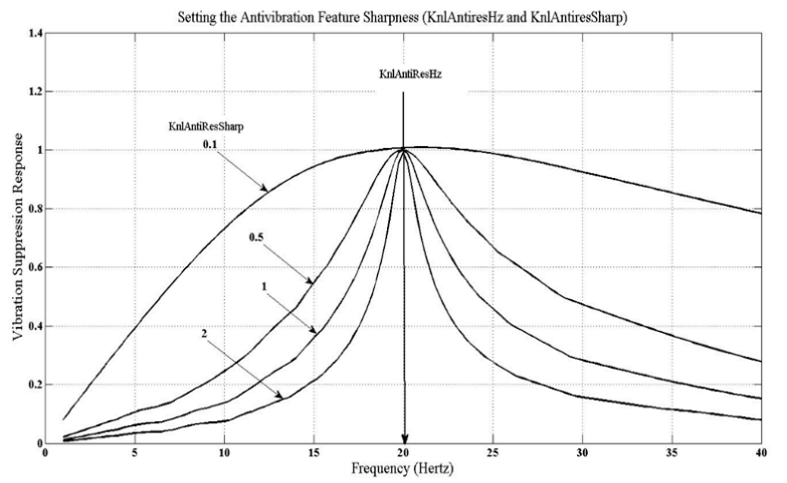
Vibration Suppression Filter抑振滤波器
NLANTIVIBHZ ; NLANTIVIBHZ2 ; NLANTIVIBHZ3
  Center Frequency 中心频率
NLANTIVIBGAIN ; NLANTIVIBGAIN2 ; NLANTIVIBGAIN3
  Gain - Increase parameter until optimal damping is achieved
  增益-增加参数直到达到最佳阻尼
NLANTIVIBSHARP ; NLANTIVIBSHARP2 ; NLANTIVIBSHARP3
Set the bandwidth sharpness (width).
设置带宽清晰度（宽度）
Notes:
DIFFERENT SCALING OF THE ANTI VIB GAIN PARAMETER BETWEEN AV 1 2 AND 3
抑振滤波器抗振增益参数的不同标度
NLANTIVIBGAIN 0-200 【HZ】
NLANTIVIBGAIN2 0-10 【HZ】
NLANTIVIBGAIN3 0-10 【HZ】
AV2 AND 3 ARE THE LATEST VERSIONS FOR AV.
抑振滤波器2/3是最新版本的。

Slide 24
Hands On
Notes:
Short Hands on, on the DEMO units in order to understand the BW effect on the gains
简要实操，在DEMO演示，以获得每个增益实际效果。

Slide 25
Flexibility Compensation
柔性补偿
The flexibility compensation reduce the vibrations induced to the load by abrupt changes in acceleration (jerk), and reduce tracking error. They also serve to minimize overshoot.
柔性补偿降低了加速度突变（冲击）对负载的振动，减少了跟踪误差。它们还起到了最小化超调的作用。
  For non- flexible systems the effect of this feature will be very minor.
At Stop 停止
During
Acceleration加速期间
Notes:
Helps to eliminates vibrations at the beginning of the motion (acceleration)
Helps reduce overshoot at the end of the motion (deceleration) how ever we will “pay” with longer settling time. It will create an undershoot thus eliminating the overshoot at the end of the motion.
有助于消除运动开始时的振动（加速度）。
帮助减少结束时的超调（减速）如何我们将“执行”更长的整定时间。在运动结束，这将减少过冲从而消除了超调。
We’ve come to realize that this feature is not as dominant 。
我们已经意识到这个特性并不那么重要

Slide 26
Flexibility Compensation
柔性补偿
NLAFFLPFHZ加减速弹簧滤波增益
  Defines a low pass filter to the calculation of the acceleration profile. NLAFFPHZ is set to three times the value of KNLD to make sure the bandwidth of the filter is sufficiently higher than the system response time.
  为加速度剖面的计算定义一个低通滤波器。将NLAFFPHZ设置为KNLD值的3倍，以确保滤波器的带宽足够高，超过系统响应时间
  NLAFFPHZ = 3 x KNLD
NLPEAFF
Reflects the natural oscillation frequency of the coupling between the motor and the load. The more flexible the system, the lower this frequency.
反映了电动机和负载间耦合的固有振荡频率。系统越灵活，这个频率就越低
How to set flexibility compensation 怎么设置柔性补偿功能
  Set NLAFFLPFHZ = 3 X KNLD 设置 NLAFFLPFHZ = 3 X KNLD
  Reduce NLPEAFF (default value = 5000Hz) until you reach the results you require. Criteria may be either settling time or position error.
  降低NLPEAFF（默认值=5000Hz)直到你达到你想要的结果。标准可以是调整时间，也可以是位置误差。
    Typically, the highest frequency value is 400Hz (for low load and flexibility). So, for heavily loaded and flexible systems the typical range will be 400Hz to 30 Hz通常，最高频率值是400赫兹（低负载和灵活性）。因此，对于重负载和灵活的系统，典型的范围将是400赫兹到30赫兹
Notes:
My system has flexibility, and overshoots at the end of the movement. How can I avoid overshoot?
Use a low value of acceleration filter NLAFFPHZ and decrease NLPEAFF. This will create an undershoot before the stop and eliminate the overshoot.
NLPEDFFRATIO
HD Acceleration/Deceleration Spring Filter Gain
0 NLPEAFF used only during acceleration.
0<n<1 NLPEAFF used during acceleration. n × NLPEAFF used during deceleration.
1 NLPEAFF used during both acceleration and deceleration.
1<n<2 NLPEAFF used during deceleration. (2-n) × NLPEAFF used during acceleration.
2 NLPEAFF used only during deceleration.
我的系统很灵活，在动作结束时过冲。我如何才能避免超调？采用低值加速滤波器NLAFFPHZ，降低NLPEAFF。这将创建一个下冲之前停止和消除超调。
NLPEDFFRATIO加减速弹簧滤波增益
0 NLPEAFF只在加速时使用：0<n<1的NLPEAFF在加速过程中使用，（2~n）×NLPEAFF用于减速。
1 NLPEAFF用于加速和减速：1<n<2的减速过程中使用的NLPEAFF，（2-n）×NLPEAFF用于加速过程。
2 在减速时使用。

Slide 27
Smooth Filter平滑滤波器
MOVESMOOTHMODE 平滑滤波器模式
  Point-to-point move smoothing mode:点到点移动平滑模式
  0→ No smoothing 0 →没有平滑
  1→ LPF smoothing [Hz] 1→ 低通滤波平滑
  2→ S-Curve smoothing [ms] 2→S型平滑
MOVESMOOTHLPFHZ
  Calculates a proportional fraction of the next position command. The lower the value is, the more effect the smoothing have. The higher the value, the least effect the smoothing have. The effect on acceleration and deceleration is not symmetrical.
  计算下一个位置命令的比例分数。数值越低，平滑效果越好。数值越高，平滑效果越小。对加速度和减速的影响是不对称的。
MOVESMOOTHAVG位置指令移动平均数
  Position Command Move Averaging Number. It has the same affect on Acceleration and Deceleration；The delay is correlate to the average window time.
  位置指令移动平均数，对加速和减速也有同样的影响；延迟与平均窗口时间相关。

Slide 28
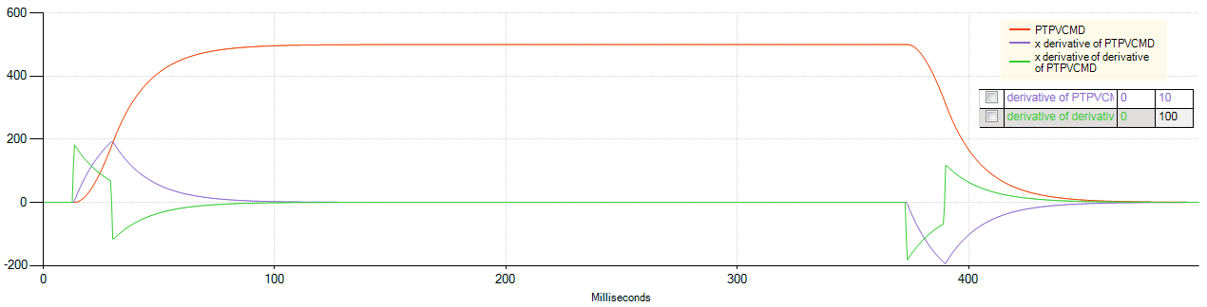
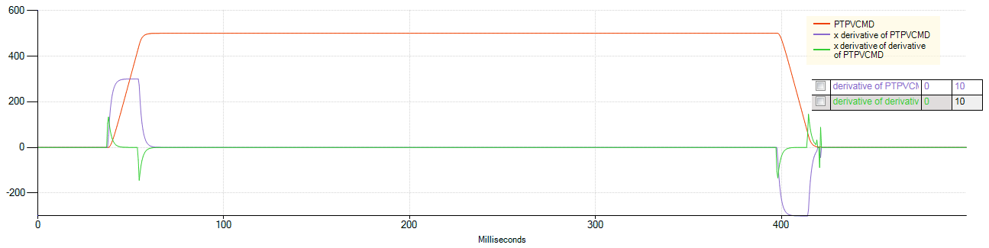
MOVESMOOTHLPFHZ
MOVESMOOTHLPFHZ 10
MOVESMOOTHLPFHZ 100

Slide 29
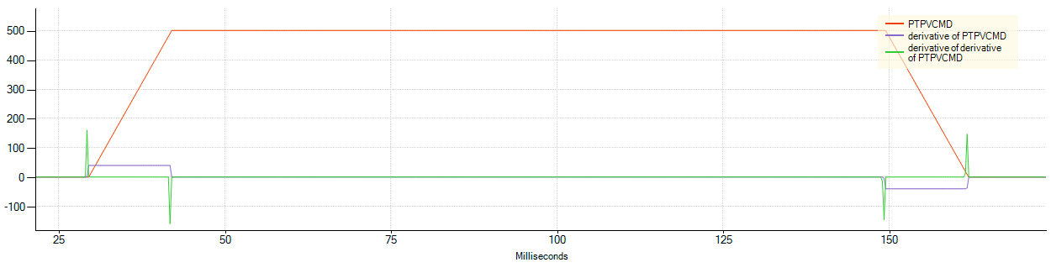
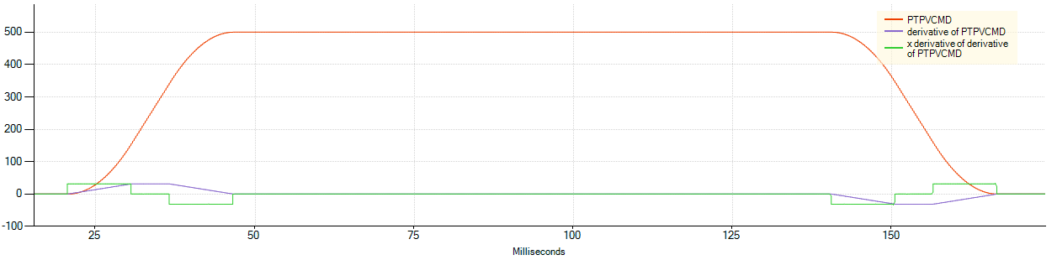
MOVESMOOTHAVG
位置指令移动平均数
No smoothing没有平滑
MOVESMOOTHAVG 16 [ms]位置指令移动平均数
Notes:
SMOOTHING ADDS DELAY TO THE SYSTEM.
平滑增加系统延迟。
LOOK AT THE PROFILE TRAJECTORY. IT IS VERY IMPORTANT THE COMMAND GIVEN BY THE CONTROLLER IS GOOD i.e. no steps, no jumps…
看看剖面轨迹。控制器发出的命令非常重要，比如即没有步骤，没有跳跃。
BEFORE ACTIVATING THE SMOOTHING CHECK THAT THE QUALITY OF PROFILE TRAJECTORY IS GOOD.
在激活平滑检查之前，轮廓轨迹的质量是好的

Slide 30
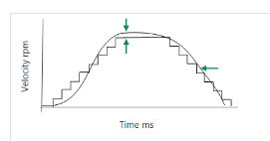
Gearing Filter锯齿滤波器
GEARFILTMODE：Gearing Filter Mode 锯齿滤波模式
0 = Gearing filter not activated. 0=锯齿滤波没有激活
1 = Gearing filter activated. For firmware version 2.0.x and higher
1=锯齿滤波激活，对于固件版本2.0.x和更高版本
2 = Gearing filter activated. For firmware versions prior to 2.0.x.
2=锯齿滤波激活，For firmware versions prior to 2.0.x.
Maintained for backward compatibility.为了向后兼容而维护。
GEARFILTT1
Maintained for backward compatibility with firmware versions priorto 2.0.x.
为与2.0.x之前的固件版本保持向后兼容。
Applicable when GEARFILTMODE=2.适用于GEARFILTMODE=2。
Gearing filter depth, in 0.25 ms quanta.齿轮传动过滤器深度， Increasing GEARFILTT1 smooths the input command PTPVCMD, butadds a delay. 在0.25毫秒的量子。增加GEARFILTT1平滑输入命令PTPVCMD，但添加延迟。
GEARFILTT1 = ~2 x input step width
GEARFILTT1=~2x输入步宽

Slide 31
HD Loop Tuning Sequence (From Scratch)
HD环调试顺序
Set high BW 设置高带宽
Define high BW according to the table provided before根据提供的表定义高的工作带宽
Increase KNLD 增加速度环微分增益
  Once the system become noisy, reduce the value of KNLD by ~20%一旦系统有噪声，降低设置值的20%
Reduce the system BW 减少系统带宽
reduce until the noise and current ripple are acceptable.直至降低噪音和电流波动被接受。
Increase KNLD增加速度环微分增益
once eliminating the high frequencies with LPF, you might be able to increase KNLD. 一旦消除了低通滤波器的高频率，你也许还能增加KNLD。
Increase KNLP增加位置环比例增益
  Once the system starts to vibrate\become noisy, reduce the value of KNLP ~20% 一旦系统开始振动\噪声变大，降低KNLP~20%的值。
Increase KNLI增加位置环积分增益
Until you reduce the settling time to the required value. If see oscillations or overshoot at the start of the motion reduce the value by ~10%直到你把整定时间减少到所需的值。如果在运动开始时看到振荡或过冲，则数值减少10 %。
Increase KNLIV增加位置环微分积分增益
In order to reduce position error as well as improve the settling time. If see oscillations or overshoot at the start of the motion reduce the value by ~10%In order to reduce position error as well as improve the settling time. If see oscillations or overshoot at the start of the motion reduce the value by ~10%
以减少定位误差，提高整定时间。如果在运动开始时看到振荡或过冲，则数值减少10 %。
Increase KNLAFRC增加加速度前馈增益
If LMJR is set correctly setting it to 100 will be ideal.如果LMJR设置正确，将它设置为100将是理想的。
Notes:
When setting torque filter look at the current, the signal should not be noisy.. If it is it will show on the velocity ripple and position error.
当设置转矩滤波器看电流时，信号不应该有杂音。如果是它，将显示在速度波动和位置误差。
IF YOU HAVE LOW\HIGH FREQ VIBRATIONS, USE ANTI-VIB \NOTCH FILTERS TO REDUCE THE FREQ.
如果你有低频/高频率振动，使用抑振/抗振降低
YOU MIGTH NEED\ BE ABLE TO MODIEFY THE LPF BETWEEN OTHER STAGES TO REACH THE REQUIRED BW (WE DON’T KNOW WHAT IT IS WE NEED TO FIND IT)
你需要能够调整其他阶段之间的LPF达到规定的重量（我们不知道）我们需要找到它的是什么)

Slide 32
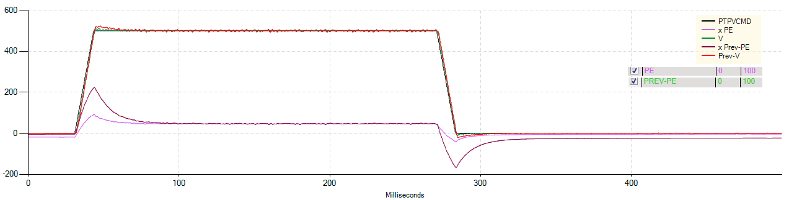
Acceleration Feedforward
KNLAFRC
  Acceleration feed-forward gain. Used to achieve minimal position error during motion. Predicts the current necessary for accelerating and decelerating, and inject it directly as a current command to the current loop. 加速度前馈增益。用于在运动过程中实现最小位置误差。预测加速和减速所需的电流，并将其作为当前命令直接注入到当前循环中。
      $τ=K_{t}∙I=J_{total}∙\frac{d^{2}θ}{dt^{2}}$ $I=\frac{J_{total}}{K_{t}}∙ Acc$
KNLAFRC 0 => KNLAFRC 200
Notes:
INCREASING IT TOO MUCH WILL CAUSE THE POSITION ERROR GRAPH TO FLIP.
过多的增加会导致位置误差图翻转。

Slide 33
Tuning Issues and Solutions 调试问题点及处理方案
Issue | Solution
Acoustical noise | Reduce BW; Reduce gains (KNLUSERGAIN)减小带宽，减小增益（全局增益）
Acoustical noise (During jerks)（噪声伴有振动） | Use MOVESMOOTH filter使用平滑滤波器
Setting time is too long（整定时间太长） | Increase KNLIV and KNLI加大位置环微分积分增益和位置环积分增益
Tracking error is too big（跟随误差太大） | Increase KNLD and KNLP加大速度环微分增益及位置环比例增益
Rising time (Response time) is too slow（上升时间太慢） | Increase KNLD加大速度环微分增益
Control loop is too soft 控制环太软 | Increase KNLUSERGAIN加大全局增益
Vibrations in specific frequency 特定频率振动 | Use anti-vibration (Low freq) or notch filter (High freq)使用抑振滤波器和高频陷波滤波器
Velocity ripple is too high速度波动太大 | Increase KNLD and KNLP加大速度环微分增益和位置环比例增益
Improve control loop stiffness提高控制环刚性 | Increase BW ; Increase KNLIV加大贷款和位置环微分积分增益

Slide 34
CONTROL MODE控制环模式
GAIN |  | POSCONTROLMODE 5
Velocity Loop速度环 | KNLD P8-00 | 16KHz
Position Loop位置环 | KNLP P8-03 | 8KHz
 | KNLI P8-01 | 8KHz
 | KNLIV P8-02 | 8KHz
Notes:
THE CONTROL LOOP SAMPLE RATE WAS INCREASED THUS ALLOWING US TO RESPOND FASTER TO DISTURBANCES AND CLOSE THE ERROR QUICKER.
增加控制回路采样率从而允许我们对指令做出更快的响应，更快地关闭错误。
WE INCREASED THE BW THUS ALLOWING US TO INCREASE THE GAIN VALUE.
我们增加带宽从而允许我们增益值。

