Slide 1
Linear Controller

Slide 2

Linear Control Loop
Current feedback
Position command
Position
error
Velocity
command
Velocity
error
Current
Command
PWM
M
+
Position Loop
+
Velocity Loop
+
Current Loop
Feedback
Velocity Feedback
$$\frac{d}{dt}$$
Position feedback

Slide 3
Outline
Linear controller structure (PDFF)
Velocity loop structure
  Velocity loop parameters: KVI, KVP, KVFR.
  Velocity loop Filters: Output and Input Filters.
  Feedforward, Bandwidth and LPF
Position control structure
  Position control parameter: KPP, KPVFR, KPAFRV.
Linear Control Loop Tuning Sequence
Questions

Slide 4
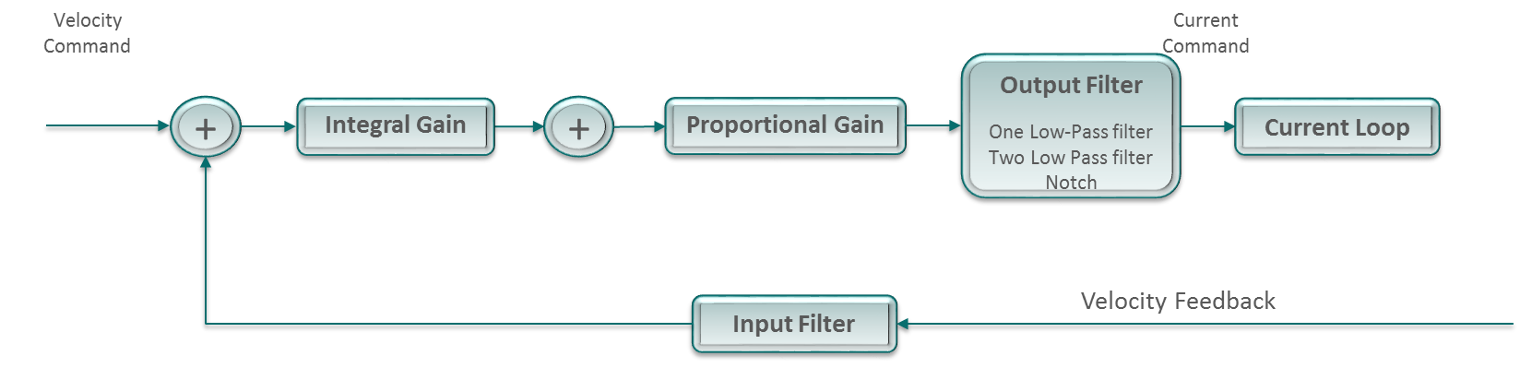
Velocity Loop - PDFF

Slide 5
Velocity Loop Parameters
Integral Gain – KVI
Closes the accumulative error. since the integrator reacts to the accumulated error it has slower dynamics and its disturbances rejection capabilities are weak.
Proportional Gain – KVP
Closes the proportional error. The proportional gain reacts immediately it is very good for disturbances rejection and increasing bandwidth.
Output Filter – VELFILTMODE\FILTHZ1\FILTHZ2
Filter on the output of the velocity loop.
Input Filter – VELFILTMODE\VELFILTFRQ
Low pass filter on the velocity feedback used to eliminate noise from the encoder and ensure a more stable controller.

Slide 6
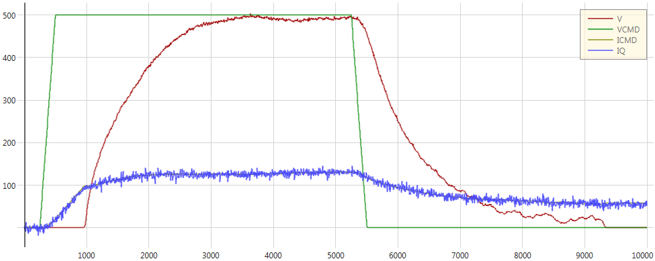

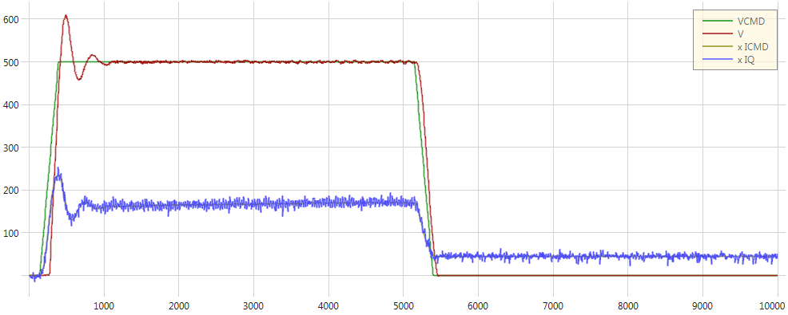
Integral Gain – KVI
KVI 2 KVP 0.01
KVI 50 KVP 0.01

Slide 7
Integral Gain – KVI
Advantage:
Closes the accumulative error, good settling time
Disadvantage:
High value may cause overshoot
KVI 2 KVP 0.01
KVI 50 KVP 0.01

Slide 8
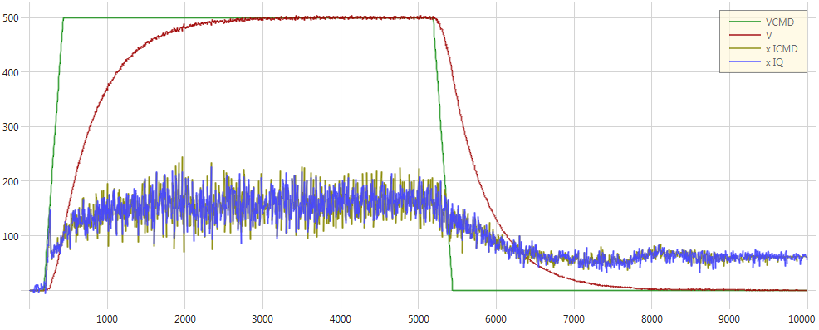
Proportional Gain – KVP
KVI 2 KVP 0.01
KVI 2 KVP 0.5

Slide 9
Proportional Gain – KVP
Advantage:
Motor response is faster
Disadvantage:
High value may cause noise
KVI 2 KVP 0.01
KVI 2 KVP 0.5

Slide 10
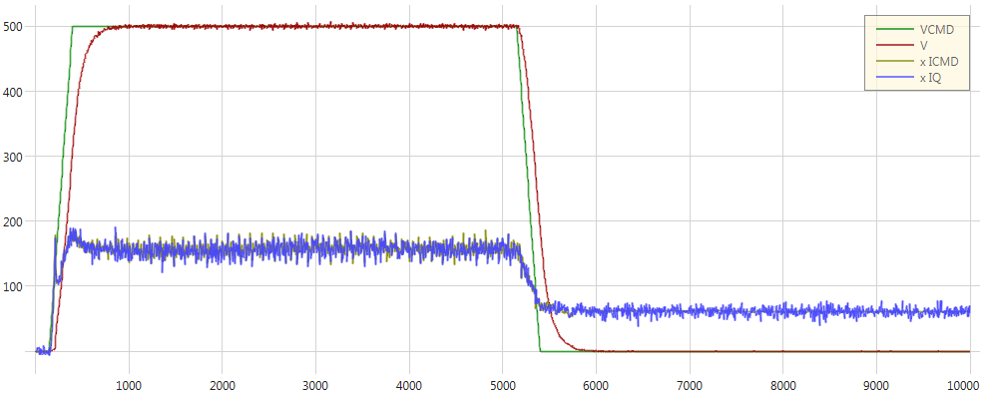
Integral and Proportional Gain
Lets combine the Integral and the Proportional gain.
KVI 50, KVP 0.01
KVI 2, KVP 0.5
KVI 10, KVP 0.3

Slide 11
Feedforward Ratio – KVFR
Why is the controller named PDFF? PDFF stands for: “Pseudo Derivative Feed Forward”.
“Pseudo”: Resembling or Imitating.
Feedforward Ratio
Current Command
Velocity Command
Output Filter
One Low-Pass filter
Two Low Pass filter
Notch
±
Integral Gain
±
Proportional Gain
Current Loop
Input Filter
Velocity Feedback
KVFR: Feedforward term determines how responsive the system will be.
KVFR range between 0 – 1.

Slide 12

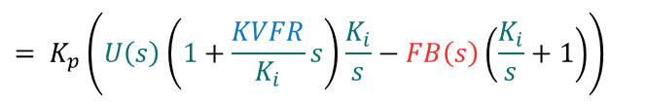








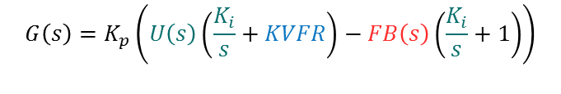
Feedforward Ratio – KVFR
$$G\left(s\right)=E\left(s\right)\frac{K_{i}}{s}K_{p}+KVFR∗U\left(s\right)K_{p}−FB(s)K_{p}$$
KVFR
$$E(s) = U(s) – FB(s)$$
Reorganize $K_{p}$ and substitute $E(s)$:
U(s)
E(s)
$$\frac{K_{i}}{s}$$
±
±
$$K_{p}$$
G(s)
$G\left(s\right)=K_{p}((U\left(s\right)– FB\left(s\right))$ $\frac{K_{i}}{s}+KVFR∗U\left(s\right)−FB\left(s\right))$
FB(S)
Reorganize for $U(s)$and $FB(s)$ :
$$G\left(s\right)=K_{p}\left(U\left(s\right)\left(\frac{K_{i}}{s}+KVFR\right)−FB\left(s\right)\left(\frac{K_{i}}{s}+1\right)\right)$$
U(S)
$$1+\frac{KVFR}{K_{i}}s$$
E(S)
$$\frac{K_{i}}{s}$$
±
±
$$K_{p}$$
G(s)
$$= K_{p}\left(U\left(s\right)\left(1+\frac{KVFR}{K_{i}}s\right)\frac{K_{i}}{s}−FB\left(s\right)\left(\frac{K_{i}}{s}+1\right)\right)$$
FB(S)

Slide 13

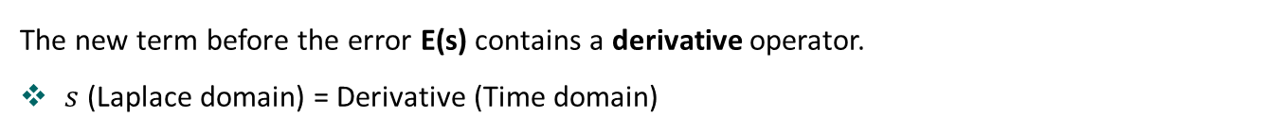


Feedforward Ratio – KVFR
The new term before the error E(s) contains a derivative operator.
$s$ (Laplace domain) = Derivative (Time domain)
U(S)
$$1+\frac{KVFR}{K_{i}}s$$
E(S)
$$\frac{K_{i}}{s}$$
±
±
$$K_{p}$$
G(s)
FB(S)
Since the input U(s) is updating according to the motion profile, the feedforward (KVFR) term will determine how responsive the system will be. It will feed the proportional controller with smaller error. Therefore, higher KVFR will results in a more responsive system.
Note: The derivative operates on the command and not on the error.

Slide 14
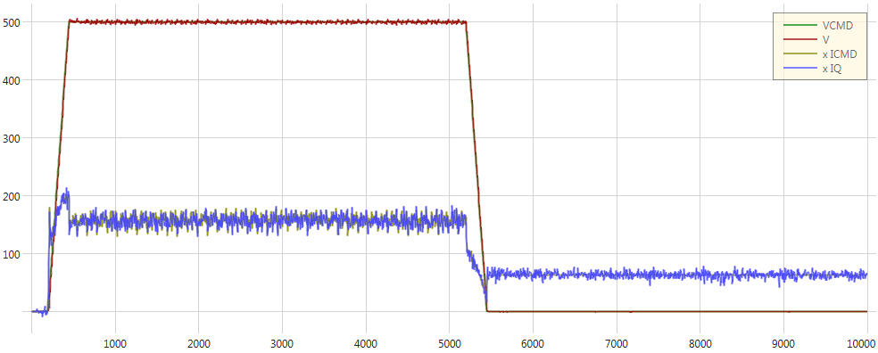
Feedforward Ratio – KVFR
KVI 10 KVP 0.3 KVFR 0
KVI 10 KVP 0.3 KVFR 1

Slide 15
Feedforward Ratio – KVFR
Advantage:
Fast response time, velocity error closes quickly
KVI 10 KVP 0.3 KVFR 0
KVI 10 KVP 0.3 KVFR 1

Slide 16
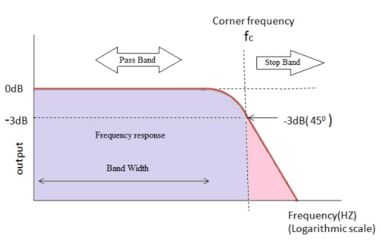
Linear Loop Filters
Low pass filter
  A filter that passes signals with a frequency lower than a certain cutoff frequency and attenuates signals with frequencies higher than the cutoff frequency.
  The low pass filter determines the bandwidth of the system. The BW is equal to its upper cutoff frequency. The higher the Bandwidth the faster the response of the system.

Slide 17
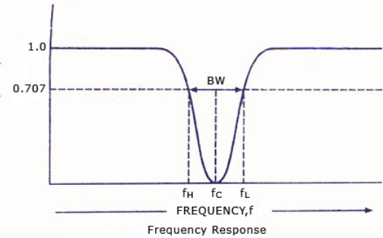
Linear Loop Filters
Notch filter
Passes most frequencies unaltered, but attenuates those in a specific range to very low levels.
We use notch filter to block high frequencies, which cause vibrations in the system.

Slide 18
Output Filter – FILTMODE\FILTHZ1\FILTHZ2
There are 3 filters available:
One Low Pass Filter
FILTMODE 1 => FILTHZ1 set as corner frequency.
Two Low Pass Filters
FILTMODE 2 => FILTHZ1 and FILTHZ2 set as corner frequencies.
Notch Filter
FILTMODE 3 => FILTHZ1 set notch frequency width and FILTHZ2 set notch center frequency.
Note: You can only activate one mode at a time

Slide 19
Input Filter – VELFILTMODE\VELFILTFRQ
Input filter parameters:
  VELFILTMODE
0 = Filter is deactivated
1 = First order filter
  VELFILTFRQ
Sets the cutoff frequency applied on the velocity feedback before applying the velocity controller

Slide 20
Feedforward, Bandwidth and LPF
Before we continue to the Position loop, lets look at the following example:
Bandwidth: Bandwidth defines the system’s capability of tracking changes in its input. In other words, it defines the maximum input frequency that the system can support. The higher the bandwidth, the more responsive you system is.
Disturbances
Set point
Error
M
+
Controller
Plant
Feedback
Noise

Slide 21
Feedforward, Bandwidth and LPF
Before we continue to the Position loop, lets look at the following example:
There are three sources which can cause error in the system:
The set point and the disturbances are errors that we want the controller to respond to and correct.
However, the noise from the feedback, usually in high frequencies, is not a real state error and therefore, we want the controller to ignore it.
Disturbances
Set point
Error
M
+
Controller
Plant
Feedback
Noise

Slide 22
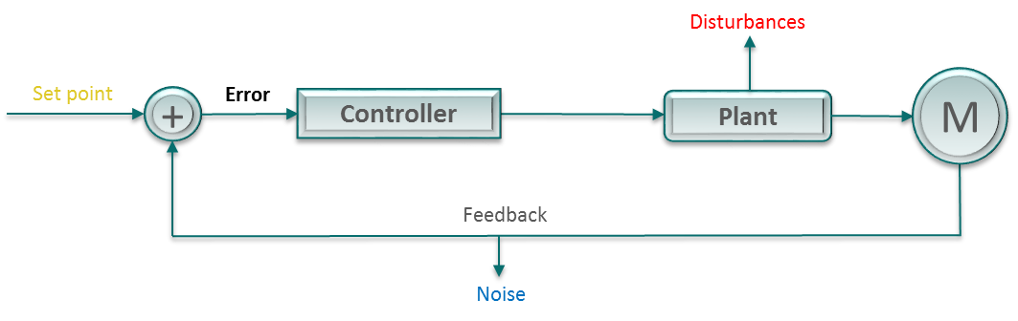
Feedforward, Bandwidth and LPF
So How do we get rid off the noise?
One solution is to reduce the bandwidth using low pass filler so that the controller would not react to the noise. i.e. cutoff frequency before the noise frequencies.
Total error
Error
Set point
Set point
Disturbances
Disturbances
Noise
Noise
Time
Frequency

Slide 23
Feedforward, Bandwidth and LPF
However, what happens if the noise overlaps with the set point disturbances frequency?
If we lower the bandwidth even more, it will not be able to follow the set point quick enough and may not respond to some disturbances.
Set point
Disturbances
Noise
Frequency

Slide 24
Feedforward, Bandwidth and LPF
Feedforward can be used to remove a lot of the set point and disturbance error before it gets to the controller. Ideally allowing to reduce the bandwidth further and eliminate the noise.
However, perfectly eliminating all noise frequencies is very difficult to achieve in real life scenario.
Set point
Disturbances
Noise
Noise
Frequency
Frequency

Slide 25
Feedforward, Bandwidth and LPF
Another solution is to use a low pass filter on the feedback (Input filter).
This will eliminate the noise from the encoder (Feedback) before it reaches the controller. This will ensure a more stable controller without decreasing the bandwidth and result in a faster controller.
Set point
Disturbances
Noise
Input Filter
Frequency

Slide 26


Position Loop - Linear
Acceleration Feedforward to Velocity Loop
$$\frac{d}{dt}$$
Velocity Feedforward
$$\frac{d}{dt}$$
Position Command
Position
Error
Velocity Command
+
Proportional Gain
+
Velocity Loop
Position feedback

Slide 27
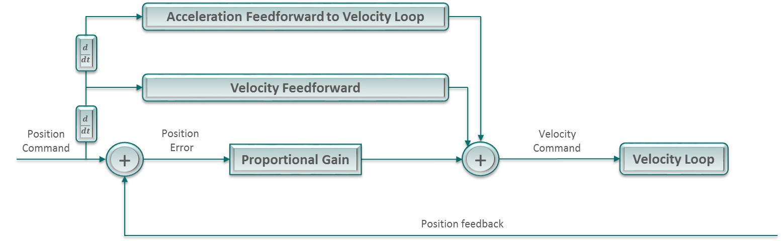
Proportional Gain – KPP
Proportional Gain – KPP
Closes the proportional error. The proportional gain reacts immediately it is very good for disturbances rejection and increasing bandwidth.

Slide 28
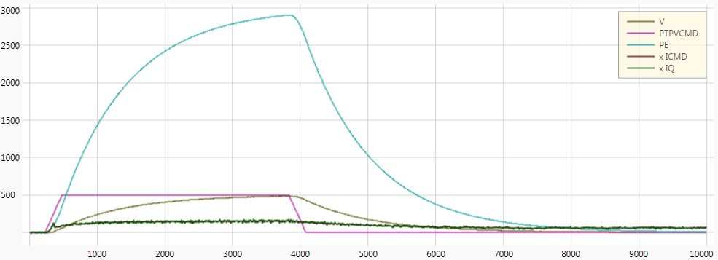
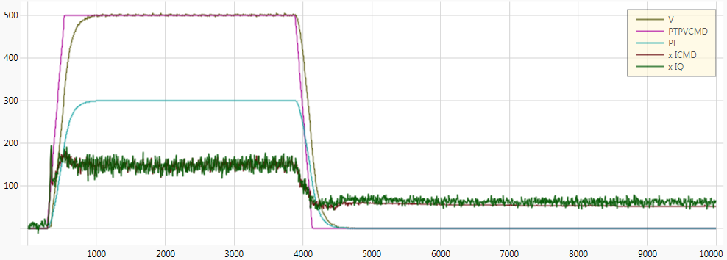
Proportional Gain – KPP
KVI 10 KVP 0.4 KVFR 1 KPP 1 KPVFR 0 KPAFRV 0
KVI 10 KVP 0.4 KVFR 1 KPP 10 KPVFR 0 KPAFRV 0
Notes:
PE units [deg]

Slide 29
Proportional Gain – KPP
Advantage:
Motor response is faster, PE is reduced
Disadvantage:
High value may cause noise
KVI 10 KVP 0.4 KVFR 1 KPP 1 KPVFR 0 KPAFRC 0 KPAFRV 0
KVI 10 KVP 0.4 KVFR 1 KPP 10 KPVFR 0 KPAFRV 0
Notes:
PE units [deg]

Slide 30
Position loop Feedforward
Velocity Feedforward – KPVFR
Predicts the velocity necessary to reach the position command, and inject it directly to the velocity loop as an addition to the velocity command.
Acceleration Feedforward to Velocity Loop – KPAFRV
Predicts the velocity necessary to reach the position command, and inject it directly to the velocity loop as an addition to the velocity command operational at acceleration and deceleration.
*KVFR is a factor in KPAFRV equations. If KVFR = 1 => KPAFRV will have no effect on the performance
Notes:
PE units [deg]

Slide 31
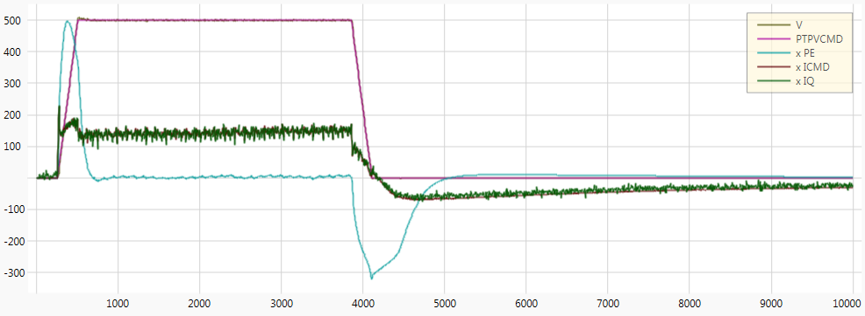

Velocity Feedforward – KPVFR
KVI 10 KVP 0.4 KVFR 1 KPP 10 KPVFR 0 KPAFRV 0
KVI 10 KVP 0.4 KVFR 1 KPP 10 KPVFR 1 KPAFRV 0
Notes:
PE units [deg]

Slide 32
Velocity Feedforward – KPVFR
Advantage:
Motor response is faster, PE is reduced
KVI 10 KVP 0.4 KVFR 1 KPP 10 KPVFR 0 KPAFRC 0 KPAFRV 0
KVI 10 KVP 0.4 KVFR 1 KPP 10 KPVFR 1 KPAFRV 0
Notes:
PE units [deg]

Slide 33
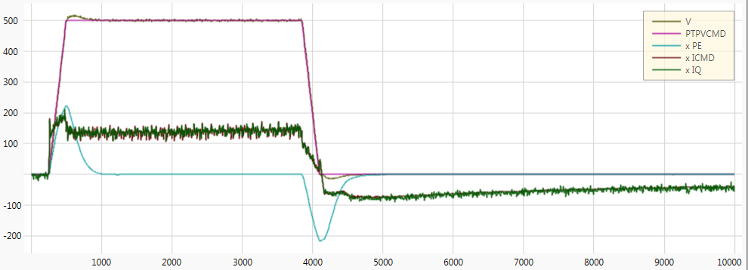

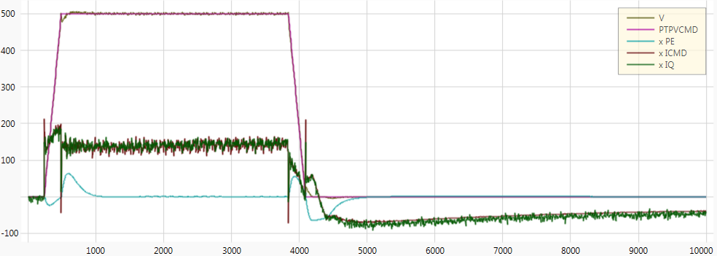
Acceleration Feedforward to Velocity Loop – KPAFRV
KVI 10 KVP 0.4 KVFR 0.8 KPP 10 KPVFR 1 KPAFRV 0
KVI 10 KVP 0.4 KVFR 0.8 KPP 10 KPVFR 1 KPAFRV 1
Notes:
PE units [deg]
KVFR is considered in KPAFRV equations. If KVFR = 1 => KPAFRV will have no effect on the tuning.

Slide 34
Acceleration Feedforward to Velocity Loop – KPAFRV
Advantage:
Reduce position error
KVI 10 KVP 0.4 KVFR 0.8 KPP 10 KPVFR 1 KPAFRV 0 KPAFRC 0
KVI 10 KVP 0.4 KVFR 0.8 KPP 10 KPVFR 1 KPAFRV 1
Notes:
PE units [deg]
KVFR is considered in KPAFRV equations. If KVFR = 1 => KPAFRV will have no effect on the tuning.

Slide 35
Linear Control Loop Tuning Sequence
Velocity loop (OPMODE 0)
  Set high BW: Normally use 2 LPF set to 1000Hz and 2000Hz.
  Set KVFR to 1
  Increase KVP: Once the system become noisy, reduce the value by roughly 20%.
  Increase KVI
    Until the steady state error is closed and the requested settling time has been reached.
    Once you see overshoot or the current is noisy reduce the value by roughly 20%.
  Reduce the system BW: Reduce the values of the 2 LPF.
Position loop (OPMODE 8)
  Increase KPP: Once the system becomes noisy, reduce the value by roughly 20%.
  Set KPVFR to 1
  If PE requirements were not met, reduce KVFR <10% and increase KPAFRV.
Notes:
Demo unit:
2 LPF 1000 2000
KVFR 1
KVP 0.5 (kvp 1 noise)
KVI 80 (kvi 300 noise)
2 LPF 500 400
KPP 10
KPVFR 1
No need to use KPAFRV on the demo unit ☺

Slide 36
Questions
Jaxson Wang
Whether there is a certain relation between the velocity proportional gain and the velocity integral gain to avoid the system vibration?
The answer is that isn’t a straight forward relationship between the gains. Every system may results is a different pair of values and combinations.
Whether there is also a certain relationship between the position proportional gain and the velocity proportional gain.
There isn’t a relationship between position and velocity proportional gains. However, There is a relationship between the position proportional gain and the velocity integral gain.
since velocity is the derivative of position, a proportional gain for velocity loop is equivalent to a derivative gain for the position loop and the integral gain in velocity loop is similar to proportional gain in position. This is called “Gain equivalencies”.
In other words: Adding proportional gain to the position loop will be equivalent to adding an integrator on the velocity loop.
Notes:
Demo unit:
2 LPF 1000 2000
KVFR 1
KVP 0.5 (kvp 1 noise)
KVI 80 (kvi 300 noise)
2 LPF 500 400
KPP 10
KPVFR 1
No need to use KPAFRV on the demo unit ☺

Slide 37
Questions
Steve Mao
When tuning PDFF controller for velocity, can we enable LPF filters and notch filters together? FILTMODE 1 and 2 are both only LPF filters, and FILTMODE 3 and 7 are both only notch filters.
On the drives CDHD1/2 you cannot apply Low pass filter and notch filter simultaneously.
Notes:
Demo unit:
2 LPF 1000 2000
KVFR 1
KVP 0.5 (kvp 1 noise)
KVI 80 (kvi 300 noise)
2 LPF 500 400
KPP 10
KPVFR 1
No need to use KPAFRV on the demo unit ☺

Slide 38
Questions
Questions?
Notes:
Demo unit:
2 LPF 1000 2000
KVFR 1
KVP 0.5 (kvp 1 noise)
KVI 80 (kvi 300 noise)
2 LPF 500 400
KPP 10
KPVFR 1
No need to use KPAFRV on the demo unit ☺

