Slide 1
HDM Controller

Slide 2
HDM Control
HDM controller
Designed at frequency domain and based on the Machine model.
Machine model is created by plant identification.
在频域设计，基于电机模型。电机模型由设备测定建立。
  HDM is used for:
    Flexible machines like robotics
    诸如工业机器人柔性设备
    Multi-resonance machines like material tooling, CNC etc.
    材料加工、数控等多共振机床

Slide 3
Synopsis要点
Identification测定
  Machine model 机器模型
  Manual process 手动调试
Bode Plot波特图
  Machine model机器模型
  Gain and Phase Margin
  增益裕量/相位裕量
Nichols Chart尼科尔斯图
  Gain and Phase Margin
  增益裕量/相位裕量
  Stability Point
  稳定点
CDHD Design capabilities
CDHD设计能力
Velocity Loop structure
速度环结构
HDM Tool HDM 工具
  Velocity Loop速度环
  Position Loop位置环
  NOTCH in VFI陷波器
Examples案例
  Design Example #1
  Design Example #2
  设计案例#1
  设计案例#2

Slide 4
Identification – Machine model
The identification is done by injecting a disturbance signal in various frequencies within a certain range.
测定是通过在一定范围内注入不同频率的转矩指令来完成的
Once we identify the plant of the system we know where the resonances of the system are.
一旦我们识别出系统的设备，我们就知道系统的共振在哪里。
Having found the plant of the system we are now able to design a controller to the system without waking up the system’s resonances.
在找到了系统的设备之后，我们现在可以设计一个控制器来控制系统，而不会发生系统的共振。
Notes:
First we need to identify the machine model (plant) of the system we are working on.
The signal is similar to white noise.

Slide 5
Identification – Manual Process
Before we start with the identification process, make the following preparations: 在开始识别过程之前，请做好以下准备工作：
  1.Emergency stop is working properly – this is very important due to weak controller and high current injection while identification is running.
  紧急停止工作正常-这是非常重要的，因为在识别运行时控制器很弱，注入电流很大。
  2.Set velocity and position control loops to linear loop (POSCONTROLMODE 0, VELCONTROLMODE 1).
  将速度和位置控制回路设置为线性回路（poscontrolMode 0，velcontrolMode 1）。
  3.Remove all feedforwards, filters\notch (KPVFR, KPAFRV, KPAFRC, KVFR = 0, FILTMODE = 0).
  3.移除所有前馈、滤波器\陷波器（kpvfr、kpafrv、kpafrc、kvfr=0、filtmode=0）。
  4.Carefully Reduce position and velocity gains as much as possible (KPP, KVI, KVP).
  4.尽可能地降低位置和速度增益（kpp、kvi、kvp）。
  5.Set acceleration, velocity and position units to the following: rpm/s ; mm/s^2 (UNITSROTACC ; UNITSLINACC = 1), rpm ; mm/s (UNITSROTVEL ; UNITSLINVEL = 1), counts (UNITSROTPOS ; UNITSLINPOS = 1).
  5.将加速度、速度和位置单位设置为：rpm/s；mm/s^2（unitsrotac；unitslinacc=1）、rpm；mm/s（unitsrotvel；unitslinvel=1）、计数（unitsrotpos；unitslinpos=1）。
  6.Enable the drive and make sure the controller is strong enough so the axis is held in position. Try small moves to verify the axis is responsive.
  6.启动驱动器并确保控制器足够坚固，使轴保持在适当位置。尝试小动作以验证轴是否响应。
Notes:
The idea is to reduce the control low enough to hold the axis but not resist the disturbance injected.

Slide 6
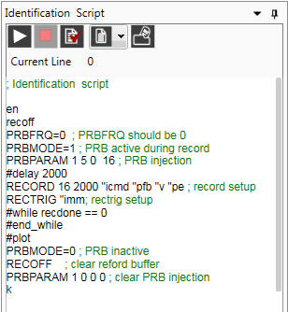
Identification – Manual Process
Identification is done for configuration in which the system is most stable and unstable:
对系统最稳定和最不稳定的配置进行识别：
  1.System at minimum inertia (axis 1 of PUMA when the robot is perpendicular to the floor and has no load on).
  系统处于最小惯性（当机器人垂直于地面且没有负载时，如Puma的轴1）。
  2.System at maximum inertia (axis 1 of PUMA when the robot is horizontal to the floor and has maximum load on).
  2.系统处于最大惯性（当机器人水平于地面且负载最大时，Puma的轴1）。
  3.Cover full path of the application at min and max load (close to motor, away from motor, middle of the path).
  以最小和最大负载覆盖整个应用程序路径（靠近电机，远离电机，路径中间）。
  4.Other weak spots that might add information to the machine model
4.可能增加机器型号信息的其他弱点
For each system configuration you determined run the following identification script:
对于您确定的每个系统配置，运行以下标识脚本：
PRBPARAM 1 5 0 16 => injection current of 5A with sampling gap of 16
PRBPARAM 1 5 0 16 =>注入电流为5A，采样间隔为16
We run identification with current of 0.5-0.75 of MICONT
我们用持续电流0.5-0.75的电流进行识别
For each current value we use the following sampling values – 4, then 8, 16, 32, 64
对于每个当前值，我们使用以下采样值–4，然后是8、16、32、64
Note – in higher sampling value the actual current injection increased…It might be required when
  moving to higher sampling rate to decrease the current.
  注：在较高的采样值中，实际电流注入增加……可能需要移到较高的采样率以减小电流。
Notes:
If axis Y is charring axis X => different location of axis X will effect axis Y performance.

Slide 7
Identification – Manual Process
You only 2 lines of parameters you need to change is “PRBPARAM” and “RECORD”:
您只需要更改两行参数：“prbparam”和“record”：
PRBPARAM 1 2 0 4
Current Injection – start with 0.5*MICONT to 0.75MICONT
电流注入-从0.5*micont到0.75 micont开始
Sampling value: 采样值
  Gap 2 provides information ➔ 8 KHz
  Gap 4 provides information ➔ 4 KHz
  Gap 8 provides information ➔ 2 KHz
  Gap 16 provides information ➔ 1 KHz
  Gap 32 provides information ➔ 0.5 KHz
  Gap 64 provides information ➔ 0.25 KHz
Sampling value should be changed both in PRBPARAM last field and in RECORD first field:
应在prbparam last字段和record first字段中更改采样值
    PRBPARAM 1 5 0 16
    RECORD 16 2000 "icmd "pfb "v "pe
Signal Type=1,PRB Noise
Current injection
Velocity Injection=0 (Not used)
Sampling Value

Slide 8
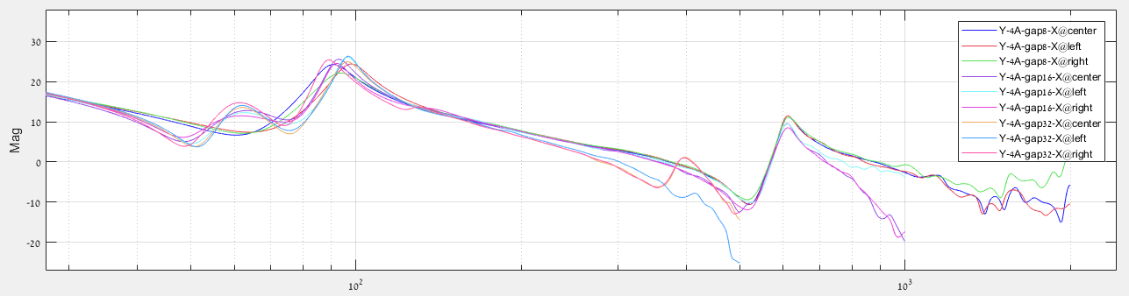
Identification – Manual Process
After we are done with the identification process, we go to the ToolBox and upload the records. We need to filter from all the records the most informative records.
完成测定过程后，我们将转到ToolBox并上载记录。我们需要从所有记录中筛选出信息量最大的记录。
How do we do it?
Notes:
With this system axis X was mounted on axis Y.
That is why the identifications of axis Y were done not only with relation to axis Y location but also to axis X location on top of axis Y.

Slide 9
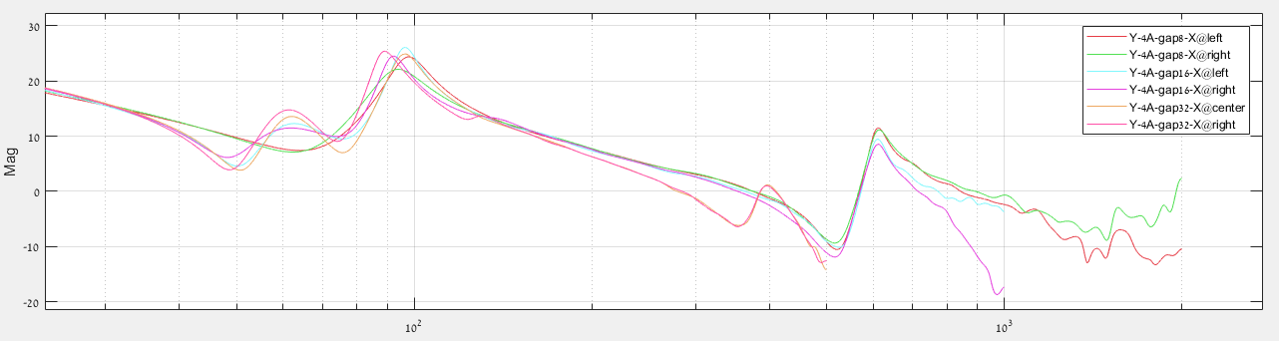
Identification – Manual Process
We removed 3 graphs:
  Y-4A-gap8-X@center
  Y-4A-gap16-X@center
  Y-4A-gap32-X@left
These graphs didn’t provide important information that we don’t get from the other graphs:
这些图表没有提供我们，我们无法获得的重要信息

Slide 10
BODE Plot波特图
The Bode plot Consists of a magnitude plot (dB) and a phase plot vs. the frequency presented in logarithmic scale.
波德图由一个幅度图（db）和一个相位图与以对数尺度表示的频率组成。
Using Bode Plot we can analyze the system’s parameters:
使用波特图，我们可以分析系统参数：
  Gain Margin 增益裕量
  Phase margin 相位裕量
  Bandwidth (BW) 带宽
The System’s transfer function is created using the identification process.
系统的传递函数是使用测定过程创建的。

Slide 11
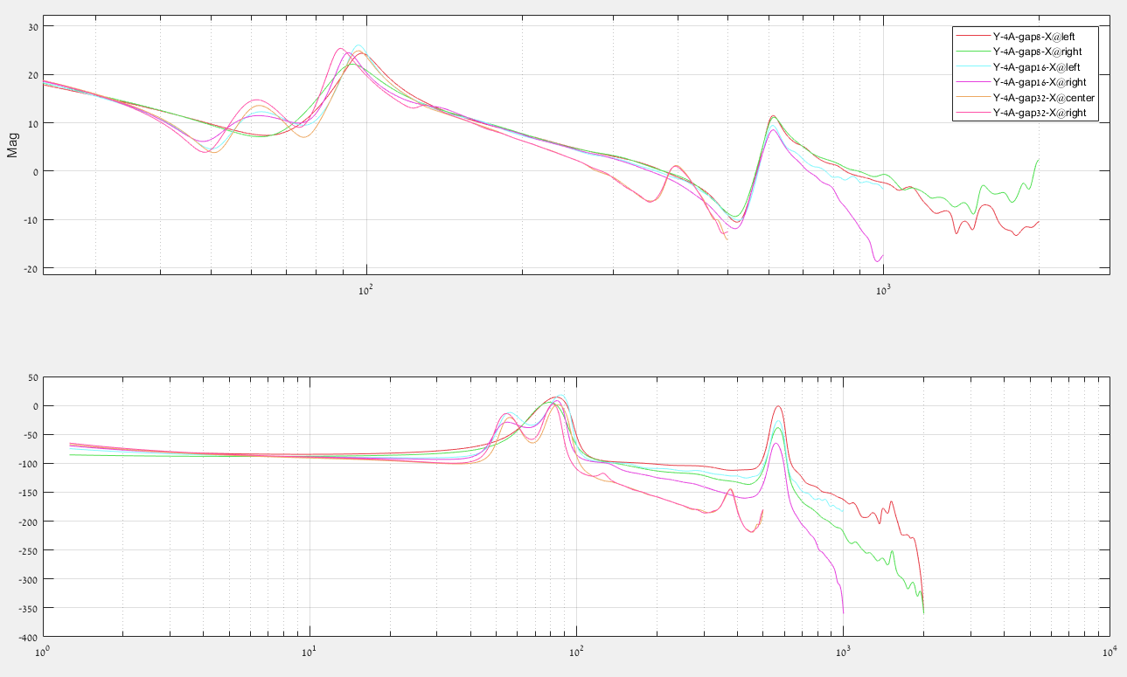
Bode Plot – Machine Model
Identification
HNC – Dingtai (PRHD2)
CNC machine axis Y

Slide 12
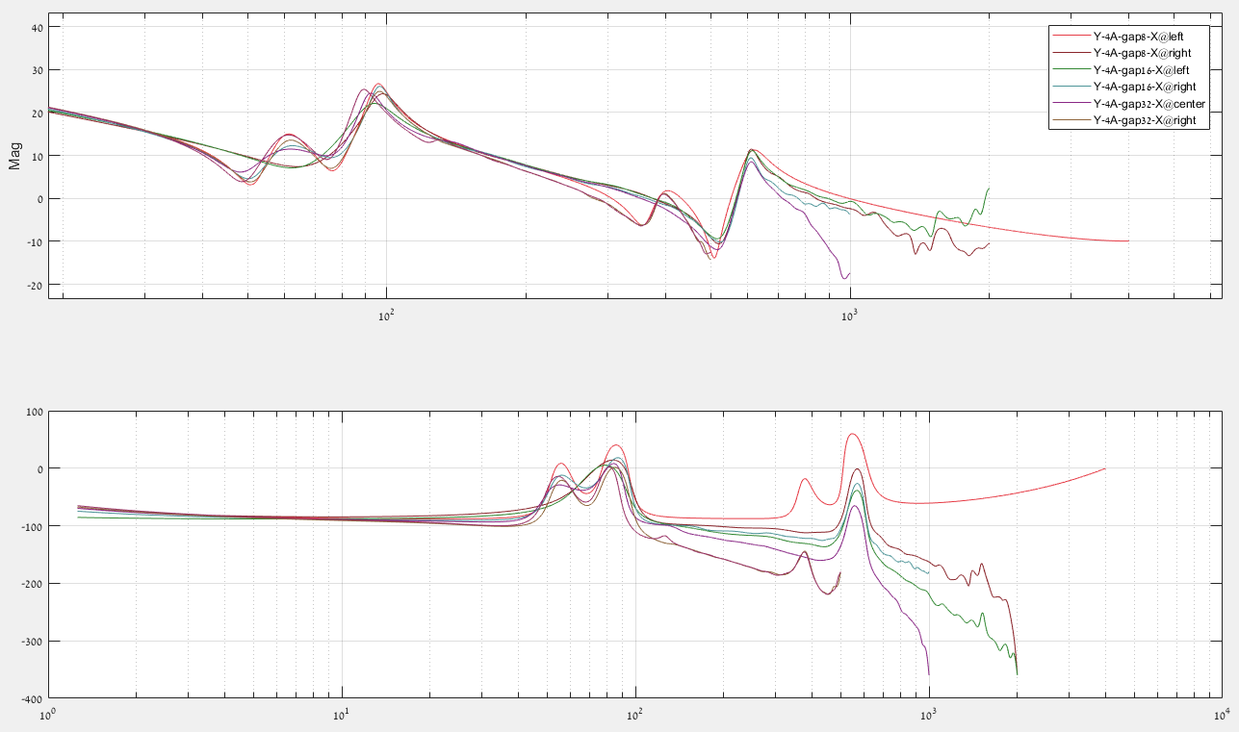
Bode Plot – Machine Model
Machine model
电机模型
HNC – Dingtai (PRHD2)
CNC machine axis Y
Notes:
Red Line is the fit.
We try to cover all the anti-resonance and resonance pairs… sometimes it is not possible so we create 2 fits.
Gain Margin
Find the freq where Phase = -180deg
Find the Gain at that freq = G
Gain Margin = 0 – G [dB]
Phase Margin
The freq where the Gain = 0dB
Find the Phase at that freq = P
Phase Margin = +P + 180deg

Slide 13
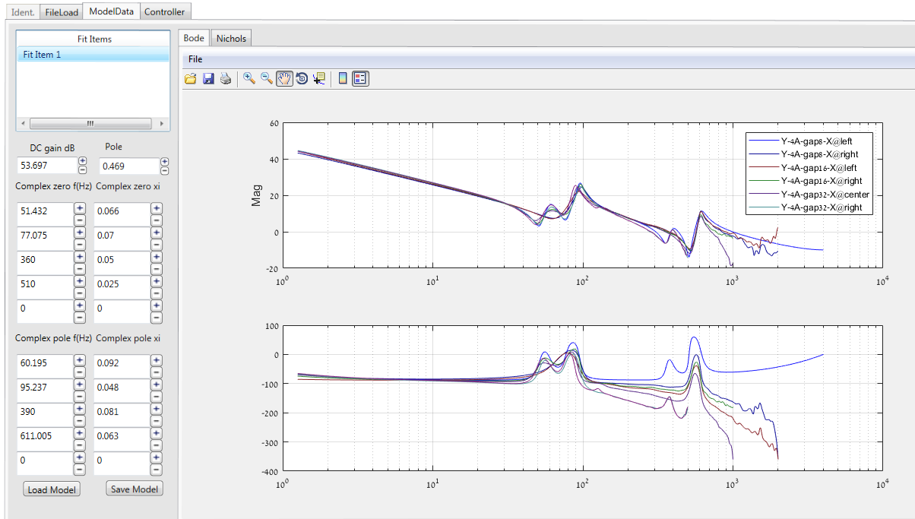
Bode Plot – Machine Model
Zero = Valley
Pole = Peak

Slide 14
Bode Plot – Gain and Phase Margin
波特图-增益和相位裕量
Gain Margin增益裕量 | Phase Margin相位裕量
Find the frequency where Phase = -180deg Find the Gain at that frequency = G Gain Margin = 0 – G [dB] 查找相位=-180度的频率 找到该频率下的增益=g 增益裕度=0–g[db] | The frequency where the Gain = 0dB Find the Phase at that frequency = P Phase Margin = +P + 180deg 增益=0dB的频率 在该频率下求相位=p 相位裕度=+P+180度
Let’s look at Y-4A-gap8-X@left
Gain Margin | Phase Margin
Frequency where the phase is -180deg = 1133Hz The gain at that frequency = -3.3dB Gain Margin = 0 – (–3.3) = 3.3dB 相位为-180度时的频率=1133 赫兹该频率下的增益=-3.3db 增益裕度=0–（–3.3）=3.3db | Frequency where the gain is 0dB = 375Hz The phase at that frequency = -112deg Phase Margin = -112 + 180 = 68deg 增益为0db=375Hz 该频率下的相位=-112度 相位裕度=-112+180=68度
Notes:
We try to cover all the anti-resonance and resonance pairs… sometimes it is not possible so we create 2 fits.

Slide 15
Nichols Chart尼科尔斯图
HDM Controller is designed at the frequency domain using the Nichols plot.
HDM控制器采用尼科尔斯图在频域进行设计。
Nichols Plot describes in one graph the frequency response of the Plant transfer function and the controller.
尼科尔斯图在一张图中描述了设备传递函数和控制器的频率响应。
Using the open loop (Plant + Controller) we can see on the Nichols chart Phase and Gain Margin, stability and the close loop BW.
使用开环（设备+控制器），我们可以在nichols图上看到相位和增益裕度、稳定性和闭环BW。
Notes:
The close loop depends on the open loop.
Open loop = C(s)*P(s)
Close loop = C(s)*P(s) / [1 + C(s)*P(s)]
Nichols shows the open loop but it’s also gives an understanding on the stability of the close loop.
Equal gain and phase lines.

Slide 16
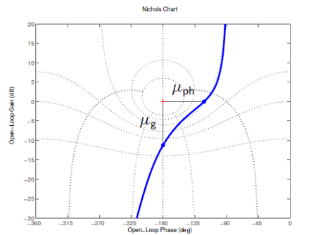
Nichols Chart – Gain and Phase Margin
Gain and Phase margin are easily calculable from Nichols chart:
增益和相位裕度很容易从尼科尔斯图表中计算出来：
Nichols chart for a stable system will
Pass to the right and below the stability
point.
稳定系统的尼科尔斯图在稳定性的右边和下方传球点。
$μ_{ph}−is the horizontal distance from the critical point$
$$μ_{g}−is the vertical distance from the critical point$$
Stability Point Open loop
should pass right to this point
稳定点开环应该通过这里

Slide 17
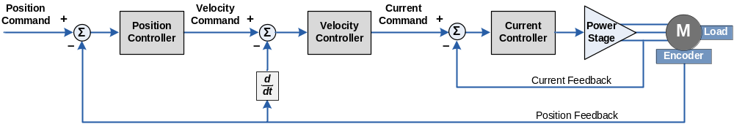
CDHD Design capabilities
In the CDHD drive we are capable to provide solution for:
在CDHD驱动器中，我们能够提供以下解决方案：
  High BW for a CNC machine with many resonance.
  Low BW for robotics with low frequency resonance.
  高BW，适用于多共振的数控机床。
  低BW，适用低频共振机器人。
FF

Slide 18

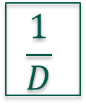
Velocity Loop structure
FF
KPAFRC – AFF to current
KPAFRV – AFF to velocity
KPVFR – VFF
VFI
R
$$\frac{1}{D}$$
Current
Controller
Vcmd
Icmd
H
Filter
Feedback
VELFILT
Notes:
VFI and R are filters on the output of the position loop.
We can put notch in the VFI or in the velocity loop (D and H).
This info is important when designing a control loop for robots.

Slide 19
HDM Tool HDM工具
Choose the control loop you want to work with
  I choose PDFF
  选择要使用的控制循环，我选择PDFF。
Set VLIM and DIPEAK as well as VELFILTFRQ
设置vlim和dipeak以及velfiltfrq
3.Raise KVP, KVI and KVFR while maintaining gain and phase margin.
在保持增益和相位裕度的同时，提高kVp、kVi和kVfr。
4.Set LPF and Notch (in velocity loop or in VFI)
设置LPF和陷波器（在速度回路或VFI中）
5.Raise KPP, KPVFR and KPAFRV
提高KPP,KPVFR和KPAFRV

Slide 20
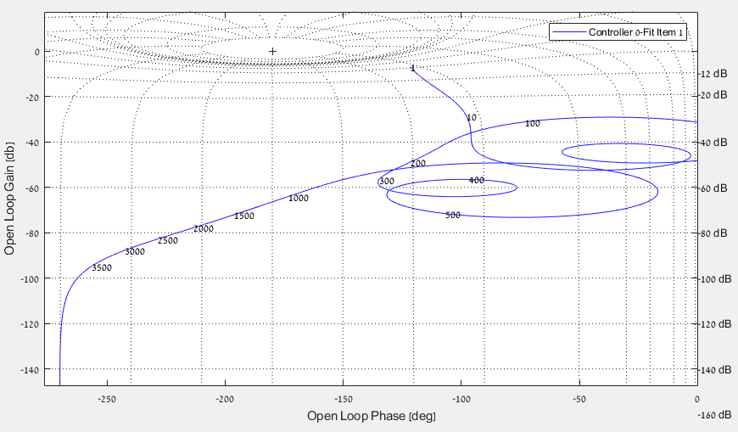
Velocity Open Loop速度开环回路
KVP 0.1
KVI 10
KVFR 0.65
VELFILTFRQ 440

Slide 21
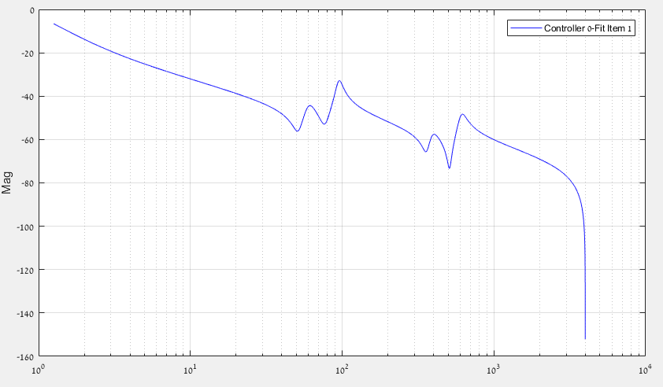
Velocity Close Loop
KVP 0.1
KVI 10
KVFR 0.65
VELFILTFRQ 440

Slide 22
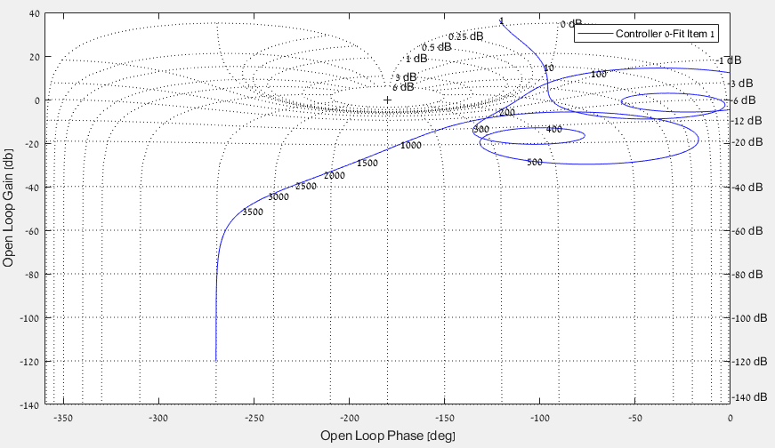
Velocity Open Loop - KVP
KVP 15
KVI 10
KVFR 0.65
VELFILTFRQ 440
Notes:
Reducing the error

Slide 23
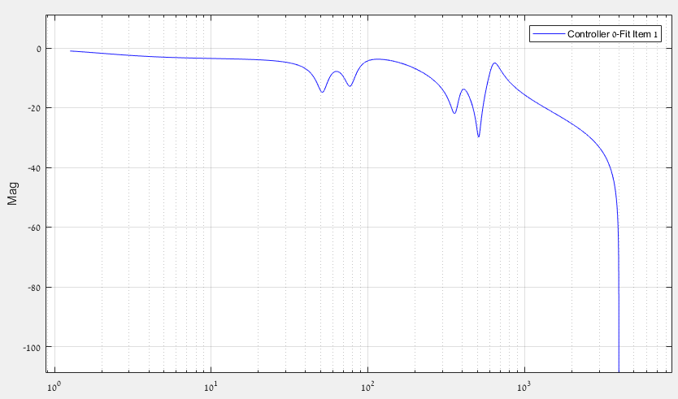
Velocity Close Loop – KVP
KVP 15
KVI 10
KVFR 0.65
VELFILTFRQ 440

Slide 24
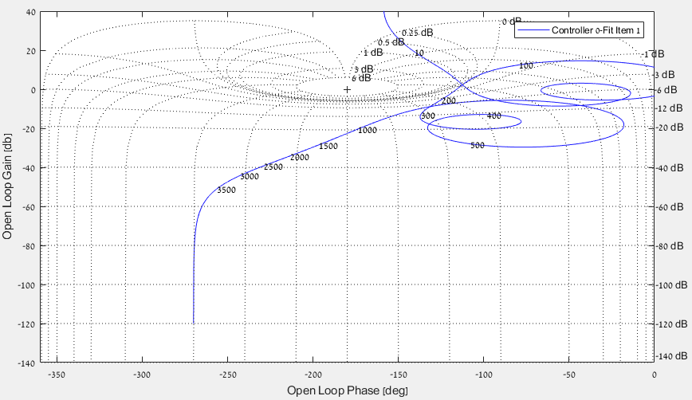
Velocity Open Loop - KVI
KVP 15
KVI 80
KVFR 0.65
VELFILTFRQ 440
Notes:
For the low frequencies we would like a gain higher than 0.
This means the integral will be higher and the response will converge faster and the Rejection of interference will be better.

Slide 25
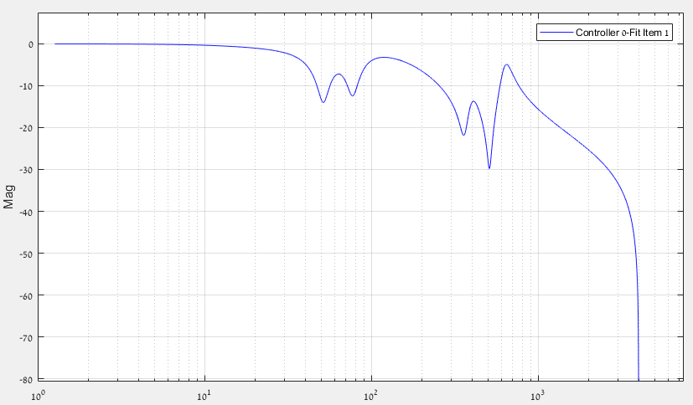
Velocity Close Loop – KVI
KVP 15
KVI 80
KVFR 0.65
VELFILTFRQ 440

Slide 26
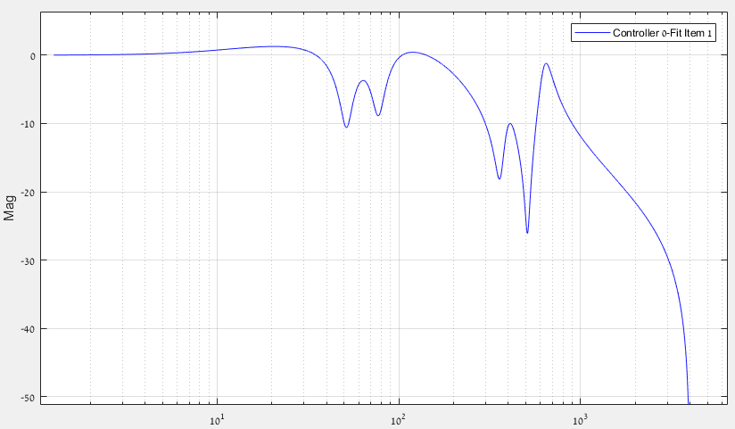
Velocity Close Loop – KVFR
KVP 15
KVI 80
KVFR 1
VELFILTFRQ 440
Notes:
Reduce response time

Slide 27
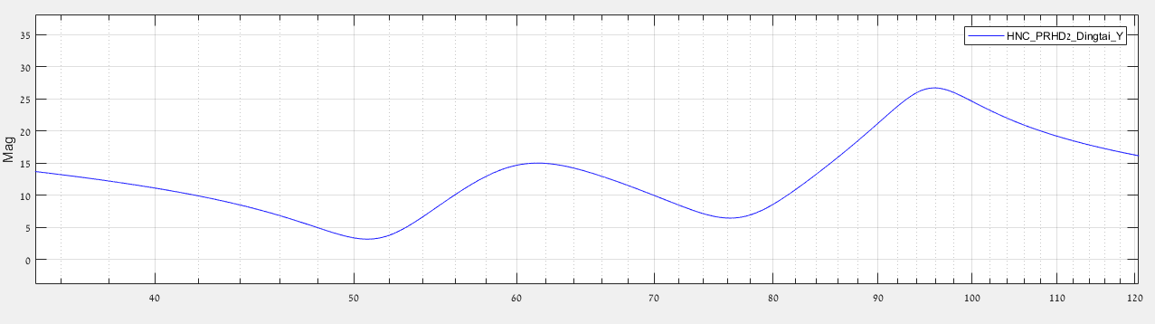
Velocity Close Loop
When tuning the velocity loop, we need to pay attention not to diminish the anti-resonance depth (we might see it later as vibrations in the system).
在调整速度环时，我们需要注意不要减小反共振深度（稍后我们可能会将其视为系统中的振动）。
For each pair of anti-resonance and resonance we measure the magnitude from peak to peak divide it by 2 and that is the minimum value that we need to keep of the anti-resonance depth.
对于每对反共振和共振，我们测量从峰到峰的幅度除以2，这是我们需要保持反共振深度的最小值。
20dB
12dB

Slide 28
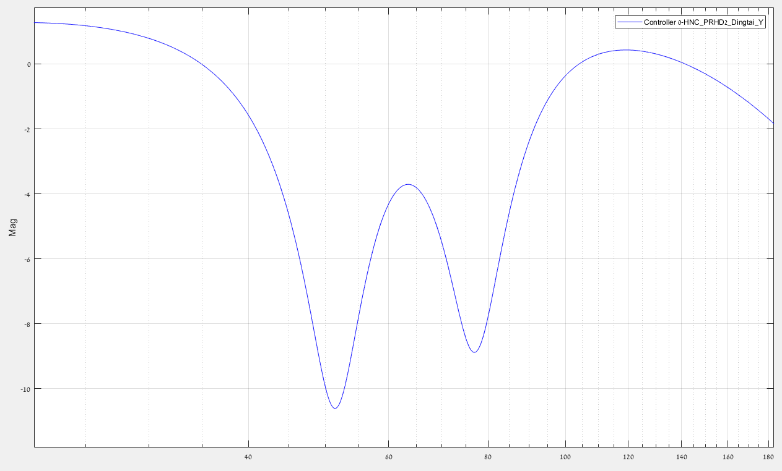
Velocity Close Loop
~10dB
>6dB
Not relevant for Robot tuning与机器人调谐无关

Slide 29
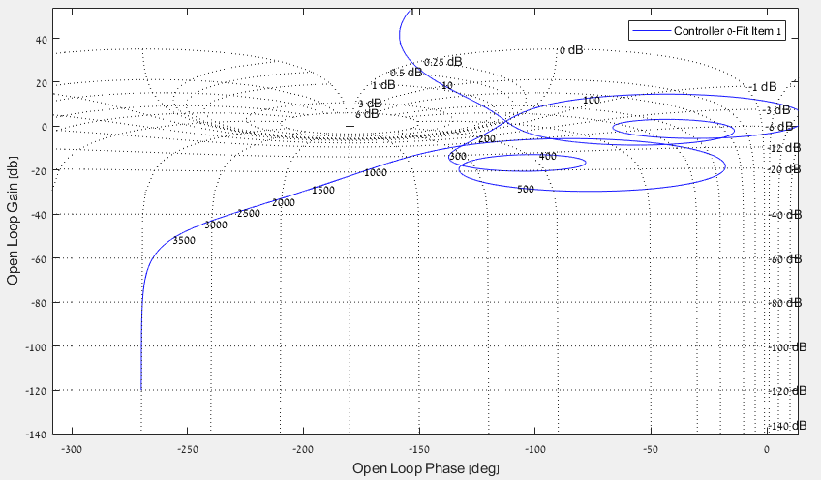
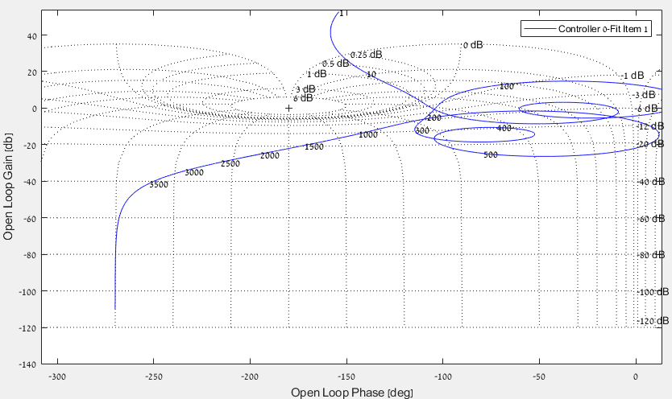
Velocity Close Loop – VELFILTFRQ
VELFILTFRQ 440
VELFILTFRQ 1500
Notes:
Reduce response time. Give more phase and gain margin.

Slide 30
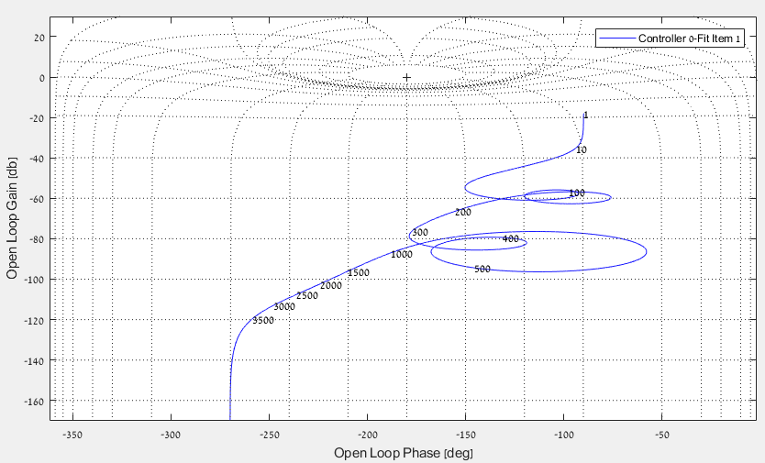
Position Open Loop
KVP 15
KVI 80
KVFR 1
VELFILTFRQ 440
KPP 1
KPVFR 0
KPAFRV 0

Slide 31
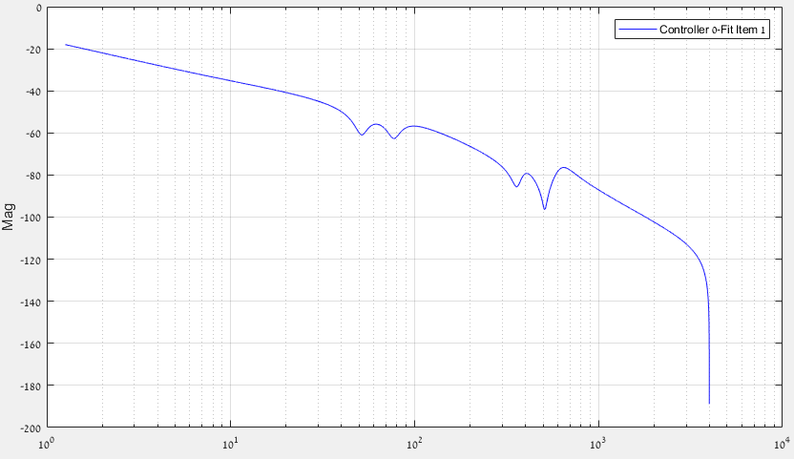
Position Close Loop
KVP 15
KVI 80
KVFR 1 VELFILTFRQ 440
KPP 1
KPVFR 0
KPAFRV 0

Slide 32
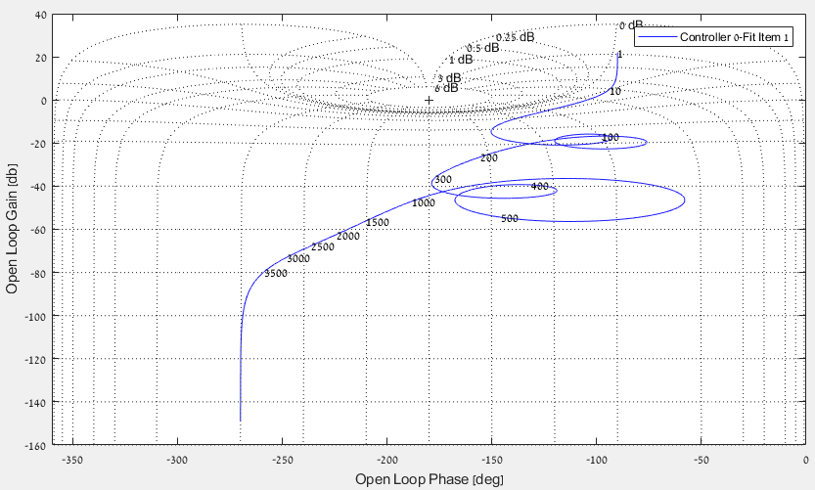
Position Open Loop - KPP
KVP 15
KVI 80
KVFR 1
VELFILTFRQ 440
KPP 100
KPVFR 0
KPAFRV 0

Slide 33
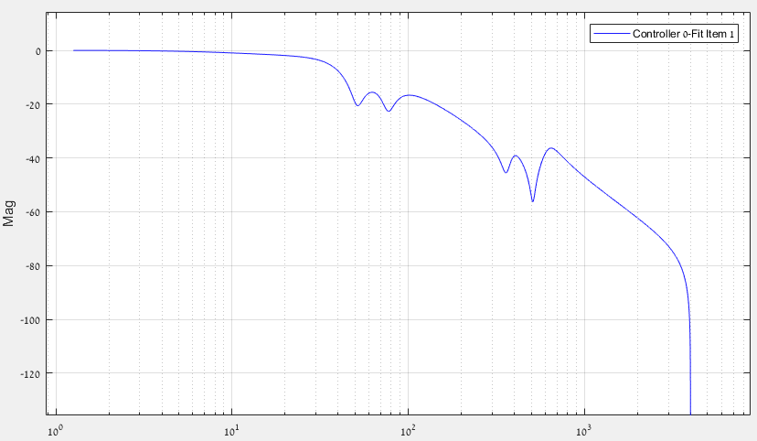
Position Close Loop – KPP
KVP 15
KVI 80
KVFR 1
VELFILTFRQ 440
KPP 100
KPVFR 0
KPAFRV 0

Slide 34
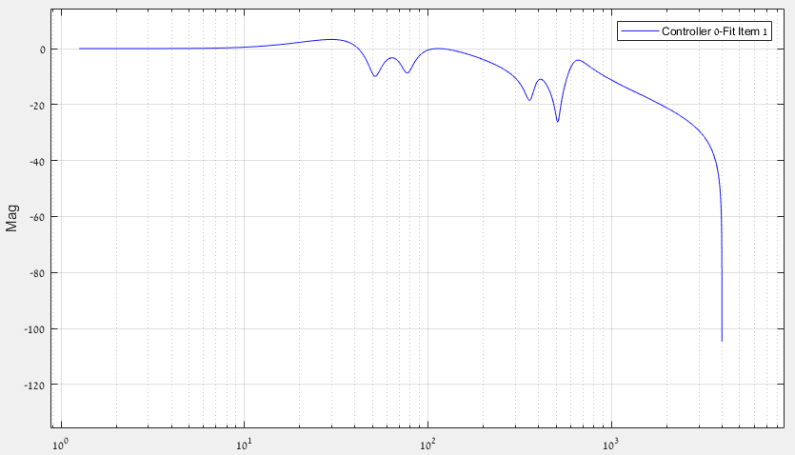
Position Close Loop – KPVFR
KVP 15
KVI 80
KVFR 1
VELFILTFRQ 440
KPP 100
KPVFR 1
KPAFRV 0

Slide 35
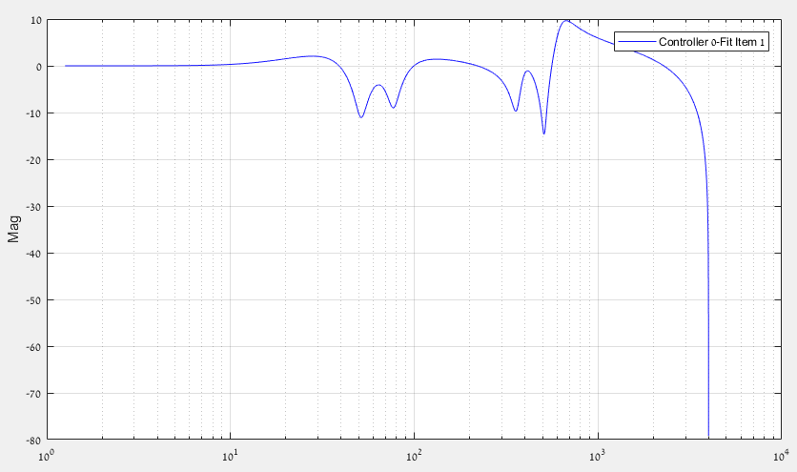
Position Close Loop – KPAFRV
KVP 15
KVI 80
KVFR 0.9
VELFILTFRQ 440
KPP 100
KPVFR 1
KPAFRV 1
Notes:
KVFR effect KPAFRV.
If KVFR is 1 KPAFRV is deactivated.
So we need to reduce KVFR in order to activate KPAFRV

Slide 36

Synchronization同步
When tuning axes that work in synchronization (CNC etc.), we need to maintain the same time delay caused by the control loop response.
在调整同步轴（CNC等）时，我们需要保持控制回路响应引起的相同时间延迟。
Delay time calculation:延时时间计算
1-$Kpvfr$
$=T\left[ms\right]∙Kpp$

Slide 37
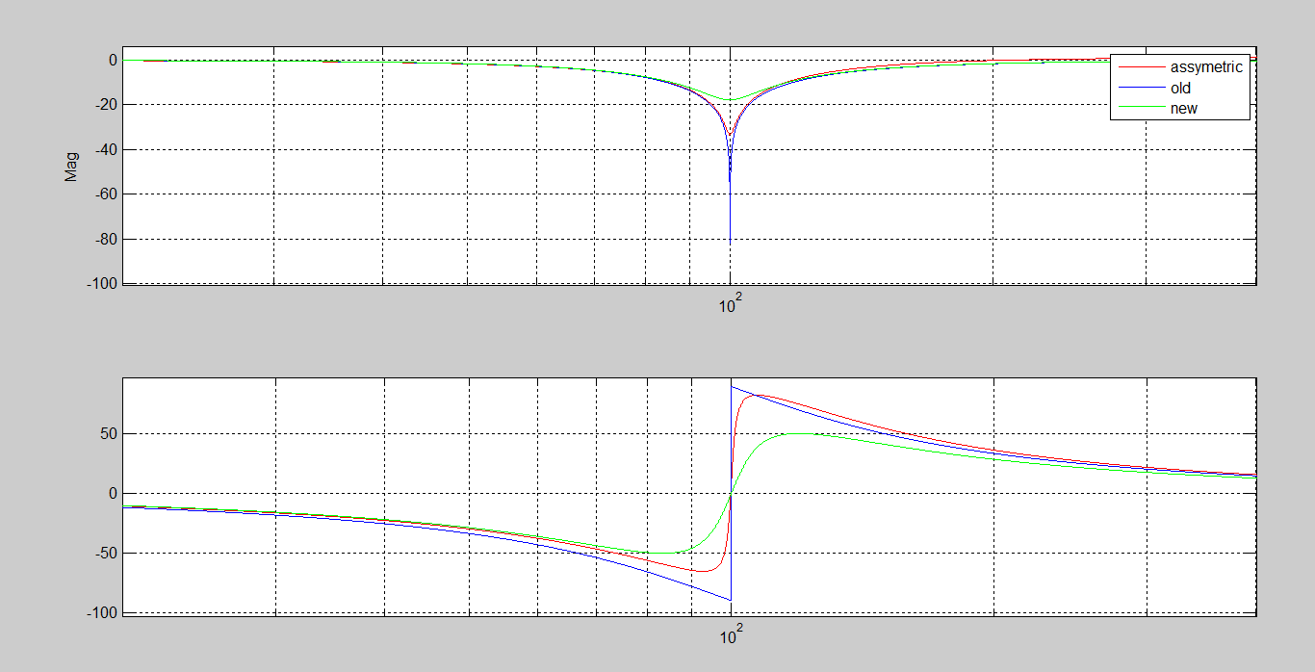
Notch and Asymmetric Notch
New Notch
-18dB attenuation
Phase change +/-50
Assymmetric Notch
-30dB attenuation
Phase change -65,+80
High frequency +1.5dB
  When setting higher frequencies the phase change is +/-70 and the amplification is reduced.
  当设置更高的频率时，相位变化为+/-70，放大减小

Slide 38
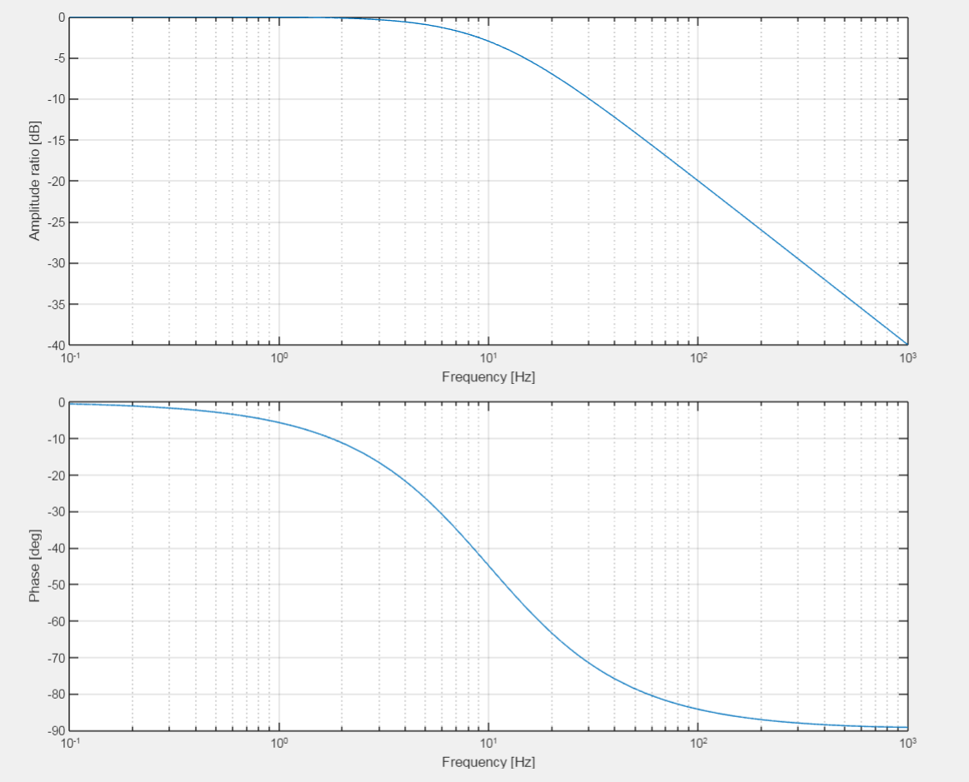
Pole
Pole at 10[Hz]
-3[dB] attenuation at knee frequency
频率衰减3[db]
-20[dB/Decade] reduction
减少
Phase drops to -45[deg] at knee frequency
相位下降到-45[度]
Knee Frequency -3[dB]
Gain reduction -20[dB/decade]
Knee Frequency/10
Phase = -6 degree
Knee Frequency*10
Phase = -84[degree]
Knee Frequency -45[degree]

Slide 39
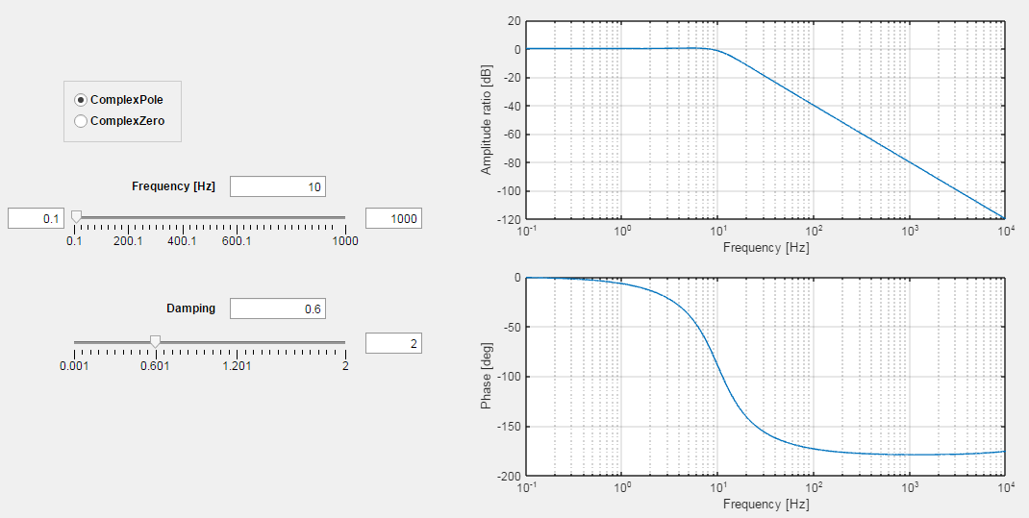
Complex Pole
Gain reduction
-40[dB/decade]
Knee Frequency
~ 0[dB] with damping 0.6
Knee Frequency/10
Phase ~ -8[degree]
Knee Frequency
-90[degree]

Slide 40
Notch in VFI – Robotics
Normally the anti resonance and resonance are at a low frequency (below 25Hz).
通常，反共振和共振是在低频（低于25Hz）。
When we put the notch inside the velocity loop at such a low frequency it will harm the stability and performance of the loop (push the Nichols to the left, reduce BW).
当我们把陷波器放在如此低的频率下，它会损害环路的稳定性和性能（把尼科尔斯推向左边，减少bw）。
VFI is located at the output of the position loop. Since the BW of the position loop is normally 2-3 time lower than the velocity loop (no FF) putting the notch there will not harm the performance of the position loop.
VFI位于位置回路的输出端。由于位置环的BW通常比速度环低2-3倍（无FF），因此放置陷波器不会影响位置环的性能。

Slide 41
Design Example #1

Slide 42
HNC Axis 1 – Robotics arm
Arm Plant
Open loop velocity (Plant + Velocity Controller)
Close loop velocity
Open loop Position (Close loop velocity+ Position controller)
Close loop Load
Close loop Position & Position with FF

Slide 43
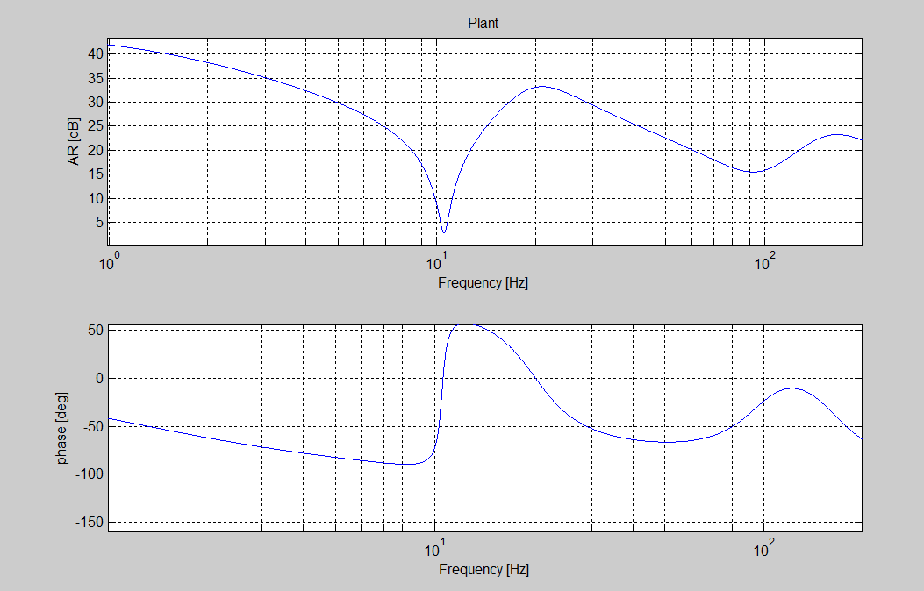
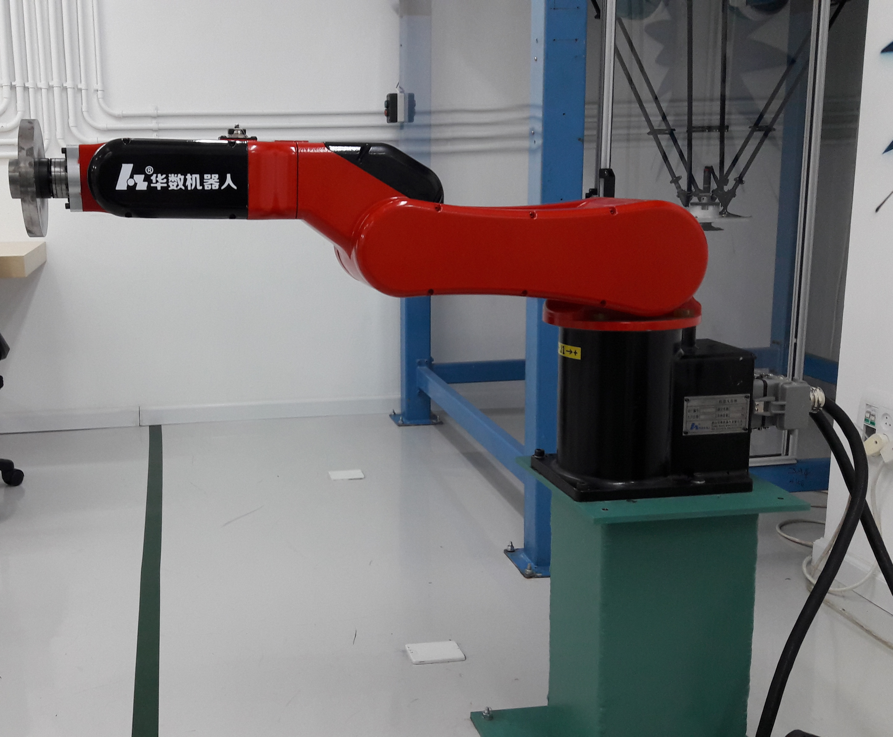
Plant of Robotic Arm – HNC Axis 1
HNC 3.5Kg robot,
Maximum inertia
AR 11Hz
Res 20Hz
Back

Slide 44
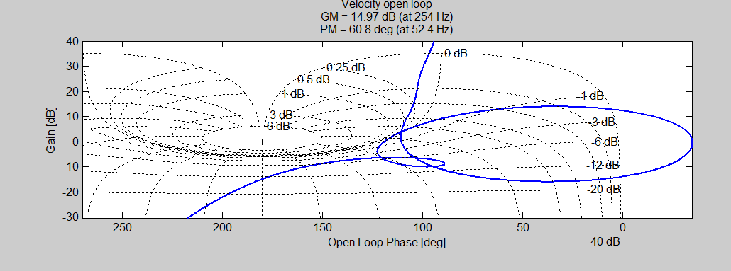
Open Loop – HNC Axis 1
HNC 3.5Kg robot
Open loop motor:
- PI
- LPF
- VFI (Effect can be seen only at close loop)
Back

Slide 45
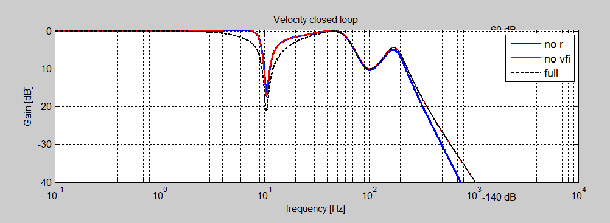
Close Loop velocity – HNC Axis 1
HNC 3.5Kg robot
Close loop motor
Full (including VFI, R)
Using notch design at VFI, we keep AntiRes at correct level, to provide good transfer function at load
Back

Slide 46
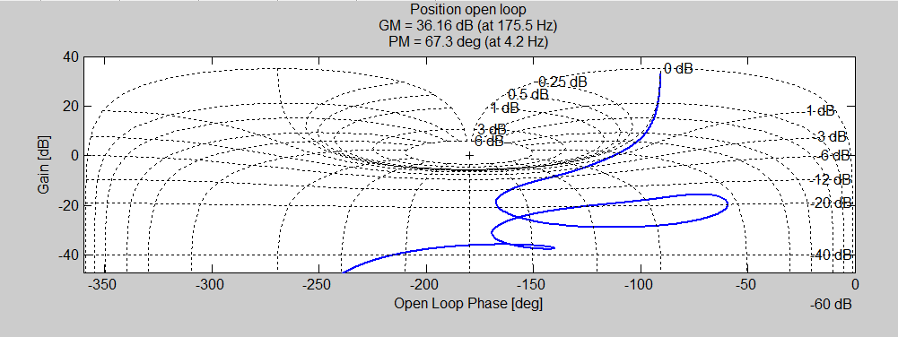
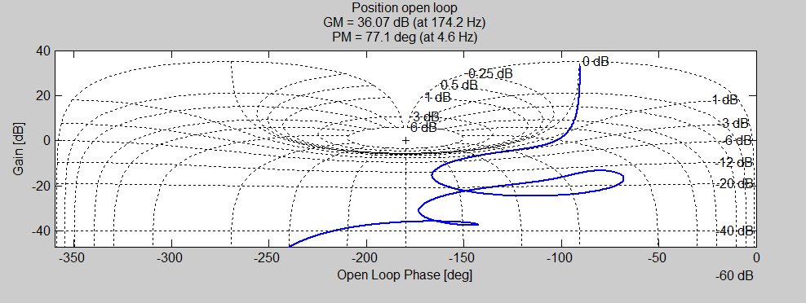
Open loop Position – HNC- Axis1
With VFI
Without VFI
With VFI (Left), Close loop gain is lower
Back

Slide 47
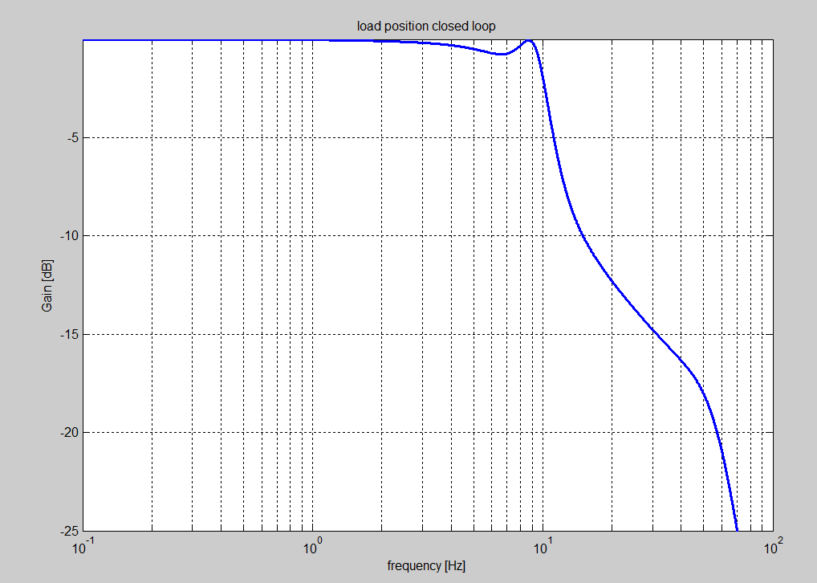
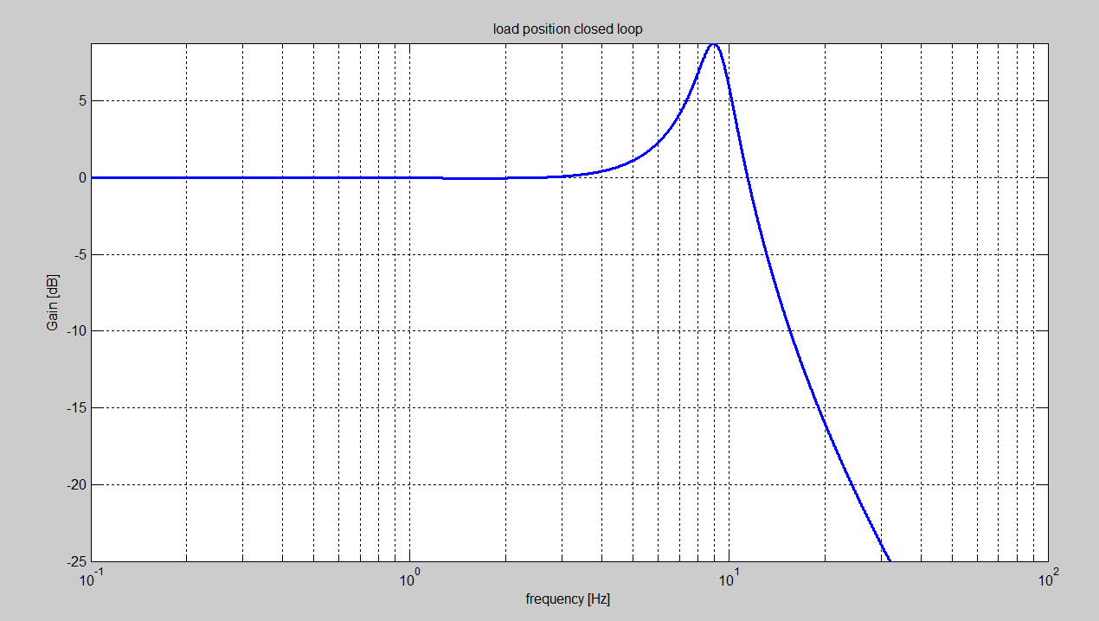
Close Loop Load – HNC Axis 1
Close loop Position Load
With VFI, No peaks/overshoot at load
Good response
Bad response
With VFI, load has 0 overshoot
Without VFI, load has ~9 dB overshoot
Back

Slide 48
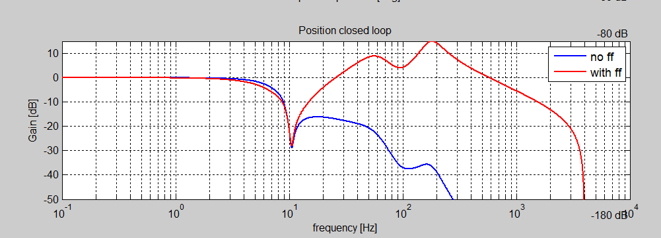
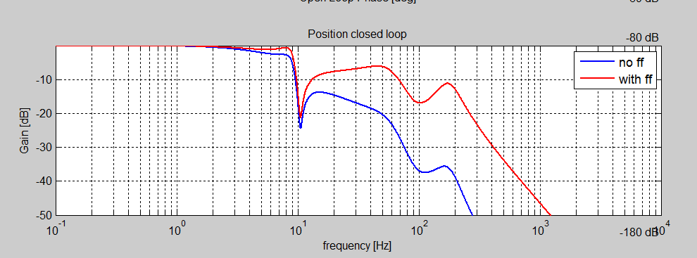
Close Loop Position – HNC Axis 1
With VFI
Without VFI
Back

Slide 49
Design Example #2

Slide 50
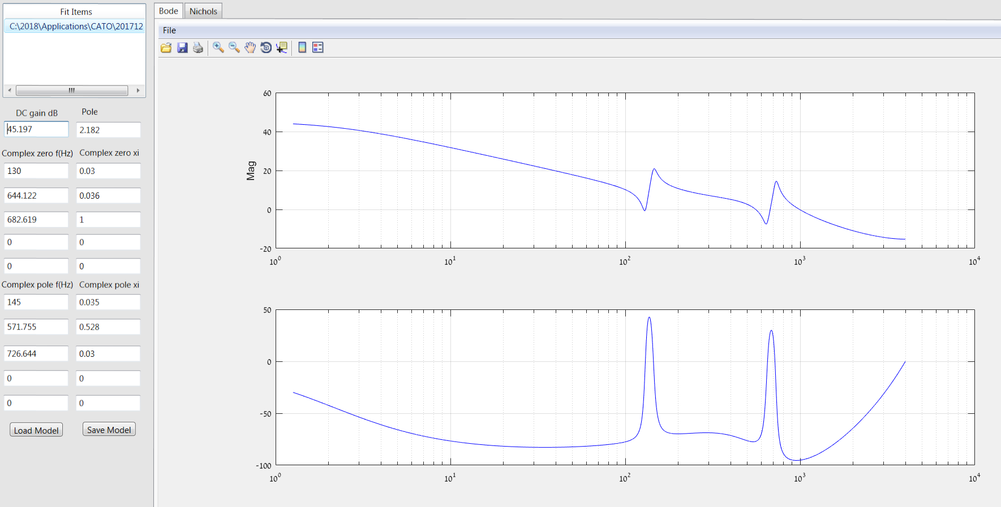
CATO – CNC, X Axis model
Res: 150 Hz, 730Hz

Slide 51
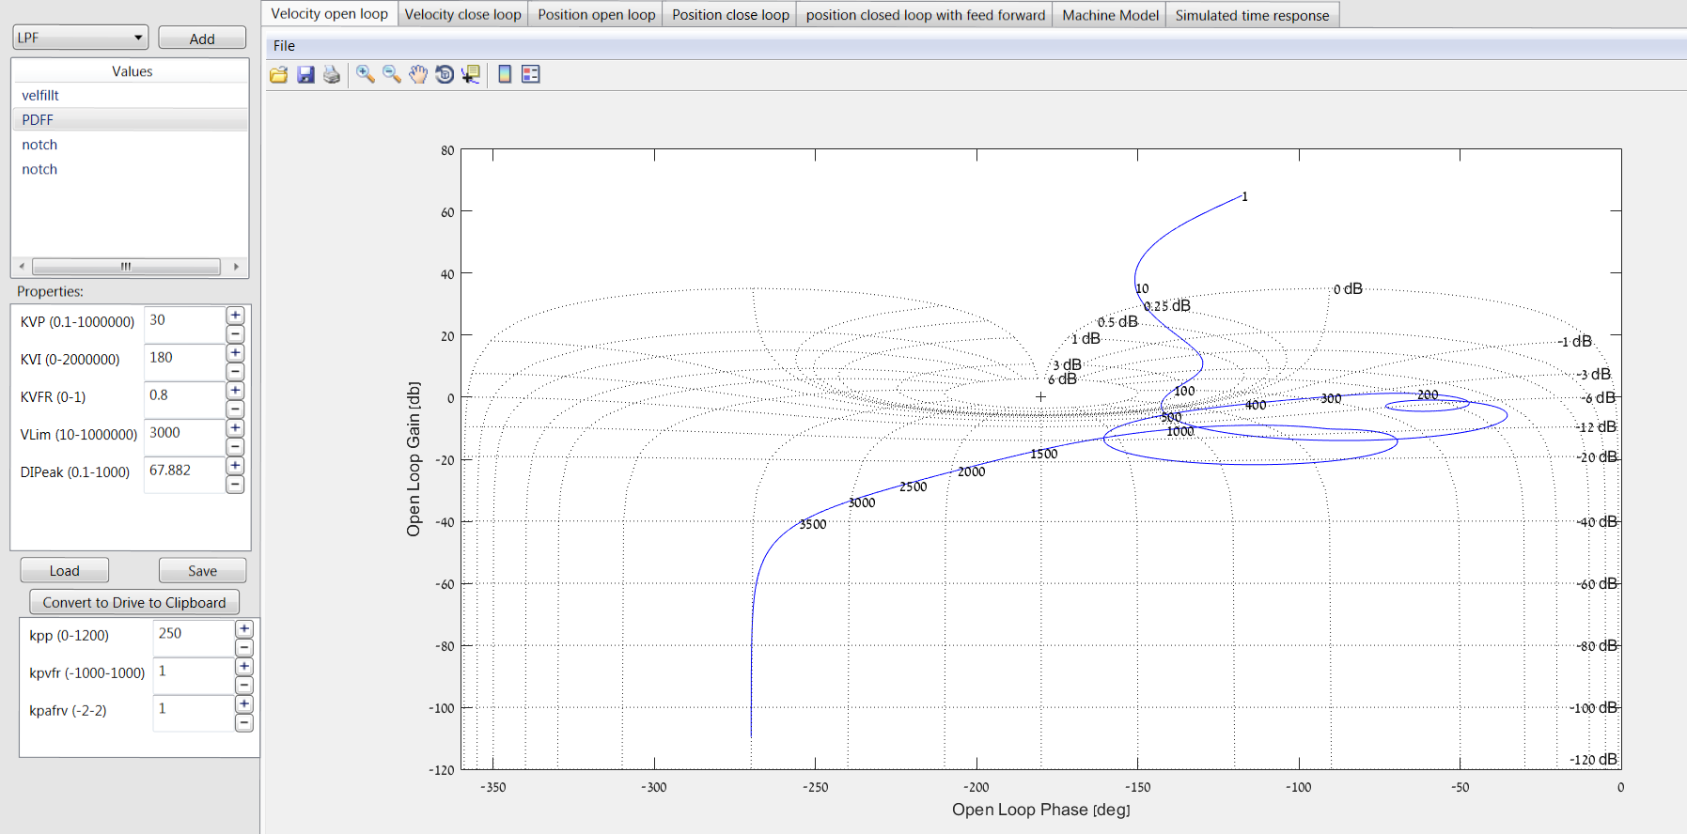
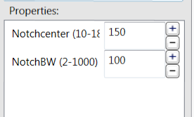
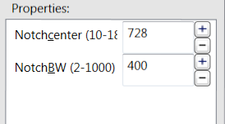

CATO – CNC, X Axis controller
Open Loop Velocity

Slide 52
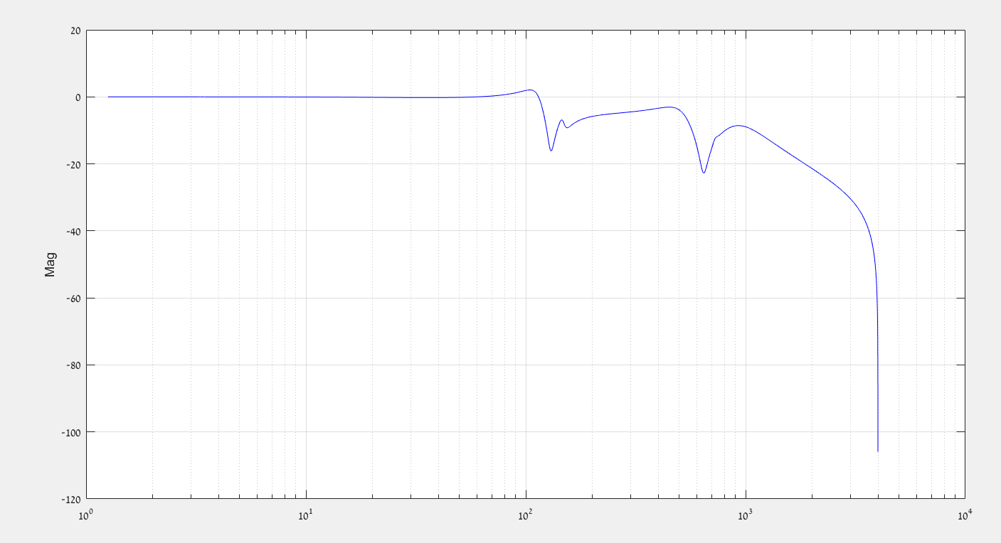
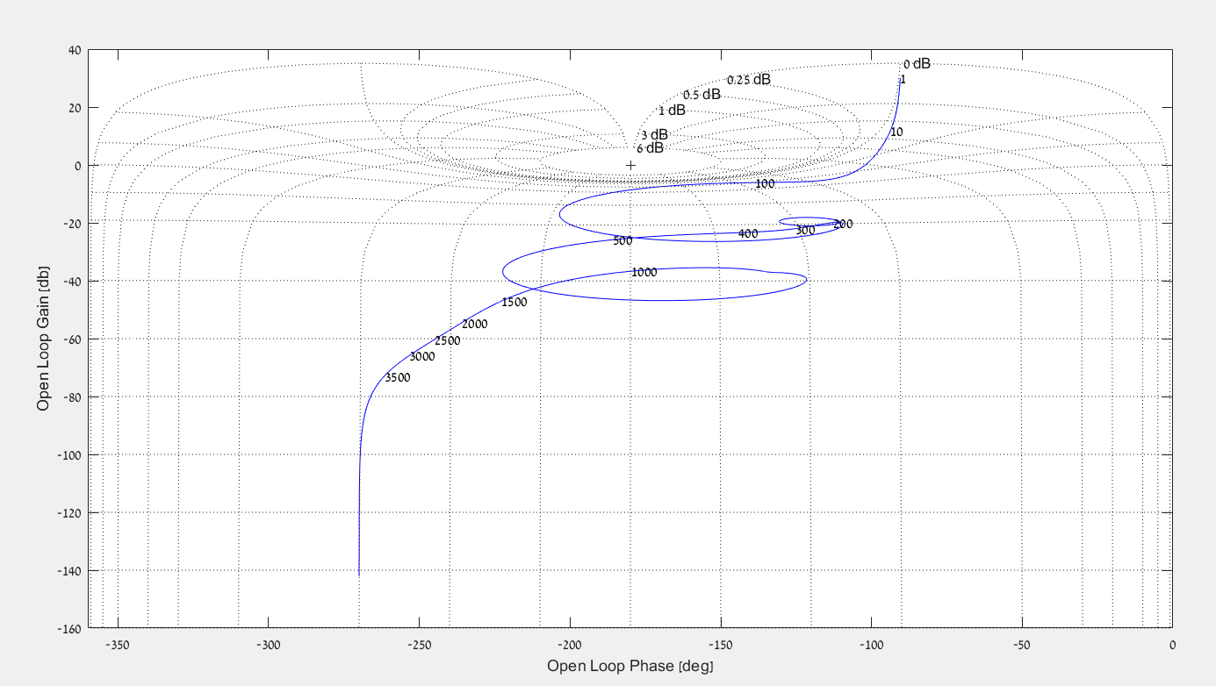
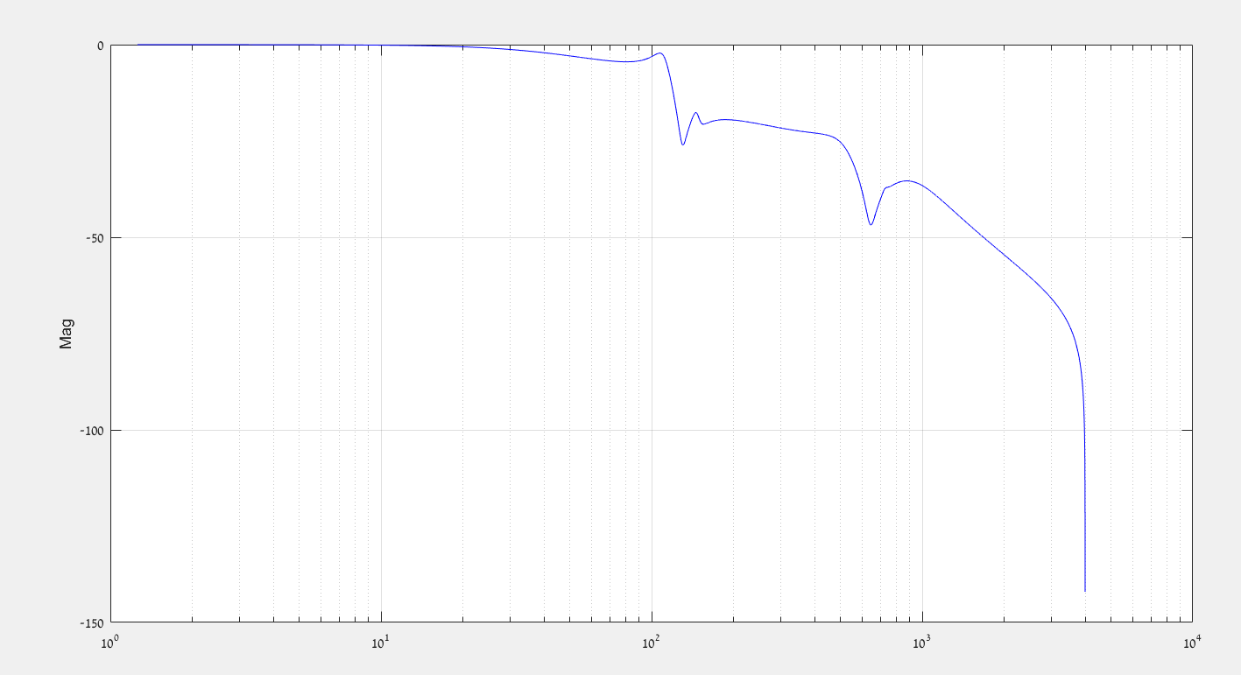
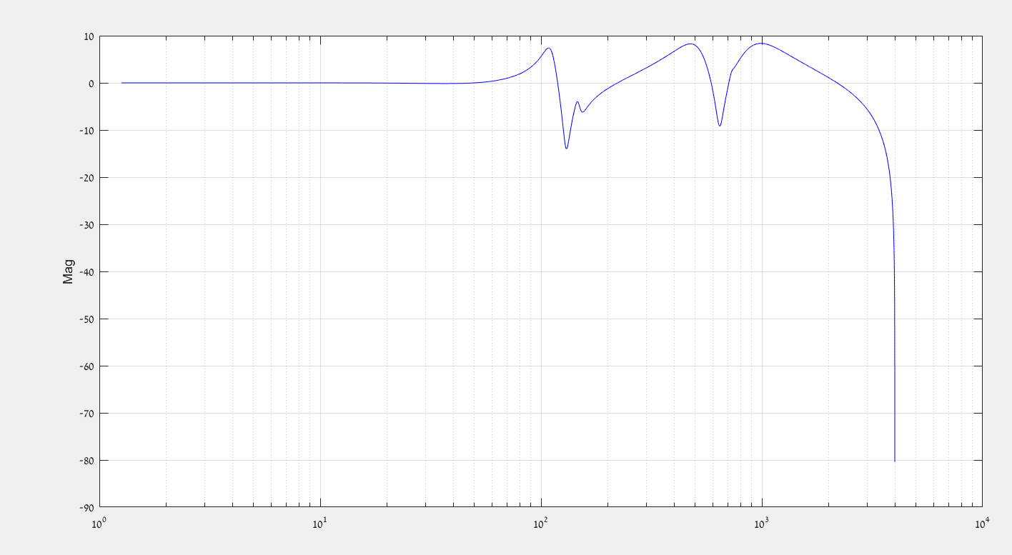
CATO – CNC, X Axis Open /Close Loop
Close Loop velocity
Open Loop Position
~-30dB attenuation
Close Loop Position
Close Loop Position with FF

Slide 53
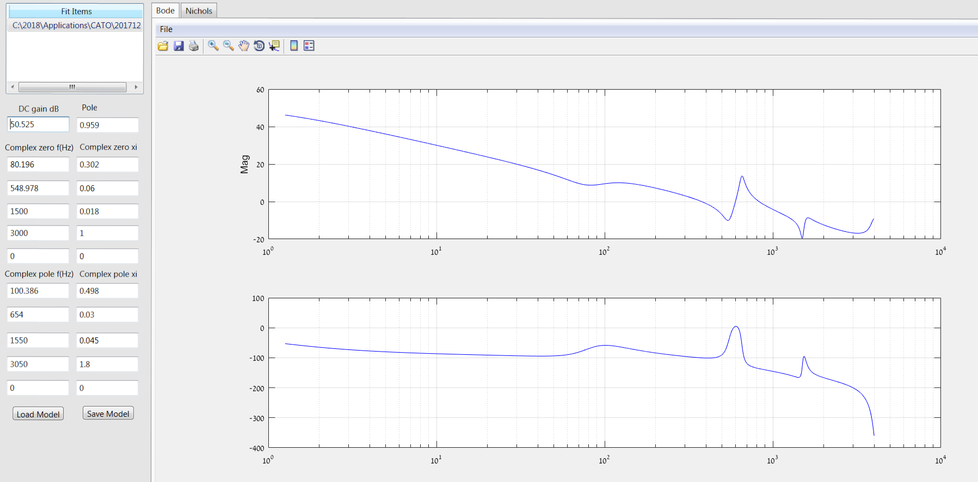
CATO – CNC, Z Axis model
Res: 550 Hz, 1500Hz

Slide 54
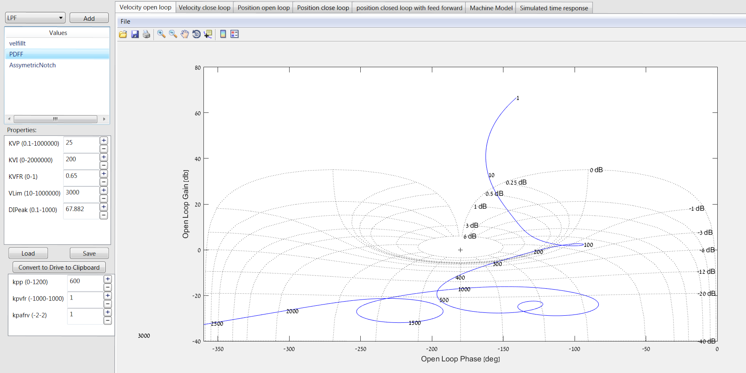


CATO – CNC, Z Axis controller
Open Loop Velocity

Slide 55
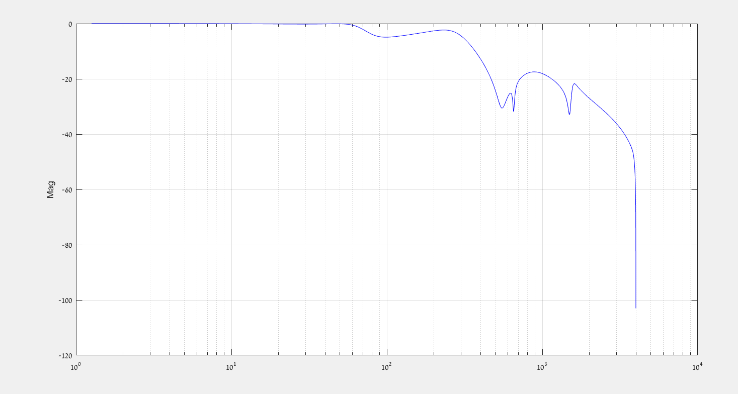



CATO – CNC, Z Axis Open /Close Loop
Close Loop Velocity
Open Loop Position
~-40dB attenuation
Close Loop Position
Close Loop Position with FF

Slide 56

CATO Axis Z – Acoustic noise
~-40dB attenuation
When we tuned axis Z we encountered
acoustic noise. Using visual audio program – which provides the power spectrum, we identify the frequencies which requires further attenuation
当我们调整Z轴时，我们遇到了噪音。使用提供功率谱的可视音频程序，我们可以识别需要进一步衰减的频率。

